Slide 1

‘What a Cite’
A Project from
Asher newbigging

Slide 2



Introduction – my approach
Useful
Realistic
Ambitious

Slide 3

Concept
Create Citations for your project
Keep track of citations you’ve used in previous work
Find Citations through keywords
Create unique topics with which you can categorize projects and citations
Share citations with other who might be interested in your findings
Focused at students & academics

Slide 4
Users
Project
Citations
Notes:
First sprint focus on users, project, and citations

Slide 5
Topics
Reviews

Slide 6
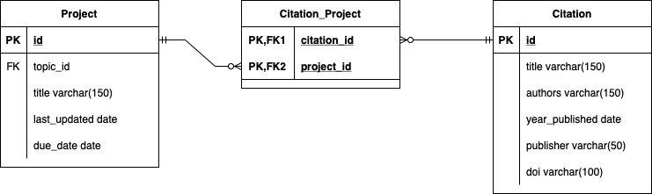
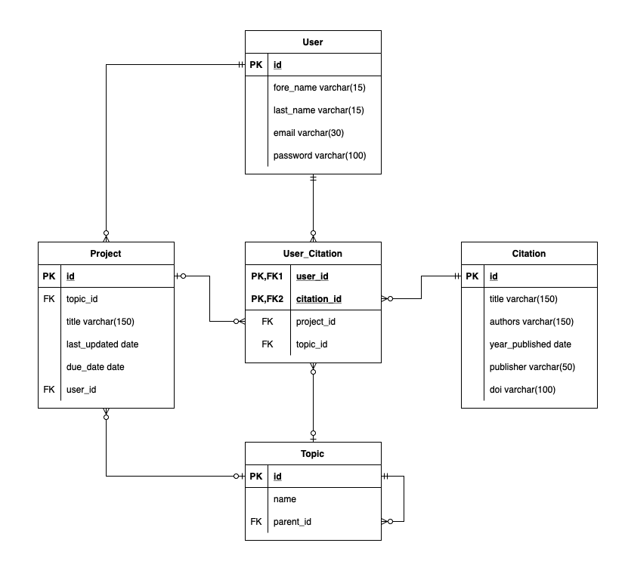
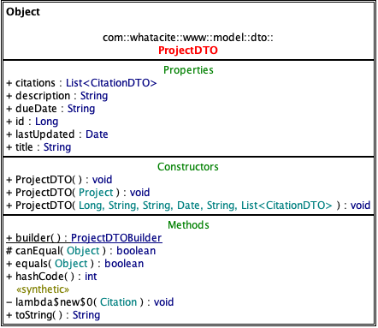
UMLs and ERDs

Slide 7
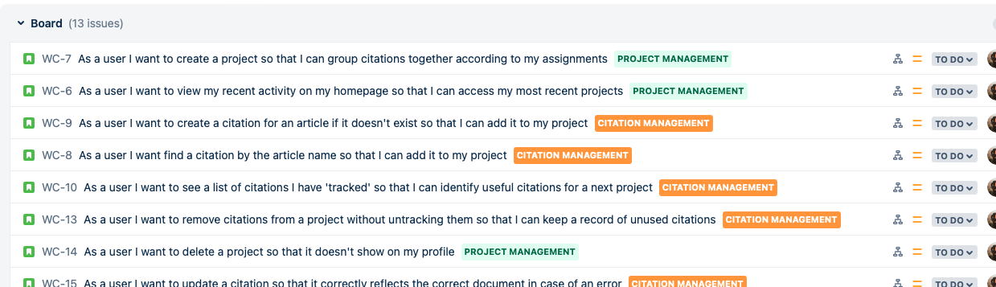
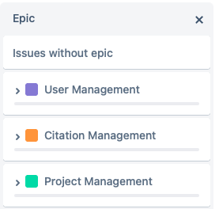
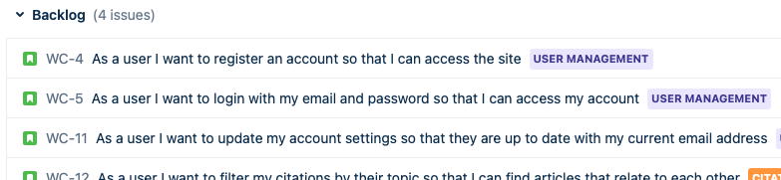
Sprint Plan
3 Epics within tickets could be categorised.
Emphasis put on Project and Citation management for first sprint
User management could be added later
Future epics include:
Topic Management
Citation Reviews

Slide 8
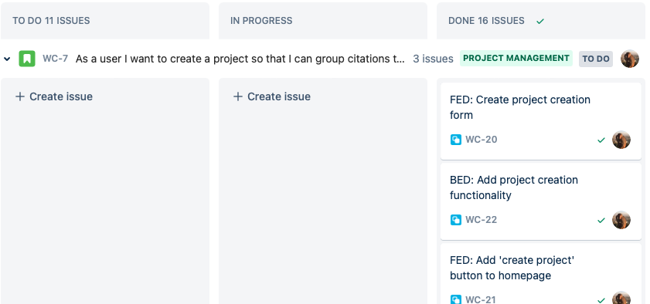
Tickets
Subtasks for BED and FED tasks were created for each story
Example story: grouping citations in a project
Involved: creation of projects and adding of citations to project
Important divide

Slide 9

Technologies
Core JavaScript
CSS + flexbox
HTML
Visual Studio Server
Java Spring RESTful API
Lombok
Hibernate

Slide 10
Risk Assessment
Description | Evaluation | Likelihood | Impact | Responsibility | Response | Control Measures
Hosting Service crashes | Application is offline | LOW | HIGH | Hosting Service (AWS in this case) | Recreate virtual environment on a separate machine | Have a backup service readily created and up-to-date with most recent deployed version.
Front-end not completed by deadline for Sprint 1 | Application is incomplete | HIGH | HIGH | FED development team | Provide more support for dev team to ensure work can be quickly completed | Ensure more experienced developers are leading development of FED
Back-end not completed | Application is incomplete | MEDIUM | HIGH | BED development team | Provide more support. Reconsider requirements. | Ensure that developers are spoken with regarding requirements prior to setting an end-date.
Styling bug found in front-end | Front-end appears unprofessional | HIGH | LOW | FED development team | Create ticket for bug to be fixed in next sprint | Ensure adequate testing and setting of design requirements in future sprints
SQL injection attack | Database connection is insecure | LOW | MEDIUM | BED development team | Check for data breaches, what data was released, what was removed, etc. | Ensure the use of prepared statements in the database connection; check hibernate security requirements for prepared statements.

Slide 11

Testing
Unfortunately, the application is not currently at a point where the testing is completed
Unit tests and Integration tests are currently incomplete
Tests have been done extensively using Post-Man

Slide 12
Current point
Due to bank holidays and lack of front-end specialists, we are behind on this current sprint of work.
Given another day, tests and front-end could be completed to an acceptable amount.
Why have I prioritized what I have?

Slide 13
Demonstration
Project Management
Citation Management – Creation + Removal from project

Slide 14
Retrospective
Complexity of project was underestimated
Desire to stretch self meant no templates were used, all front-end is written from scratch and displays a clear learning curve
Back-end development went smoothly, though complications came up in establishing a bi-directional many-to-many relationship
A less complex project would have met the given scope requirements
Next sprint: user login capability + management, topic creation

Slide 15

Questions

