Slide 1
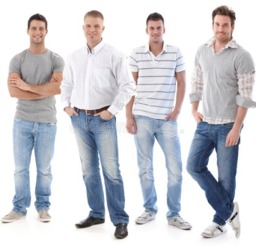
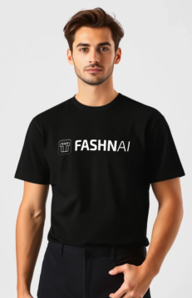
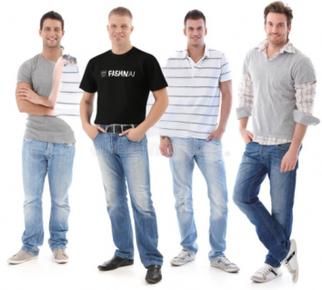
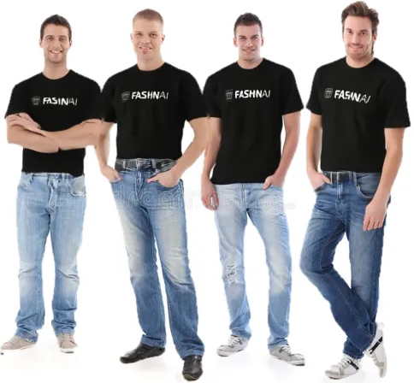
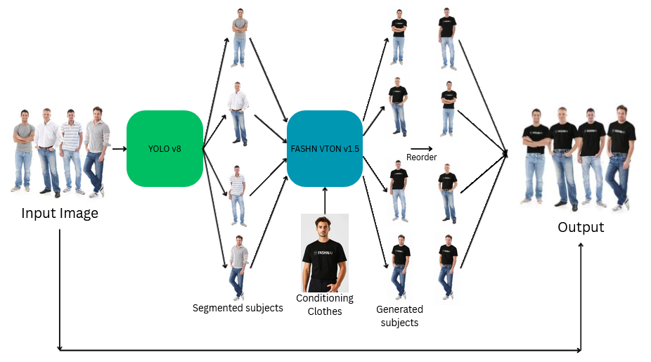
Virtual Try-On System
By Francois Poh, Alexander Reade and Bortis Fedorov
Introduction
Results
A large portion of the cost of marketing new clothing is the cost of contracting and taking photos of models with the product. It costs at least $500 [1] for just a single new product. This motivates the need for virtual try-on models, which allow image-to-image editing of a model with a new set of clothes, drastically reducing the overall cost. Advances in image generation have improved rapidly and can cut the cost down by 80-90%[1].
Nonetheless, this is still an emerging field and still has shortcomings that need to be addressed. One such problem is the focus on single-model images. While these models can excel at images with only a single subject, they struggle to generalise to multiple subjects, leading to complete failure of the models. This motivates our model for multi-subject VTON. Our demo is available at: https://huggingface.co/spaces/mvp-lab/VTON_TEST
From the above input photos, the original pipeline produced the image on the left. Only one subject has his clothing swapped, and the surrounding people are corrupted by this process.
Our pipeline resolves these two issues, producing the image on the right. This successfully swaps the clothing for all 4 individuals while preventing the corruption in the original pipeline. However, some artifacts appear.
For example, the man on the left’s arms are incorrectly rendered. This is due to the segmentation model incorrectly removing part of his arm.
Methodology
Model
Building from the FASHN VTON v1.5 model [2] as a backbone, we incorporate subject detection and segmentation using the Ultralytics YOLO v8 model [3] to separate the original image into the individuals before processing separately and re-composing the completed image.
The people are first segmented by the YOLO v8 model, and the masks are used to separate each subject to their own image with a blank background. FASHN VTON v1.5 is run separately for each image, generating images of the people with the specified clothing. The images are processed at intersection boundaries to prevent the blank background leaking. The order of the subjects is then estimated heuristically based on the concavity or convexity of overlaps, and they are recomposed into the original image back-to-front to properly handle occlusion.
Inference Pipeline
Discussion
Remove subjects and inpaint
While this approach shows that it is feasible to extend a pre-trained virtual try-on model to multiple subjects, several important limitations remain.
Firstly, the technique we apply here relies on an ordering of subjects to exist (i.e. back to font), however this assumption breaks down when they overlap, for example when linking arms. Such an image would require the model to either preserve the linked arm, or process both subjects in one pass, something the current model is incapable of.
Secondly, this method does not work if a subject is extremely occluded. While the FASHN VTON v1.5 model can handle some occlusion of body parts, such as parts of the arms, when too much of the subject is occluded, it does not know how to correctly predict the pose or extrapolate body parts, leading to incorrect generation of clothing.
References
[1] https://klodsy.com/blog/virtual-models-for-fashion-sellers/ [2] https://fashn.ai/research/vton-1-5
[3] https://github.com/ultralytics/ultralytics
Conclusion
While this provides an inexpensive method to extend existing VTON models to multiple subjects, a more robust approach would require retraining with the model's inherent limitations in mind. Further work with this method could also address the background artifacts that occur from this method. Parts of the original subjects may still be visible behind the recomposed image. This could be addressed by using inpainting to remove the original subjects from the image, leaving only the background before recomposing the new subjects.

