Slide 1
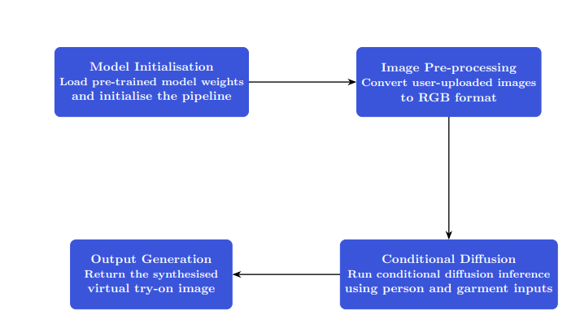
Virtual Try-On System
By Francois Poh, Alexander Reade and Bortis Fedorov
Introduction
Results
Online clothing shopping companies currently must spend a lot to take a lot of photos of the same person in the same pose wearing different cloths. Trying to automate this process with traditional image editing or template-based try-on approaches struggle to generalise across body poses, garment styles, and lighting conditions.
With recent advances in diffusion models that allow for high-quality image generation while preserving realism and structural integrity. Our goal is to explore whether a pre-trained diffusion-based model can be adapted into a usable, interactive virtual try-on system suitable for real-world deployment.
Methodology
Model
We use a pre-trained diffusion-based virtual try-on pipeline that performs conditional image generation. The model is conditioned on person appearance, garment appearance and clothing category. The diffusion process refines noise into a photo realistic image, aligning the garment to the person’s pose and body shape.
Inference Pipeline
Discussion
References
Conclusion

