Slide 1

Neural Networks and Deep Learning
Zach Blanks
MIT 15.003

Slide 2
Overview
Why deep learning?
So what is a neural network?
Image Recognition
Sentiment Analysis
Kaggle Competition

Slide 3
Goals
De-mystify neural networks
Introduce common applications
Apply techniques to real-world problem
Highlight additional resources for further exploration

Slide 5
Why Deep Learning?

Slide 6
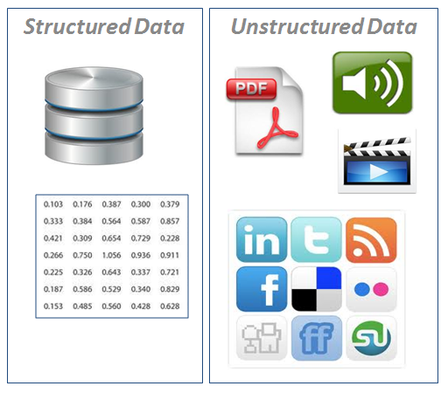
Why deep learning?
Unstructured data

Slide 7
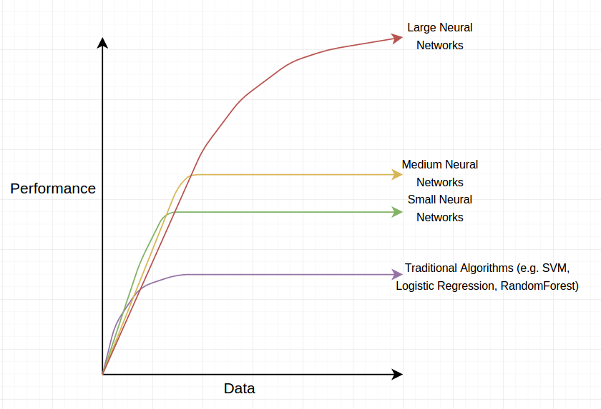
Why deep learning?

Slide 8
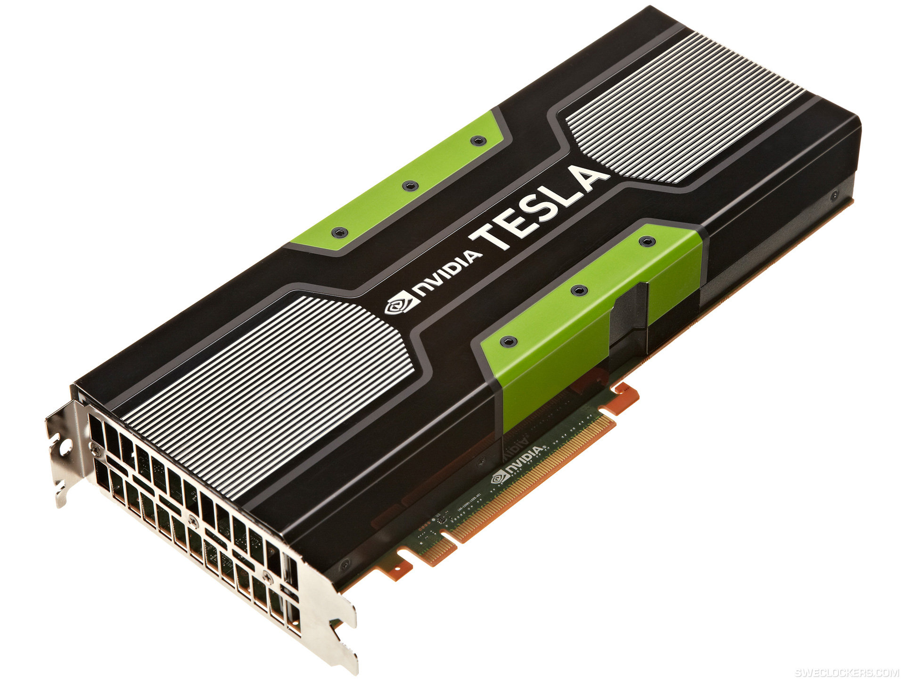
Why deep learning?

Slide 9
Intro to Neural Networks

Slide 10
Project 1: Predict Boston House Prices
Goal: Understand intuitively how neural networks operate
Introduce TensorFlow/Keras API

Slide 11
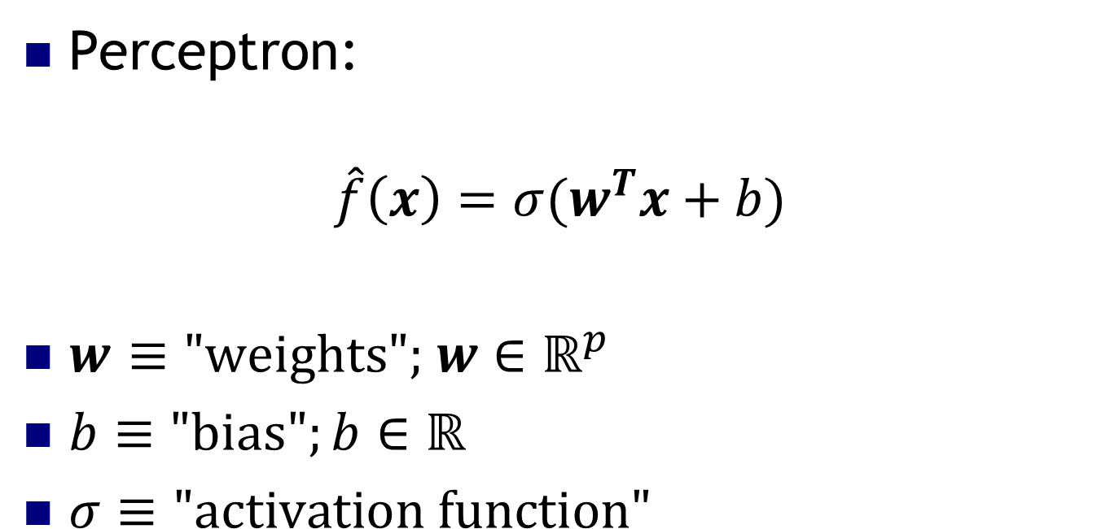
Perceptron
Perceptron:
$$\hat{f}\left(x\right)=σ(w^{T}x+b)$$
$w$ $≡\text{"}\text{weights}\text{"; }w∈ℝ^{p}$
$b≡\text{"}\text{bias}";b∈ℝ$
$σ≡\text{"}\text{activation} \text{function}"$

Slide 12
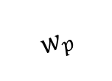
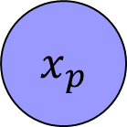
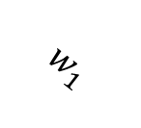
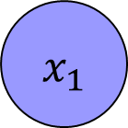
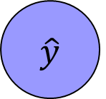
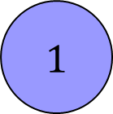

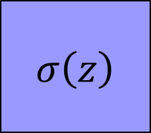

Perceptron
$$x_{1}$$
$$w_{1}$$
$$⋮$$
$$σ\left(z\right)$$
$$\hat{y}$$
$$w_{p}$$
$$x_{p}$$
$$b$$
$$1$$

Slide 13
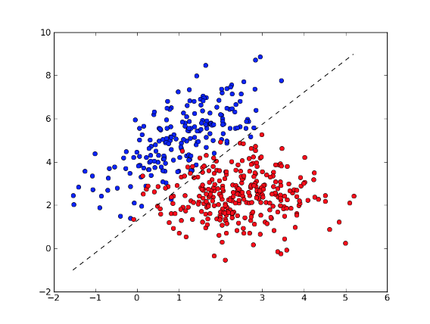
Perceptron

Slide 14
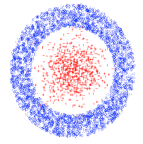
Main Issue with Perceptrons
What if the data is not linearly separable?

Slide 15

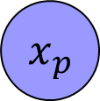

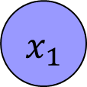
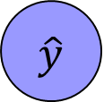



Multi-Layer Perceptrons
$$x_{1}$$
$$w_{1A}$$
A
$$⋮$$
$$w_{AC}$$
C
$$\hat{y}$$
$$x_{p}$$
B
$$w_{BC}$$
$$1$$

Slide 16
Activation Functions
STEP FUNCTION
Used in good old-fashioned perceptron

Slide 17
Activation Functions
LINEAR
like linear regression
(only used for final layer)
LOGISTIC / SIGMOIDAL / TANH
Smooth, differentiable, saturating functions
RECTIFIED LINEAR (ReLU)
Cheap to compute, popular lately

Slide 18
MLP Generalization
Output can be multi-dimensional

Slide 19
MLP Theorem
Theorem: 2-layer NNs with sigmoid activation functions can approximate any other function
(Kurt Hornik: Approximation Capabilities of MultiLayer FeedForward Networks, 1991)

Slide 20
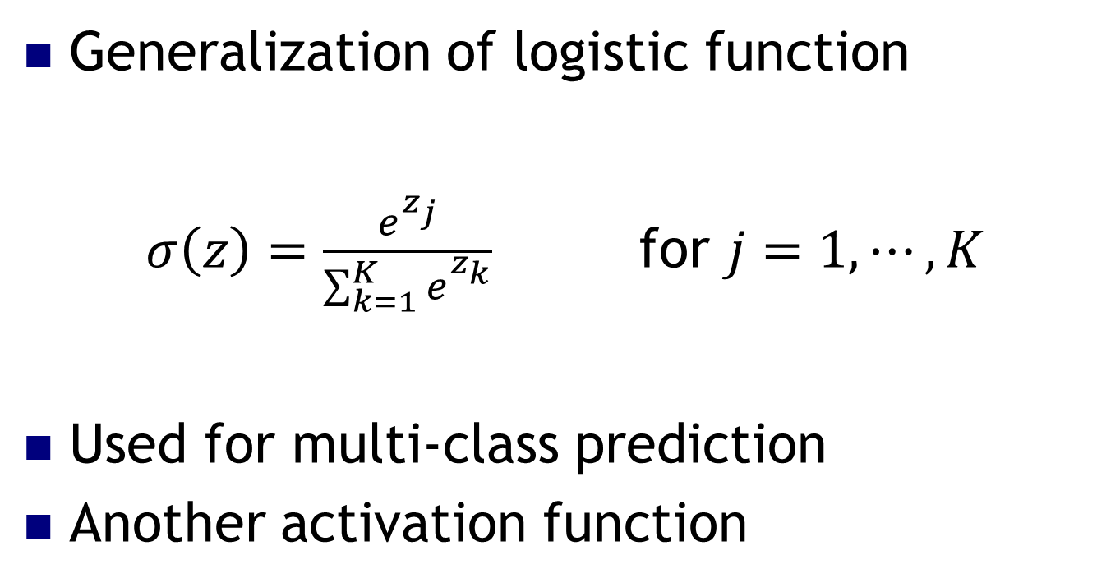
Project 1: Softmax Layer
Generalization of logistic function
$σ\left(z\right)=\frac{e^{z_{j}}}{\sum_{k=1}^{K}{e_{}^{z_{k}}}}$ for $j=1,⋯, K$
Used for multi-class prediction
Another activation function

Slide 21
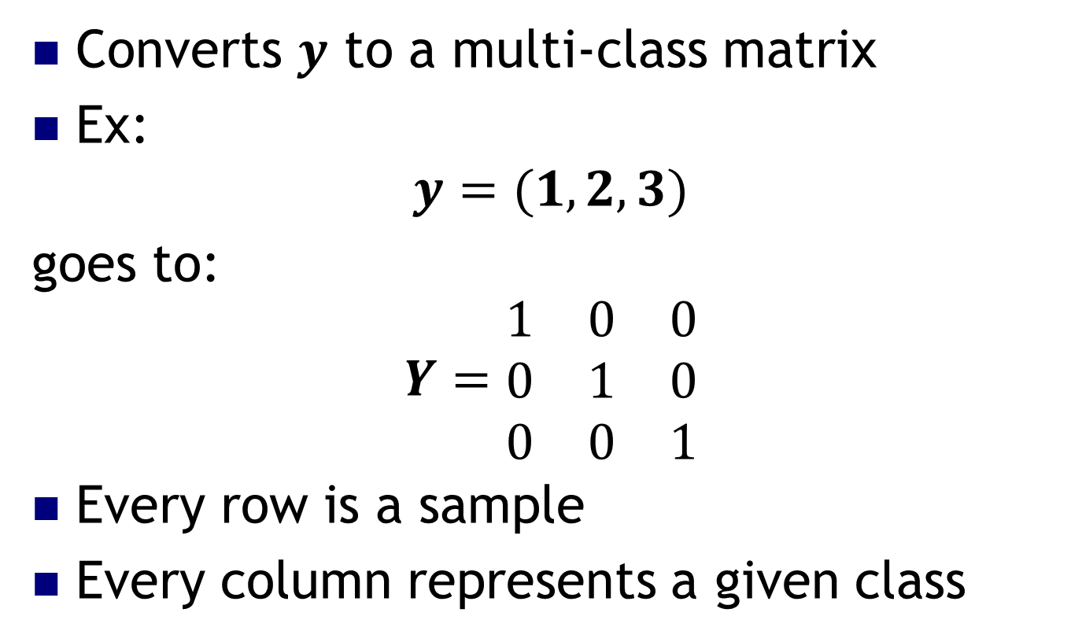
Project 1: One-Hot Encoding
Converts $y$ to a multi-class matrix
Ex:
$$y=(1,2,3)$$
goes to:
$$Y=\begin{matrix}1 & 0 & 0 \\ 0 & 1 & 0 \\ 0 & 0 & 1\end{matrix}$$
Every row is a sample
Every column represents a given class

Slide 22
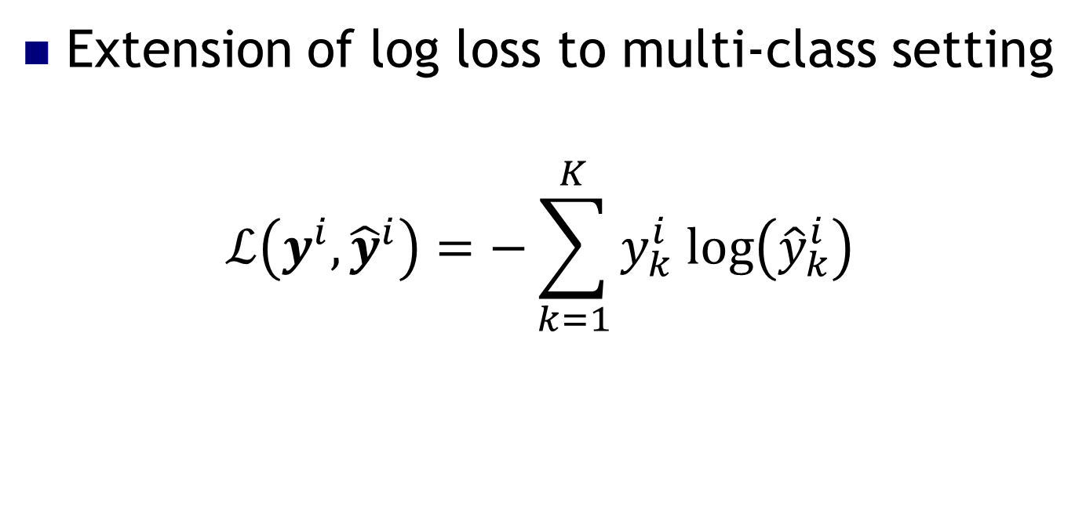
Project 1: Cross-Entropy Loss
Extension of log loss to multi-class setting
$$ℒ\left(y^{i}, {\hat{y}}^{i}\right)=−\sum_{k=1}^{K}{y_{k}^{i} log\left({\hat{y}}_{k}^{i}\right)}$$

Slide 23
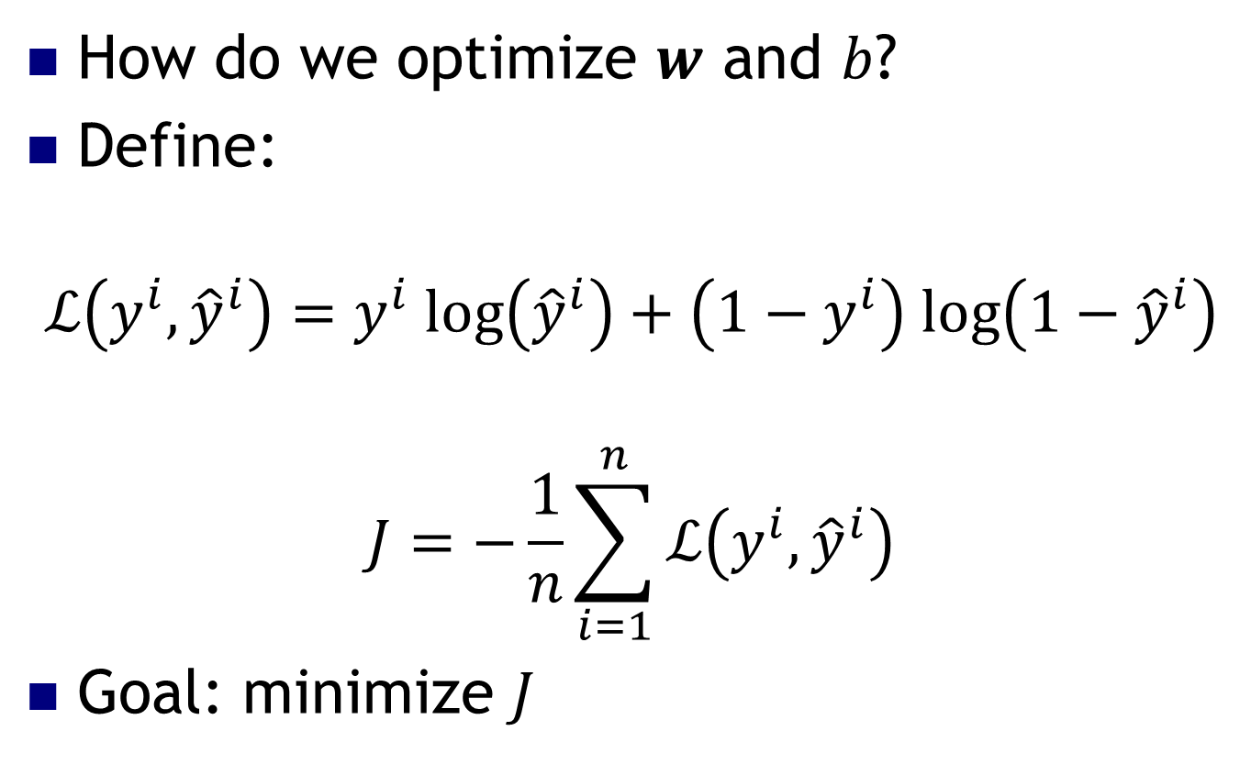
Optimizing MLPs
How do we optimize $w$ and $b$?
Define:
$$ℒ\left(y^{i},{\hat{y}}^{i}\right)=y^{i} log\left({\hat{y}}^{i}\right)+\left(1−y^{i}\right) log\left(1−{\hat{y}}^{i}\right)$$
$$J=−\frac{1}{n}\sum_{i=1}^{n}{ℒ\left(y^{i},{\hat{y}}^{i}\right)}$$
Goal: minimize $J$

Slide 24
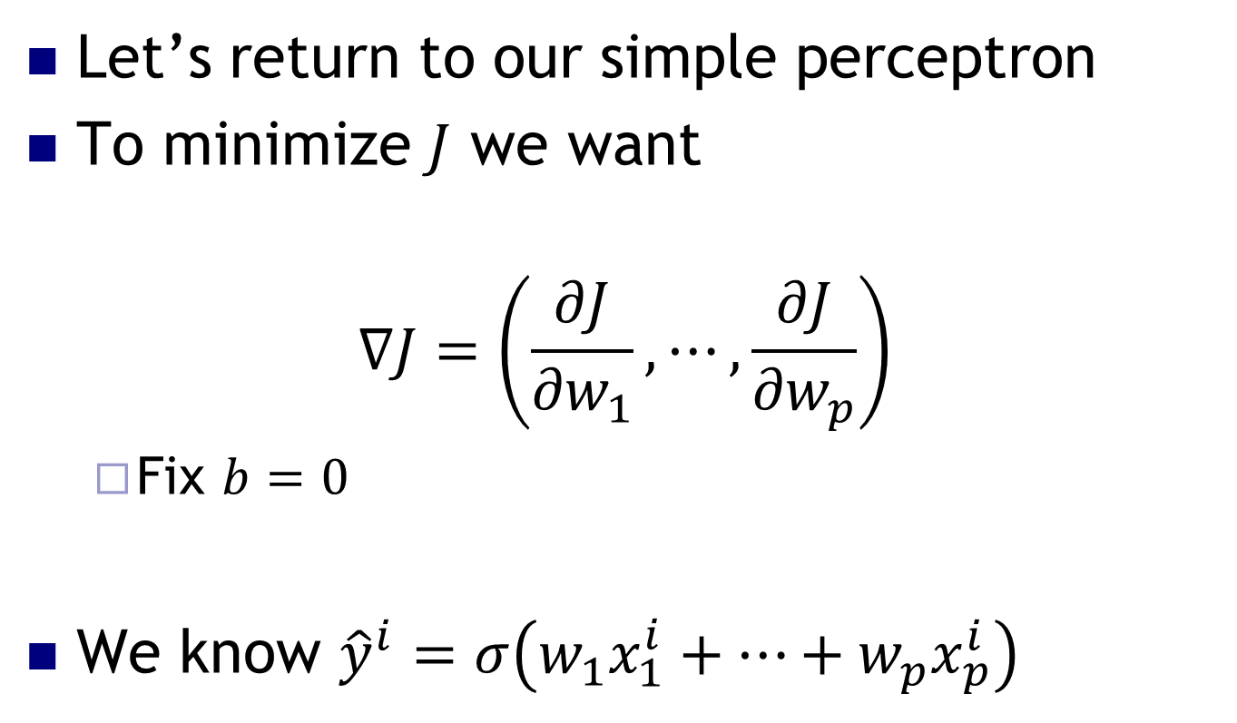
Neural Network Basics
Let’s return to our simple perceptron
To minimize $J$ we want
$$∇J=\left(\frac{∂J}{{∂w}_{1}}, ⋯,\frac{∂J}{{∂w}_{p}}\right)$$
Fix $b=0$
We know ${\hat{y}}^{i}=σ\left(w_{1}x_{1}^{i}+⋯+w_{p}x_{p}^{i}\right)$

Slide 25
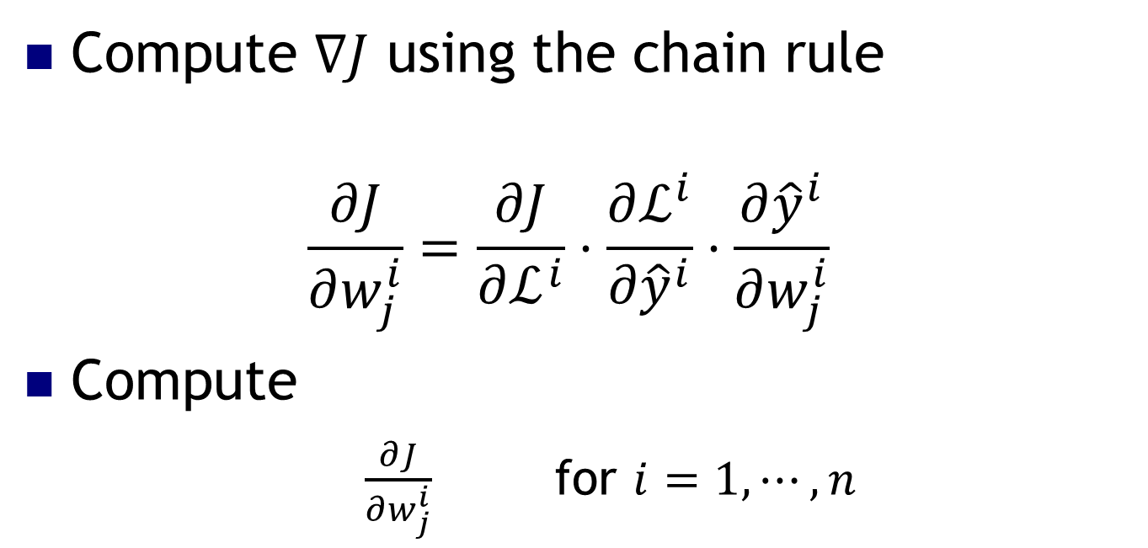
Backpropagation Algorithm
Compute $∇J$ using the chain rule
$$\frac{∂J}{∂w_{j}^{i}}=\frac{∂J}{∂ℒ^{i}}⋅\frac{∂ℒ^{i}}{∂{\hat{y}}^{i}}⋅\frac{∂{\hat{y}}^{i}}{∂w_{j}^{i}}$$
Compute
$\frac{∂J}{∂w_{j}^{i}}$ for $i=1,⋯, n$

Slide 26
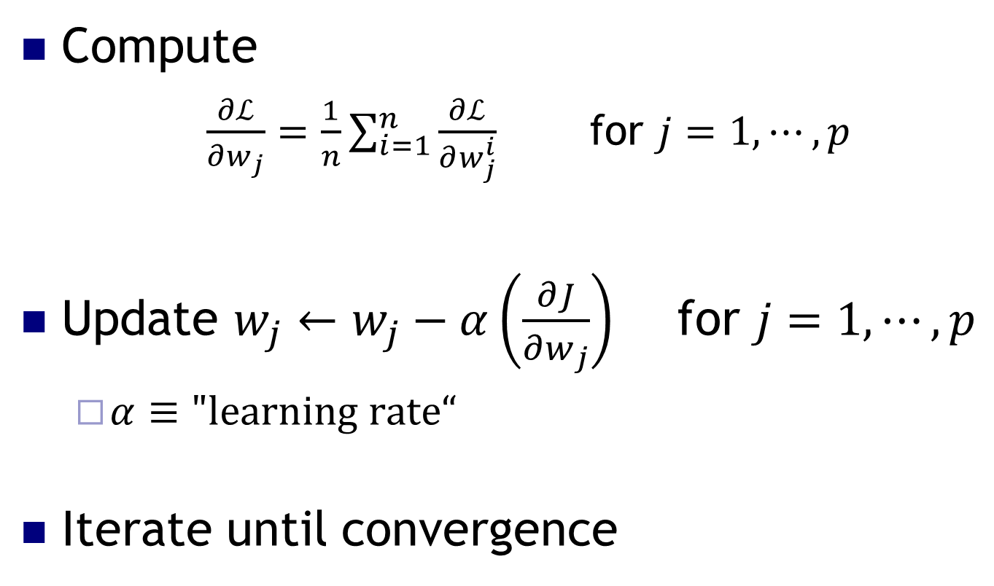
Backpropagation Algorithm
Compute
$\frac{∂ℒ}{∂w_{j}}=\frac{1}{n}\sum_{i=1}^{n}{\frac{∂ℒ}{∂w_{j}^{i}}}$ for $j=1,⋯, p$
Update $w_{j}←w_{j}−α\left(\frac{∂J}{∂w_{j}}\right)$ for $j=1,⋯, p$
$α≡"learning rate“$
Iterate until convergence

Slide 27
Backpropagation Algorithm
Backbone of deep learning
Opportunities for parallelism
Painful to implement yourself

Slide 28
Quick break…
https://www.youtube.com/watch?v=6KeG_i8CWE8

Slide 29
Deep Learning with ConvNets
Based on:
https://adeshpande3.github.io/adeshpande3.github.io/A-Beginner's-Guide-To-Understanding-Convolutional-Neural-Networks/

Slide 30



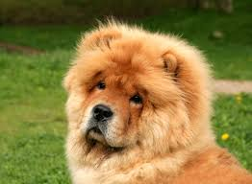
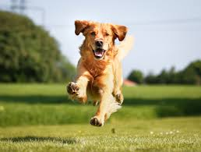

Supervised Learning
Dog=1
Cat=0
Cat=0
Dog=1
Dog=1
Now tell me: cat or dog?

Slide 31
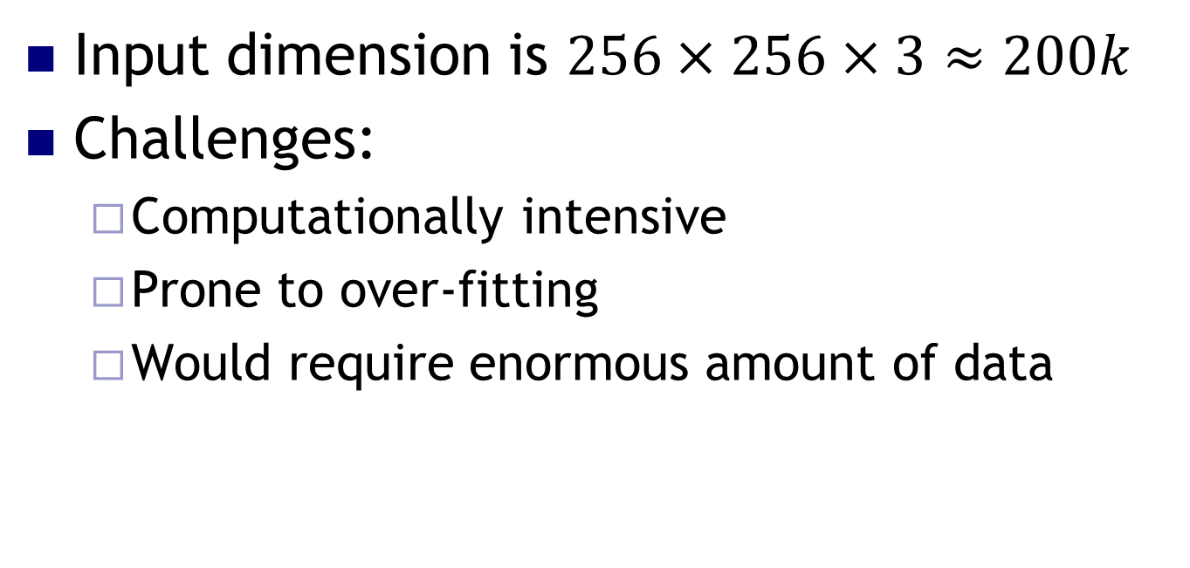
Deep Learning for Image Processing
Input dimension is $256×256×3≈200k$
Challenges:
Computationally intensive
Prone to over-fitting
Would require enormous amount of data

Slide 32
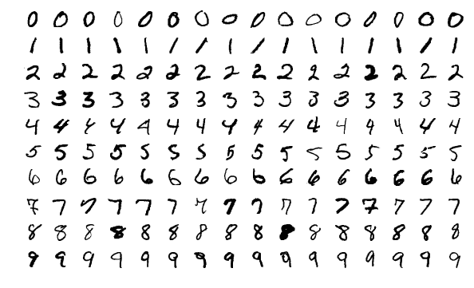
MNIST

Slide 33
Project 2 - MNIST
Goal: Identify hand-written digits from an image
Understand intuitively how convolutional networks operate

Slide 34
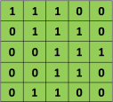

Convolution
Image
Filter

Slide 35
Convolution
Image
Filter

Slide 36
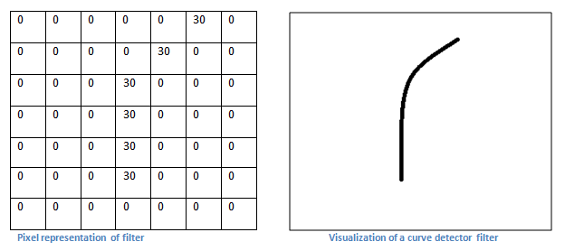
Convolution – The intuition

Slide 37
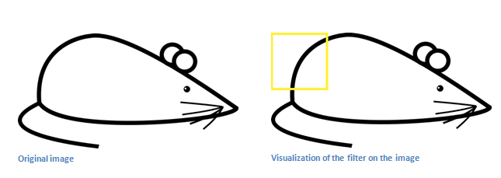
Convolution – the intuition
Recall the curve detector
Output matrix will have a large value here!

Slide 38
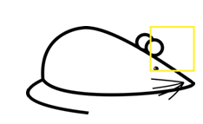
Convolution – the intuition
Conversely, the output matrix will have a
zero value here!

Slide 39
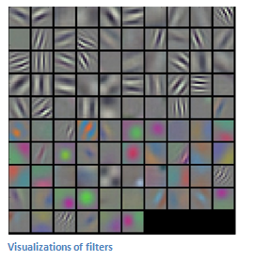
Convolution
Different filters (each acting as a feature detector) produce a feature map
Shallow layers detect low-level features
Deeper layers learn more complicated features

Slide 40
Pooling layers in CNN, deep structures
Maybe a filter learns to detect eyes
Precise location of eye is maybe unimportant
Use a pooling layer to downsample
CONVOLUTION
OUTPUT
2x2 MAX
POOL
POOLING
OUTPUT

Slide 41
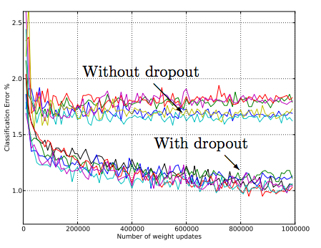
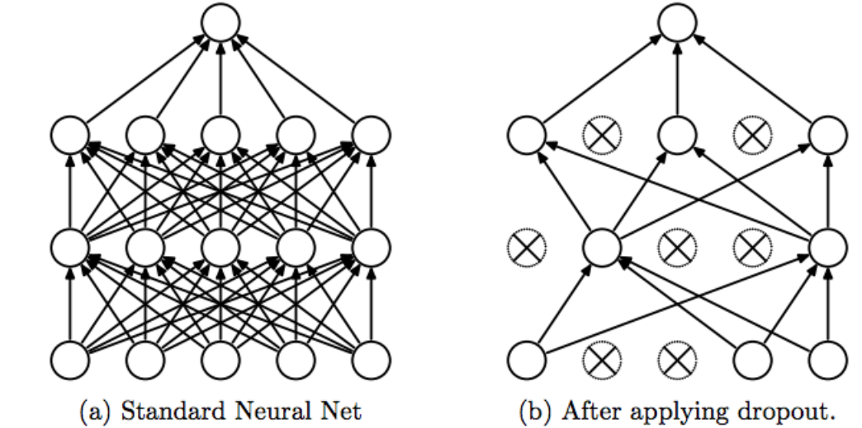
Dropout - cheap regularization for ANN
http://jmlr.org/papers/volume15/srivastava14a/srivastava14a.pdf

Slide 42
Basic ingredients of ConvNets
Lots of layers... more usually perform better!
Most commonly used:
Fully Connected Layers
Convolution
Pooling

Slide 43
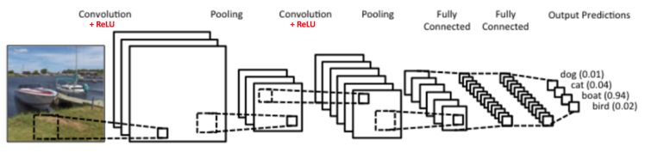
Early ConvNet: “LeNet-5”
http://deeplearning.net/tutorial/lenet.html

Slide 44
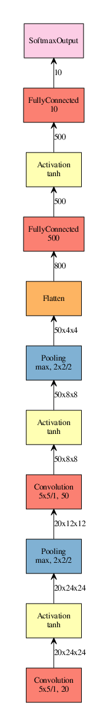
“LeNet”
1998:
“AlexNet”
2012:
“GoogLeNet”
2014:
“Inception v3”
2015:
Source: http://josephpcohen.com/w/visualizing-cnn-architectures-side-by-side-with-mxnet/

Slide 45
Natural Language Processing with Neural Networks

Slide 46
What is Natural Language Processing (NLP)?
Ability of computers to understand human language
Abundant quantities of data
Wide range of use cases
Sentiment analysis
Speech recognition
Text generation
Etc.

Slide 47
First Attempts
Taxonomy
Hard-coded rules
One-hot encoding

Slide 48
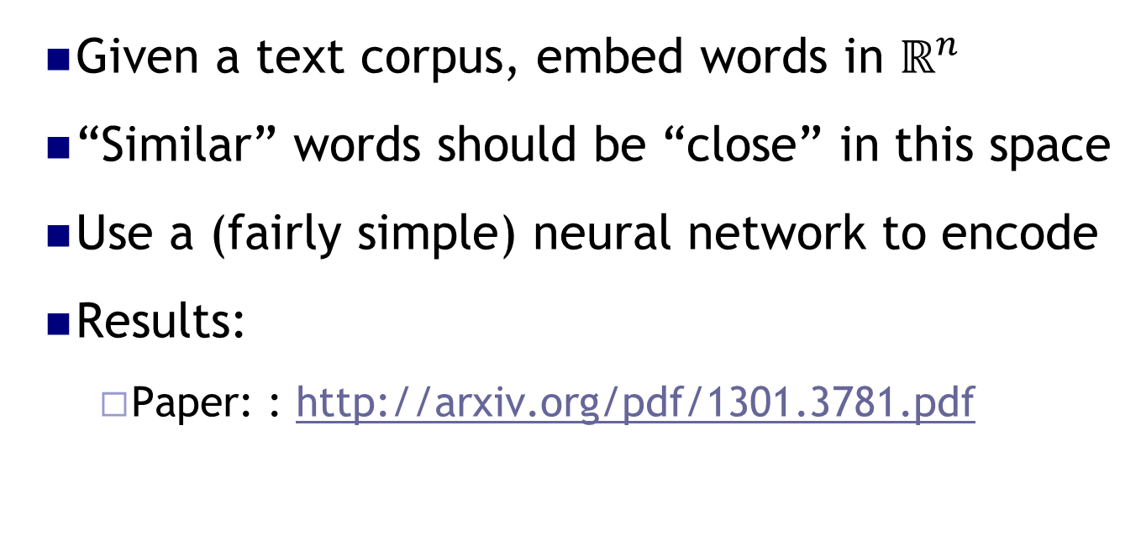
Big Breakthrough: Word2Vec
Given a text corpus, embed words in $ℝ^{n}$
“Similar” words should be “close” in this space
Use a (fairly simple) neural network to encode
Results:
Paper: : http://arxiv.org/pdf/1301.3781.pdf

Slide 49
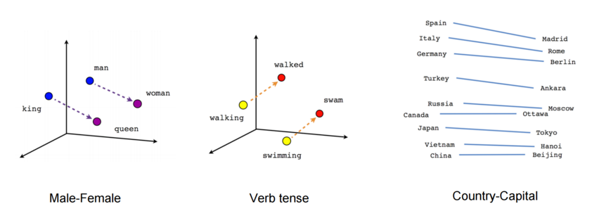
PARIS - FRANCE + ITALY = ROME
JAPAN - SUSHI + GERMANY = BRATWURST
BIG - BIGGER + COLD = COLDER

Slide 50
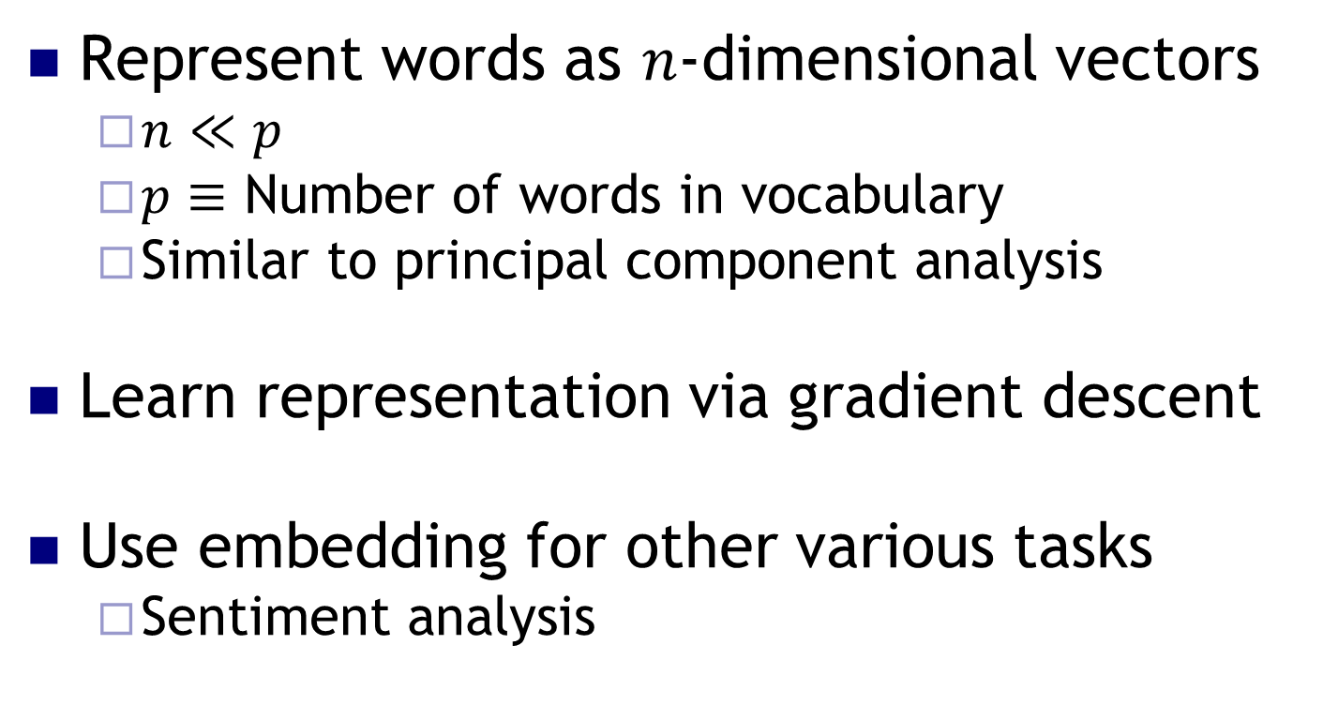
Word Embedding
Represent words as $n$-dimensional vectors
$n≪p$
$p≡$ Number of words in vocabulary
Similar to principal component analysis
Learn representation via gradient descent
Use embedding for other various tasks
Sentiment analysis

Slide 51
Sentiment Analysis
Understand emotion from text
Wide number of use cases:
Product reviews
Market analysis
Etc.

Slide 52

Project 3: IMDB Sentiment Analysis
$50,000$ reviews of polarizing movies
Goal: classify review as positive or negative

Slide 53
Quick break…
https://www.youtube.com/watch?v=iRqypM7jb5Y

Slide 54
Final Thoughts

Slide 55
Hyper-parameter Tuning
Enormous hyper-parameter space
Where to start?
Paper: https://arxiv.org/pdf/1206.5533v2.pdf

Slide 56
Hyper-parameter Priority
Not much consensus in the field
Often problem dependent
Difficult to know beforehand
General thoughts:
Learning rate
Number of layers
Number of hidden units

Slide 57
Hyper-parameter Search
Grid search vs. random search?
Almost always random search
Why?
Explore more values
Coarse to fine search

Slide 58
Additional Resources
Online courses:
Andrew Ng: Coursera – five classes on neural networks
Geoffrey Hinton: Coursera
Fast AI
Kaggle
Code and winners’ write-ups

Slide 59
Additional Resources
Books/Papers/Videos:
http://www.deeplearningbook.org/
http://deeplearning.net/reading-list/
https://ift6266h13.wordpress.com/home/resources/

Slide 60
Key Takeaways
Neural networks are not magical
Wide range of applications for unstructured data
Tons of resources available for further learning
Rapidly changing field

