Slide 1

Nursebot
Vital signs monitor

Slide 2
members
SORIANO ALVARO
CEBALLOS EDUARDO
SALMANCA RAUL
BAJAÑA MOISÉS

Slide 3
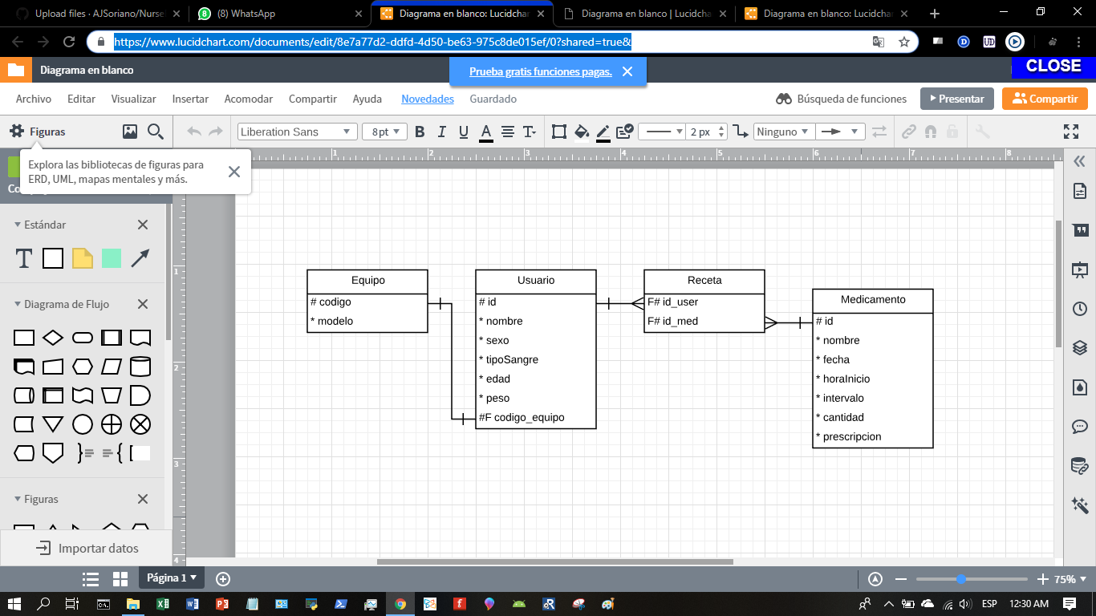
ENTITY RELATIONSHIP DIAGRAM

Slide 4
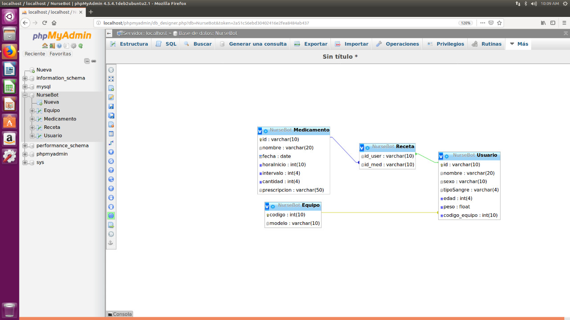

Slide 5
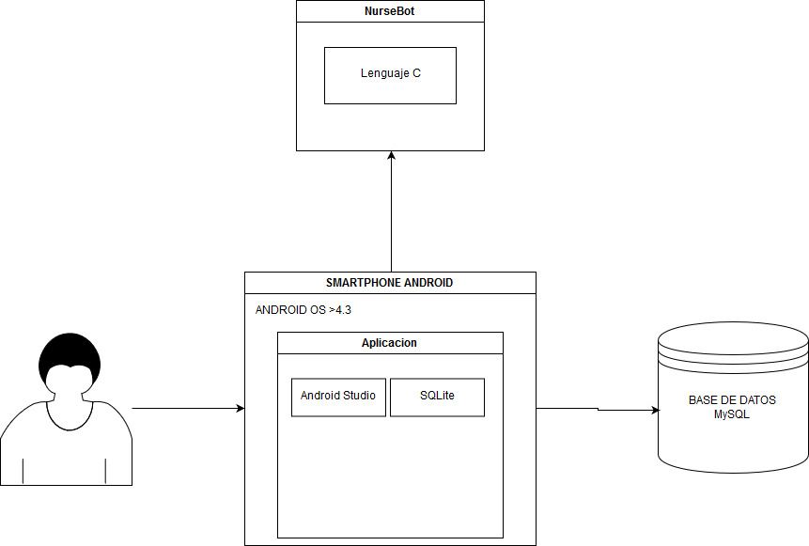
SYSTEM DEPLOYMENT DIAGRAM

Slide 6
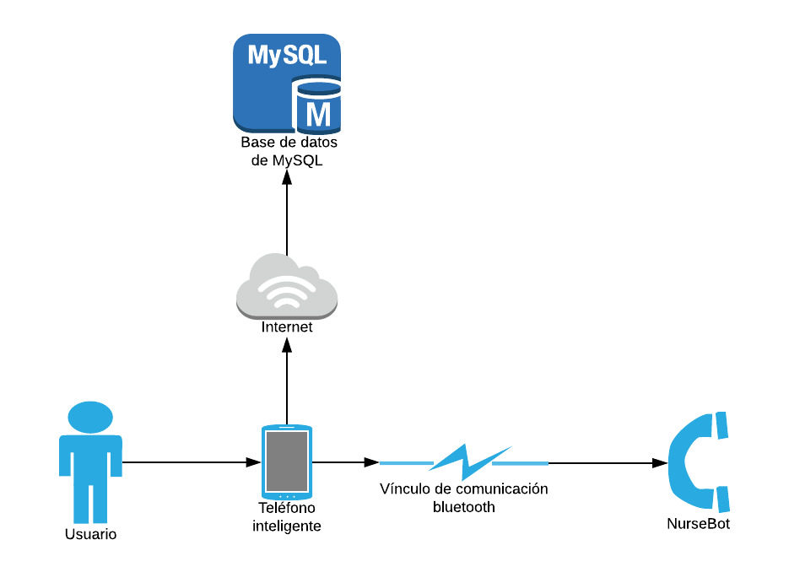
network diagram

Slide 7
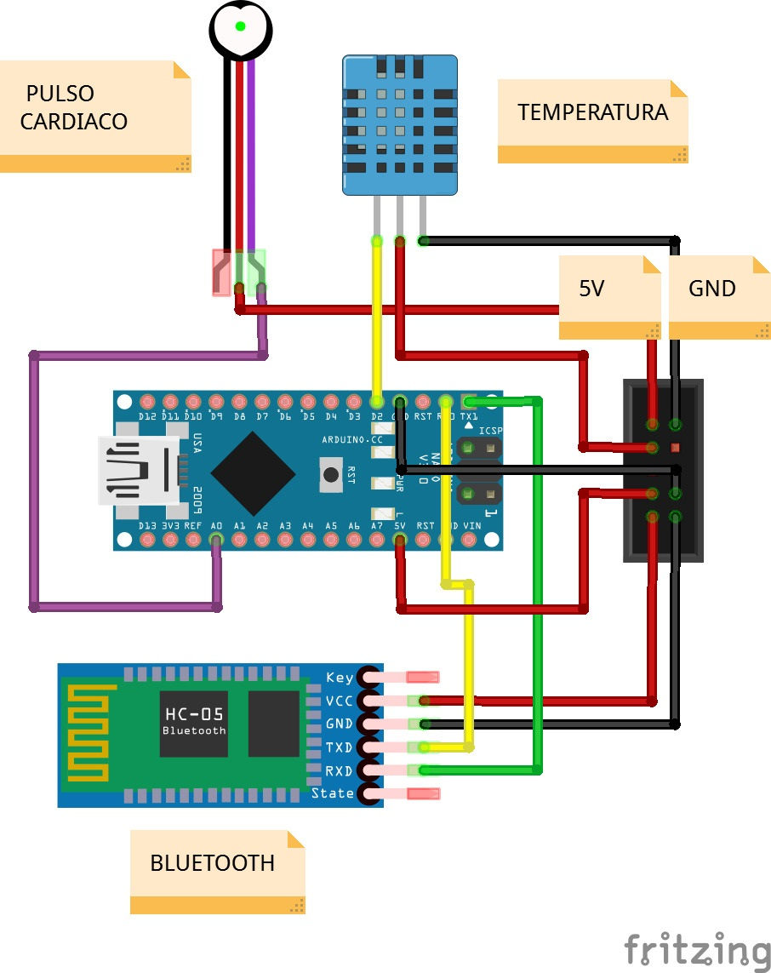
CONECCIONES DE COMPONENTES ELECTRÓNICOS

Slide 8
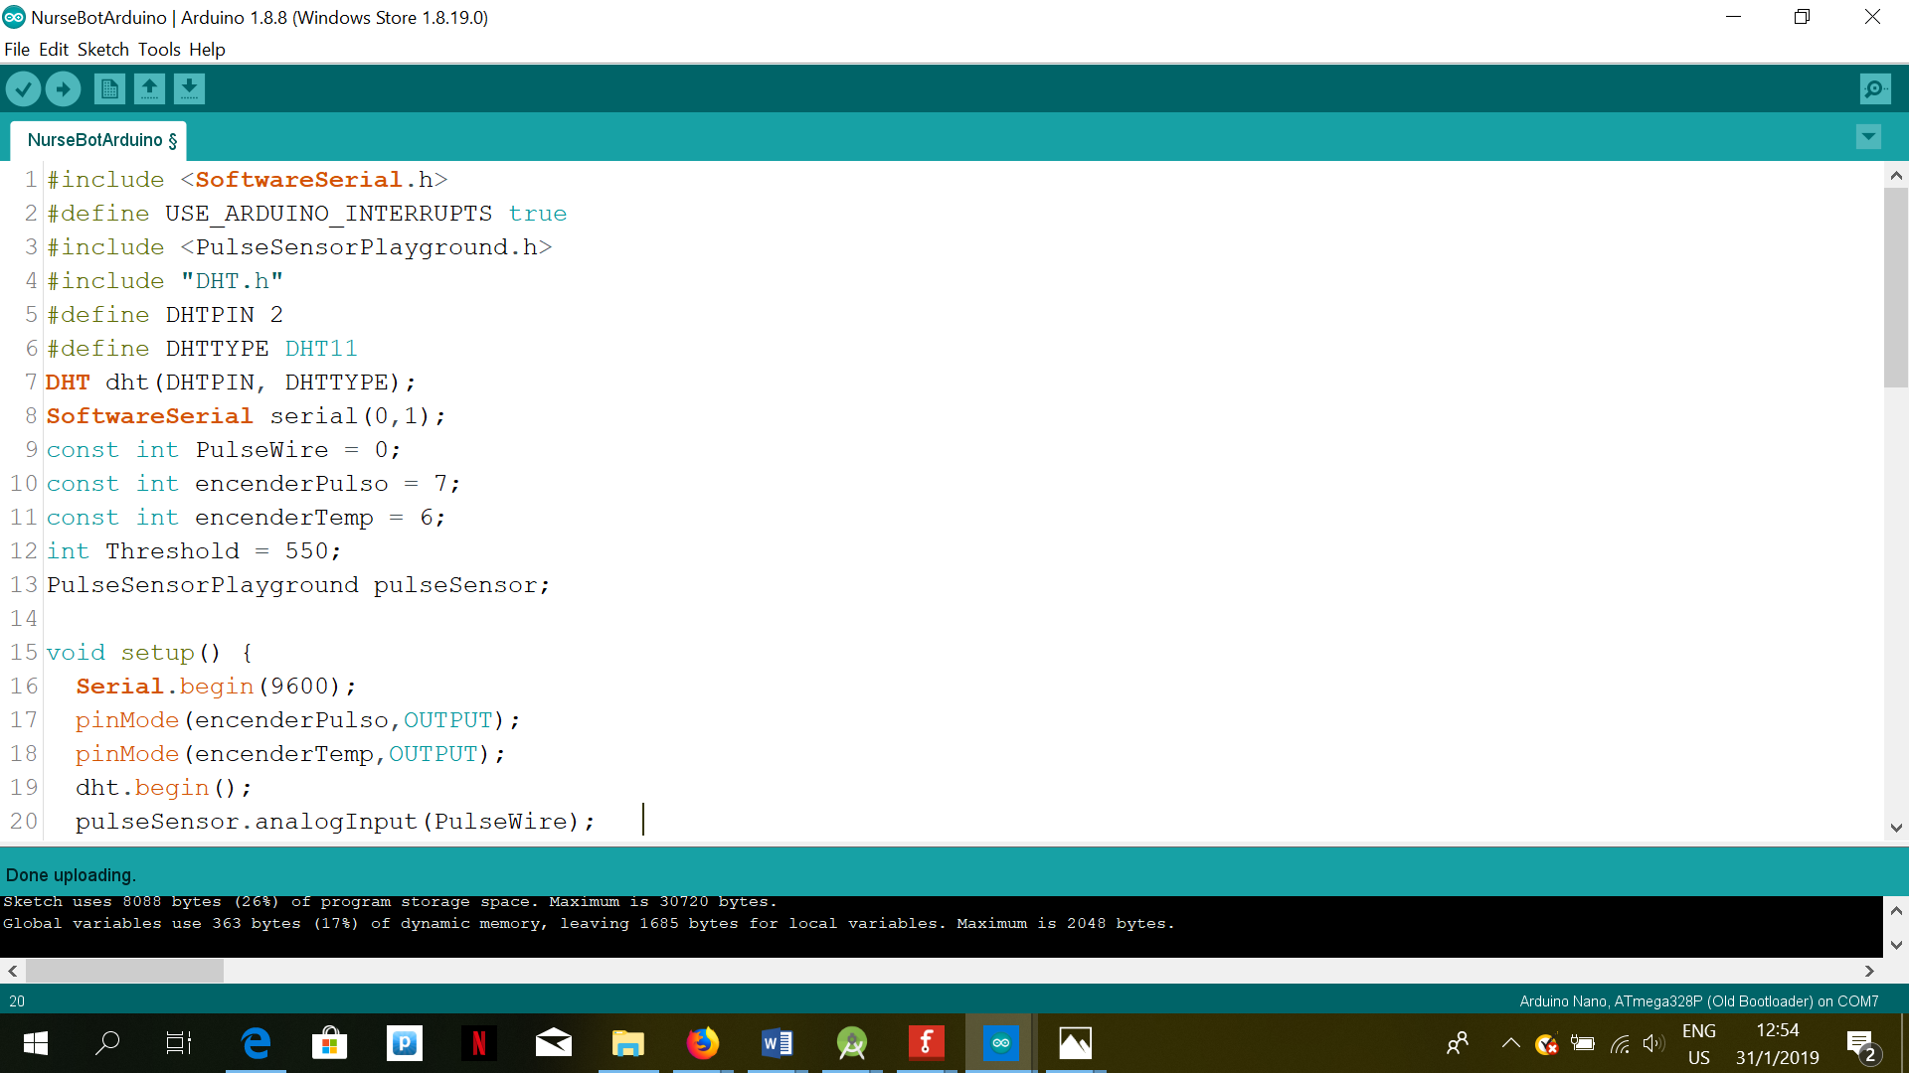
Arduino code

Slide 9
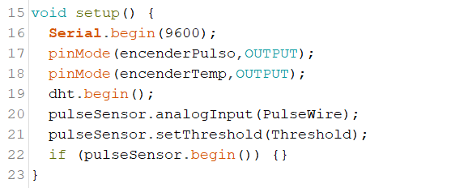
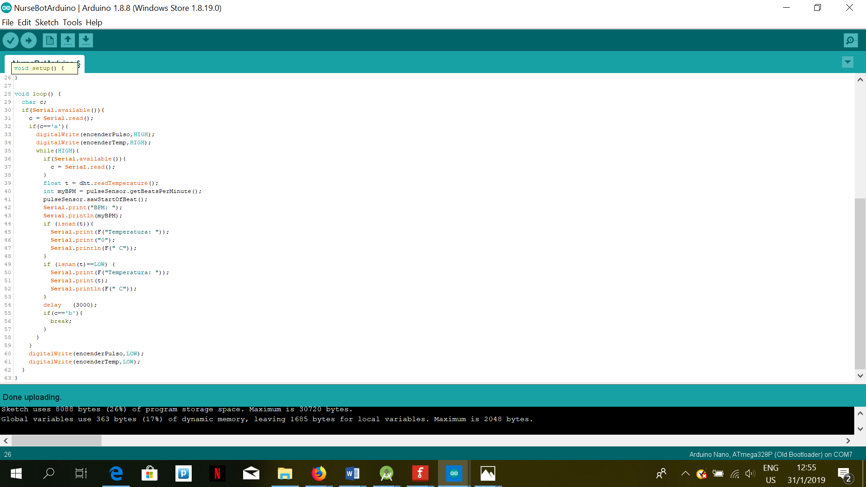

Slide 11
ANDROID STUDIO code (Activity LogIn)
package com.example.nursebotpst; import android.app.Activity; import android.content.Intent; import android.support.v7.app.AppCompatActivity; import android.os.Bundle; import android.view.View; public class LogIn extends AppCompatActivity { @Override protected void onCreate(Bundle savedInstanceState) { super.onCreate(savedInstanceState);

Slide 12
setContentView(R.layout.activity_log_in); } public void iniciar(View v){ Intent i = new Intent(this, MainActivity.class); startActivity(i); finish(); } public void registrar(View v){ Intent i = new Intent(this, SignIn.class); startActivity(i); } }

Slide 13
Activity Menu
package com.example.nursebotpst; import android.content.Intent; import android.support.v7.app.AppCompatActivity; import android.os.Bundle; import android.view.View; public class MainActivity extends AppCompatActivity { @Override protected void onCreate(Bundle savedInstanceState) { super.onCreate(savedInstanceState); setContentView(R.layout.activity_main); }

Slide 14
public void medicion(View view) { Intent i = new Intent(this, MedActivity.class); startActivity(i); } public void cronograma(View v){ Intent i = new Intent(this, Cronograma.class); startActivity(i); } public void medicamento(View v){ Intent i = new Intent(this, Medicamento.class); startActivity(i); } }

Slide 15
Activity Medicion
package com.example.nursebotpst; import android.content.Intent; import android.support.v7.app.AppCompatActivity; import android.os.Bundle; import android.view.View; public class MainActivity extends AppCompatActivity { @Override protected void onCreate(Bundle savedInstanceState) { super.onCreate(savedInstanceState); setContentView(R.layout.activity_main); }

Slide 16
public void medicion(View view) { Intent i = new Intent(this, MedActivity.class); startActivity(i); } public void cronograma(View v){ Intent i = new Intent(this, Cronograma.class); startActivity(i); } public void medicamento(View v){ Intent i = new Intent(this, Medicamento.class); startActivity(i); }

Slide 17
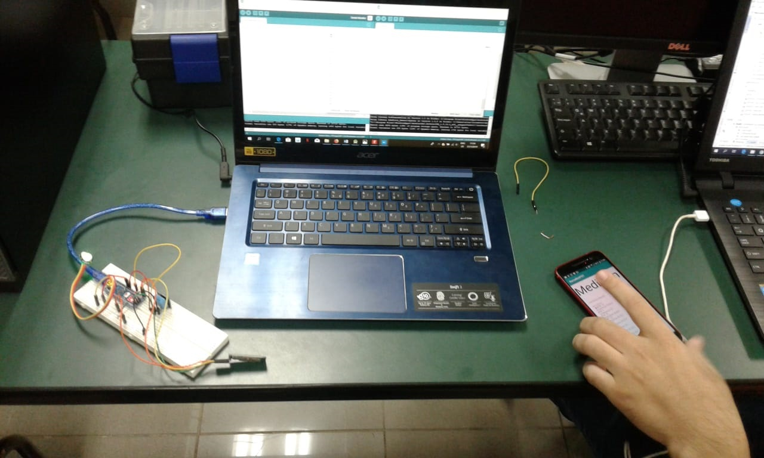
Prototype

Slide 18
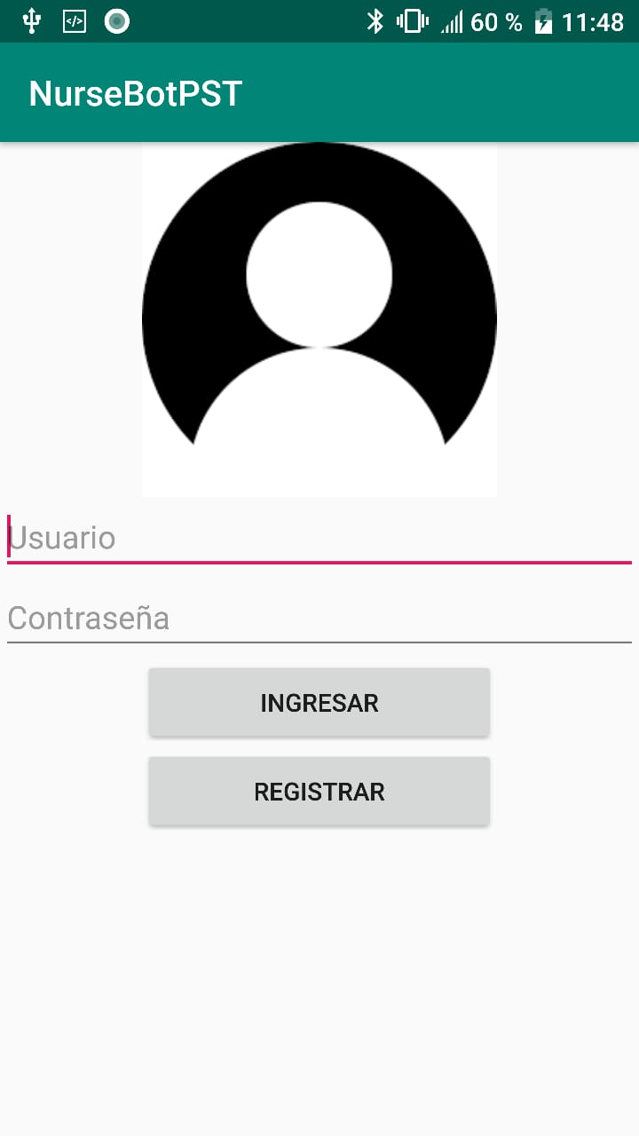
NURSEBOTPST

Slide 19
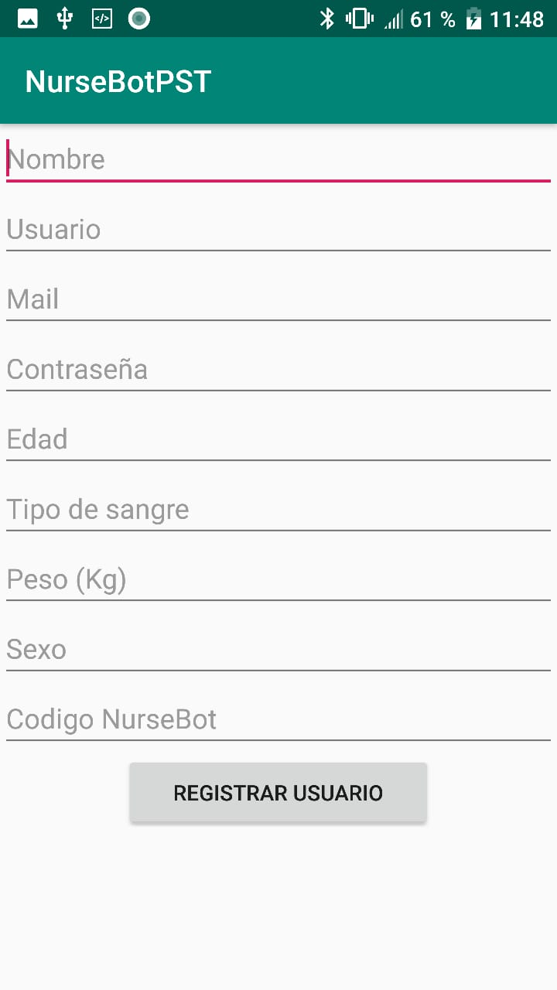

Slide 20
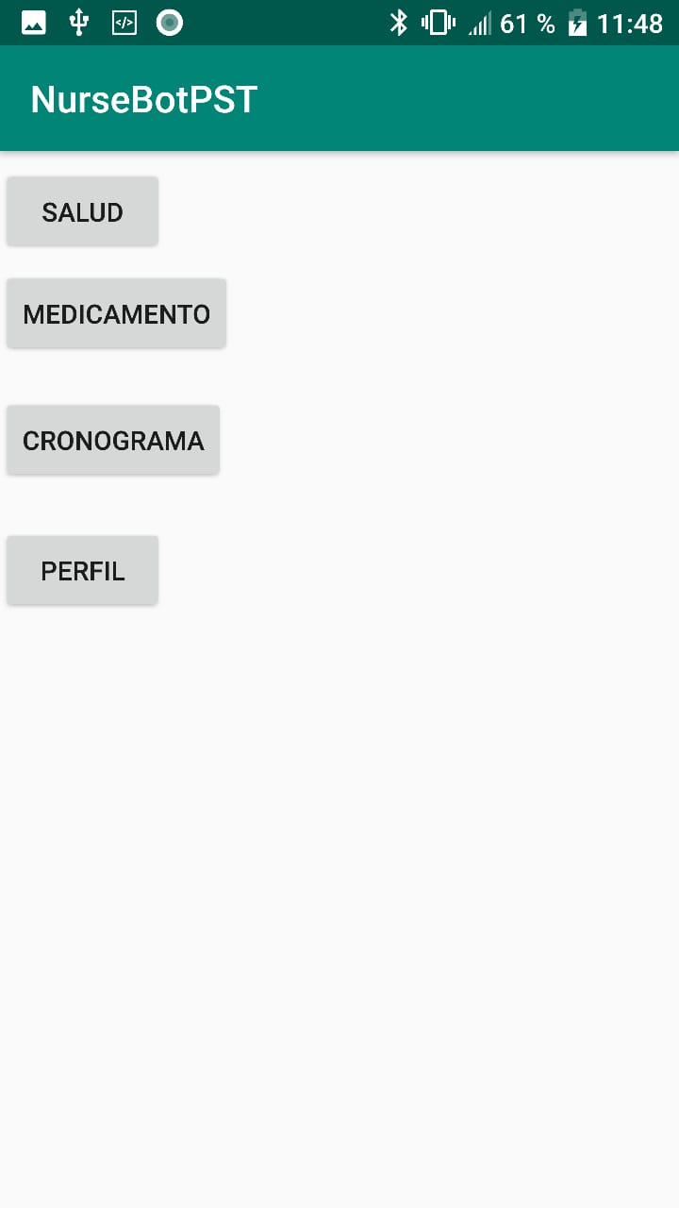
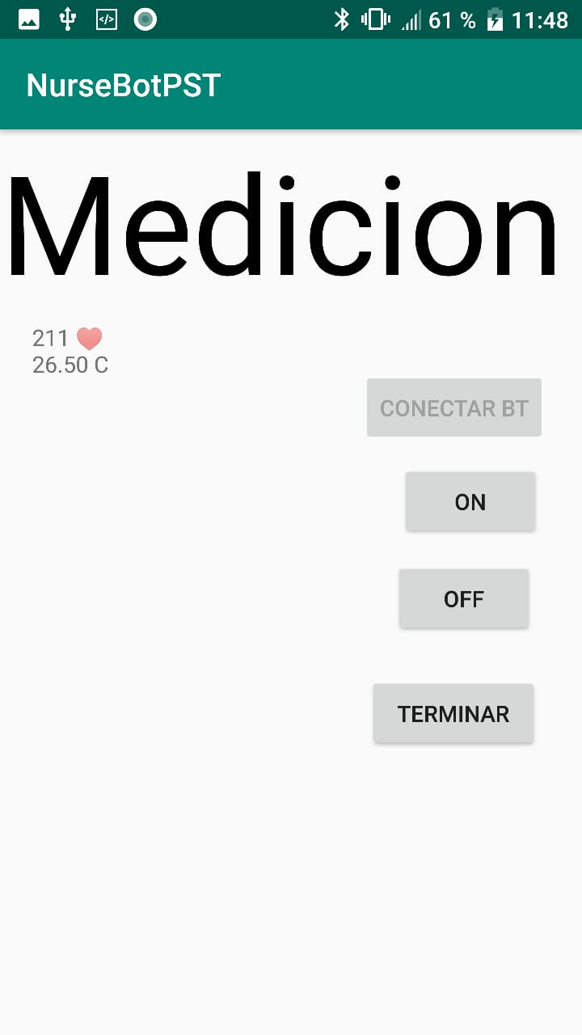

Slide 21
