Slide 1
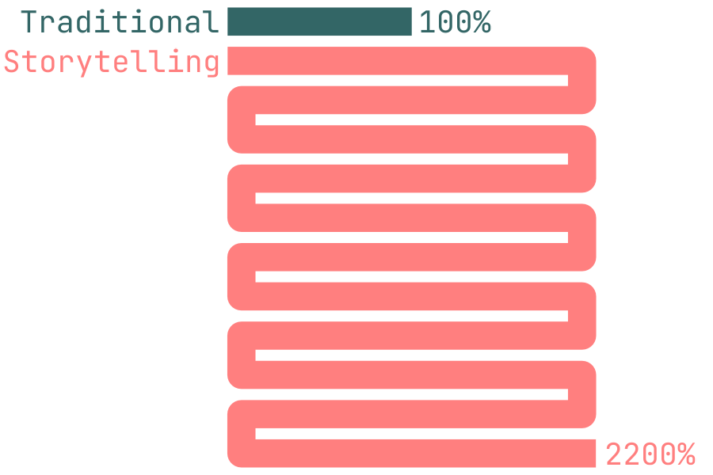
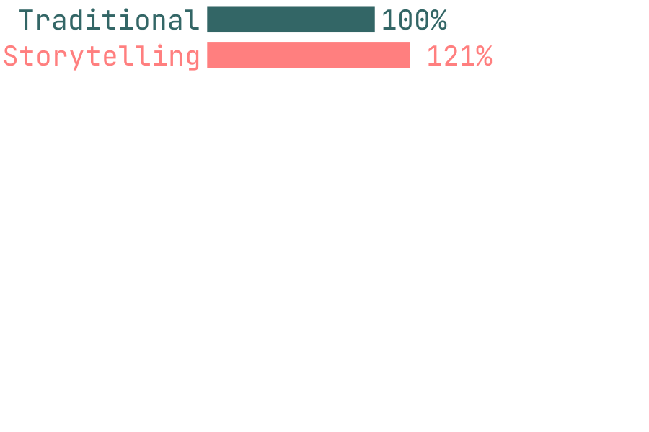
There’s a myth that says we’re 22x more more likely to remember a fact from a story than on its own.¹
Robust meta-analytic evidence² finds we’re about 21% more likely³ to remember storytelling…
Myth
Reality
… while a 21% lift may not make headlines it does get results.
archive.is/MizBp
doi.org/10.3758/s13423-020-01853-1
Hedge’s g = .55 ≈ Cohen’s u3 = .71 assuming a .5 base rate representing an increase of .21., (ajthurston.com/u3)
Andrew J. Thurston © 2025
@AJThurston

