Slide 1
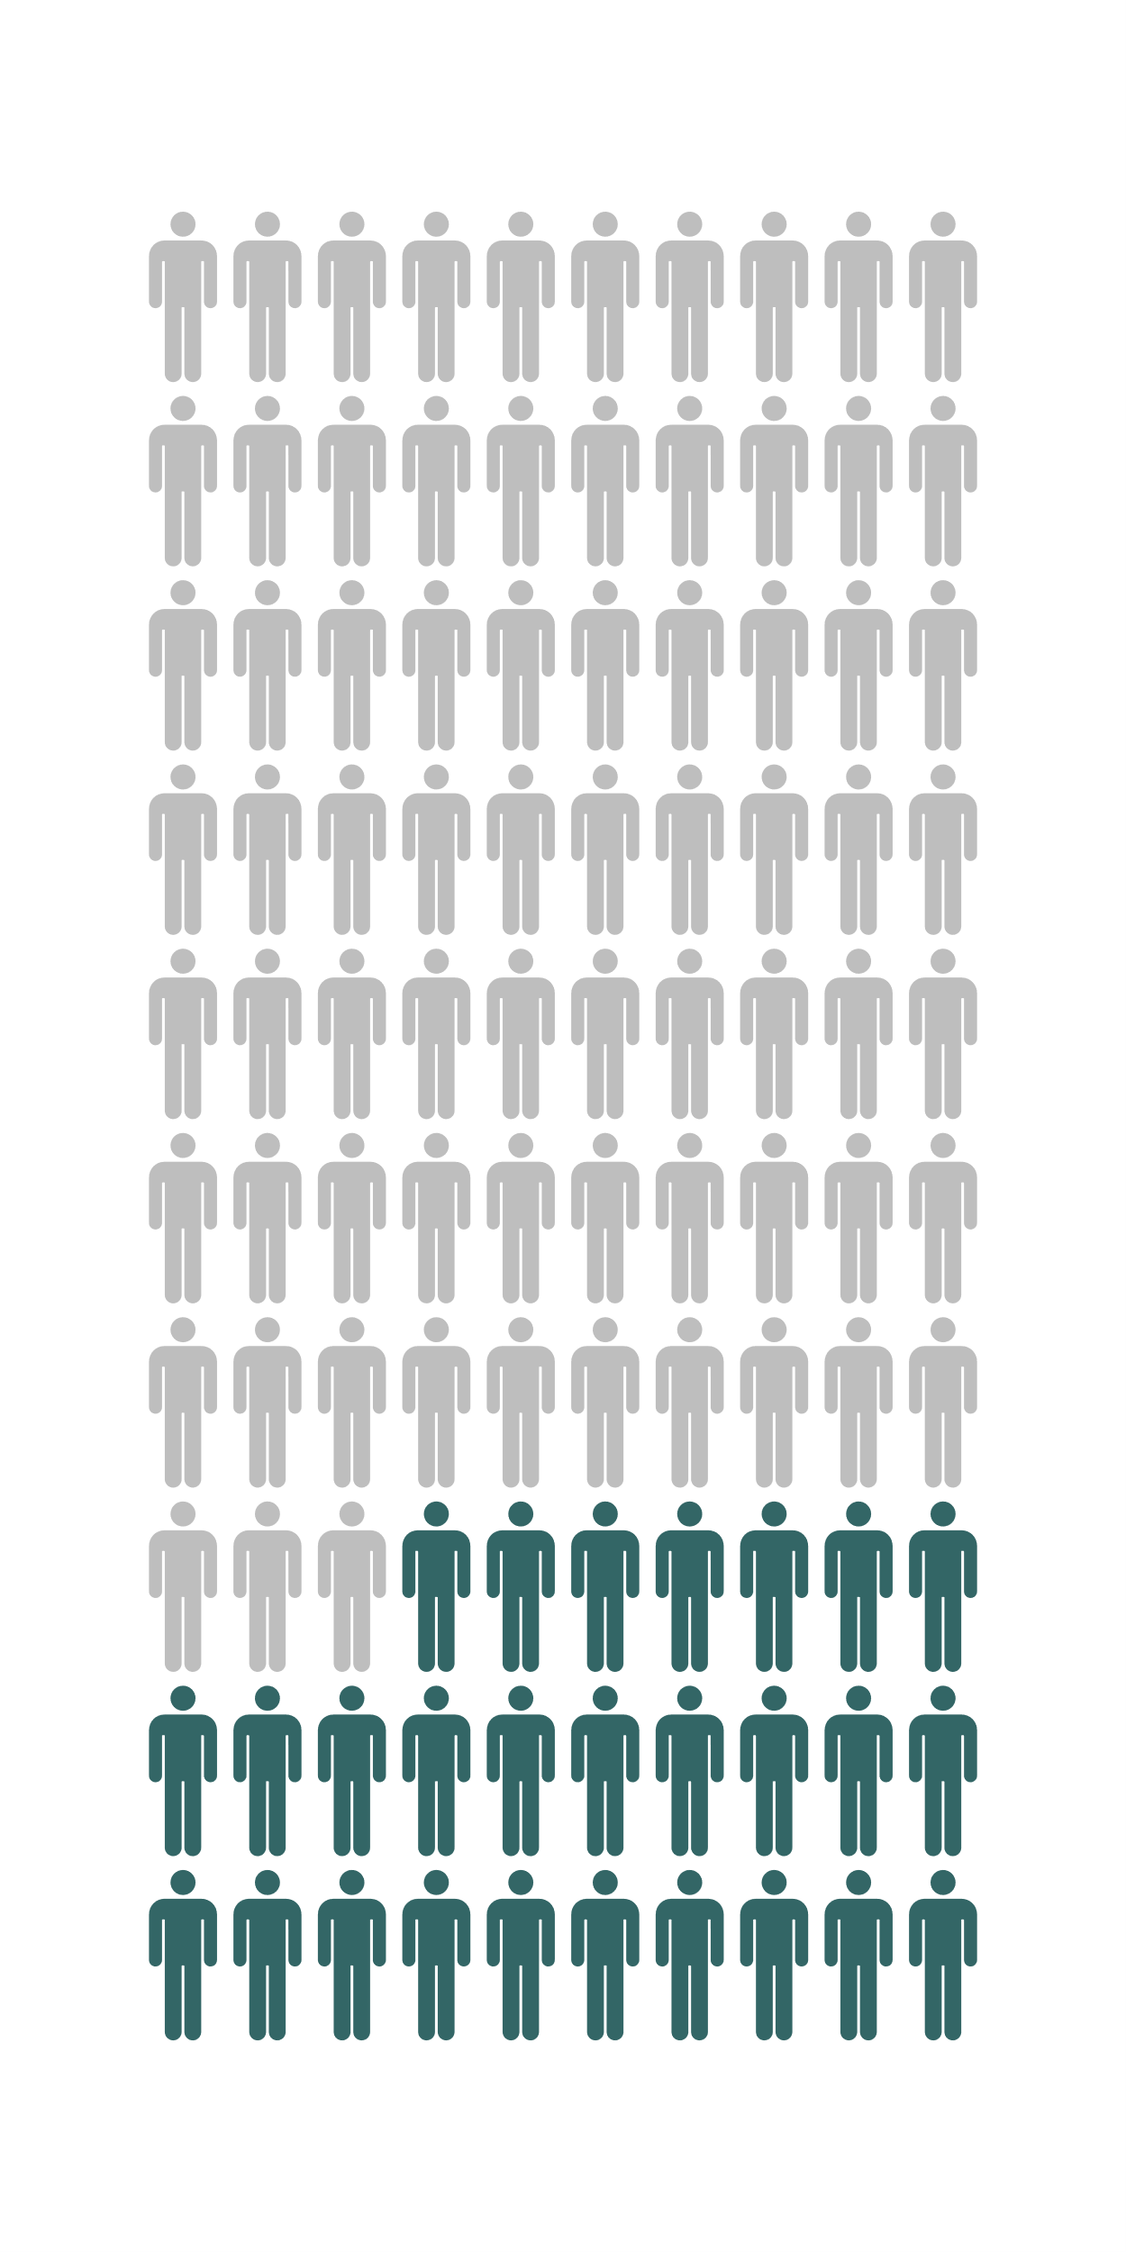
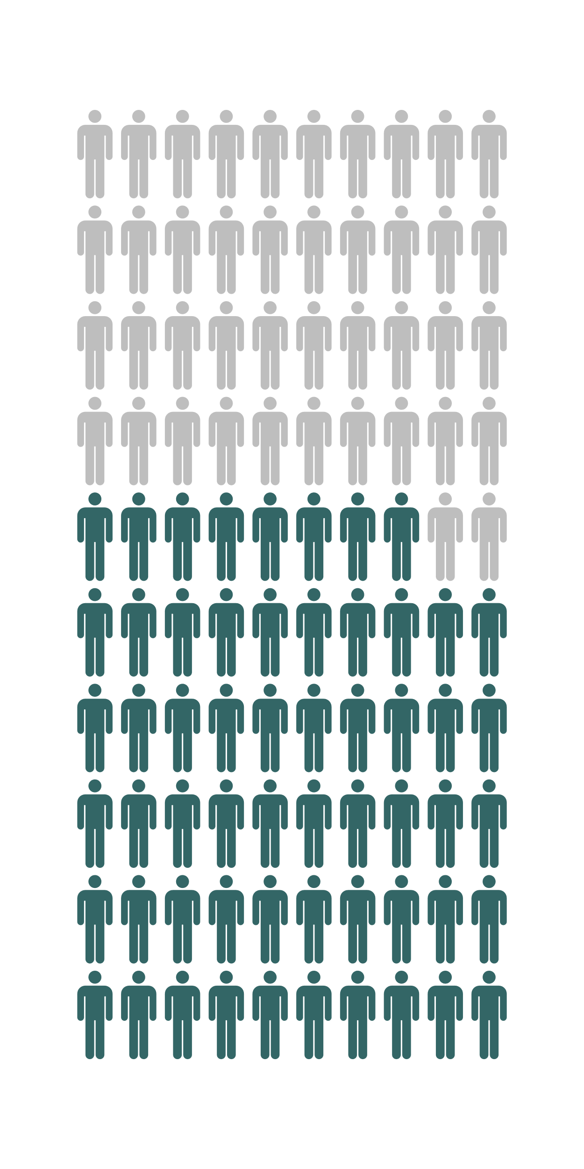
Pre-training
Post-training
● 27/100 passed ● 73/100 failed
● 58/100 passed ● 42/100 failed
Notes:
Note: I flipped the left plot horizontally as I like the plot filling from left to right.

