Slide 1


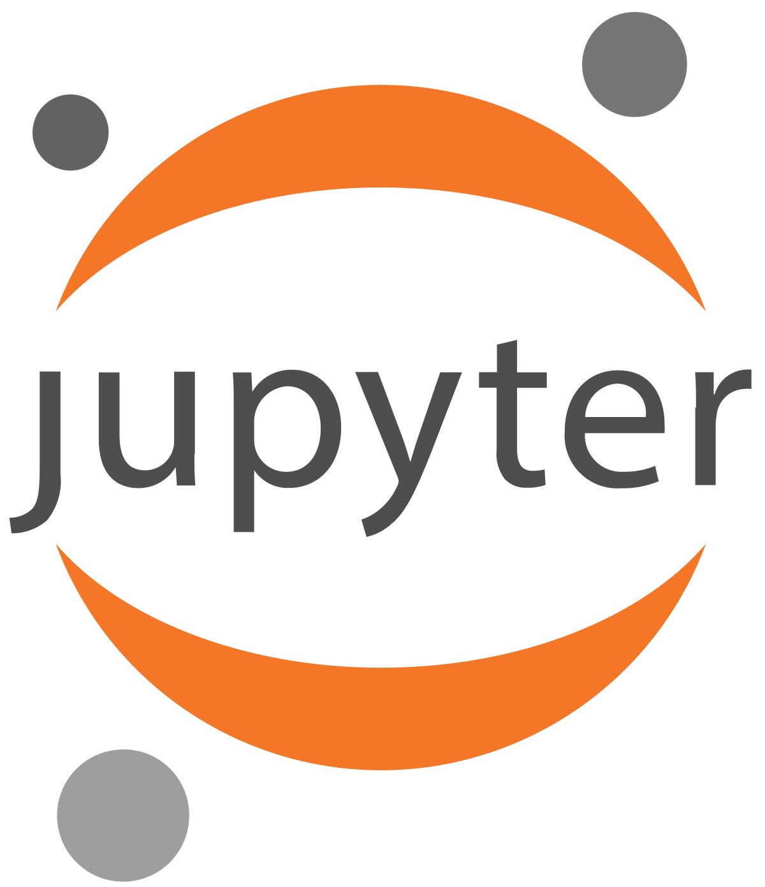

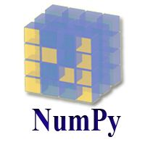
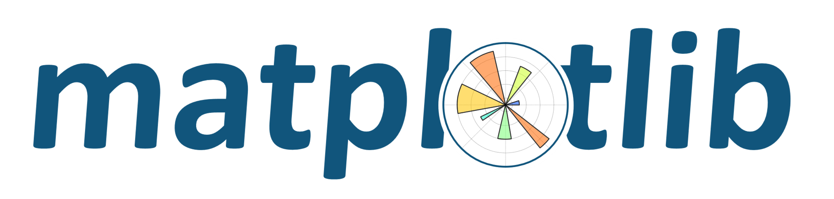

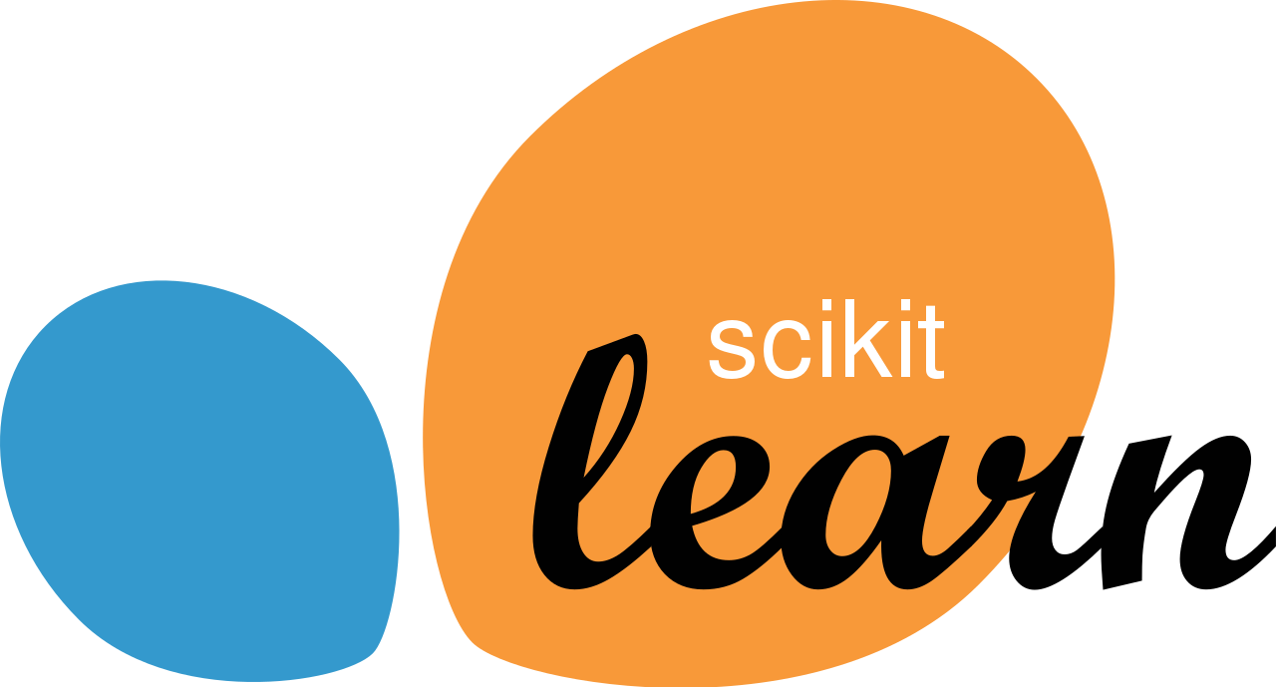
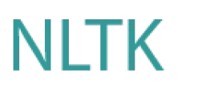
Quick intro about Conda, Jupyter Notebooks, Matplotlib and many other tools for Data Science and Machine Learning newbies!

Slide 2
What is Conda? Popularly known as Anaconda? Why are we using it?
Anaconda is basically a huge package and project environment manager for Python and R.
Anaconda comes with over 1500 scientific packages build into a single installer.
Allows managing of libraries, dependencies and environments with ease using Conda
What is Miniconda?
A minimal installer for Conda.
Miniconda is fast, less disk space.
Task: Setup a basic Conda environment and python!

Slide 3
What are Jupyter Notebooks?
Jupyter Notebooks comes from project Jupyter a open source initiative.
Combine live code, equations, visualizations and narrative text in a single file called a notebook.
Jupyter Lab a next generation UI extension of classical project Jupyter. Supports more file formats and features.
Task: Setup a Jupyter Notebook and perform some python operations with markdown text.

Slide 4
What are NumPy & Pandas?
NumPy stands for Numerical Python, this is the core library used in scientific computing.
Speedy calculations.
Less memory
Just too better than Python Lists.
Pandas a library build specifically for data manipulation and analysis.
Fast and powerful.
Can handle huge chunks of data.
Task: Speed test NumPy vs Python Lists, make a DataFrame object in pandas.

Slide 5
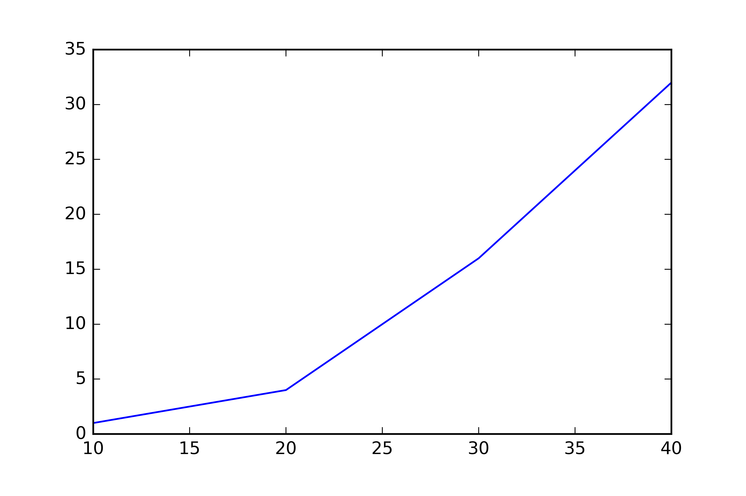
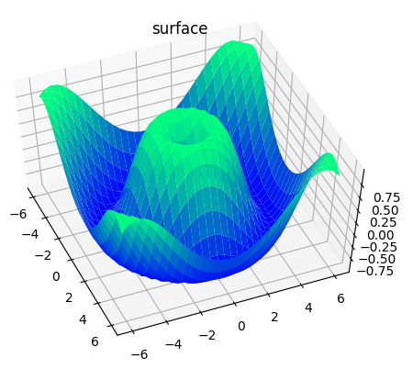
What is Matplotlib?
Maplotlib is a comprehensive library for creating static, animated and interactive visualizations in Python.
Simple Plot
3D Plot
Task: Make a simple plot and encourage you guys with a copied 3d plot code!

Slide 6
What is Scikit-Learn? Also known as sklearn
Scikit-Learn is the de-facto Machine Learning library used by every ML practitioner.
It features various classification, regression and clustering functions like SVM, Random Forests, Gradient Boosting, K-means and many others already implemented ML algorithms which are ready to use. Just fit and predict.
It also has a ton of data preprocessing methods already implemented and ready to use.
Task: Implement super basic Linear Regression using sklearn, also draw a graph!

Slide 7
What are OpenCV & NLTK
OpenCV stands for Open Source Computer Vision. Another de-facto library aimed for real-time vision based functions.
NLTK stands for Natural Language Processing Toolkits. A huge suite of libraries and functions aimed for Natural Language Processing for English.
Task: Two micro projects using Scikit-Learn, OpenCV and NLTK.

Slide 8
Projects / Programs we completed
Simple Linear Regression (pandas, sklearn, matplotlib)
Linear Regression with Categorical Column (pandas, sklearn)
Polynomial Linear Regression (pandas, sklearn, matplotlib)
Sentiment Analysis using NLTK
Digit Recognition using OpenCV and sklearn

Slide 9
Free resources for further studies into Data Science and Machine Learning!
NOTE: This was actually an introduction to making use of Jupyter, Conda and little bit of Matplotlib. You are no way ready to enter the whole scene of ML with just this knowledge. Please consider going through this resources page for more info!
ML from Kaggle - https://www.kaggle.com/learn/overview
Introduction to Deep Learning by MIT (Massachusetts Institute of Technology, US) - http://introtodeeplearning.com/
Fast.ai courses - https://course.fast.ai/ (fast.ai is a Deep Learning Library based on PyTorch a Deep Learning library by Facebook.)
Do you find people discouraging you saying “You need to do a lot of Mathematics for AI”. Follow along the courses, all you need is the will to complete them and your 10th / 12th mathematics basics and nothing more.
You just really don’t need Mathematics unless you are going to do a PhD in AI!

