Slide 1
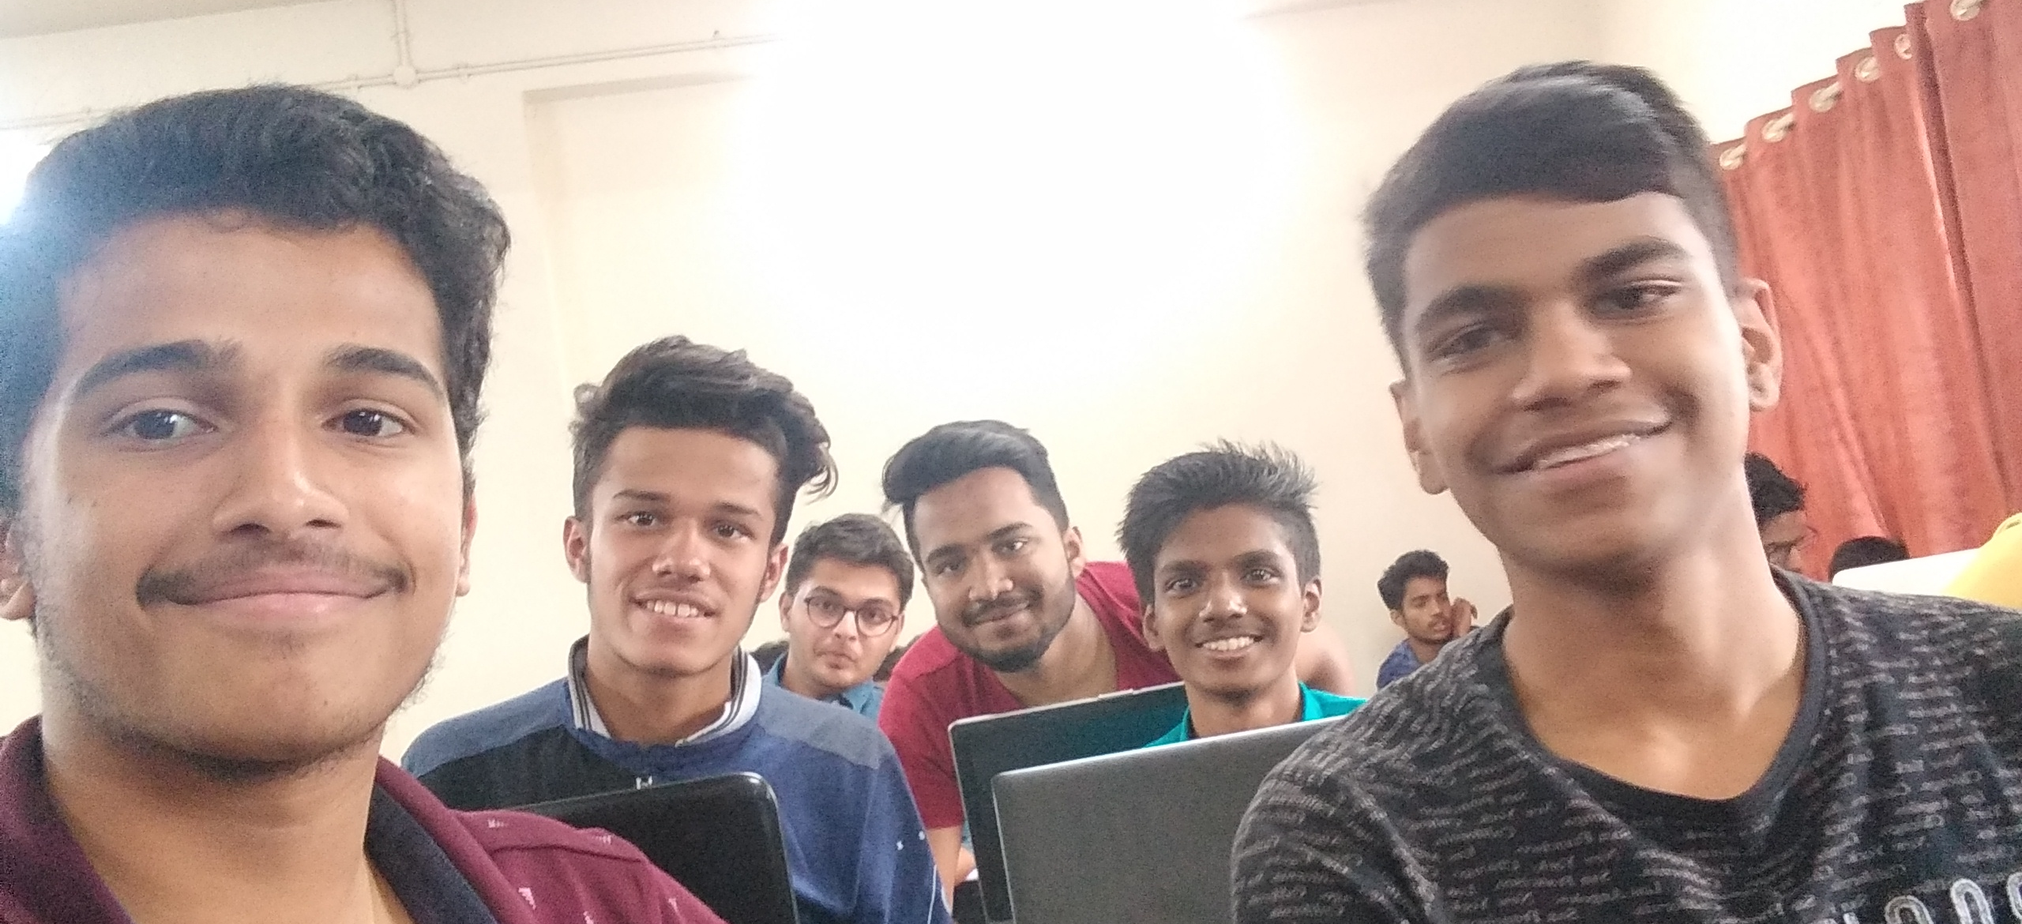
Hi Devs, I love AI & Security.
Want to collab for new ideas? Drop an email!
Dhananjay: 98%
Abhijeet: 97%
Anuj: 98%
varad: 97%
yashodeep: 90%
Alphons: 98%

