Slide 1
Data Structures
Student Schedule final project

Slide 2
Formalized Proposal
My project is student schedule that you can add new students and add new courses. You can add courses to students and then display a course list for each student.
The courses are sorted alphabetically automatically when added to the students using a linked list.
You can then take the students and sort them by their last name in an Insertion Sort.

Slide 3
Time and Change logs
The first sprint I worked on getting the main portion of my project by making a student class that takes a student id, first and last name, how many credits their major is, how many they have completed, and what their major is.
I also made a course class that will take a course name, abbreviated department code (ex. WDV, CIS, ENG), a course number, what semester it is in, and who the instructor is in the first sprint.
In the second sprint I worked on make a linked list that would accept courses being added to the students so I modified my student class to extend my linked list that way I could insert the courses while also being sorted and attached to a specific student.
In the third sprint, I was more occupied by a different class project so I didn’t get much done in regards to my project
The final and fourth sprint, I created the Insertion Sort and changed it to accept students and display them and course lists which were sorted by last name alphabetically. I also created the power point and user manual.

Slide 4
Lessons Learned
Project started off slow going because I was unsure of how to tackle putting students and courses together and display them sorted. I started off with the basic blocks off my project with a Student class and a Course class.
I also started by making a linked list. This is were it became tricky because I didn’t know if I wanted to have a class list for each course or just have a student schedule. I chose to use a student schedule list because that was the way my project steered towards.
I encountered a major block with using a gui with my project. I tried using jframe to be able to add students and courses but it was not turning out how I wanted it to or at all.
Another major block was the time I spent on other projects trying to get them done in order to spend more time on this project.

Slide 5
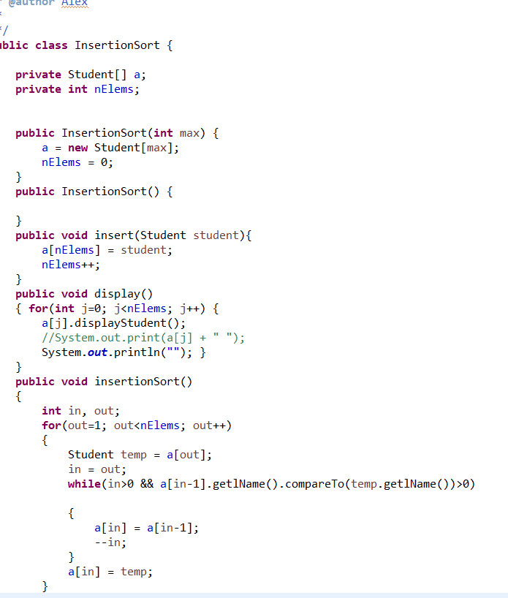
Pictures of Code and github repo
This is a picture of my Insertion sort class.
GitHub repo: GitHub Repo

Slide 6
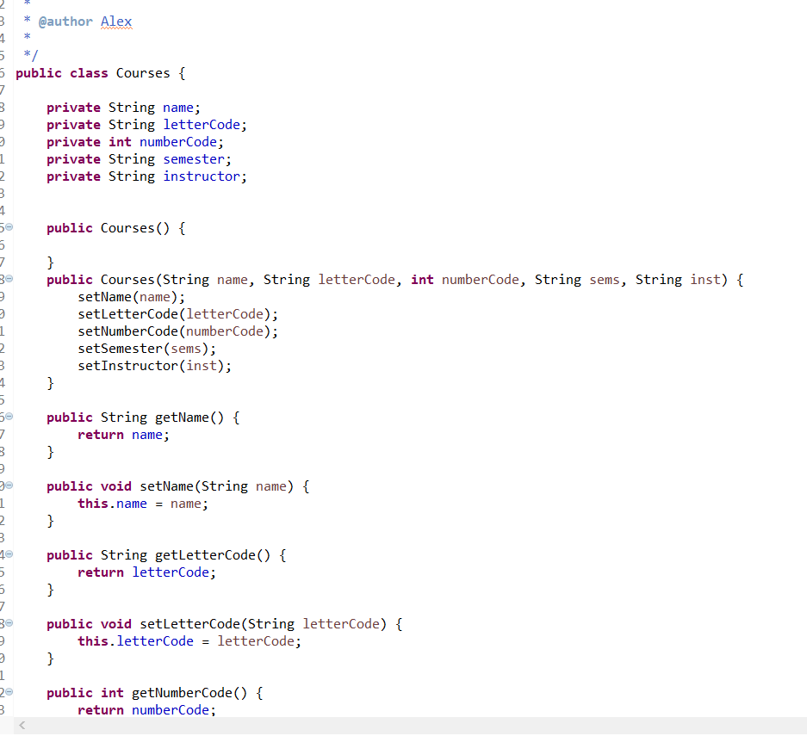
Pictures of Code
This is a picture of my course class.

Slide 7
User’s Manual
The first thing you do once you have Eclipse running you open classEnrollment.java then you add a course by using these parameters: Courses(String name, String letterCode, int numberCode, String sems, String inst).
Then you make students using the parameters Student(int id, String fName, String lName, int credits,int com, String maj).
Once you have that you can insert the courses into the students by doing the student.insert(course); command.
Then you would create an insert array using the int max size parameter for how many students you have. You insert them using the sort.insert(student); command and then sort.display to display the list.
Here is a link of it in action : Screencast Video

Slide 8
Conclusion
As I was writing my code I used the MERUSE technique described earlier in the semester. I tried to write it in a top down fashion for modularity. I tried to think of the quickest way to that it would be able to get threw mode code to free up processing power and memory. I used debugging techniques to help build more of a robustness to my code without it breaking. I tried to write this program with usability in mind so that people could use it often. I tried to make it as readable as possible by adding in comments as well as a Javadoc. I tried to make shorter code work and have to jump through multiple functions to get what I want it to do.
My program is a basic way to create students and assign them created courses. It then creates a list to view the students and the classes assigned to them.
In the future version their would be a gui for ease of use for a user. It would create a printable list for students to determine what classes they have for what semester. There would also be more safe guards against program breaking.

