Slide 1
SME Procurement Assistant
AI supports, never decides.
An agentic procurement assistant for a Ugandan stationery shop
BSE4104 Emerging Trends in Software Engineering · Makerere University · October 2026
Team: Mwesigwa Arnold Mugahi · Boonabaana Bronia · Naisanga Patricia · Nakyambadde Mariam · Tulinawe Ismail
Notes:
Presenter: Mwesigwa Arnold Mugahi. Introduce the team and the one-line idea: an assistant that prepares procurement paperwork for a small shop, where every money decision stays with a human. (~30 s)

Slide 2
The problem
WHY
• Stock records live in an exercise book and can be lost or damaged
• Staff need clear low-stock signals, order quantities and supplier comparisons
• Supplier pressure can lead to over-ordering
• Approval rules may be held by one person
• Goal: make the figures and rules checkable while keeping financial decisions with people
Notes:
Presenter: Mwesigwa Arnold Mugahi. Tell the story: the shop's stock lives in an exercise book. If it is lost or water-damaged, nobody knows what is low, how much to order or from whom. Supplier reps pressure junior staff to over-order. The goal is not faster decisions; it is the shop's own numbers and rules, available and checkable. (~45 s)

Slide 3
What we built
SOLUTION
Shop data
(CSV + 12 policy docs)
8 deterministic
tools (Python)
Bounded agent
(Gemini chooses tools)
DRAFT
requisition
Human approves
or rejects
• Flags low stock, compares quotes, estimates reorder quantities, plans within a budget
• Answers policy questions from the shop's own documents, with citations
• Console app + web UI (Streamlit) over the same functions
Notes:
Presenter: Mwesigwa Arnold Mugahi. Walk the flow left to right. Data is synthetic CSVs plus a 12-document policy corpus. The model chooses tools and explains; Python does all the maths and rules; the output is a DRAFT that a human approves. (~45 s)

Slide 4
AI supports, never decides
BOUNDARY
Capability | AI (model) | Python (deterministic) | Human
Low-stock flagging | chooses the tool, explains | stock <= reorder point | sets reorder points
Reorder quantity | explains the working | ceil(avg x 1.5) - stock, MOQ | sets qty when no history
Policy questions | answers only from retrieved text | BM25 retrieval, citation check | maintains documents
Draft requisition | decides which items | lines, totals, +/-10% band | -
APPROVAL | NEVER (no such tool) | typed confirmation, audit log | APPROVES / REJECTS
ORDERING / PAYMENT | NEVER (no such tool) | no integration exists | orders and pays offline
Notes:
Presenter: Mwesigwa Arnold Mugahi. This is the AI Boundary Matrix (docs/requirements/ai-boundary-matrix.md). Stress the bottom rows: approval and payment are not prompt rules, they are the ABSENCE of a tool. The model cannot do them even if it tries. (~45 s)

Slide 5
Architecture: an AI shell around a deterministic core
ARCHITECTURE
• UI: console + Streamlit
• Agents: tool_agent, restock_agent
• Gate: registry allow-list
• Tools: 8, all Python
• State: scoped SQLite drafts, audit, FSM
• Model: Gemini Flash + fallback chain
Notes:
Presenter: Mwesigwa Arnold Mugahi. Use the diagram. Every request goes through src/llm_client.py (one fallback chain) and every tool call through registry.execute_tool (allow-list, argument validation, trusted context, trace). The worst the model can do is explain a correct draft badly. (~60 s)

Slide 6
Model and prompt engineering
WEEK 2
Version | Change | Result
1.1.0 | first working prompt | 7/10 tests
1.2.0 | only named, low items; formulas in code spans | 9/10 (checker tightened)
2.0.0 | maths moved OUT of the prompt into tools (F-04) | live agent 6/6
2.2.0 | no draft claim without a real draft (F-13) | regression 6/6
2.5.0 | user roles removed (decision-001) | current prompt
• F-04: the model wrote Erasers 70 (correct 63) and Staplers 114 (correct 88): no wording fixes arithmetic
Notes:
Presenter: Mwesigwa Arnold Mugahi. Model: gemini-3.8-flash with a 5-model fallback chain (free tier = 20 requests/day per model; 2.5-flash returns 404, F-06). Prompts are versioned files (v1.0 -> v2.5) with tests. The key lesson: in Week 2 the model got the arithmetic wrong under injection (F-04), so v2.0.0 moved ALL maths into tools. (~45 s)

Slide 7
RAG: answers from the shop's own policies
WEEK 3
• 12 documents, BM25 retrieval
• Citations checked in code
• No-answer handling
• hit@3 10/10, MRR 0.88
• 15/15 grounded answers (live)
• R-4 open: numeric thresholds
Notes:
Presenter: Mwesigwa Arnold Mugahi. 12 synthetic policy documents, chunked by heading, BM25 index, score gate, top 3 plus the next section. Every claim must cite a source id, and the code checks the ids. Unanswerable questions say 'not in the documents'. Show R-4 honestly: keyword search cannot reason about number ranges. (~45 s)

Slide 8
Tools and the bounded agent
WEEKS 4-5
• 8 tools: low stock, quotes, reorder qty, plan within budget, draft,
  – inventory, purchase history, policy search
• Registry: allow-list -> schema validation -> trusted context -> run -> trace
• Restock agent: max 5 turns / 6 tool calls; outcome decided by code
• Worked example (all computed by tools):
  – 10 of 15 items low · Bic Pens 65 · Rulers 57 · draft UGX 84,406
  – Budget UGX 300,000 -> 4 items, UGX 294,130
Notes:
Presenter: Mwesigwa Arnold Mugahi. 8 tools, none can approve, order, pay or contact anyone. The restock agent: preconditions -> SENSE (code) -> model chooses the next tool -> registry runs it -> observe -> post-conditions -> STOP. Limits: 5 turns, 6 tool calls, 3 allowed tools. The OUTCOME is decided by code, not by the model's wording. Read the worked example numbers. (~60 s)

Slide 9
Memory, state and interoperability
WEEK 6
• FSM: INITIALIZED -> ... -> AWAITING_APPROVAL -> APPROVED / REJECTED
• SQLite, scoped by shop + user
• Shop id injected by code, never by the model
• Justified memory with erasure
• MCP JSON-RPC server
Notes:
Presenter: Mwesigwa Arnold Mugahi. The workflow is an explicit state machine: APPROVED can only be reached from AWAITING_APPROVAL, and only the human gate does that. Drafts, audit events and sessions are stored in SQLite, scoped by shop and user; the model can never choose its shop. Memory is justified (supplier preferences, feedback), never raw chat. MCP server exposes the tools with permission levels. (~45 s)

Slide 10
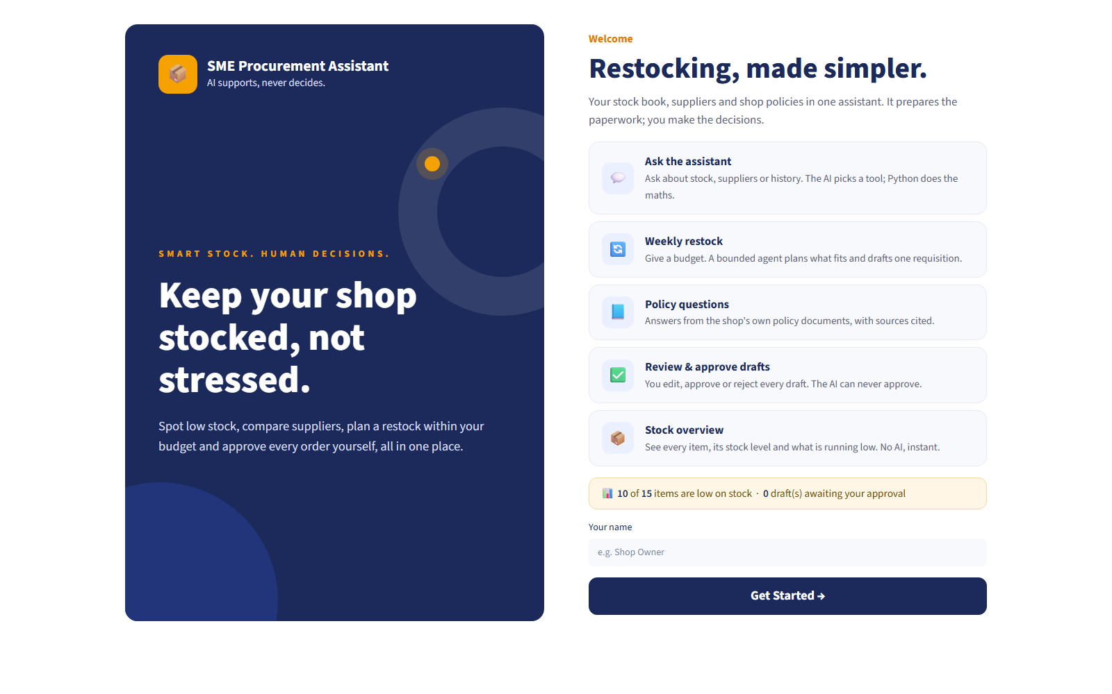
The web UI
UI
Notes:
Presenter: Boonabaana Bronia. The Streamlit UI calls the same functions as the console; no new business logic. The status line (10 of 15 low) comes from get_low_stock(), not from the model. Mention hosting (Render / Streamlit Cloud) and that the home screen needs no API key. Replace the second box with the next screen once it is built. (~45 s)

Slide 11
Live demo
DEMO
• Weekly restock, budget UGX 300,000 -> timeline + DRAFT
• Review drafts: it waits for a human
• Ask the AI to approve it -> refused (no such tool)
• Human approves -> audit event + state APPROVED
Notes:
Presenter: Mwesigwa Arnold Mugahi. 1) Open the web UI / console. 2) Run a weekly restock with UGX 300,000: show the timeline and the DRAFT. 3) Open Review drafts: the draft waits for a human. 4) Ask the AI to approve it: it refuses, because no approve tool exists. 5) Approve it yourself and show the audit entry. If the quota runs out, switch to the fallback screenshots. (~3 min)

Slide 12
Traces and logs: inspecting what the AI did
OBSERVABILITY
• llm_calls.jsonl: every model call (model, round, latency, outcome)
• tool_traces.jsonl: every tool call, allowed and blocked
• trace_T*.md: Sense -> Plan -> Act -> Observe -> Stop
• audit_events (SQLite): every human decision and edit
• state_transitions (SQLite): every workflow move
Notes:
Presenter: Mwesigwa Arnold Mugahi. Open one trace file and read a row aloud: run id, tool, arguments, status, latency. Every model call, every tool call (allowed AND blocked), every human decision and every state transition is written by code, not by the model. (~45 s)

Slide 13
A real failure: F-26, the merge that hid every draft
FAILURE
Offline suite | Before the fix | After the fix
Week 4 tools | 20/22 | 22/22
Week 5 agent | 16/17 | 17/17
MVP | 5/7 | 7/7
Week 6 storage | did not run | 9/9
• Symptom: AI said 'awaiting approval'; approval list was empty
• Cause: tool -> SQLite, approvals -> JSON files
• Fix: one scoped SQLite draft store
• Lesson: run ALL suites after EVERY merge
• Also shown: F-04 (wrong maths) -> maths moved to code
Notes:
Presenter: Boonabaana Bronia. Two Week 6 branches were merged; the tool saved drafts to SQLite while the approval screen still read JSON files. The agent said 'draft created, awaiting approval', but the human saw nothing. Each branch passed its own tests; only a full run after the merge exposed it. Fix: one scoped draft store. Lesson: run every suite after every merge. Evidence: evidence/final/f26_*. (~60 s)

Slide 14
Safety controls and guardrails
SAFETY
Brief requirement | How it is enforced (code)
Permissions | Tool allow-list; no approve / order / pay tool exists (F-07, F-19)
Validation | JSON Schema on every argument; input guardrail blocks injection; budget checks
Logs | Model, tool, decision and state-transition traces
Approval controls | Human-only gate, typed APPROVE / REJECT, reasons, audit; budget ceiling (F-12)
Tool limits | Max turns and tool calls, repeated-call guard, per-task tool list
Shop isolation | Shop/user injected by code; model-supplied shop rejected (F-25)
Notes:
Presenter: Mwesigwa Arnold Mugahi. Map each brief requirement to the code: permissions = allow-list (no approve/pay tool); validation = JSON Schema + input guardrail; logs = the four trace streams; approval = human-only gate with typed confirmation; tool limits = turn and call caps. These are code, not prompt instructions. (~45 s)

Slide 15
Evaluation results
WEEK 7
Measure | Result
Offline regression (9 suites, no API key) | 119 / 119
Week 7 scenarios (6 categories) | 31 / 31
RAG retrieval hit@3 / grounded answers | 10 / 10 · 15 / 15
Live agent / restock traces | 6 / 6 · 4 / 4
Documented failures (cause, fix, test) | 26 (23 closed)
Notes:
Presenter: Mwesigwa Arnold Mugahi. 119 offline tests across nine suites, all without the model, so anyone can verify the release without quota. 31 Week 7 scenarios cover normal, edge, corrupted, adversarial, tool-failure and unauthorised-action cases. 26 failures are documented with cause, fix and the test that proves it. (~45 s)

Slide 16
Limitations and future work
HONESTY
• Keyword RAG cannot reason about number ranges (R-4)
• State split over two SQLite files; shops share the same CSV data
• No login (single trusted user, decision-001), no CI pipeline
• Free tier: 20 requests/day per model
• Next: approval_threshold tool, one database, finish + host the UI, CI after every merge
Notes:
Presenter: Mwesigwa Arnold Mugahi. Be honest: R-4, two SQLite stores, all shops share the same CSVs, no login, no CI, UI still being completed, free-tier quota. Then the future-work list in priority order. (~45 s)

Slide 17
Team and contributions
TEAM
Member | Contribution
Mwesigwa Arnold Mugahi | Model integration, tools, agents, RAG, guardrails and evaluation
Boonabaana Bronia | Scoped SQLite storage, tenant context, F-26 fix, Streamlit UI and report/deck
Naisanga Patricia | Contribution details not documented in supplied evidence
Nakyambadde Mariam | Contribution details not documented in supplied evidence
Tulinawe Ismail | Contribution details not documented in supplied evidence
Available project-management record
docs/team/task-board.csv
No ClickUp screenshot was supplied. Three members’ contribution details were not recorded in the supplied evidence.
Notes:
Presenter: Mwesigwa Arnold Mugahi. One line per member about what they built, and show the ClickUp board (tasks, owners, deadlines). Only list work each person actually did. (~45 s)

Slide 18
Thank you
AI supports, never decides.
Questions?
github.com/AJmight/Capstone_project-
Notes:
Presenter: Mwesigwa Arnold Mugahi. Invite questions. Likely questions: why not let the model compute? (F-04); how do you know it cannot approve? (no tool + test O-15); what happens if the quota runs out? (fallback chain, offline tests); how are shops isolated? (shop id injected by code, F-25).

