Slide 1
3D-Based Gesture Controlled Pong
EVAN ARROYO AND JOSHUA SIMS
Notes:
Josh

Slide 2
What Is This Project About?
Developing a widely used application
Using popular, advancing technology
3D graphics
Gestural control
Practicing software design
Notes:
Evan

Slide 3
The Approach
An extension of a classic 2D game
Predefined, successful game design
Focus on extension rather than reinvention
Notes:
Evan

Slide 4
Goals for Pong
3D graphics
3D gameplay
Gestural control
Artificially intelligent opponent
Additive gameplay effects
Statistics
Notes:
Evan

Slide 5
Differences from Last Semester
Last semester
Current semester
3D graphics
2D gameplay
Gestural control
Statistics
3D graphics
3D gameplay
Gestural control
Additive effects
Disable goal zone segments
Award extra points
Random obstacles
Paddle shrink
Multiple balls
Notes:
Evan

Slide 6
Toolset
Notes:
Josh

Slide 7

Rendering engine
Physics engine
Popular in industry
Multi-platform development
Inexpensive
Notes:
Josh

Slide 8

Interprets gestures
All body types
Multiple bodies
Major and minor joints
Small device; small spatial requirements
Inexpensive
Notes:
Evan

Slide 9
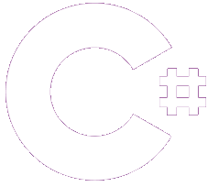
Scripting
Unity standard
Compliant with Kinect API
Exposure to a new language
Object oriented
Visual Studio (IDE)
Notes:
Evan

Slide 10

Version control
Backups
Organization
Concurrent development
Agility
Notes:
Josh
Mention the agility of git as well as the effect git had on our agility.

Slide 11
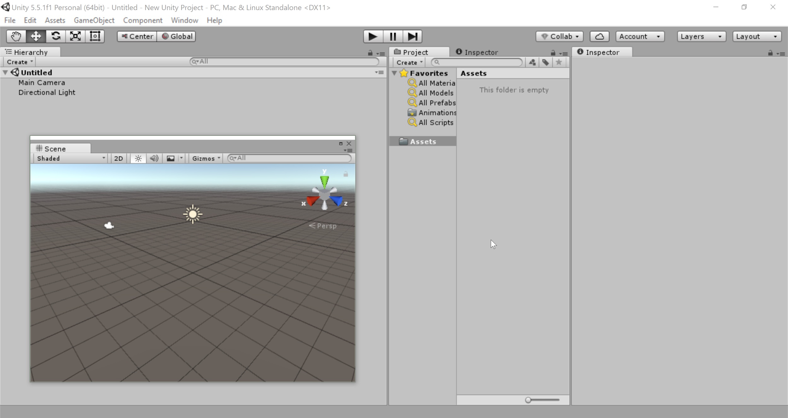
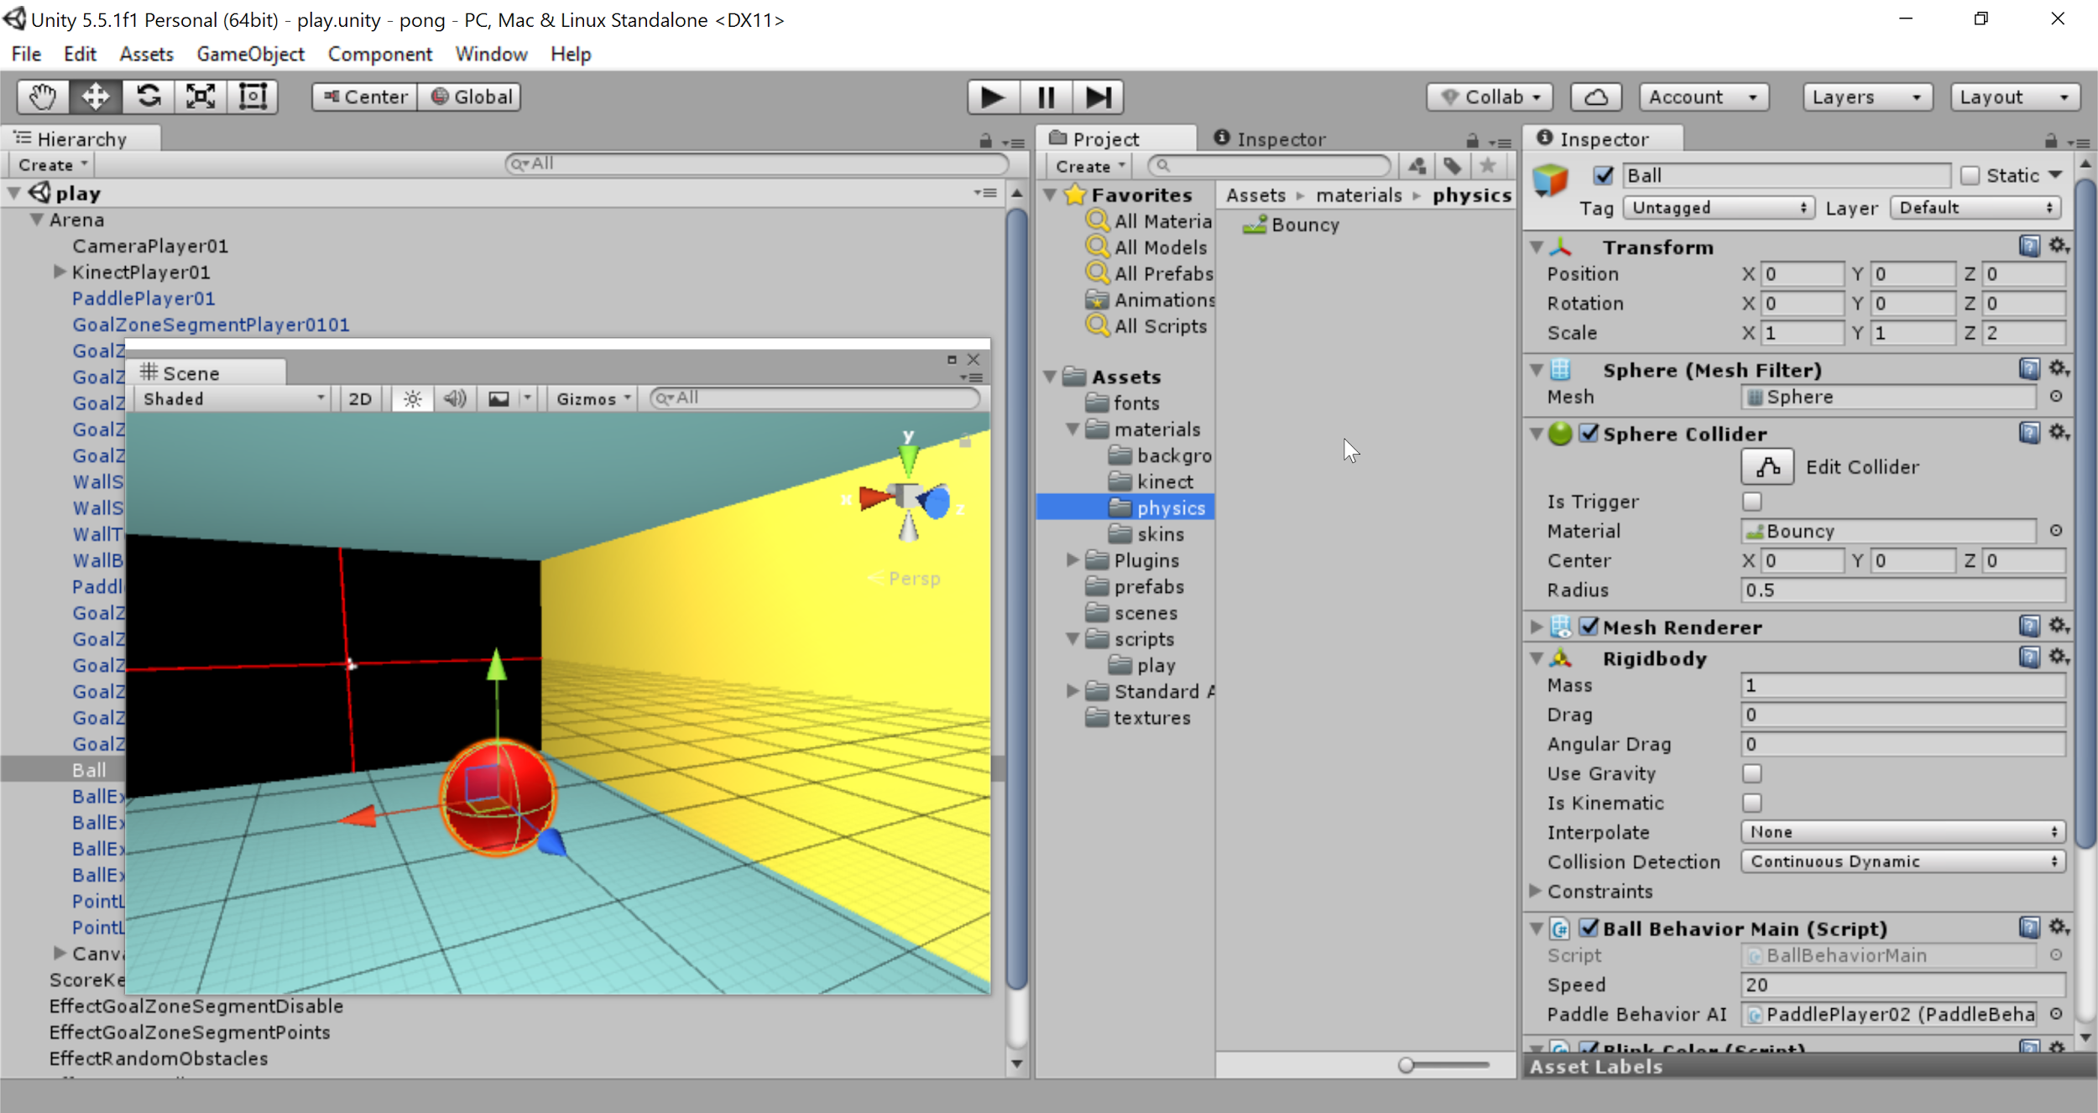
From a Developer’s Perspective
Assets
Scenes
Hierarchy of objects
Components per object
Images
Audio
Graphical editor
Notes:
Josh

Slide 12
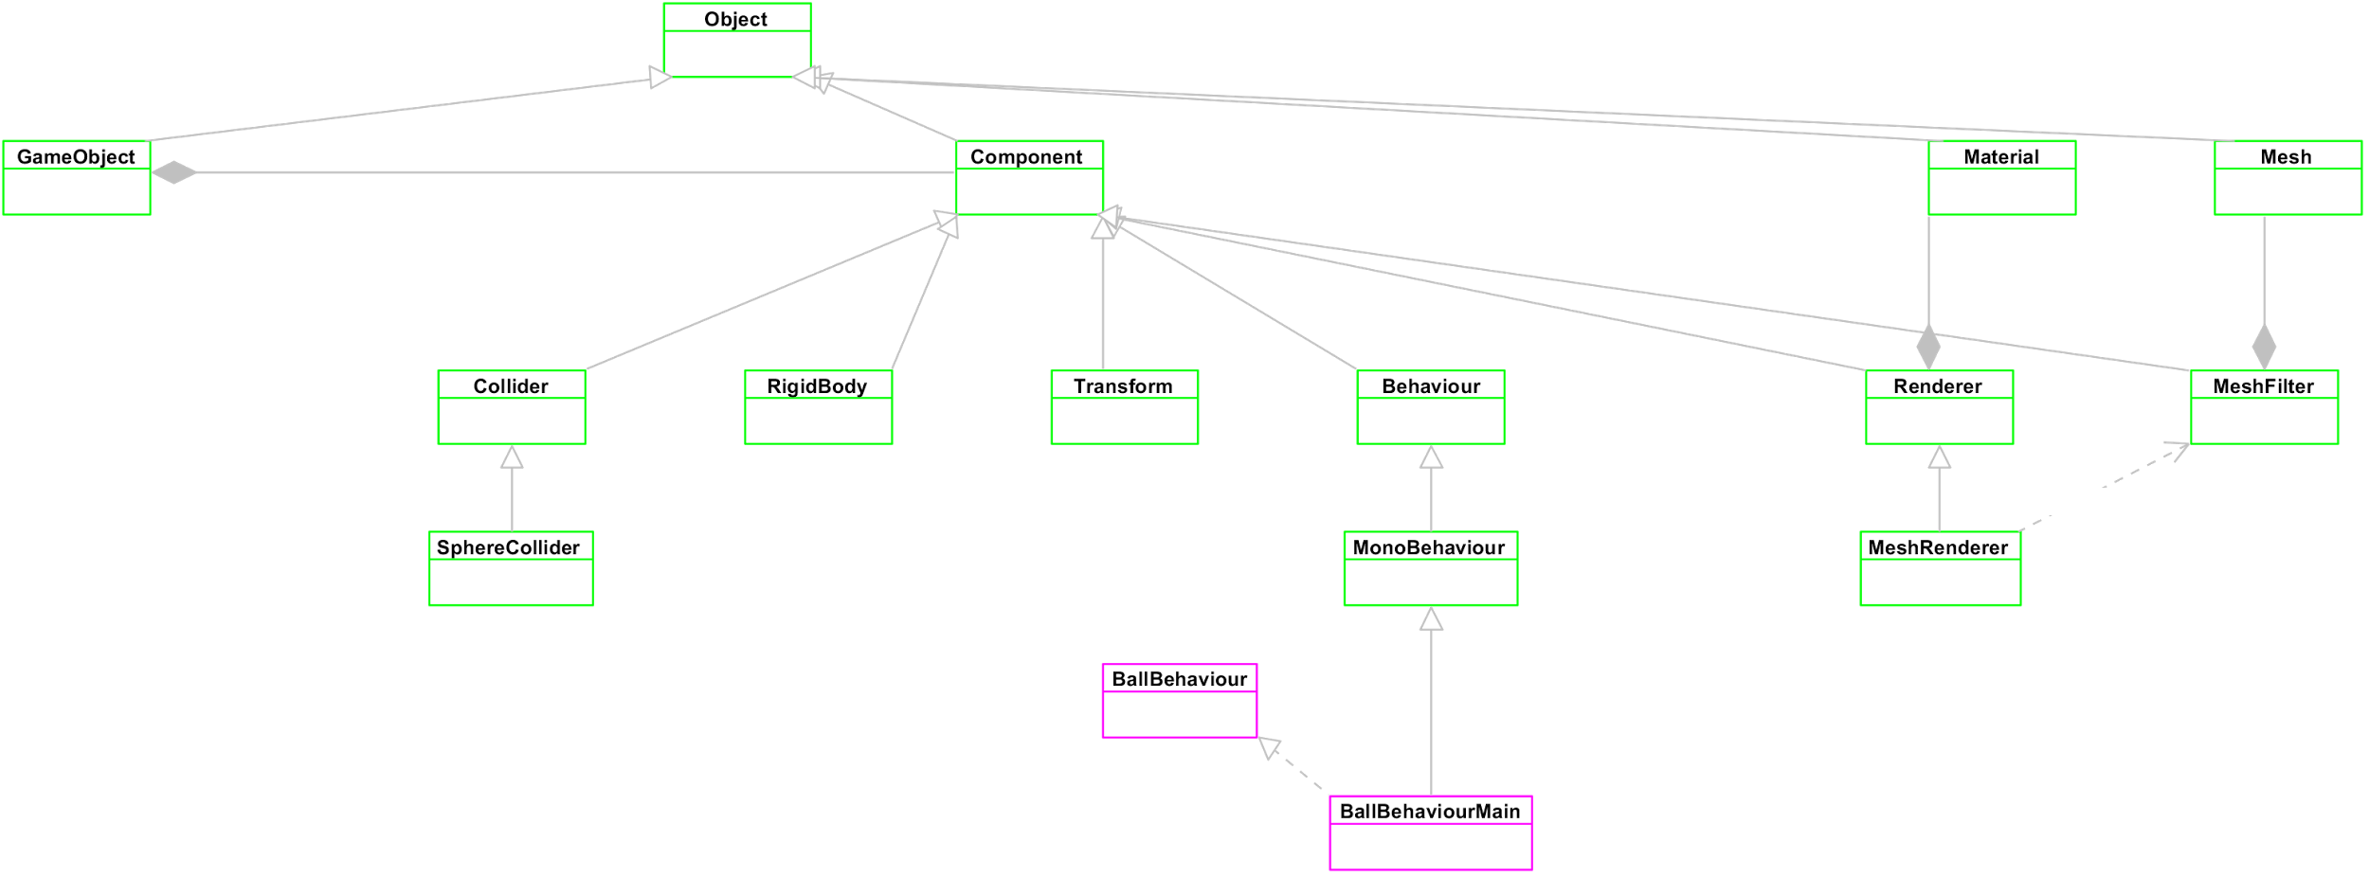
UML Class Diagram (Unity focus)
Notes:
Josh

Slide 13
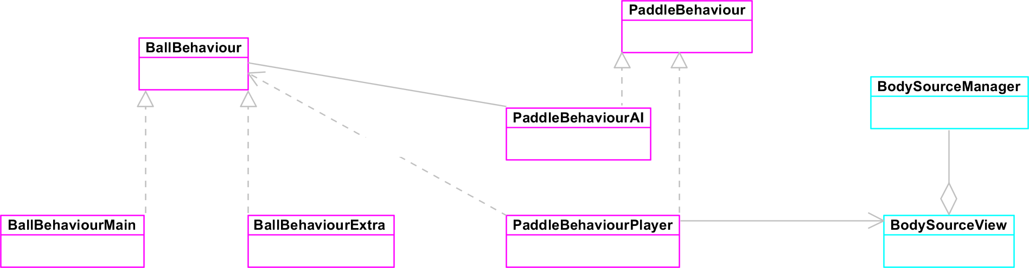
UML Class Diagram (Kinect focus)
Notes:
Josh

Slide 14
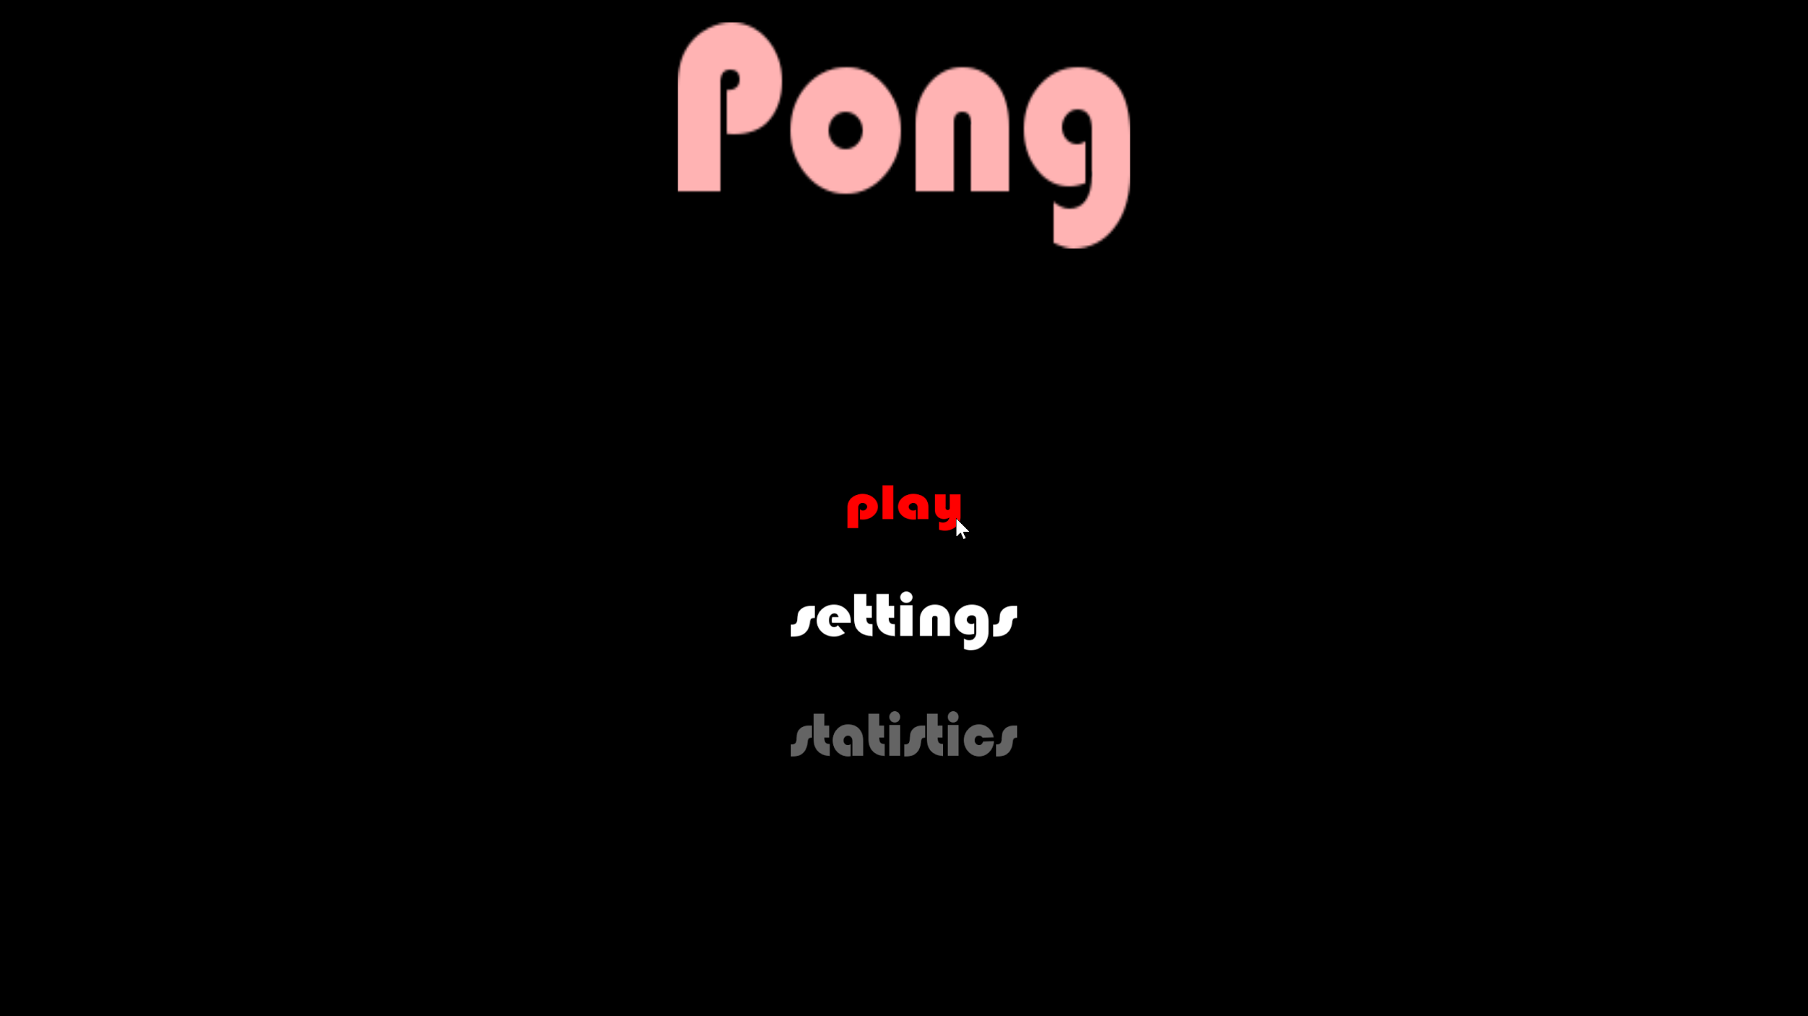
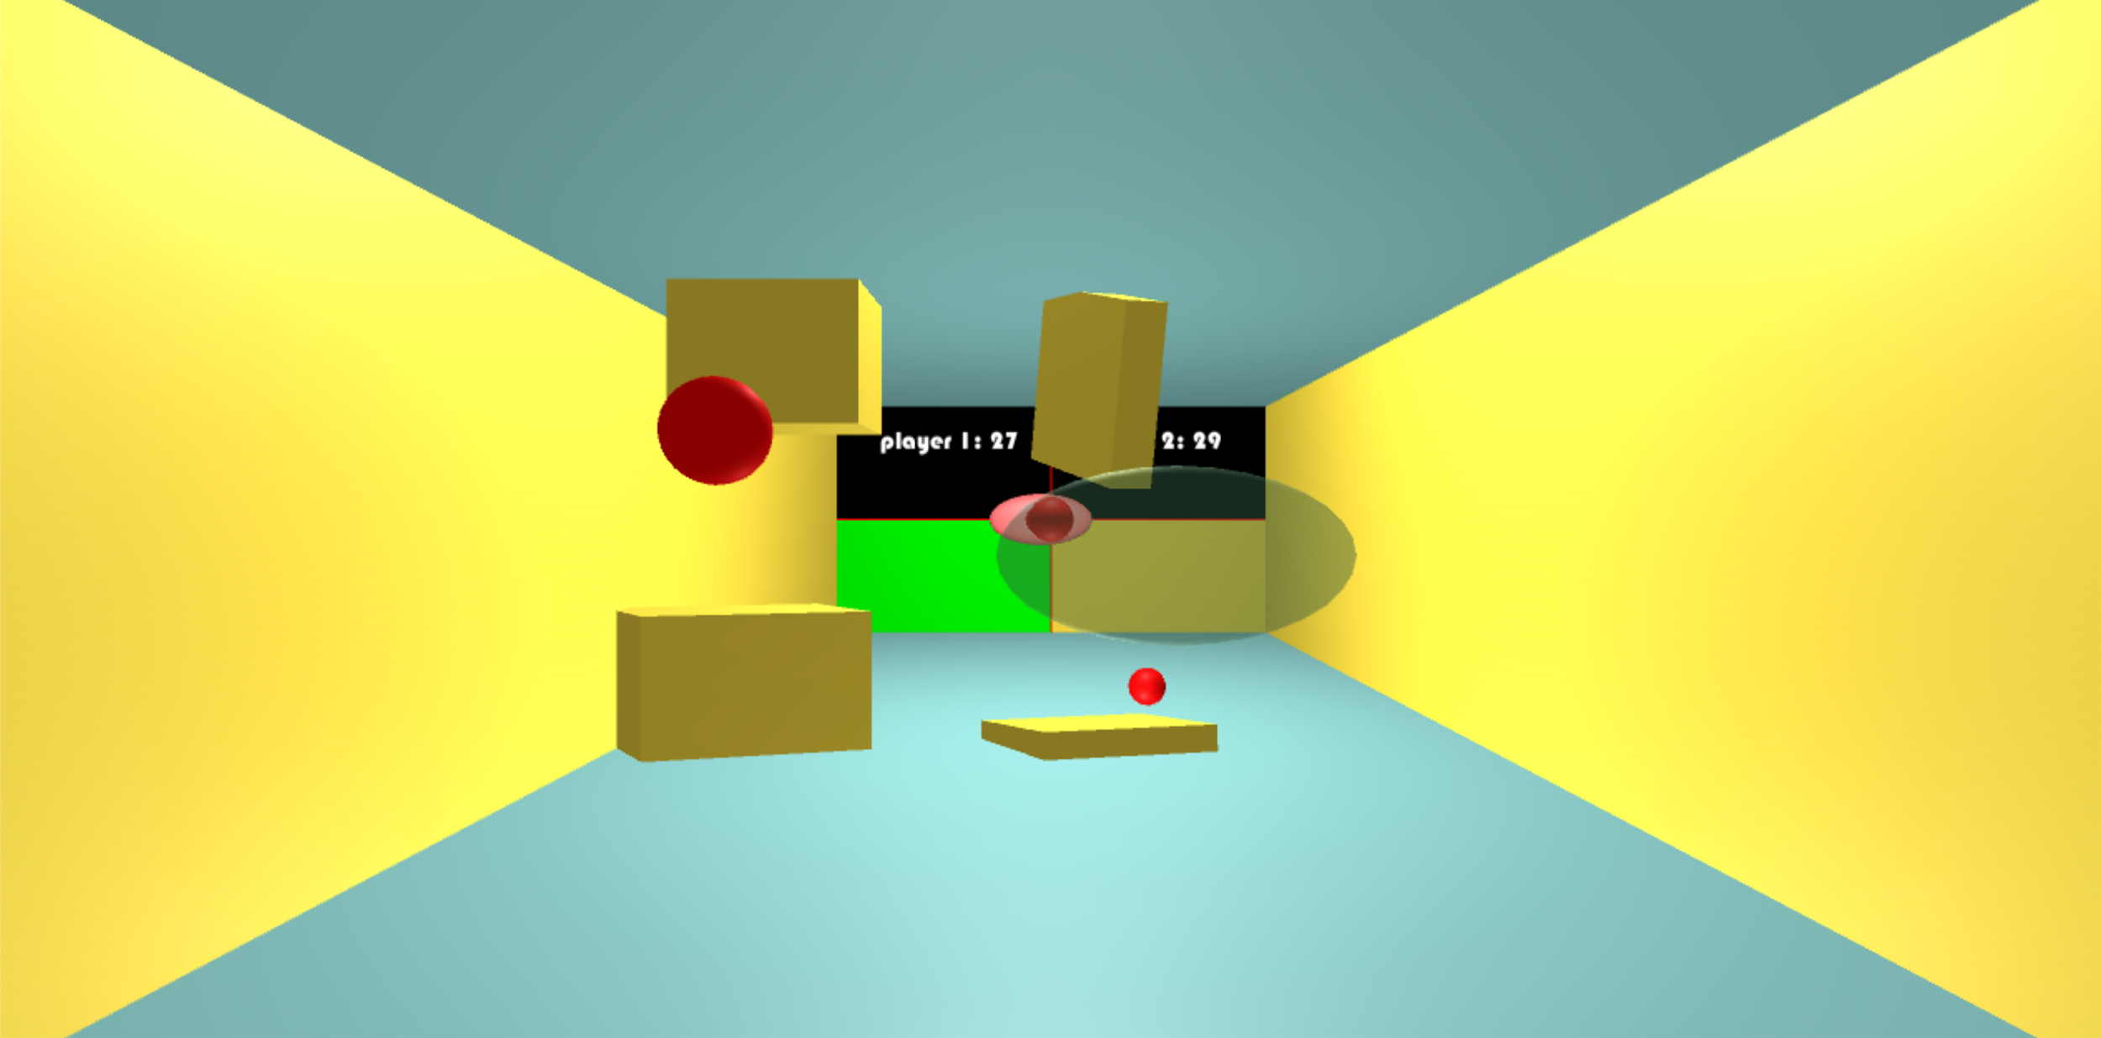
From a User’s Perspective
Traverse menus
Main menu
Settings menu
Play menu
Statistics menu
Gameplay
Score dependent effects
Immediate effects
No effects
Notes:
Evan

Slide 15
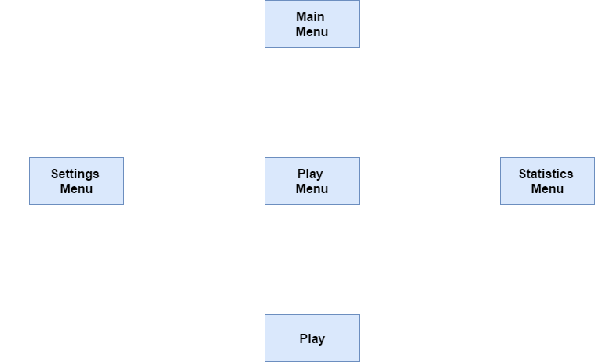
Interaction Flow Diagram
Notes:
Evan

Slide 16
Live Demonstration
Notes:
Josh

Slide 17
Problems and Solutions
3D gestural control
Artificial Intelligence
Collision with multiple goal zone segments
Introduction of gameplay effects
Statistics
Notes:
Josh

Slide 18
Further Development
TDD (test-driven development) and looser coupling
Gestural control of menus
Sound effects and background music
More settings
Multiplayer
Local (two players per match)
Online (two or more players per match)
Statistics
Notes:
Evan

Slide 19
Works Cited
Git. Software Freedom Conservancy, n.d. Web. 3 May 2017.
<https://git-scm.com/>.
Microsoft. Microsoft, n.d. Web. 3 May 2017.
<https://developer.microsoft.com/en-us/>.
Unity. Unity Technologies, n.d. Web. 3 May 2017.
<https://unity3d.com/>.
Notes:
Evan

