Slide 1
ChatterHub: Real-time Chat and File Transfer Application
Presented by:
Joty Saha (Roll : 51)
Ahona Rahman (Roll : 59)

Slide 2
Introduction
ChatterHub: Revolutionizing Real-time Communication and File Sharing
Objective: To create a seamless platform for instant communication and secure file transfer.
Scope: Empowering users with real-time chat rooms and robust file-sharing capabilities.
Technology Stack:
Python: Powering the backend logic and server-side operations.
Tkinter: Crafting an intuitive and interactive user interface for clients.
Socket Programming: Establishing reliable communication channels between clients and server.
Join us on this journey of innovation and connectivity!

Slide 3
Networking Concepts
Overview of Networking Concepts Used in ChatterHub:
Client-Server Architecture:
Centralized model where clients (users) connect to a central server to exchange data.
Socket Programming:
Mechanism for establishing communication channels between networked computers.
Data Transmission and Packet Switching:
Data is broken into packets for efficient transmission across networks, utilizing packet-switching technology.
Addressing and Routing:
IP addressing ensures packets are delivered to the correct destination, while routing determines the optimal path for data transmission.

Slide 4
Client-Server Architecture
Explanation of Client-Server Model:
Roles of the Server and Clients:
The server hosts resources and services accessed by clients.
Clients, such as user devices, request and utilize these resources.
Communication Channels:
Clients connect to the server via network connections.
Server manages multiple client connections concurrently.
Request-Response Paradigm:
Clients send requests to the server for data or services.
Server processes requests and responds with the requested data or performs the required actions.

Slide 5
Socket Programming
Creation and Use of Sockets:
Sockets are endpoints for communication between machines over a network.
They enable bidirectional data flow between a client and a server.
Socket API:
Programming interface for using sockets in various programming languages.
Provides functions/methods for creating, binding, connecting, sending, and receiving data through sockets.
Establishment of Connections:
Clients and servers establish connections using sockets.
TCP/IP sockets involve a connection-oriented approach, ensuring reliable data transmission.

Slide 6
Data Transmission
Message Exchange between Clients and Server:
Clients and the server exchange messages using established socket connections.
Messages include real-time chat messages and control signals.
File Transfer Mechanism:
Users can securely transfer various file types such as images, documents, and PDFs.
File transfer involves breaking down files into packets and sending them over the network.
Data Encryption for Security:
Implemented encryption techniques to secure data during transmission.
Ensures confidentiality and integrity of user data, enhancing overall security.

Slide 7
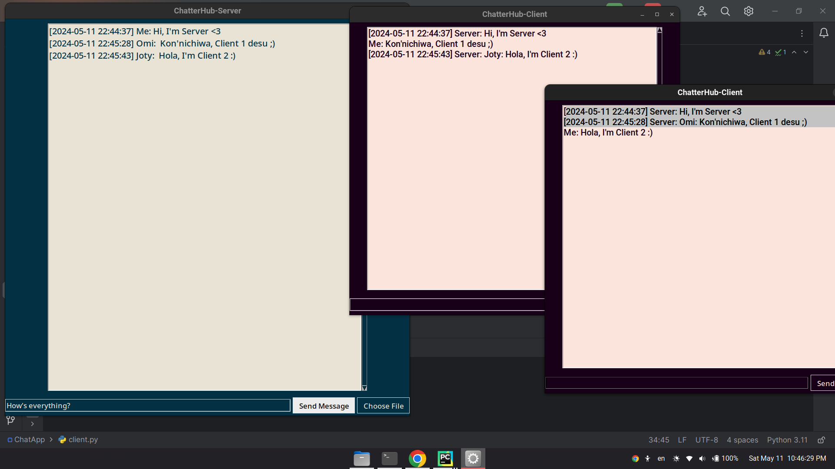
ChatterHub Architecture
Interaction between Clients and Server

Slide 8
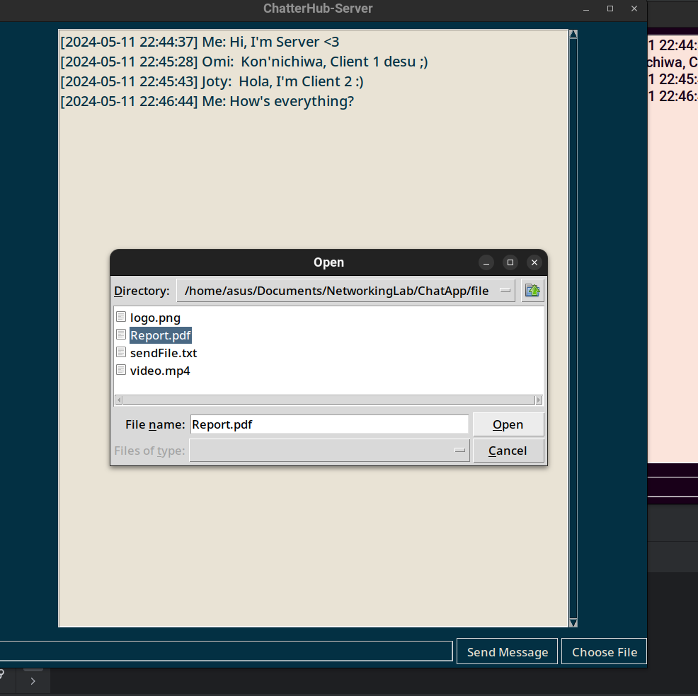
ChatterHub Architecture
Server-Side File Send Implementation

Slide 9
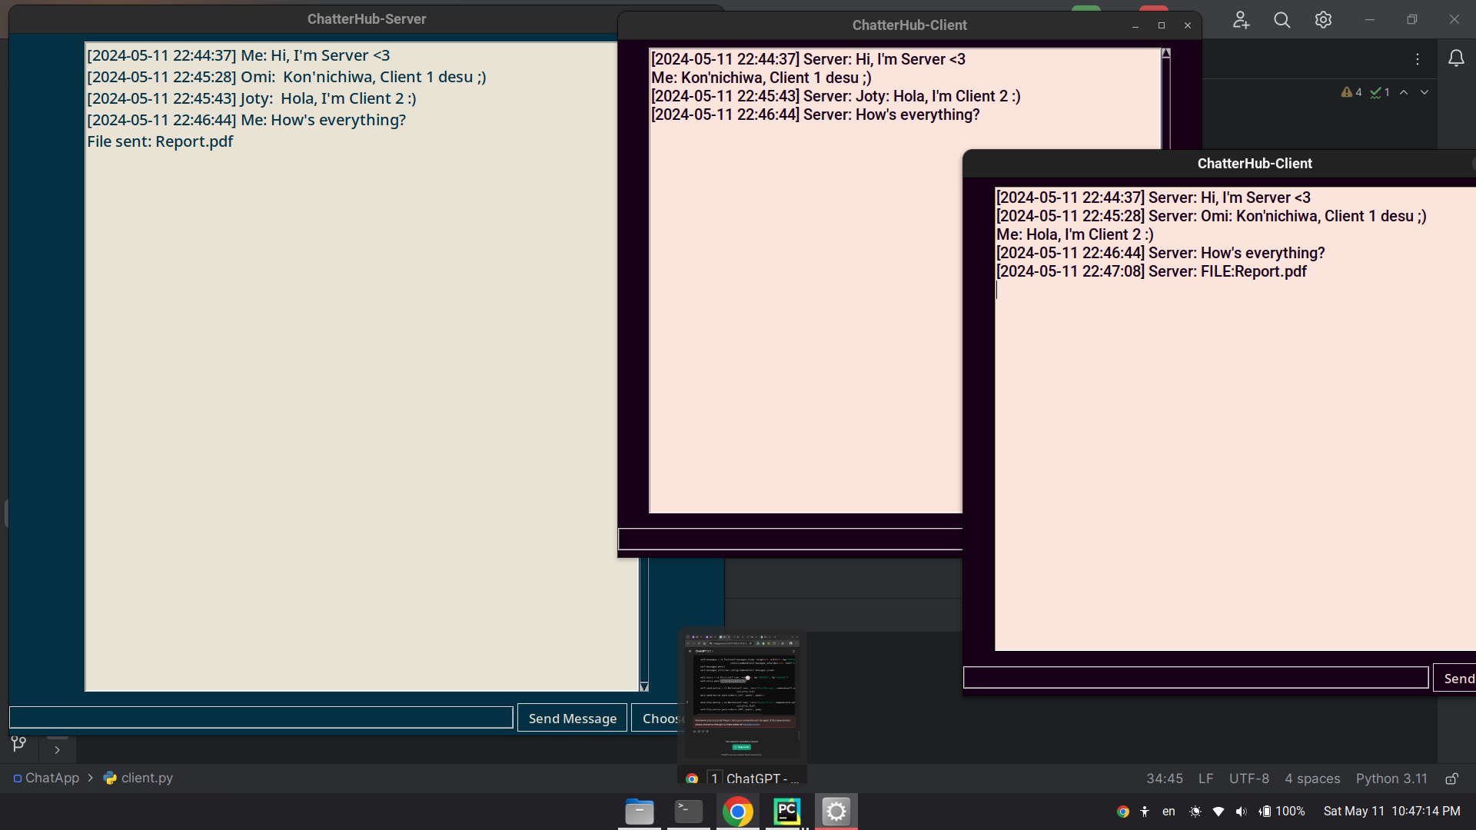
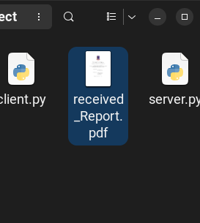
ChatterHub Architecture
Clients Receive File Implementation

Slide 10
Frontend and Backend
Frontend Development with Tkinter
Tkinter is a Python library for creating GUI applications.
Backend Development with Socket Programming
Implementation of Server Using Sockets:
Backend server is created using Python socket module.
It listens for incoming connections from clients.
Handling Client Requests:
Server handles client requests for chat messages and file transfers.
It processes and responds to client actions in real-time.
Real-time Communication and File Transfer Logic:
Backend logic manages real-time message exchange and file transfer operations.
It ensures seamless communication between clients and handles file transfer securely.

Slide 11
Conclusion
Summary of Achievements: ChatterHub has become a robust real-time communication platform, facilitating instant messaging and secure file transfer using a client-server architecture with Python backend and Tkinter frontend.
Reflection on Challenges and Learnings: Developing ChatterHub posed challenges such as socket programming intricacies and UI design complexities. Overcoming these challenges enhanced the team's technical skills and problem-solving abilities.
Future Directions and Enhancements: Continuous refinement of ChatterHub is planned, including potential additions like emoji support, message editing, and group chat functionality. Emphasis on security measures and adaptation to emerging technologies will ensure ChatterHub remains competitive.

Slide 12
Thank You

