Slide 1

Data Analytics: Data Mining With Weka by: Allen Martillano

Slide 2



Agenda
Data Analytics Task and dataset characteristics
Exploratory Data Analysis
Comparing evaluation protocols for classification
Feature Selection
Classification using decision tree
Decision tree visualization and testing
*based on vote.arff dataset

Slide 3
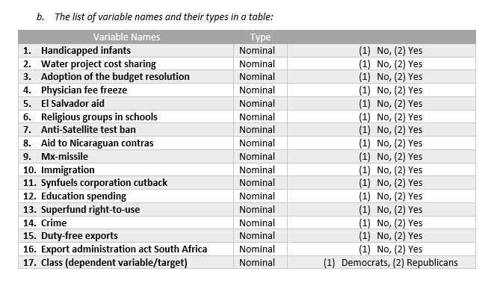
Data Analytics Task and dataset characteristics
Classification Task:
The vote.arff dataset represents the number of votes each one of the 16 bills received in favor (“yes”) and against (“no”) by the 435 members (267 Democrats and 168 Republicans) of the House of Representatives in the U.S.
Dataset characteristics:
The number of instances: 435 (267 Democrat + 168 Republican)
The first table gives the list of variable names and their types in a table
Dependent variable/target: Class
Independent variables: Consists of the other 16 variables
Category | Qty | Description
Instances (rows) | 435 | Each instance represents one vote for each Democrat seat and each Republican seat in the House of Representatives.
Division of seats: | 267 | Democrat votes
 | 168 | Republican votes
Attributes | 17 | 16 bills that were voted on and 1 Class (democrat, republican)

Slide 4
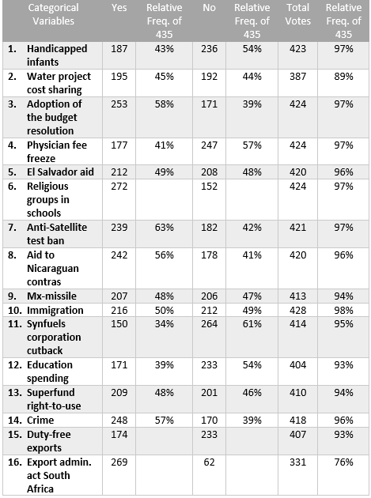
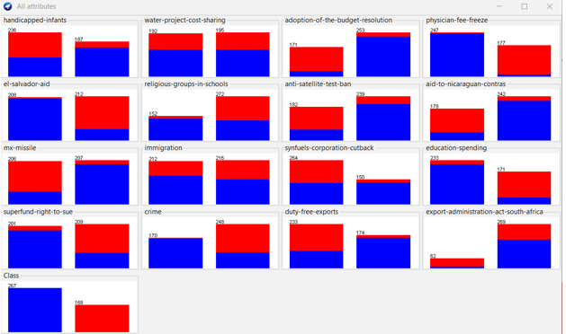
Exploratory Data Analysis
Categorical variables
Each categorical variable represents 1 bill. The frequency table corresponding to each categorical variable (each bill) shows the number of votes against (“no”) and the number of votes in favour (“yes”) that each bill received. We can determine the relative frequency of the number of “no” and “yes” votes for each bill
Data visualization
Each cluster column chart provides a visual representation of the vote frequency (yes vs no) for each categorical variable by showing:
vote quantity
vote attribution
The chart for the immigration bill, which shows an almost even distribution, makes it difficult to predict the class label, and to discriminate between the number of Democrats and Republicans.
On the other hand, for the El-Salvador-Aid bill, shows an almost even distribution of the total votes, and makes it easy to predict.
Target class variable: Class
Democrats (blue) represent approximately 61% (267/435) of the total seats
Republican (red) represent approximately 39% (168/435) of the total seats.

Slide 5
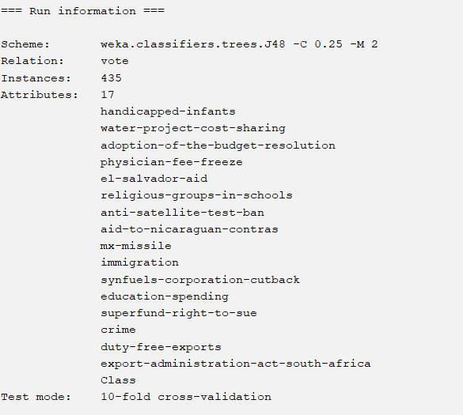
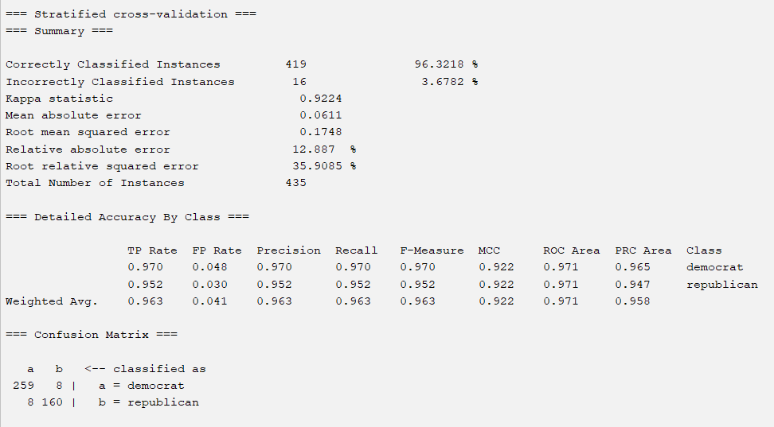
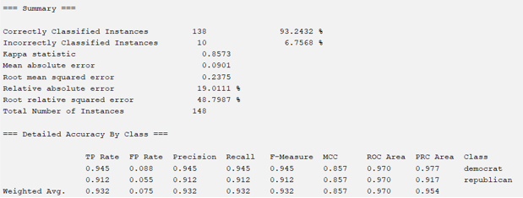
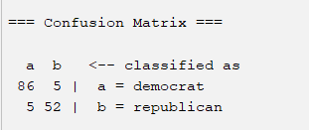
Comparing evaluation protocols for classification
2-Fold cross validation
Overall classification accuracy: Split dataset 2-fold cross validation accuracy: 93.2432%
for each class value, this reports the FP rate, TP rate, Precision, recall, F-measure.
As well as the overall weighted average over class levels for each of the of the FP rate, TP rate, Precision, recall, F-measure.
10-fold cross validation
Overall classification accuracy: Split dataset 10-fold cross validation accuracy: 96.3218%
Split dataset confusion matrix
Comparing 2-fold cross validation and 10-fold cross validation
Which evaluation protocol provided higher performance
As expected, the 10-fold cross validation resulted in a more accurate model
Interpret why?
The 10-fold cross validation provided higher performance as it is based on a small dataset.
For big datasets, a 2-fold cross validation is enough.
 | Classified as Democrat | Classified as Republican
Actual Democrats | TP = 86 | FN = 5
Actual Republican | FP = 5 | TN = 52
Model | Accuracy
2-fold cross validation | 93.2432%
10-fold cross validation | 96.3218%

Slide 6
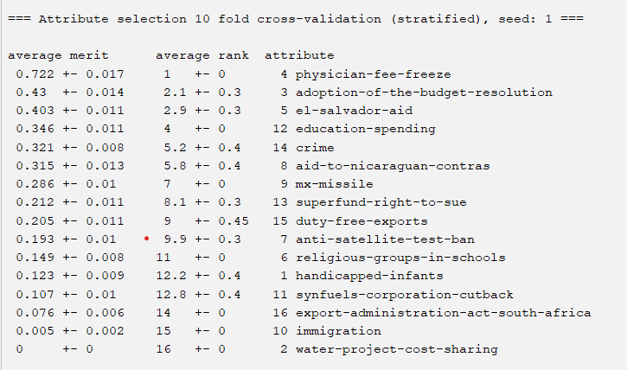
Feature Selection
Using the select attributes tab in Weka to rank attributes by importance. We Chose InfoGainAttributeEval and Ranker for the attribute evaluator and search method respectively and 10-fold cross validation for selecting attributes.
As the graph shows the list of the attributes by order of importance (based on average merit)
This ranking shows that the most important attribute to best predict the target variable (Class) is Physician-fee-freeze as it has the highest average merit (72.2%). In second place is Adoption-of-the-budget-resolution (43%) and in third place is El-Salvador-aid (40.3%). The least important attribute is Water-project-cost-sharing with an average merit of 0%.

Slide 7
Classification using decision tree
3 runs using 10- fold cross validation and different number of attributes
Classification using all 16 attributes and 1 Class Confusion Matrix using all attributes
Classification using best 3 attributes and 1 Class Confusion Matrix using best 3 attributes
Classification using best 5 attributes and 1 Class Confusion Matrix using best 5 attributes
Best classifier performance
Conclusion
All three classifiers provided results of 95%+ accuracy. However, there was no difference between selecting 3 or 5 attributes. The number of True Positives remained the same for both selections (TP = 253) as well as the accuracy (95.6322%). Therefore, it is better to select 3 attributes as the training tree is smaller and this also helps prevent overfitting.
 | Democrat | Republican
Democrats | TP = 259 | FN = 8
Republican | FP = 8 | TN = 160
 | Democrat | Republican
Democrats | TP = 253 | FN = 14
Republican | FP = 5 | TN = 163
Nr. of Attributes | Accuracy | TP Rate | FP Rate | Precision | Recall
All Attributes | 96.3218% | 96.3% | 4.1% | 96.3% | 963%
Best 3 attributes | 95.6322% | 95.6% | 3.9% | 95.8% | 95.6%
Best 5 attributes | 95.6322% | 95.6% | 3.9% | 95.8% | 95.6%
 | Democrat | Republican
Democrats | TP = 253 | FN = 14
Republican | FP = 5 | TN = 163

Slide 8
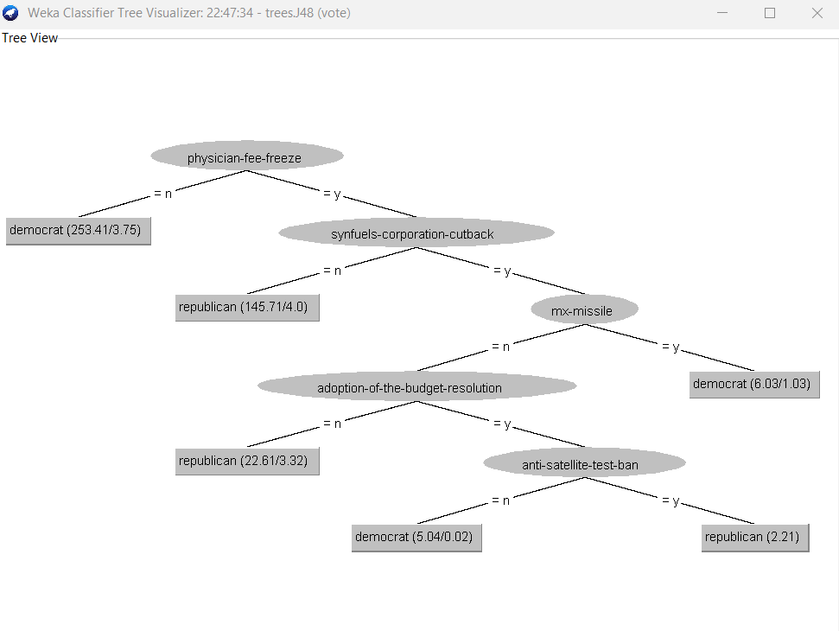
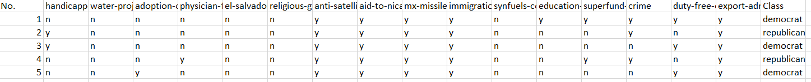
Decision tree visualization and testing
Decision tree model visualization
Classification of testing instances
Size of the tree: 11 (6 leaves, + 5 nodes)
Prediction of the first 5 instances of the testing set
 | Classified as | Actual
Physician-fee-freeze | n = Democrat | Democrat
Synfuels-corporation-cutback | n = Republican | Republican
Mx-missile | y = Democrat | Democrat
Adoption-of-the-budget-resolution | n = Republican | Republican
Anti-satellite-test-ban | y = Republican | Democrat
The first node of the tree corresponds to the Physician-fee-freeze bill. On the dataset, the first instance classifies Physician-fee-freeze as “n”. On the tree, the “n” branch from the Physician-fee-freeze node has a “Democrat” leave. Therefore, the “n” classification for Physician-fee-freeze becomes “Democrat”. On the dataset, the actual Class for the first instance is “Democrat”. This means that Physician-fee-freeze is accurately classified.

Slide 9


Thank You
Presenter:
Allen Martillano

