Slide 1


AUTOMATING GRANT CHARACTERISTICS USING NLP & MACHINE LEARNING
Helping to End Addiction Long-Term Initiative (HEAL)
Anthony Juehne — Program Officer and Data Scientist | HEAL Data Ecosystem
Erin Spaniol — Policy and Evaluation Lead | HEAL Initiative
Noreen Mayat
Rachel Dodell
Barnard College, Columbia University
Data Science

Slide 2
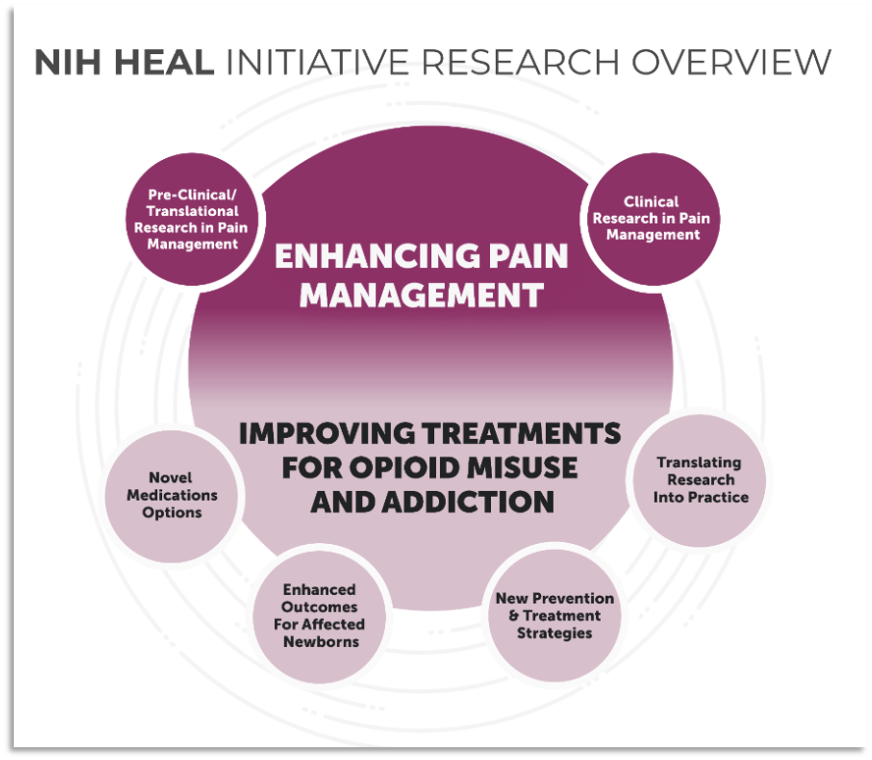
MOTIVATIONS
HEAL seeks to improve both pain management and prevention tactics for opioid use disorder.
Automating classification of HEAL awards for portfolio analysis will:
Significantly reduce the time burden of portfolio analysts within HEAL.
Highlight research themes, connect investigators studying aligned targets and interventions and determine promising areas for allocating research support.

Slide 3
PROJECT GOALS
Primary Outcome:
Classify if a study’s primary outcome is Pain, OUD or Both.
Multi-Class
Milestone
Classify if a study is/is not a milestone project.
Binary Classification
Science Type
Classify a study’s science type.
Multi-Class
Multi-Label
Notes:
Milestone projects need to meet specific metrics and/or deliverables before they can transfer from one stage to another, or receive further awards.

Slide 4
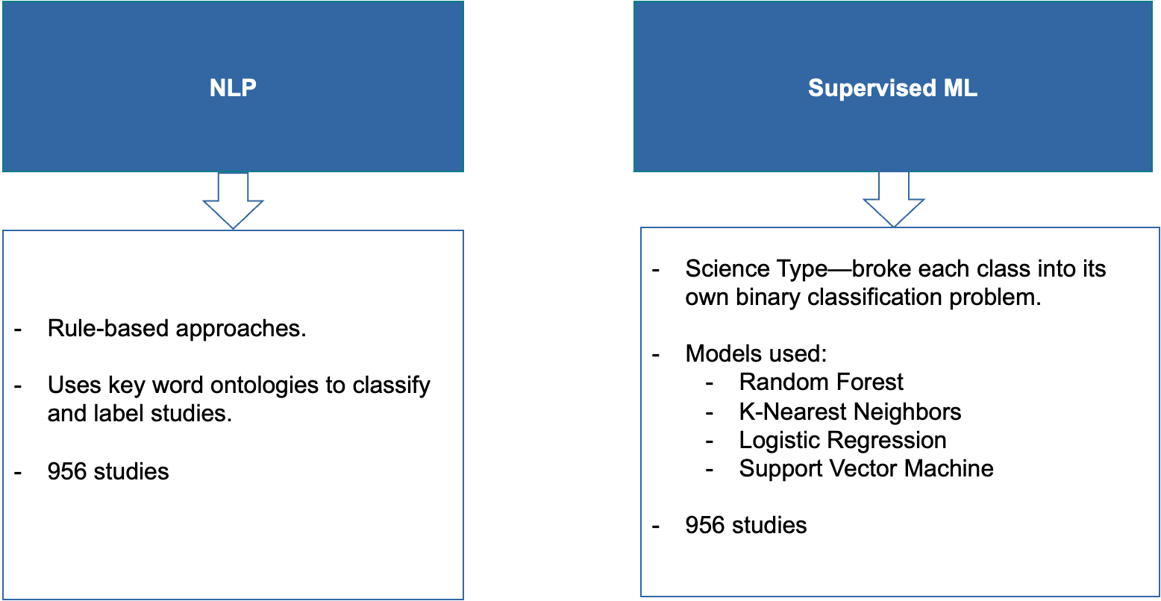
METHODS
Natural Language Processing
Supervised
Machine-Learning

Slide 5
METHODS
Pre-Processing:
Abstracts, specific aims, public health relevance cleaned for stop words.
Filtration:
Only preserved sentences with keywords.
Regular Expressions:
Iterates by row.
Search for regexes related to each category in filtered columns.
Add found terms to individual lists (Pain vs. OUD).
Labeling:
Determine which list has most terms → assign label.
Notes:
With key-words relevant to the main objective of the study

Slide 6
METHODS
Example Text: “although health social economic impacts opioid addiction…”
oud_terms = [‘opioid addiction’]
pain_terms = []
both = []
Study Outcome → OUD
Notes:
Example of cleaned text–no stop words

Slide 7
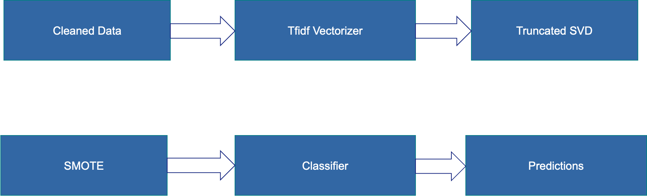
METHODS
Term-Frequency Inverse-Document Frequency Vectorizer
Truncated Singular Value Decomposition
Cleaned Data
Synthetic Minority Oversampling Technique
Classifier
Predictions
Notes:
SVD- singular value decomposition

Slide 8
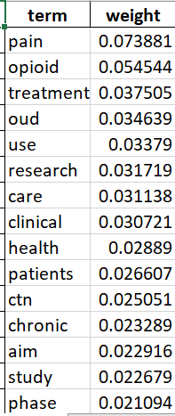
METHODS
Term Frequency-Inverse Document Frequency (TF-IDF) Matrix
Normalized count of each word / Number of docs it appears in
The higher the TF-IDF score the more important or relevant the term is

Slide 9
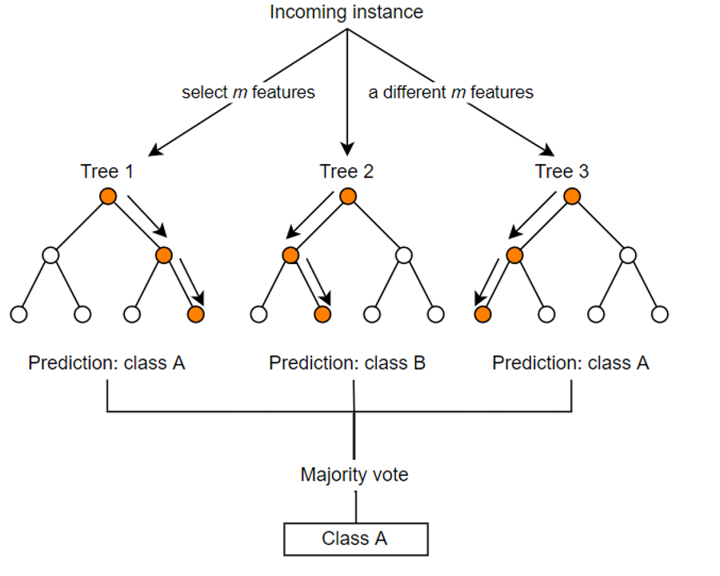
METHODS
Random Forest:
Averages predictions of various decision trees.
Each root decision tree corresponds to a feature (word) in the study text → trickles down to a label.

Slide 10
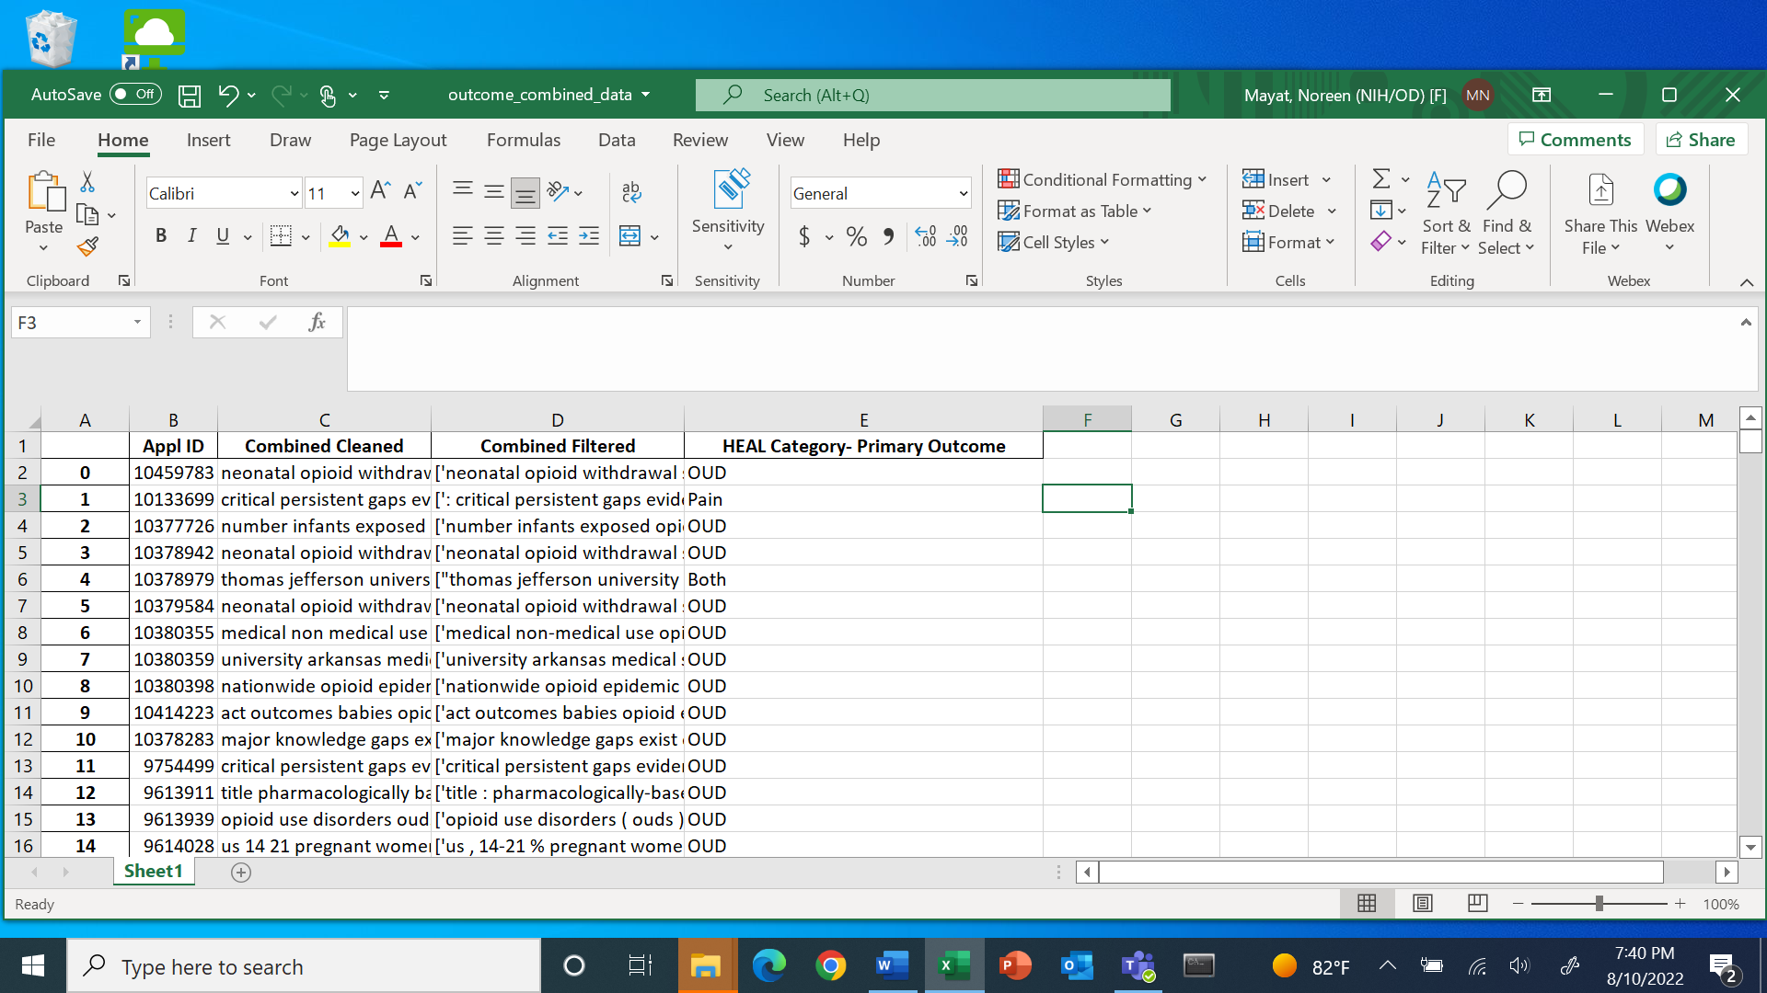
DATA
Fed to Classifier
Designated Labels
Notes:
Classifier’s are fed 75% of the data as a training set with accompanied labels
Tested on 25% of the data as a testing set which exists stripped of its labels
Learns what words relate to which labels and classifies the text that way

Slide 11
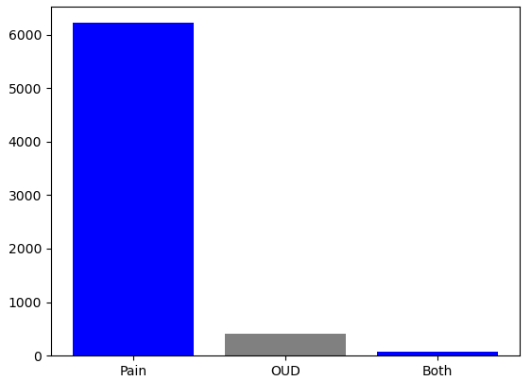
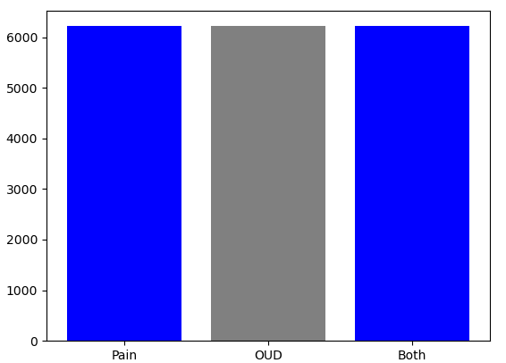
DATA
Before SMOTE
Primary Outcome Data Distribution
After SMOTE
Primary Outcome Data Distribution

Slide 12
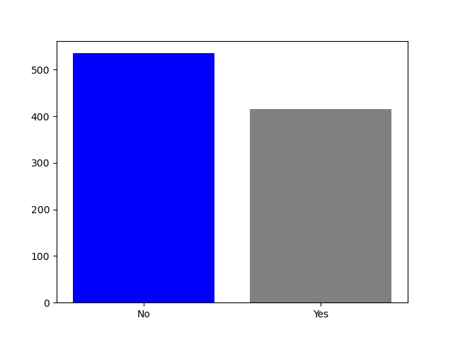
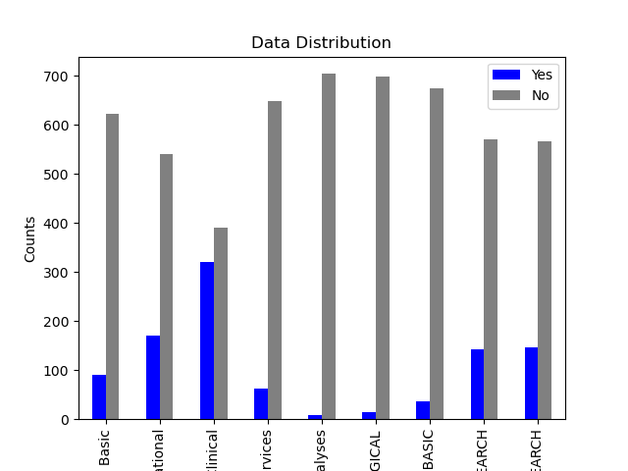
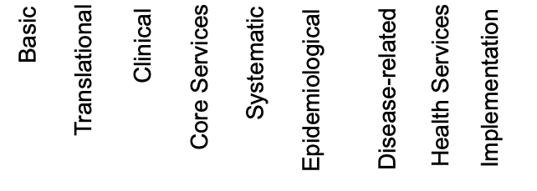
DATA
Milestone Distribution
Science Distribution

Slide 13
RESULTS
Primary Outcome:
Regex: 85%
Random Forest: 98%
Milestone:
Regex: 76%
Random Forest: 84%
Science Type:
KNN Basic: 92%
KNN Health Services Research: 85%
KNN Implementation Research: 80%
LR Disease-Related Basic: 88%
LR Clinical: 73%
RF Translational: 84%
RF Systematic Meta-analyses: 96%
SVM Core Services: 86%
SVM Epidemiological: 96%

Slide 14
CONCLUSIONS & NEXT STEPS
Expand OUD/Both datasets for primary outcome algorithm
Hyperparameter tuning for ML algorithms
NLP combined with ML approaches for final labeling
Work combined in Jupyter notebook as well as Github for future building
Notes:
https://github.com/nm3224/HEAL

