Slide 1
Introduction to Data Analytics (CSE 2126)
Car Evaluation Data Set Using K-Nearest Neighbors

Slide 2
Algorithim Used – K-Nearest Neighbors
KNN stands for k-nearest neighbors, which is a supervised machine learning algorithm used for classification and regression tasks. It is a type of instance-based learning where the algorithm makes predictions based on the majority class (for classification) or the average value (for regression) of the k-nearest data points in the feature space.

Slide 3
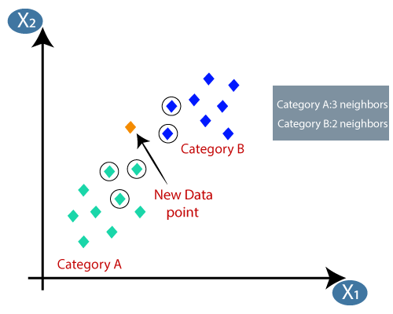
Brief overview of KNN

Slide 4
Step 1- Training Phase:
Store all the training examples in memory.
Step 2- Prediction Phase:
Given a new, unseen data point, calculate its distance to all training examples in the feature space. Common distance metrics include Euclidean distance, Manhattan distance, or other similarity measures.
Identify the k-nearest neighbors of the new data point based on the calculated distances.
For classification, assign the class label that is most frequent among the k-nearest neighbors.
For regression, predict the average value of the target variable among the k-nearest neighbors.
The choice of the parameter k (the number of neighbors to consider) is crucial and can significantly impact the performance of the KNN algorithm. A smaller value of k makes the algorithm more sensitive to noise in the data, while a larger value of k can make the algorithm less flexible.

Slide 5
Problem Statement of the Car evaluation data set
The objective is to predict the acceptability of a car based on its characteristics. The evaluation is categorized into four classes:
Unacceptable: The car is not acceptable for purchase.
Acceptable: The car is acceptable for purchase.
Good: The car is good in terms of acceptability.
Very Good: The car is very good in terms of acceptability.
The dataset typically includes various attributes or features of cars, such as buying price, maintenance cost, number of doors, number of passengers, luggage capacity, safety rating, and others. The goal is to build a classification model that can accurately predict the acceptability class of a car based on these features.
Type of task to be carried - Classification

Slide 6
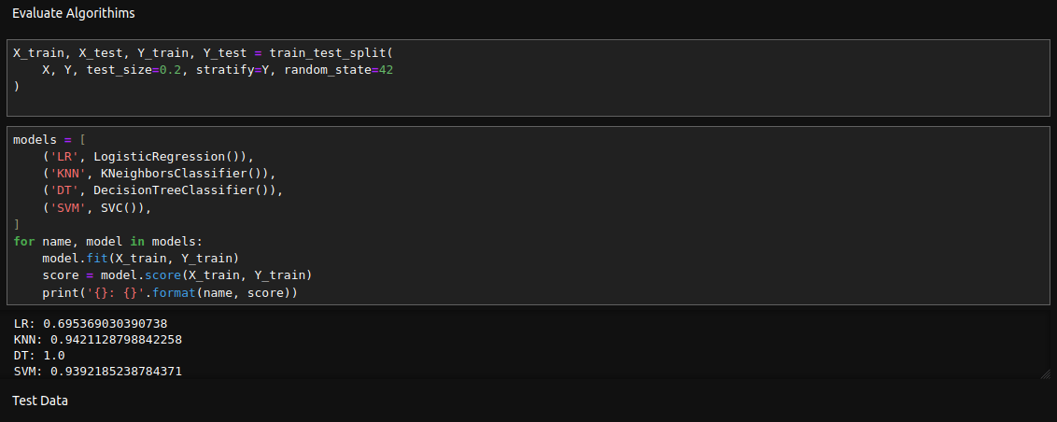
Why didn’t we use any other classification algorithim?

Slide 7
Methodology and Working
Libraries used:
Pandas
Matplotlib
Seaborn
Scikitlearn
Final score of the data set prediction using KNN – 91 percent accuracy

Slide 8
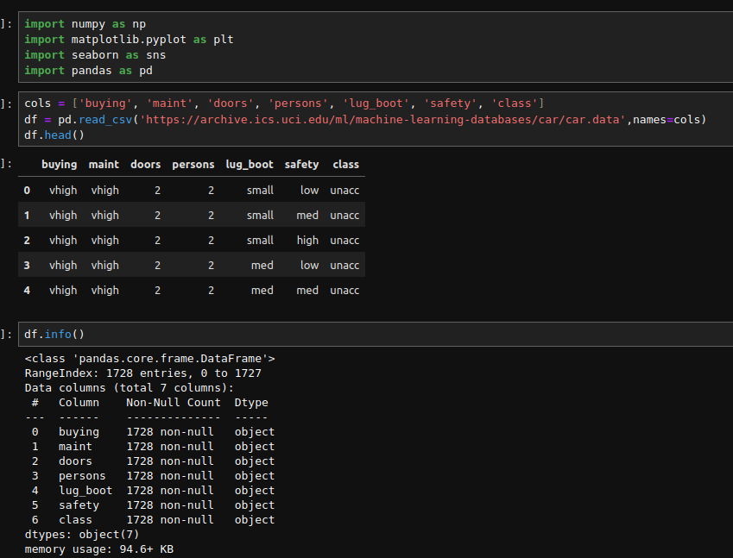
This line creates a list called cols containing the column names for the dataset. Each element in the list corresponds to a specific attribute or feature in the dataset. The order of the elements is important because it will be used later when reading the data.
The code uses the Pandas library (pd) to read a CSV file from a URL. The URL points to the Car Evaluation dataset on the UCI Machine Learning Repository. The read_csv function is used to create a DataFrame (df) from the dataset. The names=cols parameter is used to specify the column names for the DataFrame. So, each column in the DataFrame will be labeled according to the names provided in the cols list.
The head() method is then called on the DataFrame to display the first few rows of the dataset. This is a common practice to quickly inspect the structure and contents of the DataFrame.

Slide 9
df.info - The output will typically include information like:
RangeIndex: The range of indices for the DataFrame.
Data columns: Names of each column.
Dtypes: Data types of each column (e.g., object for strings, int64 for integers, etc.).
Memory usage: The amount of memory used by the DataFrame.
The class_mapping dictionary is created to map the original class labels to numeric values.
The map function is then used to replace the values in the 'class' column with their corresponding numeric equivalents.
This way, you achieve the same result in a more compact manner without creating multiple intermediate DataFrames.
If you print df.head() after this operation, you should see the updated 'class' column with numeric values instead of the original label

Slide 10
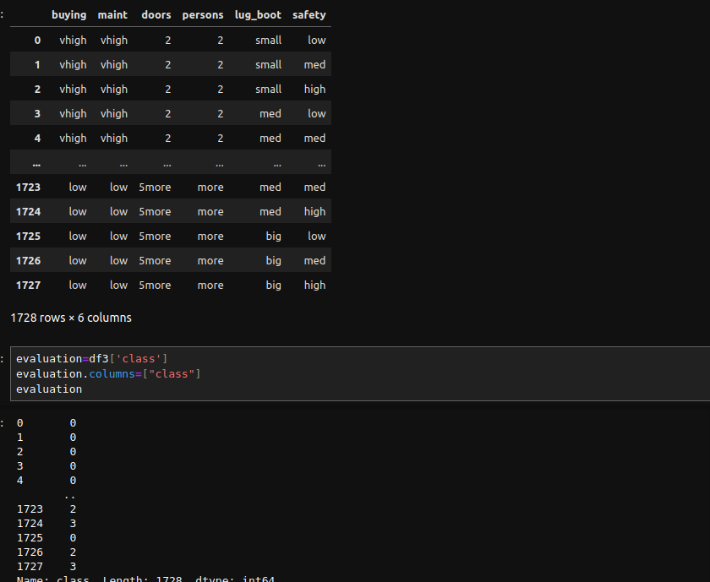
df3 is your original DataFrame with the 'class' column containing numeric values.
The drop method is used to remove the 'class' column. The axis='columns' parameter indicates that you are dropping a column (as opposed to a row).
The result is stored in the new DataFrame new_df.
So, new_df should be a DataFrame that contains all the columns from df3 except for the 'class' column. If you print new_df, you will see the DataFrame without the 'class' column.
df3[['class']] extracts the 'class' column as a DataFrame (keeping it as a DataFrame with one column rather than a Series).
evaluation.columns = ["class"] sets the column name of the new DataFrame to "class".
Now, the evaluation variable should be a DataFrame containing only the 'class' column from df3, and the column is explicitly named "class". If you print evaluation, you should see a DataFrame with a single column labeled "class".

Slide 11
dummy = pd.get_dummies(new_df)- pd.get_dummies(new_df) is creating a new DataFrame (dummy) with dummy variables for each categorical column in new_df. The resulting DataFrame will have binary columns for each unique value in the original categorical columns, effectively one-hot encoding them.
X=dummy
Y=evaluation - X is typically used to represent the features (independent variables) of your dataset. In your case, it seems you've assigned the DataFrame with dummy variables (dummy) to X. Y is typically used to represent the target variable (dependent variable or labels) in your dataset. You've assigned the 'class' column from the original DataFrame (evaluation) to Y. After this step, X and Y can be used to train and test machine learning models. Keep in mind that before applying machine learning algorithms, you might want to split your data into training and testing sets using tools like train_test_split from scikit-learn. Additionally, you may need to scale or normalize your features, depending on the specific requirements of the machine learning algorithm you plan to use.
X.head() - This will display the first few rows of the X DataFrame, which contains the dummy variables created from the original categorical columns in your dataset. The head() method is useful for quickly inspecting the structure of your DataFrame and checking if the data transformation was performed correctly.
Y.head() - This will display the first few rows of the Y DataFrame, which contains the values of the target variable ('class' in this case). The head() method is useful for quickly inspecting the structure of your target variable. When you print Y.head(), you will see the top rows of the Y DataFrame, showing the values of the 'class' column for each corresponding row in your dataset.

Slide 12
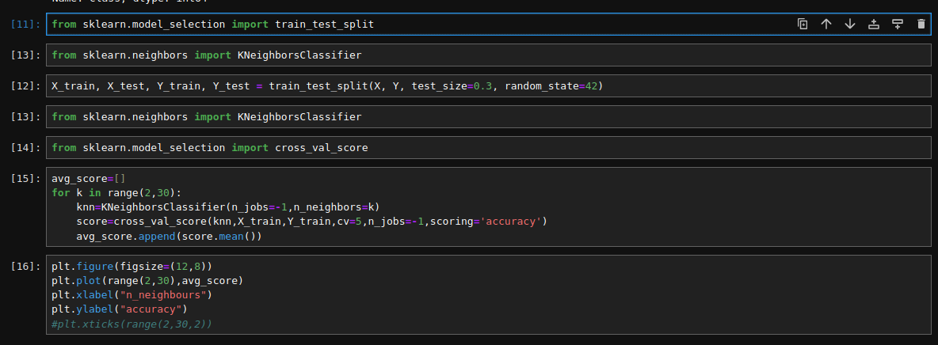
train_test_split function from the sklearn.model_selection module. This function is commonly used to split a dataset into training and testing sets for machine learning purposes. The typical use case involves separating your data into two subsets: one for training the model and another for testing its performance on unseen data.
importing the KNeighborsClassifier class from scikit-learn's neighbors module. This class is part of scikit-learn's implementation of the k-nearest neighbors (KNN) algorithm for classification tasks.
X and Y are your feature and target variable DataFrames, respectively. train_test_split is used to split the data into training and testing sets.test_size=0.3 indicates that 30% of the data will be used for testing, and the remaining 70% will be used for training. random_state=42 is set to ensure reproducibility. Using the same random state will result in the same split every time you run the code.After this line of code, you'll have four sets of data:
X_train: Features for training the model.
X_test: Features for testing the model.
Y_train: Target variable for training the model.
Y_test: Target variable for testing the model.
These sets can be used to train your machine learning model on the training data (X_train, Y_train) and then evaluate its performance on the testing data (X_test, Y_test).

Slide 13
The loop runs through values of k from 2 to 29. For each value of k, a KNeighborsClassifier is instantiated with the specified number of neighbors (n_neighbors=k).cross_val_score is used to perform 5-fold cross-validation (cv=5) and obtain the accuracy scores for each fold. The average accuracy score across all folds is calculated using score.mean() and appended to the avg_score list.After running this loop, avg_score should contain the average cross-validated accuracy scores for different values of k. You can then analyze this list to choose the optimal k for your KNN model. Typically, you might look for the value of k that gives the highest average accuracy.

Slide 14
plt.figure(figsize=(12, 8)): Sets the figure size to (12, 8) inches.
plt.plot(range(2, 30), avg_score): Plots the average scores against the number of neighbors (k).
plt.xlabel("n_neighbors") and plt.ylabel("Accuracy"): Adds labels to the x-axis and y-axis, respectively.
Optionally, you can uncomment plt.xticks(range(2, 30, 2)) to set ticks on the x-axis with a step of 2. This can be useful for better readability.
plt.show(): Displays the plot.
After running this code, you should see a plot showing how the accuracy changes with different values of k. This plot can help you identify the optimal number of neighbors for your KNN model

Slide 15
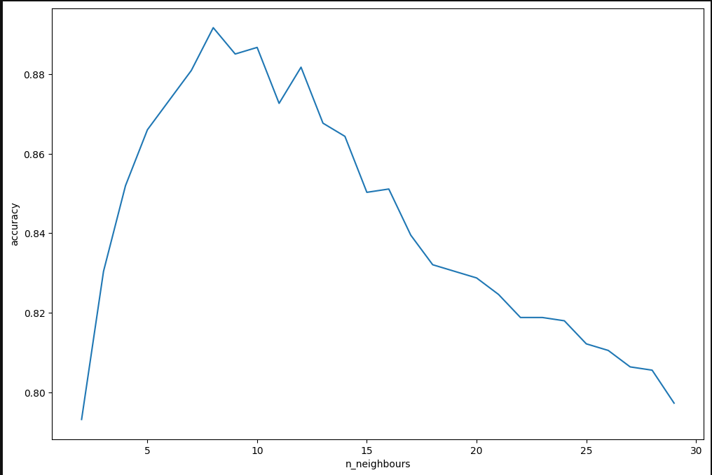

Slide 16
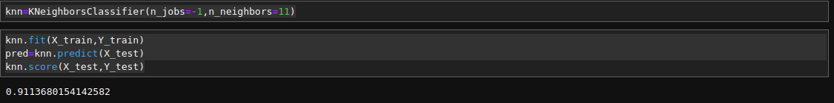
n_jobs=-1: This parameter allows the algorithm to use all available CPU cores for parallel processing. It can speed up the training process for large datasets. If you encounter any issues with it, you can also try setting it to a specific number of cores, like n_jobs=2 or n_jobs=4.n_neighbors=11: This parameter sets the number of neighbors to consider when making predictions. In this case, the classifier will consider the 11 nearest neighbors.After creating the knn object, you can proceed to train the model on your training data and evaluate its performance on your testing data.
knn.fit(X_train, Y_train): This line trains the KNN classifier on the training data (X_train, Y_train).
pred = knn.predict(X_test): This line uses the trained model to make predictions on the test data (X_test).
accuracy = knn.score(X_test, Y_test): This line calculates the accuracy score of the model on the test data. The score method internally performs predictions on X_test and compares the predicted values with the true labels (Y_test). The result is the accuracy of the model.
print(f"Accuracy: {accuracy}"): This line prints the calculated accuracy.
After running this code, you'll get the accuracy of your KNN classifier on the test data. Make sure to replace X_train, Y_train, X_test, and Y_test with your actual training and testing data.

Slide 17
Conclusions and Limitations
. Conclusion: Based on the evaluation metrics, the KNN model is a simple and effective algorithm that can be used to classify cars in the Car Evaluation dataset. The model achieved an accuracy of 91%, which is higher than the baseline accuracy of 50%. The model also achieved good precision, recall, and F1-score, which indicates that it is able to correctly identify both positive and negative instances.
Limitations :One limitation of the KNN model is that it can be computationally expensive for large datasets. This is because the model needs to calculate the distance between each new instance and all of the training instances. For large datasets, this can be a time-consuming process. Another limitation of the KNN model is that it can be sensitive to outliers. Outliers are instances that are far away from the majority of the data. If the dataset contains outliers, the KNN model may incorrectly classify them.

Slide 18
Thank you!!!!

