Slide 1
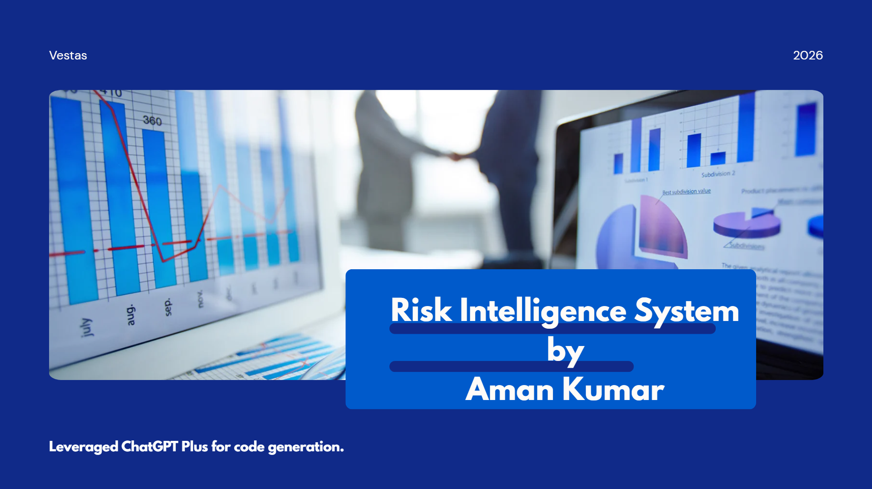

Slide 2









Structured Risk Intelligence
Aman Kumar
Understanding disclosed risks helps analysts identify exposures, emerging risks and changes over time — but doing this across 200+ annual reports every quarter is difficult to scale.
TODAY — MANUAL REVIEW
Annual Report
Analyst Review
Risk Findings
200+ PDFs reviewed per quarter
Manually reads & interprets disclosures
Risk Identified and interpreted by analyst
Slow — long manual read of every report
Costly — repeated across 200+ reports in a quarter
Inconsistent — analysts surface different risks
Can we automate this transformation — without losing quality or traceability?
PROPOSED — AI-ASSISTED PIPELINE
Annual Report
AI Risk Pipeline
Structured, Traceable Data
Same unstructured input
Extracts & structures principal risks
Source-grounded JSON / database record
WHAT STRUCTURED DATA UNLOCKS
Search
Compare
Monitor
Trend
Which companies flag cybersecurity as a principal risk?
How do a company’s risks compare across a portfolio?
Which emerging risks were recently elevated?
How has a given risk changed year over year?

Slide 3





Aman Kumar
Why This Problem Is Commercially Relevant?
AI-assisted extraction and structuring of high-value business information is already a substantial, well-funded commercial category.
MARKET SIGNAL
AlphaSense
FiscalNote
AI-powered market & financial intelligence
AI-driven regulatory & policy intelligence
$600M+ ARR* · $7.5B valuation · 6,500+ customers
~$84M ARR*
As of June 2026
Full-year 2025
Adjacent intelligence platforms, shown for market validation — not direct equivalents of this risk-extraction pipeline.
ECONOMIC LOGIC
200+ Reports / Quarter
Repeated Analyst Effort
AI-Assisted First Pass
Financial Analyst Validation
VALUE CREATION
Efficiency
Consistency
Leverage
Less repetitive document reading and extraction work
Same extraction schema and evaluation across every report
Structured risks power search, comparison, trend and monitoring
The value is not generating JSON. The value is converting expensive, manual research & unstructured information into reusable intelligence.
(*Annual Recurring Revenue)

Slide 4




PROTOTYPE SCOPE
The goal was not to prototype the entire platform, but to prove its most critical transformation reliably.
SCOPE NARROWING
Real Product Vision
Case Study Scope
Prototype Capabilities
200+ reports/quarter across companies — search, compare, trend, monitor
Vestas Annual Report — selected risk-related sections
PDF → Parse → Extract Risks → Validate → Structured Output
WHAT I OPTIMIZED FOR
01 Correctness
02 Traceability
03 Evaluability
Are the extracted risks actually supported by the report?
Can every result be traced back to its exact source?
Can a parser, model, or prompt change be objectively tested?
Not the primary optimization: maximum coverage · throughput · lowest inference cost
CAPABILITES DEVELOPED
Layout-aware Parsing Risks comes from complex annual reports
Traceability Analyst must trust the results
Schema Constraint Generation LLM output must be structured.
Scalable Modular component.
Ground Truth Regression must be
detectable
DELIBERATE CUTS
PDF only Other formats deferred
One company Portfolio-scale processing not implemented
Focused sections Not all ~190 pages processed
Core pipeline first Analyst-facing UI outside this slice
Not building the full platform. Proving the one transformation that makes it possible — correctly and traceably.

Slide 5










Solution Architecture
Modular pipeline transforming unstructured annual reports into grounded, traceable risk data
Deterministic Parsing + LLM Reasoning Generation
1. Document Intelligence & Ingestion
2. Risk Intelligence Engine
Structured Risk DB
Persistent Storage & Schema
Input Data
Report Preprocessing
Annual Report Content
Risk Name
Category
Layout Detection
Risk Identification
Description
Context
10-K Report
Data Extraction
Context Construction
Citation
Mitigation
Normalization
Annual Reports
Structured Risk Generation (LLM)
Unstructured PDFs, tables, financial narratives & layout structures
Applies AI reasoning on normalized context to generate schema-bound risk records.
User Query & Search UI
Annual Report Content
Structured Risk Output
Grounded Risk Answers Traceable to page citation & source data
Takeaway: “From unstructured annual reports to structured, traceable, and query able risk intelligence.”

Slide 6
Engineering Stage & Design Choice Matrix
Engineering Stage | What We Evaluated / Considered | Final Choice | Why This Choice (Rationale & Impact)
PDF Intake & Validation | Extension check, MIME/signature validation, corrupt/encrypted PDF handling | Validated PDF intake | Fail early before expensive processing; PDF-only scope aligned with proof of concept.
Document Identity & Deduplication | Filename, metadata identity, content hashing | Content-based hash identity | Filename is not a reliable identity; deterministic duplicate detection
PDF Parsing | PyMuPDF, pdfplumber, Docling | Docling | Better fit for mixed-layout annual reports containing text, tables and layout structure
Page & Content Representation | Plain document text vs page-wise extraction vs structured representation | Page-aware structured extraction | Preserve page provenance required for risk traceability
Text Normalisation | Raw extracted text vs aggressive cleaning vs minimal normalization | Minimal / basic normalization | Clean extraction artifacts without destroying source meaning or evidence
Extraction Quality | Assume parser success vs explicit page-level checks/warnings | Quality checks + warnings | Parser failures should be observable instead of silently propagating downstream
Intermediate Contract | Markdown/text passed directly downstream vs canonical JSON | Canonical Document JSON | Decouples document parsing from risk intelligence and creates a stable interface
Risk Context Selection | Entire ~190-page report vs fixed pages vs risk-relevant content | Risk-focused context construction | Reduce irrelevant context and model noise while preserving relevant evidence
Risk Extraction Strategy | Rules/regex, single LLM call, structured LLM extraction | LLM + structured schema | Risk interpretation is semantic, while schema constrains downstream output
LLM Model Selection | Tested models across proprietary & open weights (gemma 4-26b, gpt-oss) | Structured Output Model | Selected based on structured schema strictness, accuracy, context window & cost
Output Validation | Free-form JSON vs schema validation | Pydantic models | Enforce title, description, category, source/page, mitigation & catch malformed generations
Risk Persistence | Flat JSON/file output vs relational/document representation | Risk DB / structured records | Enables risks to become independently searchable/queryable entities
Evaluation Framework | Manual inspection only vs golden set + deterministic/LLM evaluator | Golden set + evaluator(s) | Detect regressions caused by parser/model/prompt changes

Slide 7
Evaluation Strategy — Ground Truth to Measured Performance
GROUND TRUTH GENERATION
Vestas Annual Report 2025
Manual Inspection
Human-Curated Golden Set
System Output vs. Ground Truth
Ground truth was created independently from expected source content — not generated from model output.
DOCUMENT INTELLIGENCE & INGESTION
RISK INTELLIGENCE
Can the parser faithfully reconstruct important document content?
Can the system identify the correct risks and structured attributes?
97.16%
1.00
1.00
1.00
Overall extraction score — 11 representative pages
Precision
Recall
F1
Golden set: 11 curated pages (3, 7, 8, 9, 10, 13, 38, 50, 51, 68, 71) spanning narrative text, headings, financial/sustainability tables, risk tables & infographics.
POC scope — 10 expected risks, 0 missing, 0 false positives, 0 field failures
Golden set: 10 manually identified expected risks — title, page, category, section, mitigation expected.
Heading Recall · Text Fragment Recall · Table Accuracy · Provenance Coverage
GENERALIZATION & NEGATIVE CONTROLS
Honest exceptions Page 51 → 93.75%: correct 3×4 table structure, but generic column headers (0,1,2,3) instead of semantic labels. Page 38 → 75%: full-page map infographic — heading missed; visual-map content is a known limitation.
10 / 10
6 / 6
4 / 4
Positive Risks Matched
Negative Cases Rejected
Generalization Tests Passed
Human-Curated Ground Truth → Deterministic Evaluation → Transparent Failure Analysis
POC Evaluation Scope: results validate correctness against a manually curated Vestas 2025 golden set. They demonstrate in-scope extraction quality and guard against obvious hardcoding, but do not yet establish cross-company or production-level generalization.

Slide 8
What This Prototype Demonstrates
A focused proof that unstructured annual-report disclosures can be transformed into structured, traceable and measurable risk intelligence.
01
02
03
04
DOCUMENT UNDERSTANDING
RISK INTELLIGENCE
QUALITY BY DESIGN
PRODUCT FOUNDATION
Layout-aware annual-report parsing
Semantic extraction with structured output
Grounded and regression-testable
Structured data creates downstream leverage
PDF content is converted into a canonical, page-aware representation while preserving source provenance.
Risk-relevant evidence is transformed into schema-constrained risk records with source, category and mitigation information.
Golden datasets and evaluators measure both document extraction and risk-generation quality instead of relying on visual inspection.
The output becomes suitable for search, comparison, monitoring and eventually portfolio-level analysis.
POC EVIDENCE
97.16%
10 / 10
1.00
6 / 6
4 / 4
Document extraction
Expected risks identified
Risk Precision / Recall / F1
Negative controls rejected
Generalization tests passed
From an annual report to structured risk intelligence — with evidence of where the information came from, and evidence that the pipeline works.

Slide 9
Thank You
Questions & Discussion
Happy to go deeper into the product decisions, architecture, evaluation, or implementation.
Aman Kumar
Risk Intelligence System

