Slide 1

Team Members Yongha Jang, Carlos Salazar, Anni Kang, Melody Feng, Jane Yun
Executive Coach Deepa Pai Managing Director, Technology - Accenture
Team # 2

Slide 2
Agenda
2024 Super Analytics Challenge Team 2
1
Problem Statement
2
HIQ
3
Blueprint for Solutions

Slide 3
Problem Statement
2024 Super Analytics Challenge Team 2
Phase 1

Slide 4
The Urgent Challenge: Workforce Development in Advanced Manufacturing
2024 Super Analytics Challenge Team 2
Rapid Evolution
Skills Shortage
Innovative Solutions Required
Equity & Accessibility

Slide 5
Initial Research
2024 Super Analytics Challenge Team 2
Phase 1

Slide 6
Future Workforce Trends & Challenges: Glimpse into Labor Dynamics & Talent Shortages
2024 Super Analytics Challenge Team 2
“The lack of centralized information was a limitation for analysis in the estimation of labor supply and demand for workforce.”
-Rand Corporation
Between 14% and 42% of jobs are susceptible to automation by 2030.
By 2030, 2.1 million jobs will be unfulfilled in the US, and 92,000 of those jobs will be in Pennsylvania.
The expected global talent deficit by 2030 will be 85.2 million workers. This skills shortage could result in 8.452 trillion in unrealized annual revenue.
1. https://www.congress.gov/bill/117th-congress/house-bill/7309

Slide 7
Addressing Labor Shortages: Innovations, Initiatives & Future of Work
2024 Super Analytics Challenge Team 2
1
The United States alone could miss out on $1.748 trillion in revenue due to labor shortages.
Firms are adopting new technologies as they increase the demand for skills, not necessarily with an expansion in employment levels.
The Bipartisan Workforce Innovation and Opportunity Act set the principles for new initiatives based on job-driven training, a hands-on approach, and a stronger engagement between workers, employers, and educators.
“The reason why human labor has prevailed relates to its ability to acquire new skills through education.”
2. Karabarbounis & Neiman. (2013). The global decline of the labor share. NBER
3. Frey & Osborne. (2013). The future of employment. Oxford Martin School
4. Center for Economic and Business Research. (2016). The Trillion $ Difference.

Slide 8
Empowering Workforce Development: Investing in Human Capital for Economic Growth
2024 Super Analytics Challenge Team 2
The Career Pathways program in New Orleans was a program that began in 2015. According to Rand Corporation, the program had a favorable return on investment (355.28% for participants, 7.99% for society) in a 3-year horizon.
Rand Corporation recommends improving literacy and numeracy, and responsive programs to an evolving job market. Society must be patient to get results.
The labor participation rate has decreased in people between 16 and 24 years, from 76.3% in 1980 to 60.2%.
For every $1 invested in human capital, $11.39 is added to the GDP. The best investment is People.
5. Korn Ferry. (2018). The global talent cruch.
6. Acemoglu D. et Al. (2023). Advanced technology adoption. (2023). Discussion Paper. MIT Economics.
7. Rand Corporation. (2019). What works for Job Training Programs for Disadvantaged Workers?

Slide 9
HIQ
2024 Super Analytics Challenge Team 2

Slide 10
“How can data-driven insights on the current and future demographic trends in Pennsylvania be leveraged to help schools and educators design and implement dynamic workforce development programs, ensuring that training initiatives are responsive to the evolving needs of the population and the advanced manufacturing sector?”
2024 Super Analytics Challenge Team 2

Slide 11
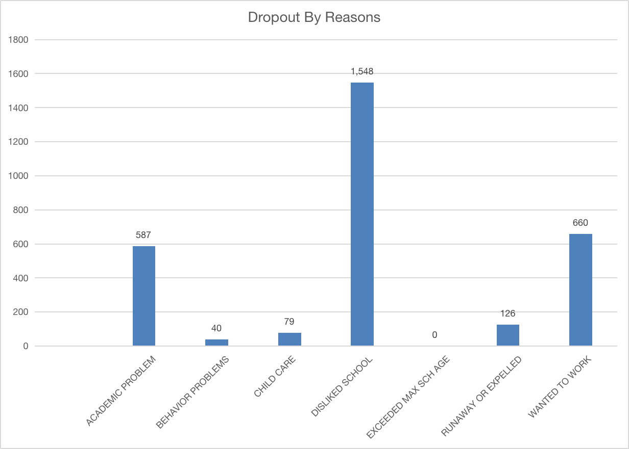
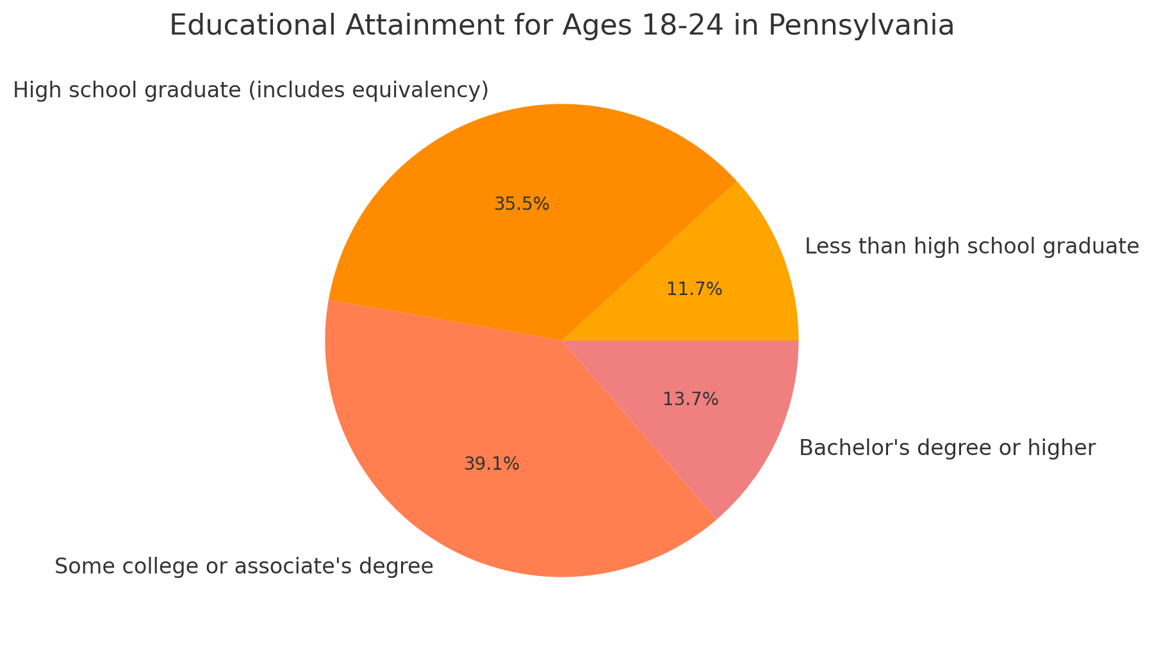
Education Systems
Source: United States Census Bureau
Source: Pennsylvania Department of Education

Slide 12
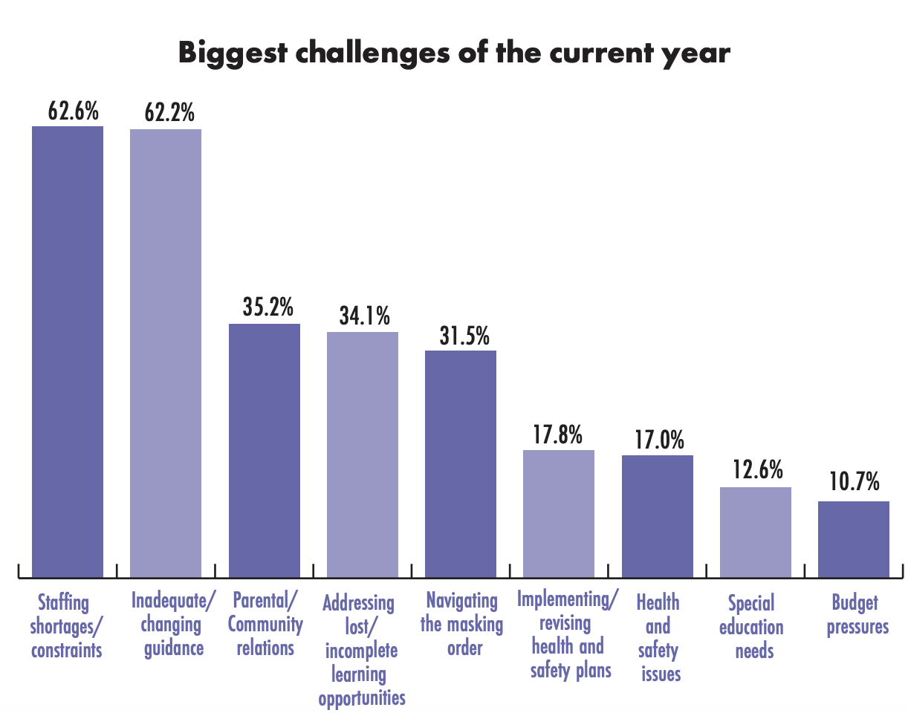
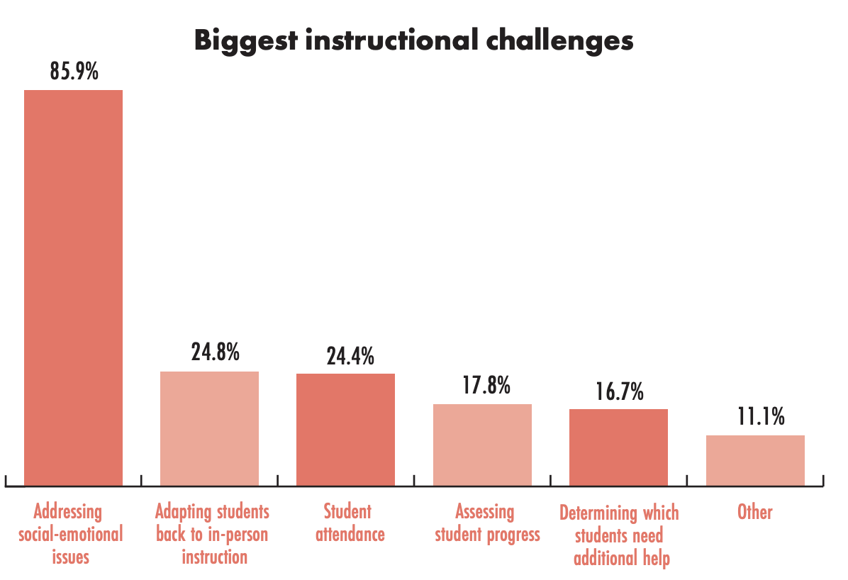
Education Systems
Source: 2022 PA State of Education Report

Slide 13
Blueprint to Solution
2024 Super Analytics Challenge Team 2

Slide 14
“A free online platform targeting younger demographic using an algorithm that focuses on developing and training the new required skill trends in the workforce that bridges the connection between companies and schools to enhance,adapt and develop to the changing landscape of the skill sets needed in the advanced manufacturing workforce within PA”
2024 Super Analytics Challenge Team 2

Slide 15
Practicality of Blueprint to Solution
2024 Super Analytics Challenge Team 2
Practicality & Capability
45% of students across schools
1277 advanced manufacturing companies
Deployed and promoted
Cross Promotion between school systems/admins and companies
Data based conclusions for solution
Uplifts younger workers
Addresses issues of staffing shortages and mental health
Addresses rapid skill changes in workforce
Suggests sustainable solution for target demographic
Source: 2022 US Government Census Data, PA Department of Community & Economic Development

Slide 16
Downstream & Upstream Implications
2024 Super Analytics Challenge Team 2
Downstream Implications
Initial expensive costs & competitive market
Heavy involvement from three parties to become pervasive & persistent
Upstream Implications
Targeted training
Persistent and adaptable solution in the marketplace that can be expanded
secondary demographic
other geographic locations
Notes:
Anywhere from 100K USD to 300K USD to launch the app with additional costs to maintain the app
Three parties of: government, schools, companies
Uplifting the young low income demographic

Slide 17
Citations
2024 Super Analytics Challenge Team 2
https://www.congress.gov/bill/117th-congress/house-bill/7309
Karabarbounis & Neiman. (2013). The global decline of the labor share. NBER
Frey & Osborne. (2013). The future of employment. Oxford Martin School
Center for Economic and Business Research. (2016). The Trillion $ Difference.
Korn Ferry. (2018). The global talent crunch.
Acemoglu D. et Al. (2023). Advanced technology adoption. (2023). Discussion Paper. MIT Economics.
Rand Corporation. (2019). What works for Job Training Programs for Disadvantaged Workers?
United States Census Bureau
Pennsylvania Department of Education
2022 PA State of Education Report
2022 US Government Census Data
PA Department of Community & Economic Development
Acemoglu D. et Al. (2023). Advanced technology adoption. (2023). Discussion Paper. MIT Department of Economics.
Drosos N. et Al. (2021). Career in the post-covid era. American Counseling Association. Journal of Employment Council.
Rand Corporation. (2019). What works for Job Training Programs for Disadvantaged Workers?

Slide 18
QnA
2024 Super Analytics Challenge Team 2
Team 2

Slide 19
Team #2
Students:
Anni Kang, Yongha Jang, Melody Feng, Carlos Salazar, Jane Yun
Executive Coach:
Deepa Pai, Managing Director, Technology - Accenture
Phase 1 - HIQ
How can data-driven insights on the current and future demographic trends in Pennsylvania be leveraged to help schools and educators design and implement dynamic workforce development programs, ensuring that training initiatives are responsive to the evolving needs of the population and the advanced manufacturing sector?
Phase 2 - Data
Phase 3 - Solution
Notes:
Add your name here please :)

