Slide 1

Team #2

Slide 2
Team #2
2024 Super Analytics Challenge Team 2
Melody Feng
Master of Marketing Science and Business Analytics @ University of Pittsburgh
Yongha Jang
Master of Business Administration and Management Information Systems @ University of Pittsburgh
Anni Kang
Master of Business Intelligence of Data Analytics @ Carnegie Mellon University
Carlos Salazar
Master in Analytics and Information @ Duquensne University
Jane Yun
Master of Business Analytics @ Pennsylvania State University
Deepa Pai
Managing Director, Technology - Accenture

Slide 3
Agenda
2024 Super Analytics Challenge Team 2
1
HIQ & Solution Overview
2
Solution Design & Model Research
3
Solution Breakdown

Slide 4
HIQ & Solution Overview
2024 Super Analytics Challenge Team 2
Phase 2

Slide 5
HIQ
2024 Super Analytics Challenge Team 2
“How can the implementation of a targeted educational platform, emphasizing certification and licensing, revolutionize the attraction and retention of young talent in the manufacturing industry, thereby bridging the skills gap and fostering industry growth in line with future labor market demands?”
Notes:
How upskilling > higher paying jobs
Create a model how upskilling helps you move to higher quadrants of salaires > solution: plug-in for gaps in skills to bridge skills to get you to higher bracket of salary

Slide 6



Solution Website & App to submit current resume
2024 Super Analytics Challenge Team 2
Features
Suggest in-demand manufacturing skills.
Provide online links/pipelines to local skill-building resources.
Integration and Evolution
Aim to be integrated with hiring websites
Enhance accuracy for skills needed
Community Impact
Connect users with local opportunities to develop relevant skills
Serve as a central hub for essential manufacturing skills

Slide 7
Solution Design & Model Research
2024 Super Analytics Challenge Team 2
Phase 2

Slide 8
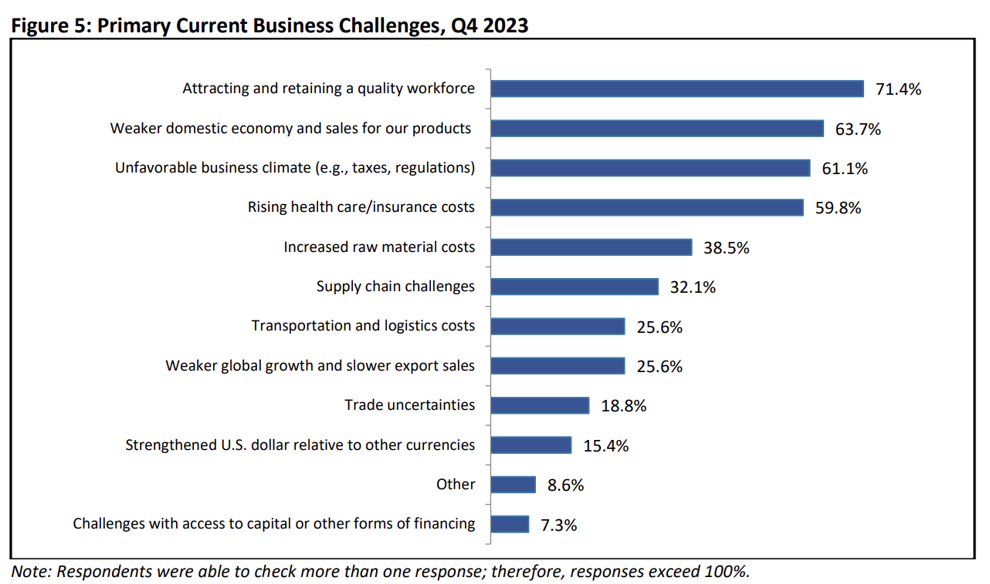
Why this Model?
2024 Super Analytics Challenge Team 2
Source: NAM Manufacturing Outlook Survey

Slide 9
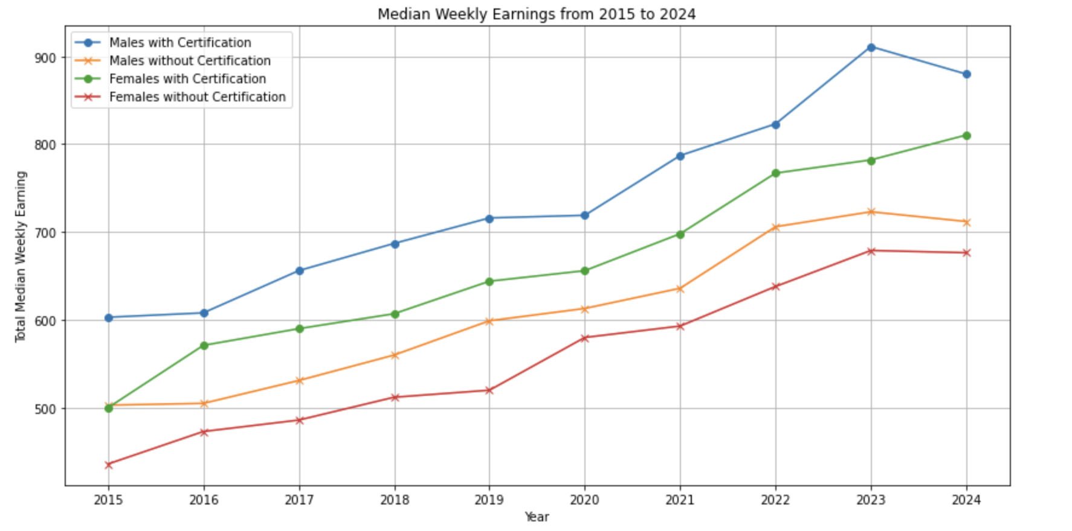
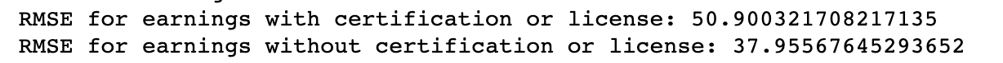
Our Model
2024 Super Analytics Challenge Team 2
Source: US Bureau of Labor Statistics
Notes:
Should I insert a screenshot of my codes??

Slide 10



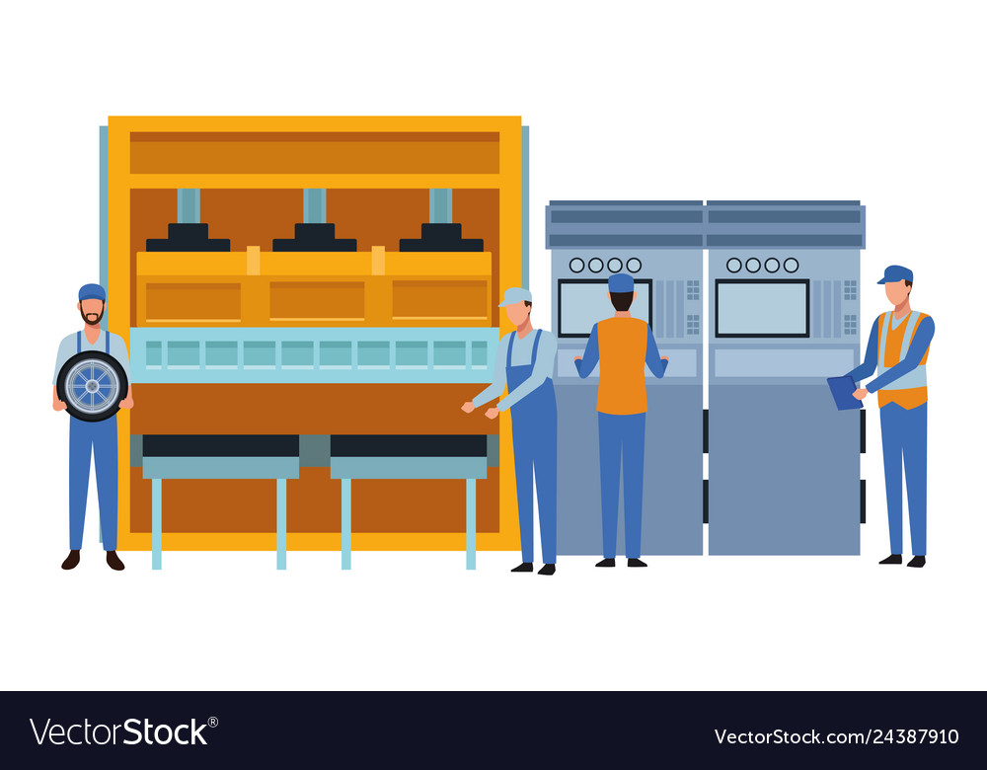
Why should we Care?
2024 Super Analytics Challenge Team 2
More/ easier access to Certificates
Better-paid jobs
More Applicants
A Thriving Industry

Slide 11
Solution Breakdown
2024 Super Analytics Challenge Team 2

Slide 12
Solution Website & App to submit current resume
2024 Super Analytics Challenge Team 2
Features
Suggest in-demand manufacturing skills
Provide online links/pipelines to local skill-building resources
Integration and Evolution
Aim to be integrated with hiring websites
Enhance accuracy for skills needed
Community Impact
Connect users with local opportunities to develop relevant skills
Serve as a central hub for essential manufacturing skills

Slide 13
3 Stages of Solution for Successful Deployment
2024 Super Analytics Challenge Team 2
Deploy website & app for 16 - 24 year old younger workers to highlight missing skills needed to enter the advanced manufacturing sector
1
2
Revitalize (demographic) by providing a direct pipeline to enhance their skills and earn certifications within their community, therefore bridging the gap between workers and employers.
3
Website & app evolves into central hub of relevant skills needed in the industry, enhanced by data of hiring websites to ensure that the skills are constantly being updated to the most needed skills.

Slide 14
Cost Effectiveness & Sustainability
2024 Super Analytics Challenge Team 2
Launch cost $ 128,000 — $ 153,000
Software engineers $103,000
Domain (75 pages) $ 10,000 — $ 35,000
Annual maintenance up to $15,000
Annual Cloud storage $ 120
Sustainability is high
Constant evolution based on data
Expansion of data
Source: USANEWS, Indeed Software Engineer PA Cost, Forbes How much does it cost for a website 2024 guide

Slide 15
Impactful Solution
2024 Super Analytics Challenge Team 2
Touches upon & Expands opportunities for
The workers
The community
The company
Constant evolution for matching skills
Potential to grow
Outside of PA 16 - 24 year old workers
Employment in advanced manufacturing industry
The worker’s potentials
Bigger than a website & app
Source:

Slide 16
Citations
2024 Super Analytics Challenge Team 2
NAM Manufacturing Outlook Survey
US Bureau of Labor Statistics
USANEWS
Indeed Software Engineer PA Cost
Forbes How much does it cost for a website 2024 guide

Slide 17
Team #2
Students:
Anni Kang, Yongha Jang, Melody Feng, Carlos Salazar, Jane Yun
Executive Coach:
Deepa Pai, Managing Director, Technology - Accenture
Phase 1 - HIQ
“How can the implementation of a targeted educational platform, emphasizing certification and licensing, revolutionize the attraction and retention of young talent in the manufacturing industry, thereby bridging the skills gap and fostering industry growth in line with future labor market demands?”
Phase 2 - Data
EDA - correlation between wage and certification
Clean null values
Random Forest Regression
Certificates → higher wages → more applicants → booming industry
Phase 3 - Solution
Notes:
Add your name here please :)

Slide 18
QnA
2024 Super Analytics Challenge Team 2
Team 2

