Slide 1






Slide 2

 | Mapping – Google Earth, GIS, Mapathons <Insert Image Link> | 360 Video and Imagery <Insert Clickable Image> | Old Presentation <Insert Clickable Image> | SAGE2 <Insert Image Link> | Development Space and Virtual Reality <Insert Image Link>

Slide 3


Slide 4
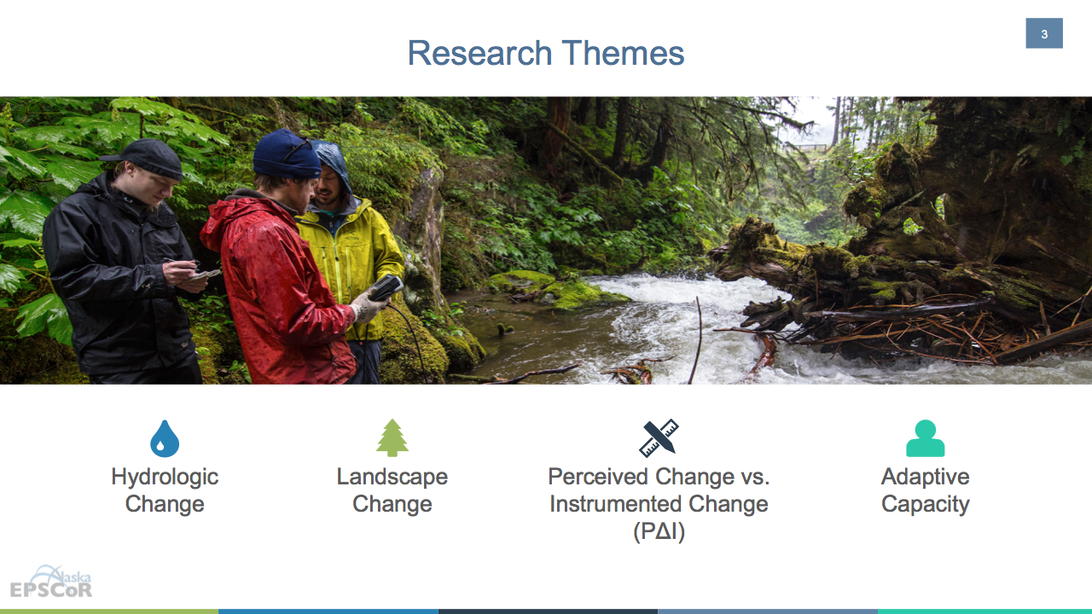
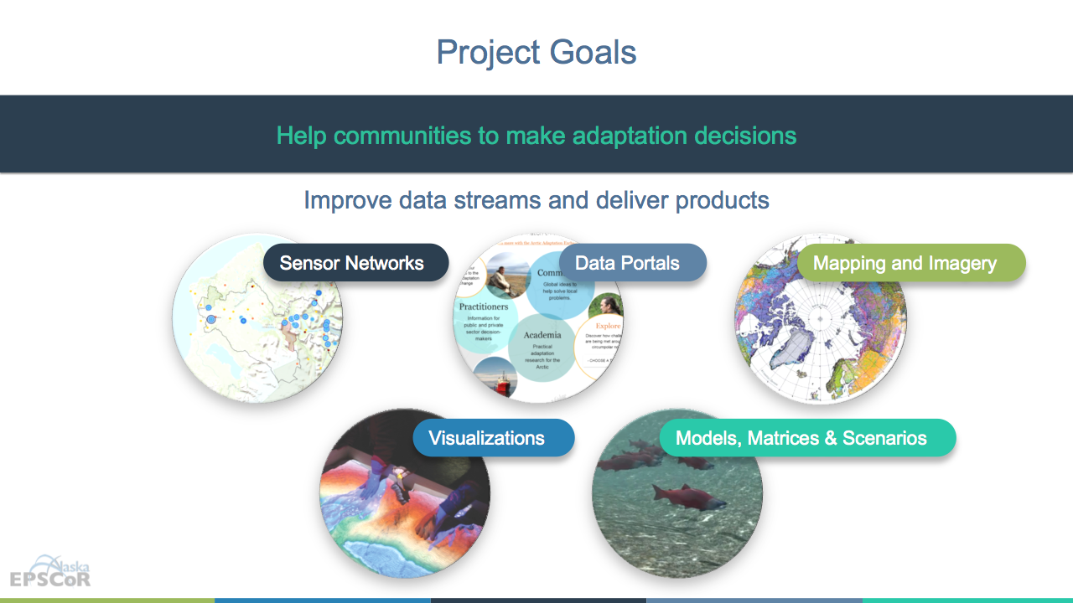
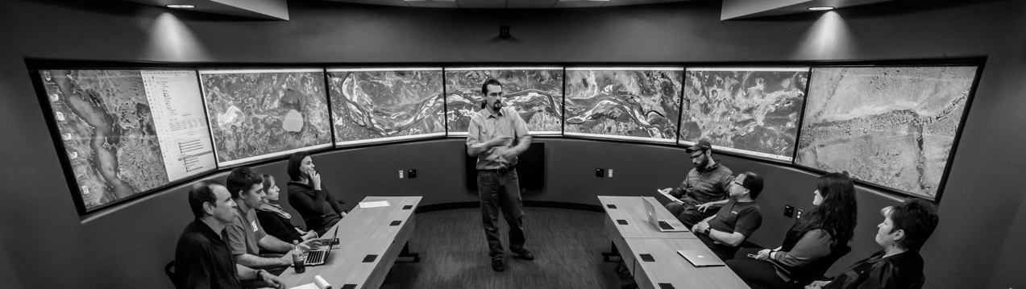


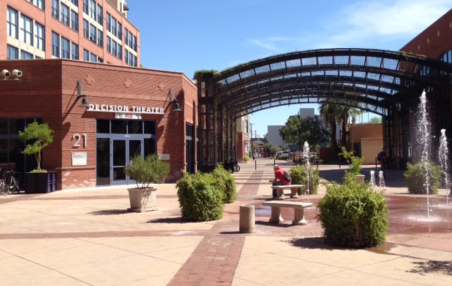




Decision Theater Network
Data to Decisions
People
desirability
Alaska ACE: Adapting to Changing Environments
The mission of Decision Theater North is to provide a cutting-edge, immersive, visual environment to facilitate dialogue and decision-making by agencies, industry, communities and academia.
Data
reliability
Solutions
sustainability
Decision Theater North is a gathering place for people to discuss issues that span the boundaries of location, time, and discipline.
ASU Decision Theater
Arizona State University
Tempe, AZ
ASU Decision Theater
McCain Institute
Washington, D.C.

