Slide 1
FAKE NEWS DETECTION SYSTEM

Slide 2
Agenda
Introduction
Problem Statement
Objective
Technology Stack
System Architecture
Model Training & Evaluation
Results
Future Scope
Conclusion

Slide 3

INTRODUCTION
In today’s digital world, information spreads rapidly across platforms. However, not all that we read is true fake news has become a major concern . It misleads people, creates confusion, and can have serious consequences on society .To tackle this issue, we’ve developed a website that detects fake news using Machine Learning and Natural Language Processing.

Slide 4

Problem Statement
The rapid spread of fake news on digital platforms is a serious concern. It misleads the public, creates panic, and manipulates opinions. Manual detection is slow and ineffective. There’s a need for an automated system to identify fake news accurately and instantly.

Slide 5
OBJECTIVE
Develop a machine learning-based system to detect fake news automatically.
Use Natural Language Processing (NLP) to analyze and understand news content.
Train the model on a labeled dataset of real and fake news articles.
Extract features using techniques like TF-IDF for better text understanding.
Classify news as real or fake using algorithms like Random Forest or Logistic Regression.
Provide a simple, user-friendly web interface for users to input and check news articles.

Slide 6
TECHNOLOGY STACK

Slide 7
TECHNOLOGY USED
Programming Language:
Python — for data processing, model training, and backend logic
Libraries & Frameworks:
Pandas – for data handling and preprocessing
NumPy – for numerical operations
Scikit-learn – for machine learning models
Matplotlib / Seaborn – for visualizing model results
Tool used:
Git for version control
Natural Language Processing (NLP):
Tfidf Vectorizer to convert text into numerical features
re (Regex) for text cleaning (punctuation, symbols, etc.)
Machine Learning Model:
Logistic Regression – used for classifying real vs fake news
Frontend : HTML, CSS for creating a simple and clean user interface with Flask
Backend: Flask to connect model with the web interface

Slide 8
SYSTEM ARCHITECTURE
User Input
Text preprocessing
Feature Extraction
Prediction using ml model
Result display

Slide 9

Model Training
Split dataset into 80% training and 20% testing.
Applied text preprocessing and TF-IDF vectorization.
Trained multiple models – best results from Random Forest.
Achieved high accuracy and F1-score on test data.
Performed hyperparameter tuning to optimize model performance.

Slide 10
Model Evaluation
METRICS | DEFINITION | VALUE | INTERPRETTION
ACCURACY | % of total predictions correctly classified | 92% | Overall performance of the model
PRECISION | TP / (TP + FP) | 91% | High means fewer false positives
RECALL | TP / (TP + FN) | 93% | High means fewer fake news articles missed
F1 SCORE | Harmonic mean of Precision and Recall | 92% | Balanced score between precision and recall
CONFUSION MATRIX | TP, TN, FP, FN values |  | Gives actual vs predicted comparison

Slide 11
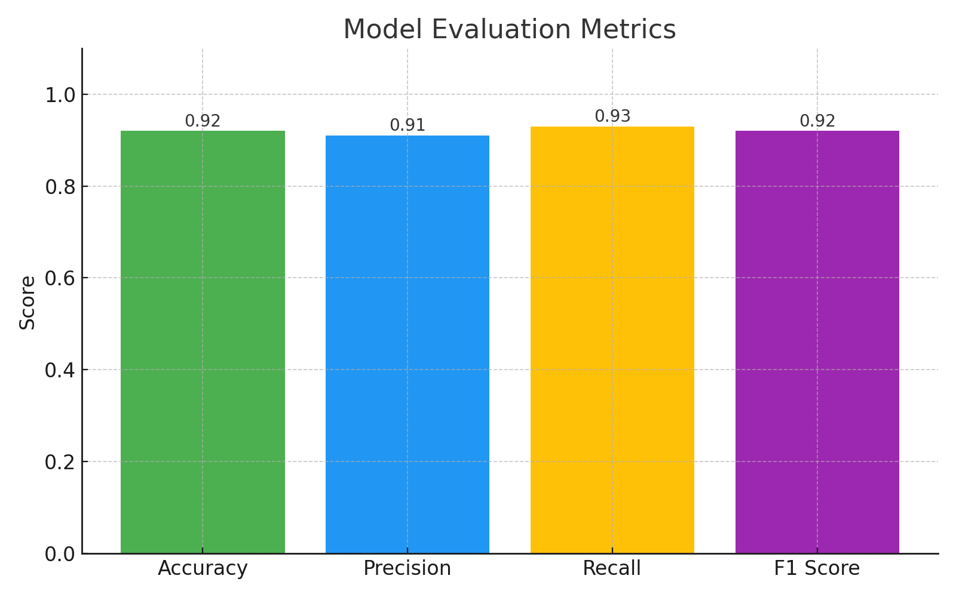
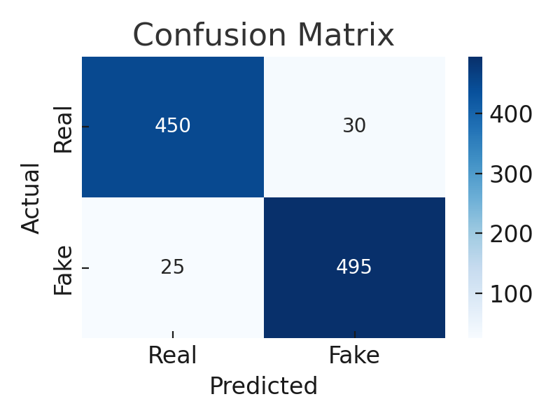
Model Evaluation Result

Slide 12
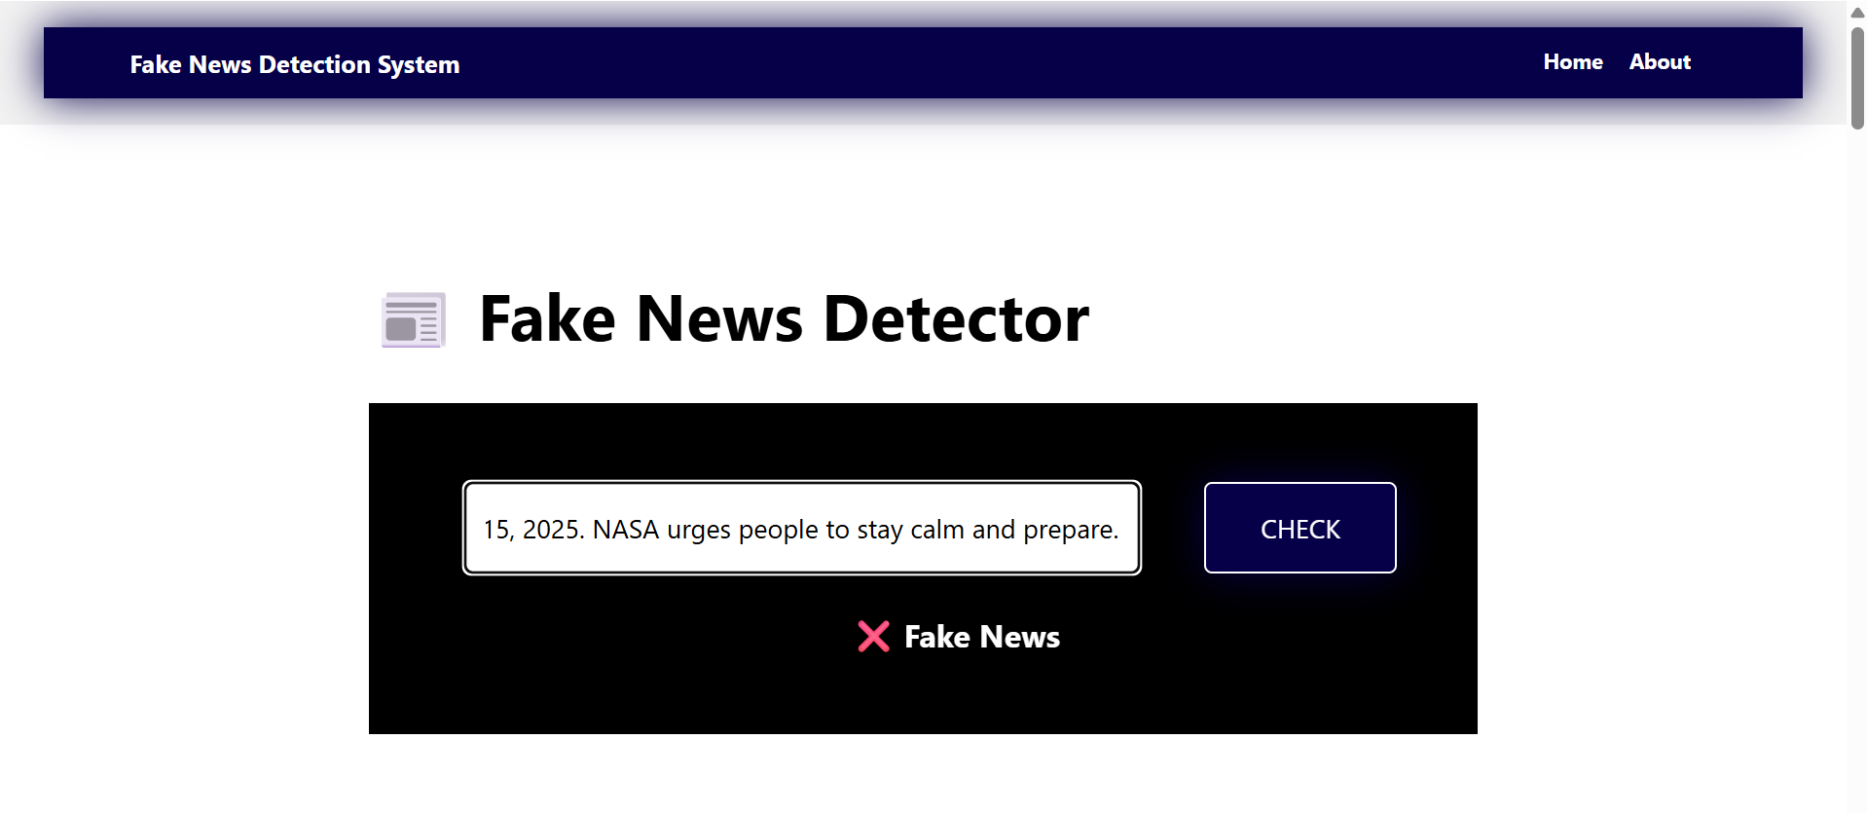
RESULT

Slide 13
FUTURE SCOPE
Implement advanced models like BERT or LSTM for better accuracy
Add support for multiple languages (Hindi, regional, etc.)
Develop a mobile app or browser extension for real-time detection
Improve detection of sarcasm, satire, and clckbait headlines
Integrate with social media platforms for live monitoring

Slide 14
CONCLUSION
This project uses Machine Learning and NLP to detect fake news effectively. It provides reliable results and supports informed content consumption..
The system has potential for real-world use with further enhancements. It can help reduce the spread of misinformation on digital platforms.

Slide 15
Eshan College Of Engineering ,Mathura
“FAKE NEWS DETECTION”
BACHELOR OF TECHNOLOGY IN COMPUTER SCIENCE AND ENGINEERING
Under the guidance of Mentor: Mrs. Neeraj Sharma
CDAC, Mohali
Shalu Chaudhary : Handled backend development using Machine Learning, performed model training, and prepared the project presentation
Sapna Kumari : Created the detailed project report and actively contributed to project coordination and assistance.
Abhishek Upadhayay : Designed and developed the frontend of the website and provided additional project support in Backend.

Slide 16

Thank you

