Slide 1
Agent-Based Architecture with MCP Integration
A lightweight, agent-based Retrieval-Augmented Generation (RAG) chatbot designed to answer user questions from uploaded documents of various formats — powered by Model Context Protocol (MCP) and Streamlit. Supports PDF, DOCX, PPTX, CSV, TXT, Markdown files. Built with modular agents and vector search using ChromaDB.
Agents:
- IngestionAgent: Parses uploaded documents (PDF, DOCX, PPTX, etc.)
- RetrievalAgent: Adds to vector store & retrieves top-matching chunks
- LLMResponseAgent: Uses retrieved chunks + query to call the LLM
Implemented an in-memory queue-based MCP:
Agents send/receive structured messages via a shared in-memory mcp_queue (like a message bus).
There is no network communication (like HTTP or WebSocket).
So everything runs in a single process, or at least in the same memory space.

Slide 2
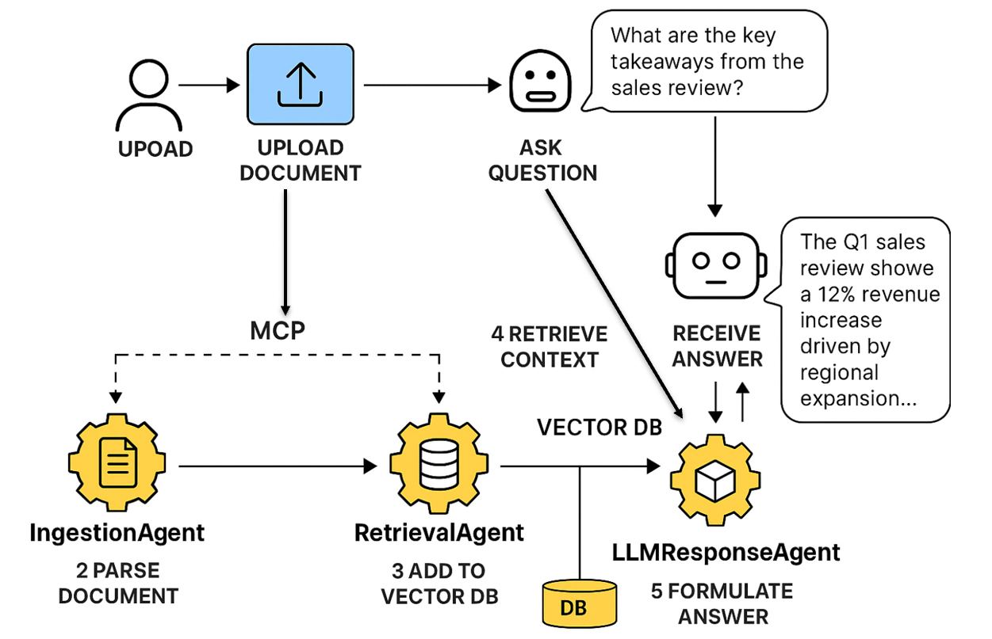
System Flow Diagram (with Message Passing)

Slide 3
Tech Stack Used
💻 Frontend: Streamlit for UI
🧱 Backend:
- Python (3.10+)
- Agent logic via custom classes
🧠 LLM + Embeddings:
- LLM: Groq API (LLaMA3) / OpenAI
- Embeddings: OpenAI / HuggingFace (MiniLM)
🔍 Vector Store: ChromaDB
📄 Document Parsing: PyMuPDF, python-docx, python-pptx, pandas, markdown

Slide 4
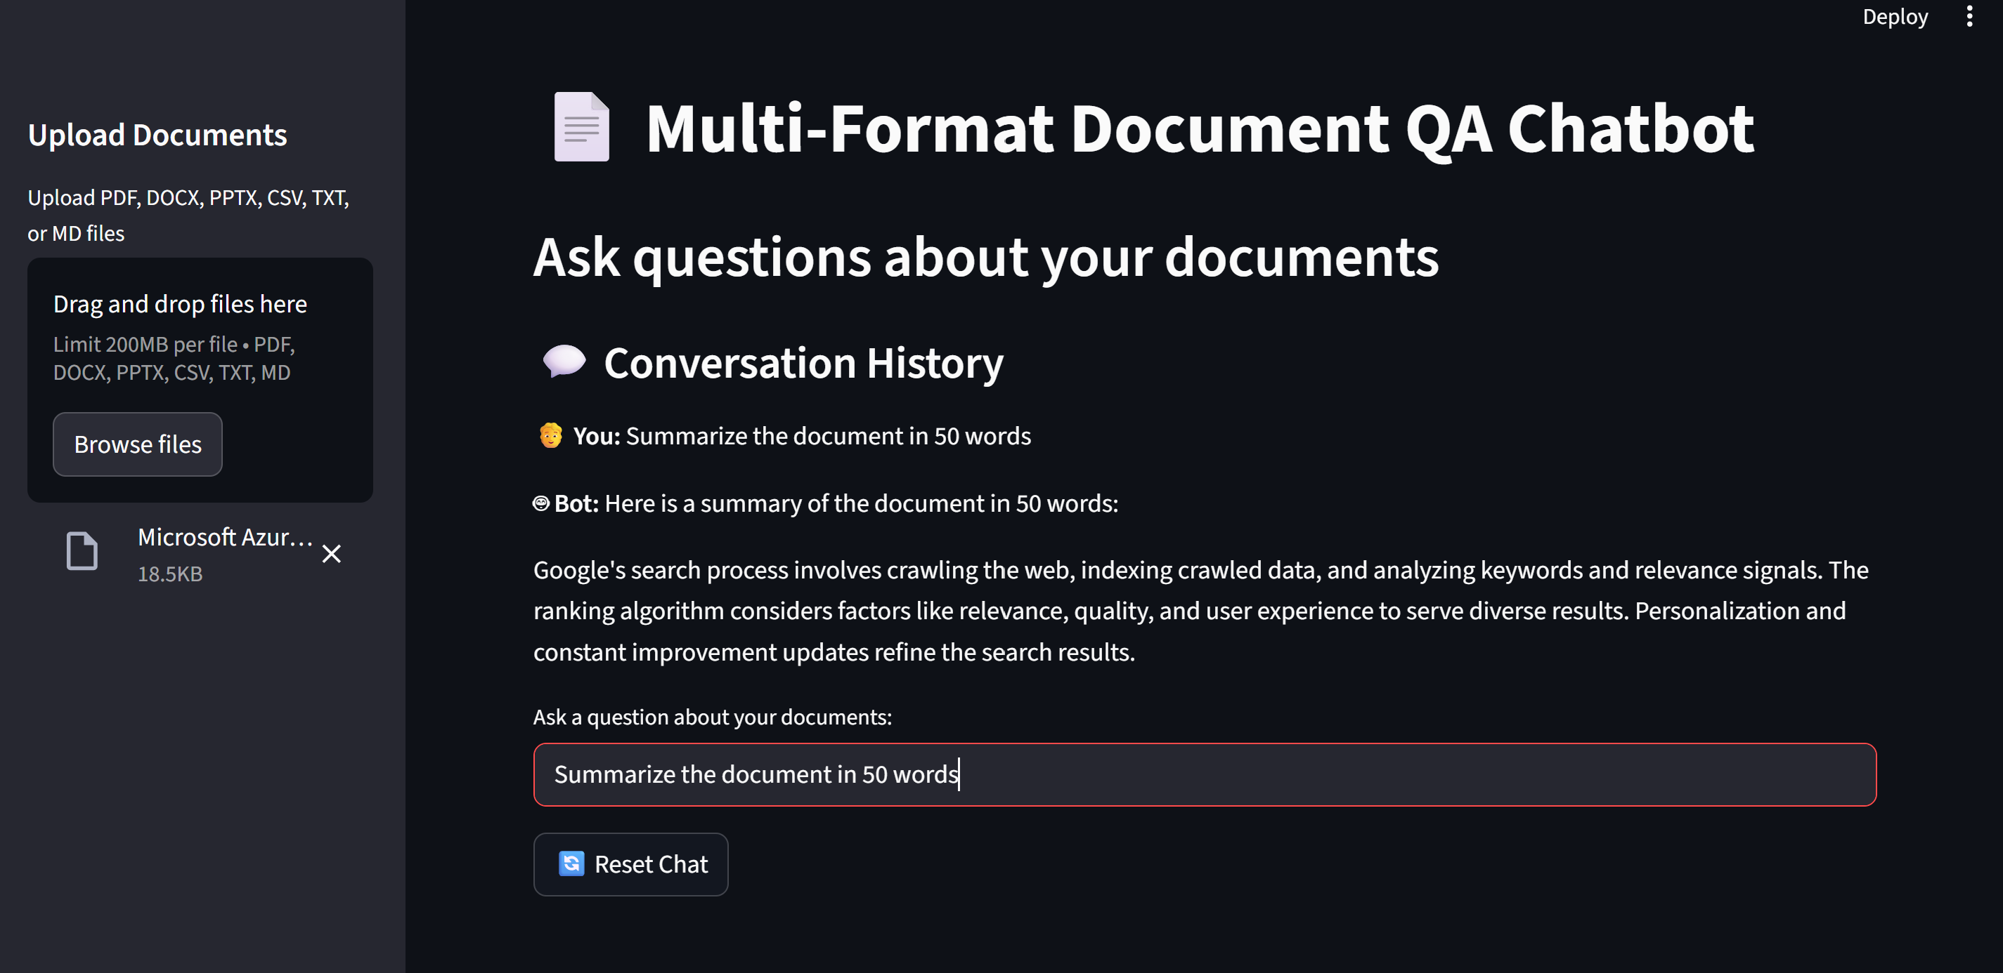
UI Screenshots of Working App
📁 Document Upload Sidebar
❓ Question Input + Chat Display
🤖 Answer with Source Context
All screenshots placed in /demo folder.

Slide 5
Challenges Faced During Project
⚙️ Integration Complexity: Coordinating 3 agents via MCP messaging logic
🔍 Embedding Errors: OpenAI key quota / model loading timeouts on HuggingFace
🧾 File Parsing:
- PDF extraction inconsistencies (table-heavy slides)
- Markdown + text required custom pre-cleaning
📦 Vector DB: Cold start delays with Chroma embedding downloads
🔁 Streamlit Refresh: Preventing repeated query reruns due to session issues

Slide 6
Future Scope / Improvements
🔄 LangGraph Integration: Structured workflows with loop, condition control
☁️ Pub/Sub MCP: Replace in-memory MCP with Redis or FastAPI endpoints
🧠 Memory & Personalization: Multi-turn memory & session-based context
🧾 Export Options: Save conversations, highlight sources, PDF download
🔐 Authentication: User login & document access control

