Slide 1
BCA CAPSTONE PROJECT (Review I) AI BASED RECOMMENDATION SYSTEM
Submitted to the Presidency University, Bengaluru in partial fulfillment for the award of the degree of Bachelor of Computer Applications(BCA)
Project Team No : 45
Under the supervision of
Dr. Geetha Arjunan Professor, Department School Of CSE
Name | Roll Number
AYUSH KUMAR | 20231BCI0011
DEEPAK | 20231BCI0017
KRISHNA | 20231BCI0033
M BILAL | 20231BCI0042

Slide 2
Content
Problem Statement
Literature Survey
Tools and Technologies to be used
Timeline of the Project
Github Link
References

Slide 3
Problem Statement
In a world flooded with information, users are often overwhelmed by the sheer volume of choices, whether it's products, movies, courses, or services. Traditional recommendation systems are either too generalized or fail to adapt in real-time to user preferences, leading to irrelevant or outdated suggestions.
Significance of the Problem in Real-World Scenarios:
Enhanced User Experience: Personalized recommendations save time, increasing user satisfaction and engagement across platforms.
Business Growth: Accurate suggestions lead to higher conversions, customer retention, and revenue.
AI Advantage: Real-time adaptation and scalability overcome limitations of traditional recommendation systems, improving accuracy and efficiency.
Ensure your problem statement is concise, specific, and research-oriented.

Slide 4
Literature Review
1. Hybrid Recommendation Systems: Hybrid systems combine content-based and collaborative filtering to improve recommendation accuracy and address issues like item novelty and personalization. Recent studies have shown that hybrid approaches provide better results in terms of diversity and relevance.
Methodologies:
Weighted Hybrid: Combines predictions from content-based and collaborative methods, adjusting the weight of each based on the context (Rendle et al., 2020( This paper presents a survey of various hybrid recommendation approaches, emphasizing their ability to combine the strengths of content-based and collaborative filtering models for improving the quality of recommendations in real-time applications.).
Switching Hybrid: Dynamically switches between methods based on the available user data (Zhou et al., 2021( The paper proposes a deep hybrid model that integrates collaborative filtering and content-based filtering using a deep neural network to learn user preferences and item features, achieving higher prediction accuracy.).

Slide 5
2. Cold-Start Problem: The cold-start problem arises when new users or items lack interaction data for accurate recommendations. To address this, recent research focuses on leveraging external data sources and advanced algorithms to overcome data scarcity.
Methodologies:
Transfer Learning: Utilizes pre-existing knowledge from similar users/items to improve recommendations for newcomers (Li et al., 2020 ) (This paper discusses how transfer learning can help overcome the cold-start problem by utilizing knowledge from similar users or items to provide initial recommendations, reducing the reliance on large datasets.).
Content-Based Filtering: Analyzes item metadata (e.g., genre, keywords) to recommend new content, mitigating the cold-start issue (Zhao et al., 2021 ) (The paper introduces a method combining content-based filtering with collaborative filtering to tackle the cold-start problem. By leveraging item metadata such as category and features, the system can make initial recommendations for new users or items.).

Slide 6
3. Deep Learning in Recommendation Systems:Deep learning techniques, particularly neural networks, have revolutionized recommendation systems by capturing complex relationships in user-item interactions. These methods are especially useful for handling large- scale, high-dimensional data.
Methodologies:
Neural Collaborative Filtering (NCF): Uses neural networks to model non-linear user-item interactions ((2023 by Xiangnan He et al). ( The paper explores the use of NCF models for top-N recommendations, demonstrating how deep learning can improve recommendation accuracy by capturing complex, non-linear relationships between users and items, particularly in large datasets.
Autoencoders: A deep learning technique used for dimensionality reduction, enhancing recommendation accuracy (Yuqing Zhang, et al. 2023 ). (This paper reviews the application of autoencoders in collaborative filtering, demonstrating how this deep learning technique can enhance recommendation accuracy by learning efficient representations of users and items.).

Slide 7
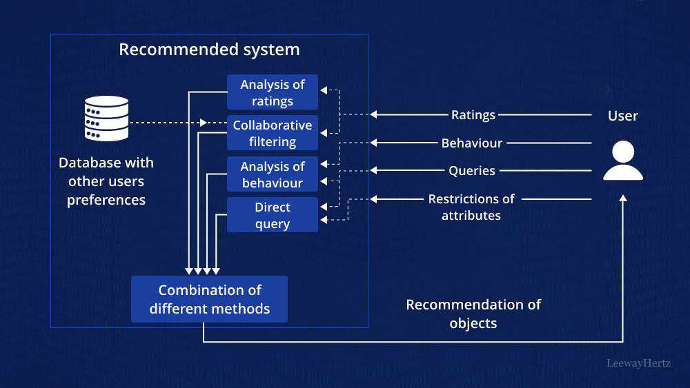
Module Design

Slide 8
Module 1: Data Collection Module
This module collects user interaction data, preferences, and behavioral patterns from various sources, including websites, mobile apps, and IoT devices. It also gathers external data such as product information and user demographics. The collected data is stored in a structured format and serves as the input for further analysis and recommendation generation.
Module 2: Data Processing Module
After data collection, this module cleans and preprocesses the data to remove noise, fill in missing values, and standardize formats. It involves feature extraction and normalization to transform the raw data into a suitable form for analysis. The module ensures that data is accurate, relevant, and consistent, preparing it for use in building personalized recommendations.

Slide 9
Module 3: Recommendation Engine Module
This module applies various recommendation algorithms (such as collaborative filtering, content-based filtering, and hybrid models) to analyze the processed data and generate personalized content suggestions. It uses machine learning techniques to understand user preferences and predict what items, such as products, movies, or courses, would be most relevant to them. The engine continually improves based on user feedback and interactions.
Module 4: User Interface Module
The user interface module provides an intuitive platform for users to interact with the system. It displays personalized recommendations, allows users to give feedback, and offers features like search and filters to refine suggestions. The UI ensures an engaging experience by offering easy navigation and real-time updates. It is designed for a seamless user journey, ensuring users can quickly find and interact with recommended items.

Slide 10
Module 5: Adaptation & Feedback Module
This module is responsible for adjusting the recommendations based on user feedback and real-time interactions. It captures actions like clicks, purchases, or ratings and uses them to fine-tune the recommendation algorithms. This dynamic adaptation ensures that the system evolves over time to meet changing user preferences, providing more accurate and personalized suggestions as the user interacts with the system.

Slide 11
Tools And Technologies To Be Used
- Development Tools: Google Colab,VS Studio
- Programming Languages: Python
- Frameworks/Libraries: TensorFlow, Keras, Pandas, NumPy, PyTorch, Scikit-learn,XGBoost
- Database: MySQL
- Version Control: GitHub

Slide 12
Github Link
Github Link
https://github.com/AK18-debug/Capstone1

Slide 13
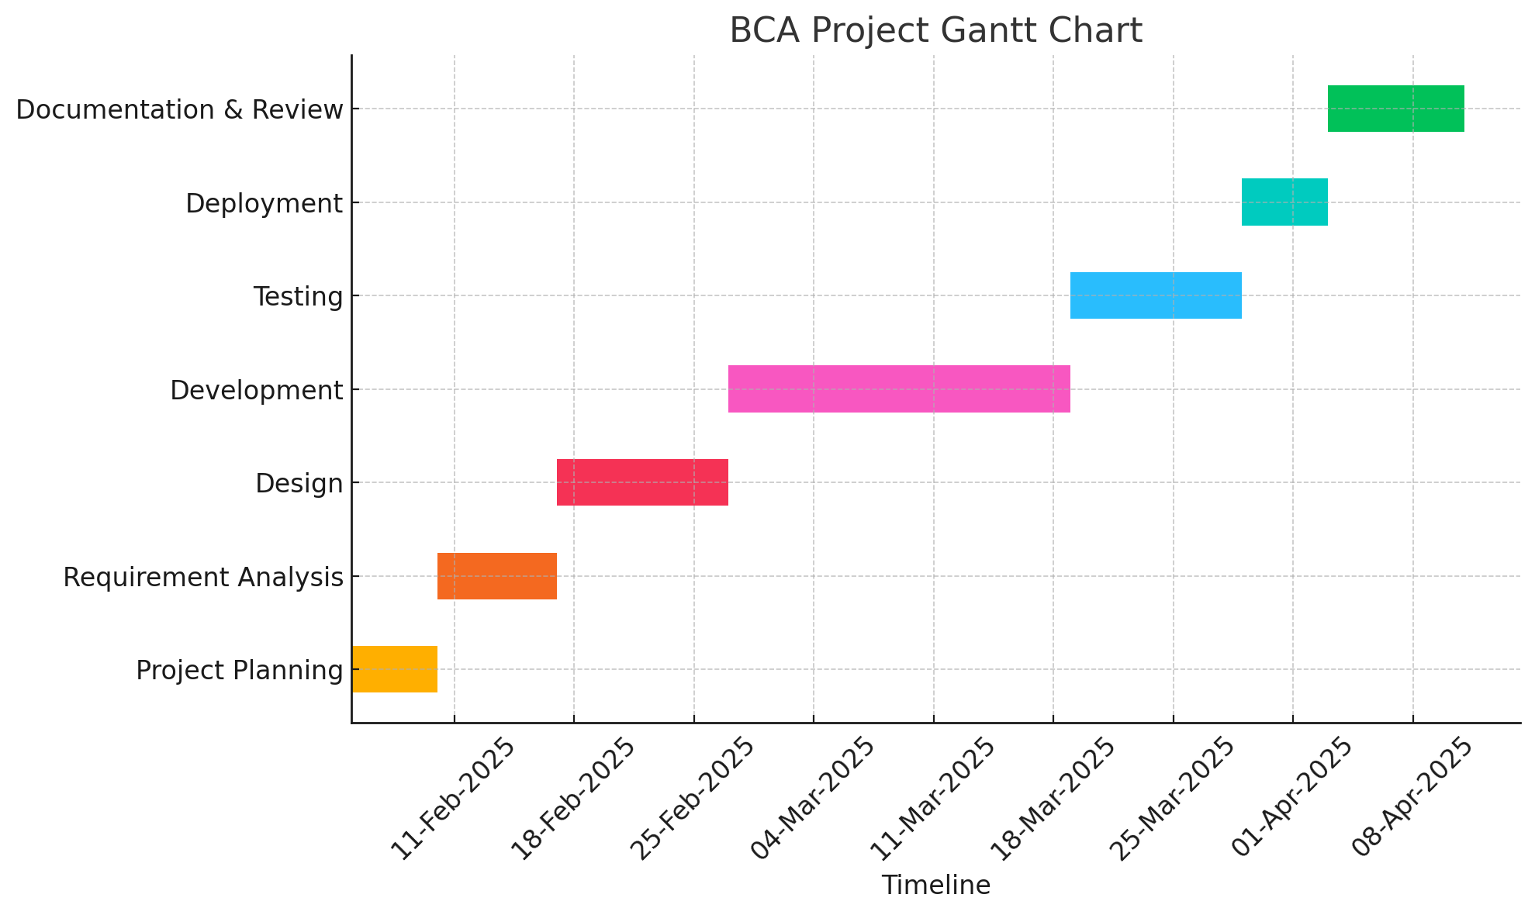
Timeline of the Project (Gantt Chart)

Slide 14
References (IEEE Paper format)
Hybrid Recommender Systems: Survey and Experiments | User Modeling and User-Adapted Interaction
Knowledge Graph Enhanced Language Agents for Recommendation (Cornell University)
https://dl.acm.org/doi/10.1145/3038912.3052569
https://dl.acm.org/doi/10.1145/3109859.3109914
https://www.leewayhertz.com/build-recommendation-system/

Slide 15


