Slide 1

TKPJava Language Notes
@LynnLangit

Slide 2
TKPJava Language Concepts
Course 1, 2
Getters/Setters
For Loops
Methods
Exceptions
Variables
Course 3, 4
If, If/Else
Course 5
HashMaps
Lists, Arrays
Course 6
Model-View-Controller
String Concatenation
Course 7
Object instances
Special Methods
Main
Constructor
Course 8
Foreach Loops
ArrayLists
Events
Course 9
Do/While Loops
Unit Tests / TDD
Keywords
List

Slide 3

Course 1

Slide 4
To view a Value -- Getters
GetPenColor ( );
GetPenWidth ( );
GetSpeed ( );

Slide 5
To Change a Value -- Setters
SetPenColor (PenColors.Reds.Red);
SetPenWidth (5);
SetX (10);

Slide 6
For Loops
for (int i = 0; i < stop; i++) {
//Do something many times
}

Slide 7
Try Catch Finally
try
{ //Do something }
catch (Exception e)
{ //Handle exception }
finally
{ //Always do this }

Slide 8

Course 2

Slide 9
Methods are like Verbs
public static void sayIt (String s) {
//Say something
}

Slide 10
Use a Method
String greeting = “hello”;
//Say hello
sayIt (greeting);

Slide 11
Create and Assign Variables
//the current zipcode is 90210 String zipcode = “90210”;

Slide 12
Increment Variables
int age = 15;
age += 1; //Shortcut
age = age + 1;

Slide 13
Increment Variables again…
int age = 16;
age ++; //Another shortcut

Slide 14
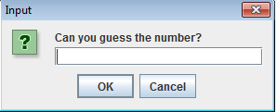
Course 3

Slide 15
Conditionals - If
int test = -1;
if (test < 0) {
//Do something
}

Slide 16
Conditionals – If / Else
int test = 75;
if (test => 90)
{ //Do something }
else if (test => 80)
{ //Do something else }
else
{ //Do something else }

Slide 17
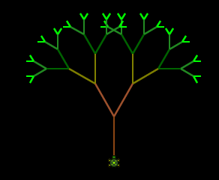
Course 5

Slide 18
HashMaps
HashMap<Integer, Color> c =
new HashMap <Integer, Color> ( );
c.put(1,Colors.Reds.Red);
c.get(1);

Slide 19
Arrays
String words[ ] =
new String[ ] {“hi”,”Java”};
words.get[1]; //Gets “Java”

Slide 20
More Arrays
//Simpler set up – fixed length
int [ ] coins = {1,5,10,25,50};

Slide 21
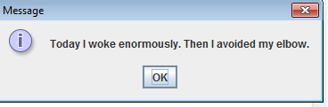
Course 6

Slide 22
String Concatenation
String story = “This is my story”;
//Add to your story
story += “. I am ” + 15 + “ years old”;

Slide 23
RegEx – Regular Expressions
String adverb = “2”;
if (adverb.matches(“[\\d]*”)) {
//Checks for pattern match
}

Slide 24

Model-View-Controller
//Model
String story = “This is my story”;
//View and Controller
MessageBox.showMessage(story);
Notes:
Image from -- http://3.bp.blogspot.com/-3YtmXVav-Zw/UL4w3cwhLVI/AAAAAAAAAGI/3svxMuEibQY/s1600/mvc_decoupling_3.PNG

Slide 25

Course 7

Slide 26
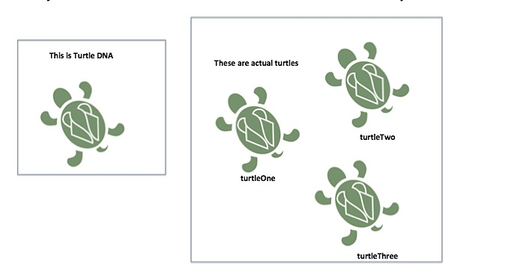
Objects and Instances - 1

Slide 27
Objects and Instances
Turtle turtle1 = new Turtle( );
Turtle turtle2 = new Turtle( );
turtle1.setX(20);
turtle2.setX(50);

Slide 28
Main Method starts it all
public static void main (String[ ] args) {
//Start by doing something
}

Slide 29
Constructor (Method)
public class Animal( ) {
public Animal( ) {
//Create your Animals here
}
}

Slide 30
Foreach Loops
for (Turtle turtle : turtles) {
//Do something to each one
}

Slide 31
ArrayList
ArrayList<String> words=
new ArrayList<String>( );
words.add(“Java”); //Adds “Java”
//Adjustable length list

Slide 32
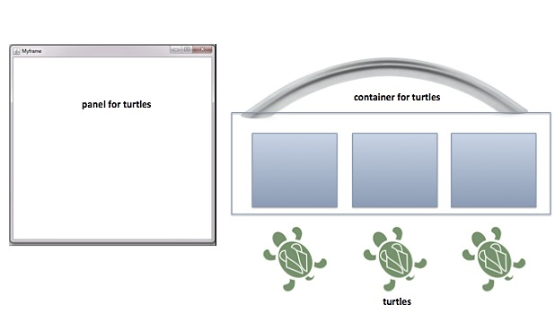
Objects and Instances - 2

Slide 33
ArrayList…again
ArrayList<Turtle> turtleBag =
new ArrayList<Turtle>( );
Turtle t1 = new Turtle( );
turtleBag.add(t1);

Slide 34

Course 8

Slide 35
Events and Listeners
public class DoIt
implements MouseLeftClickListener {
…
programWindow.addMouseLeftClickListener (this);
public void onLeftMouseClick(int x, int y) {
//Do something when clicked
}
}

Slide 36
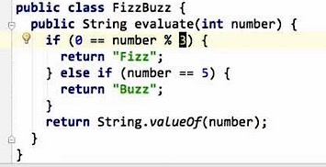
Course 9

Slide 37
While Loops
while (x < 20) {
//Do something when true
}

Slide 38
Do…While Loops
do {
//Do something at least once
//Continue to do it while true
}
while (x < 20)

Slide 39
Unit Tests
@Test
public void testReturnsFizz( ) {
String result = FizzBuzz.convert(3);
//Verify expected vs. actual
assertEquals(“fizz”, result);
}

Slide 40
Additional Material

Slide 41
Java Keywords 1
Scope and Packages
Class and Methods
public
private
protected
import
package
abstract
class
new
super
static
this

Slide 42
Java Keywords 2
Flow and Exceptions
Types
break
do
if
else
return
while
assert
try, catch, finally
throw, throws
boolean
byte
char, string
enum
int, double, float
long, short

Slide 43
Java Regex Meta Characters
RegEx | More Info
\d | Any Digits 0-9
\D | Not digits 0-9
\s | Whitespace
\S | Any Character
\w | Any word
\W | Not word
\b | End of word
\B | Not end of word
Notes:
From http://www.rexegg.com/regex-quickstart.html and http://www.javacodegeeks.com/2012/11/java-regular-expression-tutorial-with-examples.html

