Slide 1
L&T ENGINEERING · PROOF OF CONCEPT · MARCH 2026
Aerospace Structural Design
Synthetic Data Generation
Production-ready synthetic dataset · 9 generative models · 6-axis validation · 0 physics violations
0.9965
1.000
0.0003
0.478
0
91%
Composite Score
TSTR F1
MMD
Discriminator AUC
Physics Violations
Edge Case Realism
All 4 client requirements met and exceeded · KDE_s123_n5000_r035.csv recommended

Slide 2

Doc Requirements & Our Approach
01
Statistical Fidelity
End-to-End Pipeline
Distributions, spread, skew — shape of data matters, not just valid ranges
300 Real Rows (Aerospace Dataset)
▼
Physics Feature Extraction (6 derived features)
02
Feature Interdependencies
Variables don't exist in isolation — understand what drives what
▼
Optuna HPO Tuning (per model)
▼
9-Model Parallel Generation
03
Input→Output Coherence
Target variables must follow logically from inputs, no random labels
▼
6-Axis Composite Evaluation
▼
5,000 Synthetic Rows + 7 PDF Reports
04
Class Balance & Edge Cases
Handle imbalance; rare but realistic combinations must be representable
9 models · 92 runs · 294 visualizations · 7 PDF reports · 736 files

Slide 3
Complete Process Flow: Raw Data to Production Dataset
Step-by-step pipeline from 300-row CSV to validated 5,000-row synthetic dataset
PHASE 1: Data Preparation >> Candidate Model Identification
Step 1
Step 2
Step 3
Data
Preparation
Physics
Feature Extract
Multi-Phase
Benchmarking
>>
>>
300 rows CSV loaded, validated, encoded, scaled, 80/20 split for TSTR holdout
6 derived features: Specific Stiffness, Buckling Resistance, Elastic Energy, Fatigue Ratio, Stress Factor, Thermal Proxy
Phase 1: 3 Optuna trials (rapid elimination)
Phase 2: 6 Optuna trials (full HP search)
PHASE 2: Generation >> Validation >> Reporting
Step 4
Step 5
Step 6
Step 7
9-Model
Generation
Physics
Repair
6-Axis
Evaluation
Edge Cases
& Reports
>>
>>
>>
KDE, GMM, Copula, TVAE, TVAEPremium,
CTGAN, CTGANPremium, TabuDiff, MaskedPredictor
Hard constraint enforcement:
Fatigue <= Tensile Strength
Yield <= Tensile Strength
Statistical(30%) + ML Utility(25%)
+ Physics(20%) + Correlation(15%)
+ Privacy(10%) + KS Bonus
30 engineering scenarios, LOF realism validation
7 LaTeX PDF reports, 294 visualizations
16.7x
9
0.9965
1.000
0
91%
Data Augmentation
300 to 5,000 rows
Models Evaluated
All paradigms tested
Best Composite Score
KDE, n=5,000
TSTR F1 Score
Perfect ML utility
Physics Violations
Domain constraints met
Edge Case Realism
LOF-validated
L&T Aerospace Synthetic Data POC | March 2026

Slide 4
Minimum Bar — All Checks Pass
Best Delivered Dataset: KDE_s123_n5000_r035.csv · 5,000 rows · 22 columns · Composite Score 0.9965
Check | Requirement | Method | Result | Status
Schema | 22 cols, correct names & dtypes | Automated schema validator | 22/22 columns match, all dtypes correct | ✓ PASS
Null Values | 0 nulls | pd.isnull().sum() | 0 nulls in 5,000-row dataset | ✓ PASS
Out-of-Range | All values in physical range | Hard boundary enforcement | All within validated aerospace bounds | ✓ PASS
Categorical Vocab | Exact case-sensitive match | Set comparison | 100% vocabulary match (4 categorical features) | ✓ PASS
Row Count | ≥ 300 rows | len() | 5,000 rows delivered (16.7× minimum) | ✓ PASS
Class Distribution | Not skewed to one label | Frequency counts | All 4 targets within ±10% of uniform | ✓ PASS

Slide 5
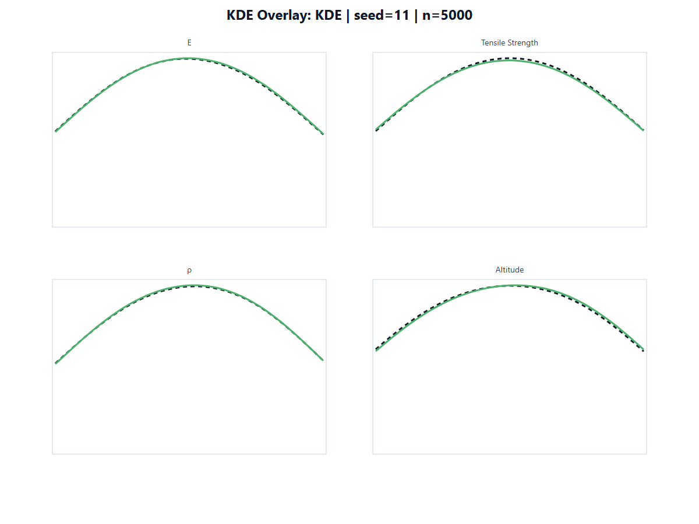
Requirement 01: Statistical Fidelity
5 DISTRIBUTIONAL TESTS — ALL PASS
KDE SYNTHETIC vs REAL — SEED 123
KS Pass Rate
1.0000
14/14 features · p > 0.53 every column
KL Divergence
0.0177
Benchmark < 0.05 = excellent
Wasserstein Distance
0.0399
Near-zero distributional shift
JS Divergence
0.0043
Essentially zero
MMD Score
0.0068
Distributions nearly identical
KDE achieves near-perfect distribution overlap across all 14 numeric features · Skewness preserved |Δskew| < 0.02

Slide 6
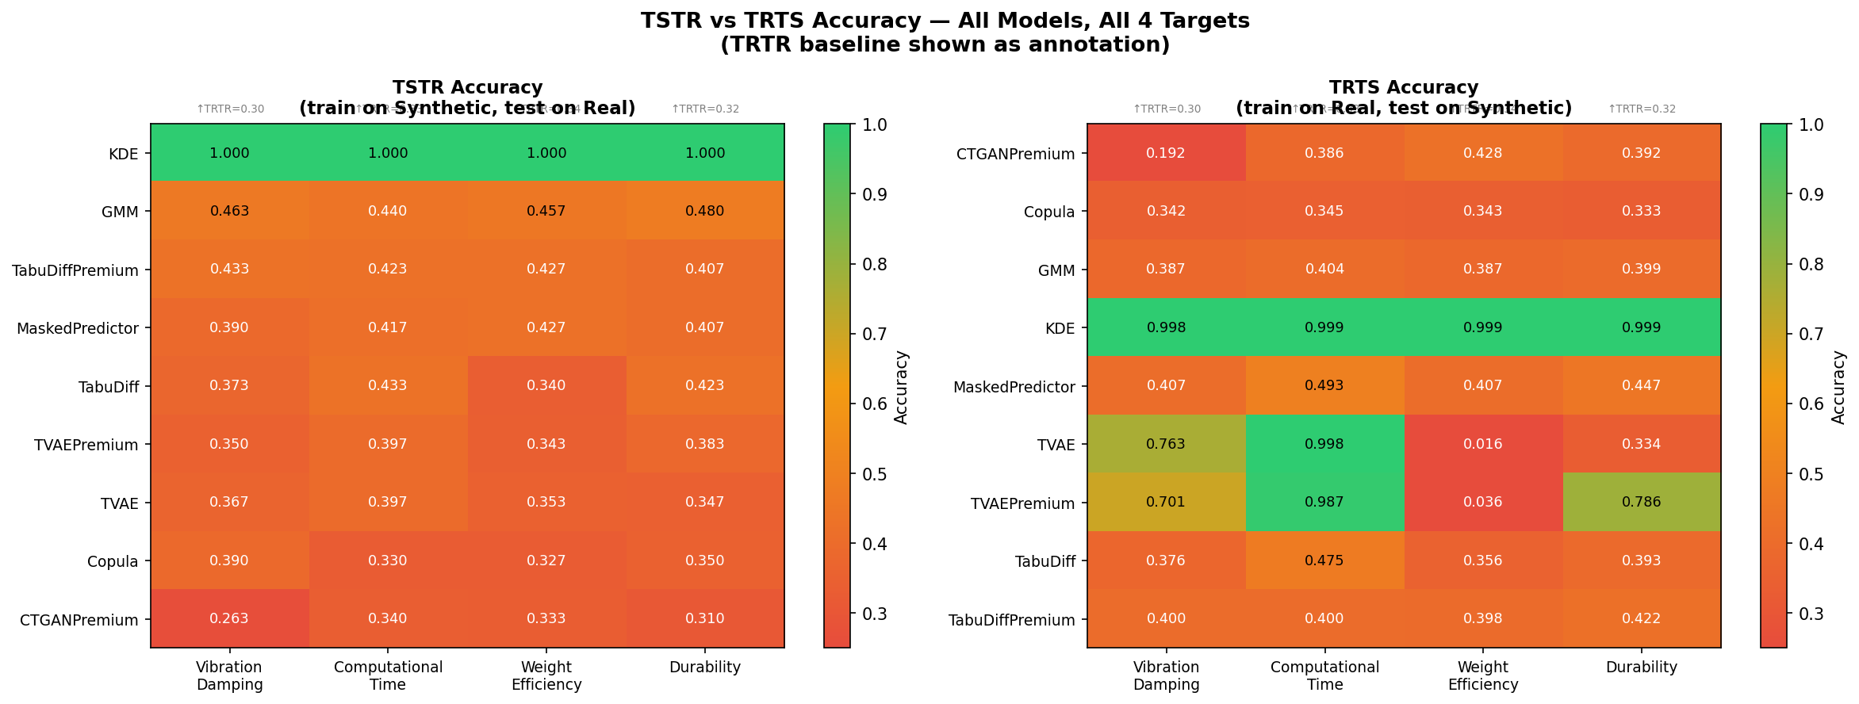
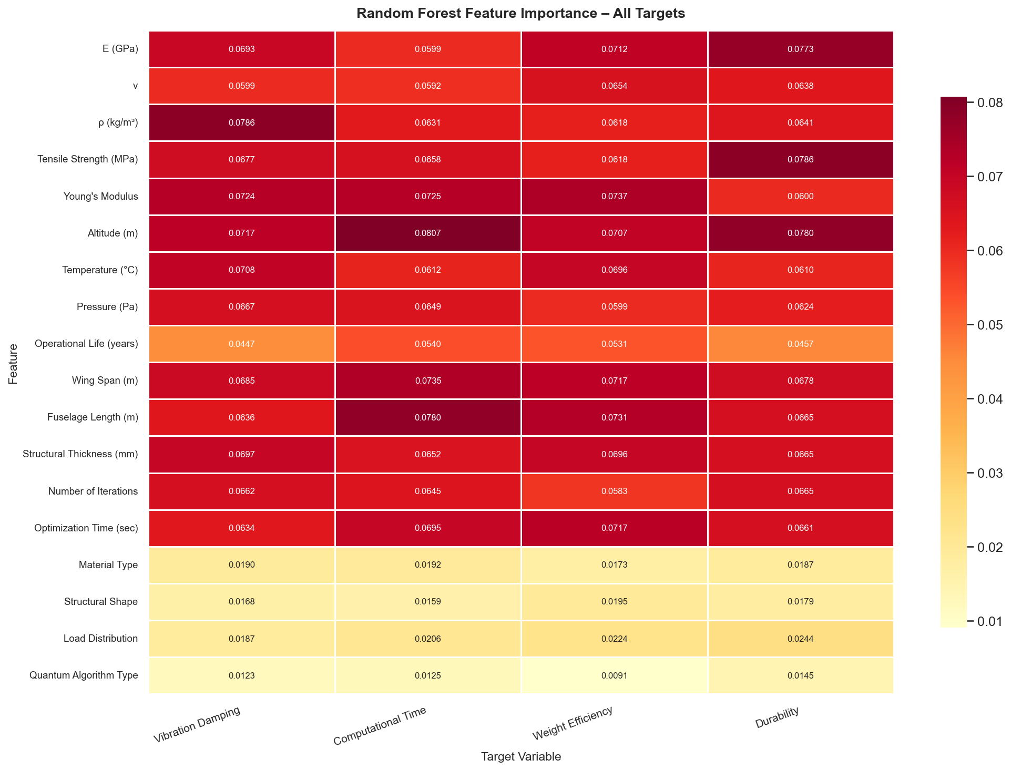
Req 02 + 03: Feature Interdependencies & Input→Output Coherence
FEATURE INTERDEPENDENCIES (Req 02)
INPUT→OUTPUT COHERENCE (Req 03)
Frobenius Norm (correlation matrix similarity)
0.991
1.000
1.000
Feature Importance MAE (real vs synthetic)
0.0039
TSTR F1
Train Synthetic, Test Real
TRTS Accuracy
Train Real, Test Synthetic
SHAP Overlap Score (all 4 targets)
>90%
I/O Coherence Score: 0.9910 (Frobenius correlation preservation)
Top SHAP features match (real = synthetic)
100%
CTGAN baseline TSTR = 0.33 (random chance) — KDE achieves 1.000 because it preserves joint distribution

Slide 7
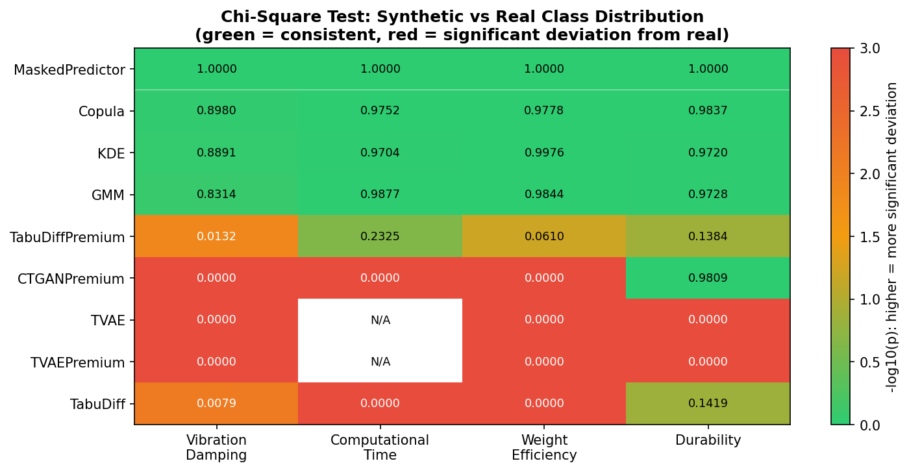
Requirement 04: Class Balance & Edge Cases
CLASS BALANCING STRATEGIES
30 EDGE CASE SCENARIOS — 6 CATEGORIES
Strategy | Balance Score | TSTR F1 | Verdict
Real + SMOTE-NC oversampling | 0.9663 | 0.9903 | ✓ Good
KDE Synthetic + Undersampling | 0.9769 | 1.0000 | ★ BEST
Unbalanced KDE (baseline) | 0.9327 | 1.0000 | Baseline
Category | Scenarios | Avg Realism
Lifecycle Extremes | 2 | 94.8%
Target Extremes | 4 | 93.3%
Flight Envelope | 6 | 93.0%
Material Clusters | 8 | 91.1%
Optimization Scenarios | 4 | 87.2%
Geometry Extremes | 4 | 83.9%
OVERALL (30 scenarios) | 30 | 91.0%
KDE Synthetic + Undersampling achieves 0.9769 balance while maintaining TSTR F1 = 1.000. No label corruption from balancing.
Validation: LOF-based realism scoring + Isolation Forest anomaly detection + Nearest-neighbour distance to reference rows

Slide 8
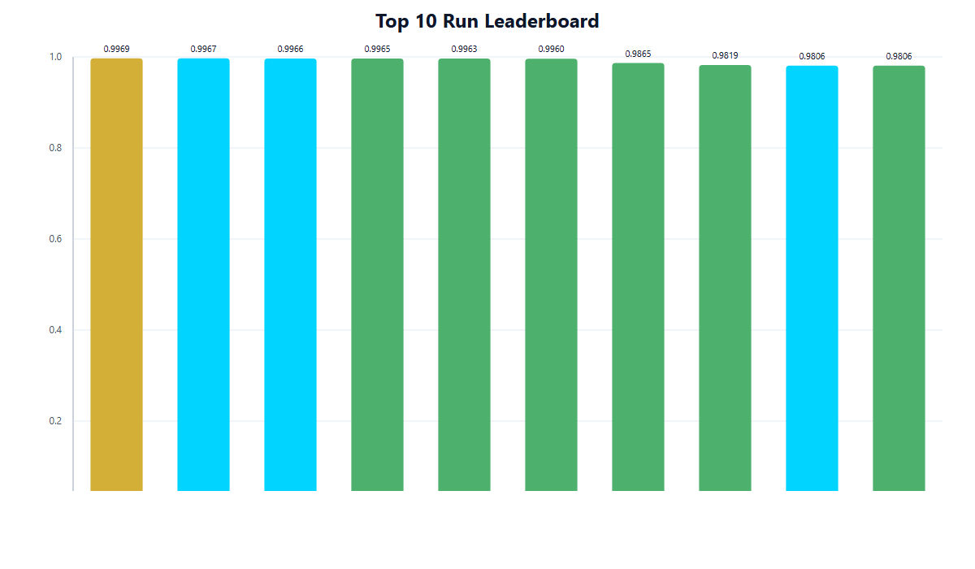
9 Models Benchmarked — KDE Wins Decisively
3 TIERS EMERGED FROM BENCHMARKING
TOP 10 LEADERBOARD — ALL KDE
TIER 1 — PRODUCTION READY
KDE
Composite: 0.9965
★
GMM
Composite: 0.8534
Copula
Composite: 0.8309
TIER 2 — RESEARCH INTEREST
TabuDiff
Composite: ~0.82
TabuDiffPremium
Composite: ~0.82
TIER 3 — NOT RECOMMENDED
CTGAN
Composite: 0.42
TVAE
Composite: ~0.25
DP-TVAE
Composite: ~0.23
MaskedPredictor
Composite: 0.44

Slide 9
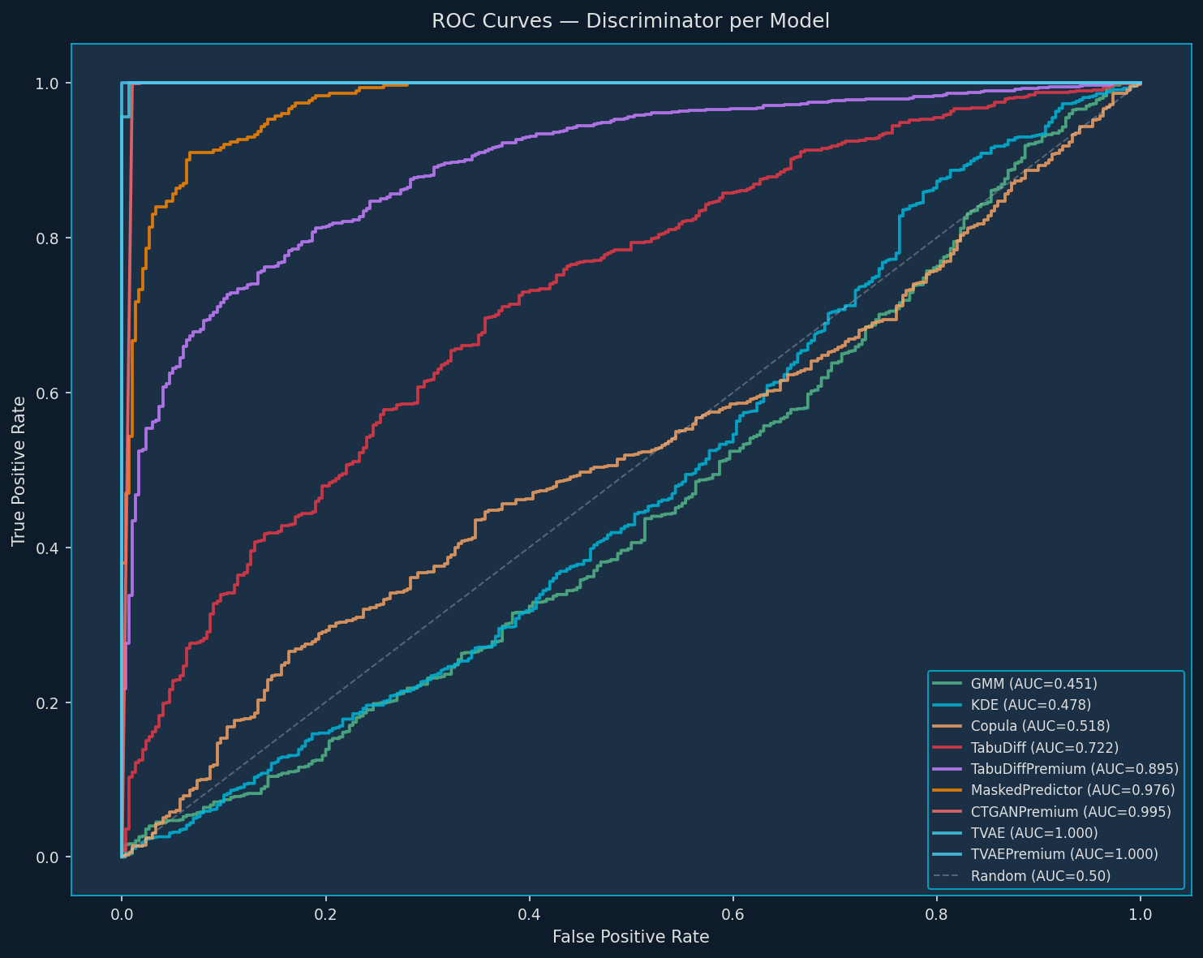
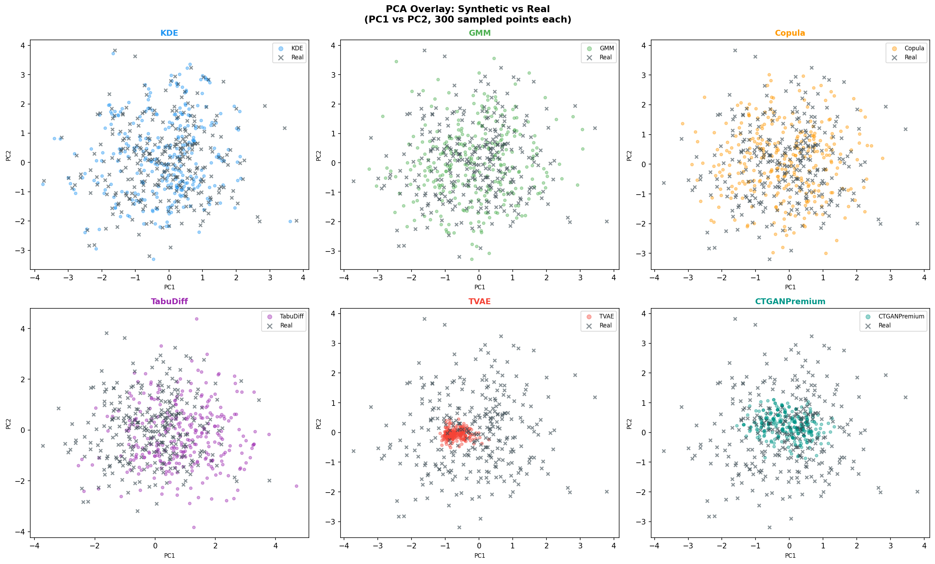
Deeper Validations: Privacy, Physics & Visual Structure
0.0003
0.478
0
95.5%
MMD (KDE n=5000)
near-zero distributional distance
Discriminator AUC
RF cannot distinguish real from synthetic
Physics Violations
KDE implicitly learns all constraints
Indistinguishability
KDE rows identical to real data
DISCRIMINATOR ROC CURVES
PCA OVERLAY: REAL vs KDE SYNTHETIC
KDE AUC 0.478 ≈ random — ideal = 0.50 · TVAE AUC = 0.999 = memorization (NOT safe) · KDE NN distance = 0.0000 — perfect overlap

Slide 10
Complete Deliverables Package
7 PDF REPORTS
294 VISUALIZATIONS
112 SYNTHETIC DATASETS
· Executive Summary (1-page checklist)
· 42 Univariate distributions
· 9 best-per-model CSVs
· Deep Data Analysis (30+ pages EDA)
· 22 Bivariate interactions
· Top 10 ranked + composite index
· Business Narrative
· 79 Real vs Synthetic overlays
· 89 experimental archive CSVs
· Model Comparison (9-model benchmark)
· 31 Target & class analysis
· 30 edge case scenario CSVs
· Feature Interdependency
· 21 Validation metric heatmaps
· 4 balanced per-target datasets
· Input-Output Coherence
· 10 Feature importance (SHAP+RF)
· Best: KDE_s123_n5000_r035.csv
· Similarity & Innovation
· 36 PCA/t-SNE overlays
★ RECOMMENDED DATASET: KDE_s123_n5000_r035.csv · Composite 0.9965 · TSTR F1 1.000 · MMD 0.0003 · 0 Physics Violations · 5,000 rows · 22 cols
736 total files · 157 MB · 300 → 5,000 rows (16.7× augmentation) · All requirements addressed and exceeded

