Slide 1
The Genesis of Physical
Artificial Intelligence
Strategic Briefing
August 2026 · Confidential & Proprietary
Notes:
Good morning. We are at a structural inflection point in the global economy. For the past five years, AI has been confined to the screen. Today, we are bringing it into the physical world. This briefing outlines the exact mathematical and commercial architecture we will use to deploy physical AI at industrial scale.

Slide 2
MODULE 1 · THE AI PARADIGM
The Macro-Economic Surge
A Half-Trillion Dollar Supercycle and the Fragile Trust Paradox
>$512B
88%
87%
Worldwide AI Spend 2027
Adopters with Revenue Gains
Adopters with Cost Savings
⚠ The Fragile Trust Paradox
Massive capital deployment coexists with systems that still fail basic logical tasks in physical space.
2/3 of enterprises report productivity gains — yet only 1/3 are reimagining business processes.
Individual AI adoption is outpacing enterprise governance. Shadow IT is expanding unchecked.
Notes:
The capital expenditure supercycle behind AI is unprecedented. But we are currently operating under 'fragile trust.' Enterprises are buying in, but these systems still unpredictably fail in physical space. The market will disproportionately reward whoever bridges this gap with verifiable capability.

Slide 3
MODULE 1 · THE AI PARADIGM
The Four Epochs of Machine Intelligence
From Static Pattern Recognition to Embodied Physical AI
01
02
03
04
pre-2018
2018–2023
2023–2025
2025–Now
Supervised
Discriminative
Autoregressive
Pretraining
Test-Time
Reasoning
Embodied
Physical AI
Human-annotated labels.
Bottleneck: labeling cost.
Raw internet text.
Bottleneck: data & compute.
Monte Carlo Tree Search.
Bottleneck: inference cost.
3D simulation & interaction.
Bottleneck: verified data.
★ Epoch 4 is the absolute frontier — where the remaining marginal intelligence capability lives.
Notes:
To understand where we are investing, we must trace how the learning signal has evolved. We have moved from human labels, to internet text, to inference-time reasoning. We are now entering the fourth epoch: Embodied Physical AI. Each epoch absorbed the previous one. Physical AI is the frontier.

Slide 4
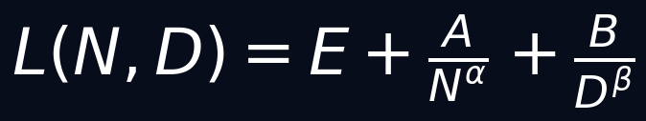
MODULE 1 · THE AI PARADIGM
The Data Exhaustion Crisis & Compute Wall
The Structural Constraints of Autoregressive Pretraining
KAPLAN / CHINCHILLA SCALING LAW
Data Exhaustion
Public internet text (~10¹⁴ tokens) will be fully consumed between 2027–2028.
The Compute Wall
Gigawatt-scale grid constraints cap hardware acceleration.
Growth decelerates: 10×/yr → 3–4×/yr by 2028.
Strategic Implication
Progress migrates from compute-bound to data-bound & verification-bound.
Proprietary, physics-verified data becomes the primary capability lever.
E = irreducible entropy floor · N = parameters · D = tokens
The irreducible floor E does not move with scale. The only lever remaining is proprietary, physics-verified data.
Notes:
The assumption that sheer scale yields general intelligence is mathematically breaking down. The irreducible entropy floor E does not move. We are literally running out of internet text. The lever for future capability is no longer raw pretraining capital — it is proprietary, physics-verified data.

Slide 5
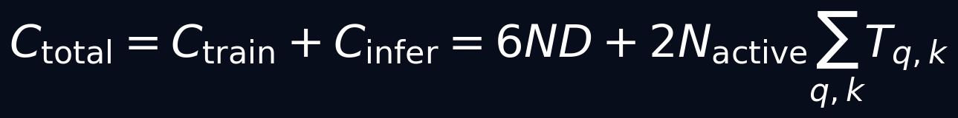
MODULE 1 · THE AI PARADIGM
The Shift to Train-to-Test Scaling
Unifying the Compute Budget — System 1 vs. System 2 Reasoning
UNIFIED COMPUTE BUDGET
System 1 — Reflexive
System 2 — Deliberative
· Single forward pass
· Monte Carlo Tree Search
· Fast & cheap at inference time
· Process Reward Models
· Brittle: fails outside training distribution
· Backtracking & self-correction
· Status: Commoditizing rapidly
· Status: The defensible frontier
Raw intelligence cost is deflating >90% annually. The moat is not the largest model — it is proprietary verified data.
Notes:
The industry has unified pretraining and test-time execution under a single compute budget. We are moving away from massive sluggish models to heavily overtrained systems that deliberate at inference time — System 2 reasoning. Raw intelligence is commoditizing. The defensible moat is proprietary, physically verified data.

Slide 6
MODULE 1 · THE AI PARADIGM
Cross-Industry Sector Impact
Quantifying the ROI of Task-Level Automation
55.8%
2.6×
TASK ACCELERATION
INDUSTRY AVG SPEND
Software Engineering
Financial Services
Closed-loop verifiability via compilers delivers instant reward signals.
High-volume, structured transaction automation leads adoption.
70%
80%
CYCLE TIME REDUCTION
SETUP TIME SAVED
Healthcare & Drug Discovery
Manufacturing & Physical AI
AI cuts lead-optimization cycle time for early-stage drug candidates.
Simulation collapses industrial pilot setup time. 80% penetration by 2027.
Projected GDP uplift: $15.7 Trillion by 2030 (McKinsey Global Institute)
Notes:
The economic impact is staggering — $15.7 trillion GDP uplift by 2030. The impact is highest where closed-loop verifiability exists: Software Engineering and Manufacturing. If the code compiles or the robot picks up the part correctly, the model gets an unambiguous success signal. This verifiable feedback loop is what we are capitalizing on.

Slide 7
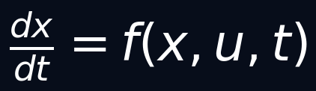
MODULE 2 · WORLD MODELS
Beyond the Autoregressive Bottleneck
Grounding AI in Physical Space via Causal Reasoning
Rung I
CONTINUOUS DYNAMICS FOUNDATION
Association
Language models: P(Y | X)
Seeing & Correlating
e.g. Predict tomorrow's weather from history.
Rung II
THE CATEGORY ERROR
Intervention
Robotics & Control: P(Y | do(X))
Deploying text-trained models into factory cells is a fundamental representational failure — not an engineering gap. Language models operate on Rung I. Physical deployment demands Rungs II and III.
Doing & Observing
e.g. What happens if I apply 15N of torque?
Rung III
Counterfactual
Planning: P(Y_x | X', Y')
Imagining Alternatives
e.g. What would have happened had I acted differently?
Notes:
A language model can write a fluent paragraph about a wrench slipping off a bolt. But it cannot predict the specific trajectory, torque, and friction required to turn that bolt. Text models are stuck on Rung I. Physical deployment requires Intervention and Counterfactual reasoning based on continuous physical dynamics.

Slide 8

MODULE 2 · WORLD MODELS
POMDPs and Latent World Models
The Mathematical Formulation of a Differentiable Physical Surrogate
PARTIALLY OBSERVABLE MARKOV DECISION PROCESS
ENCODER → TRANSITION → DECODER (LATENT WORLD MODEL PIPELINE)
· z_t — compressed latent state (reality compressed)
· T̂_θ — learned transition model (predicts next latent state given action)
· D_ϕ — decoder (reconstructs observable from latent)
· Thousands of futures simulated per second — no pixel rendering required.
Notes:
Formally, we model physical environments as POMDPs. To make this computationally tractable, world models operate in a compressed latent space. The model compresses a live video feed, predicts what the state will become if it takes an action, and reconstructs that prediction. This allows the system to roll forward thousands of scenarios per second without rendering every pixel.

Slide 9
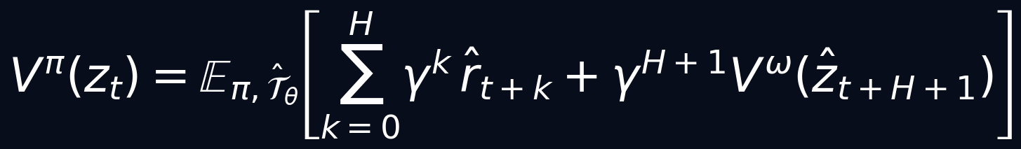
MODULE 2 · WORLD MODELS
Simulative Reasoning
The Value Function Over Imagined Latent Rollouts
VALUE FUNCTION OVER IMAGINED LATENT ROLLOUTS
V^π(z_t)
Total expected future reward from latent state z_t
γ
Discount factor — weights near-term rewards above distant ones
ĥ_t+k
Predicted reward at step t+k, computed inside the latent simulator
H
Planning horizon — number of simulated steps before real-world action
V^ω
Bootstrap value estimator at the end of the imagined rollout
Before a robotic arm moves a single millimeter, it has already imagined thousands of futures inside its own simulator.
Notes:
This equation is the mathematical beating heart of Physical AI. Before a robotic arm moves, it imagines multiple futures. It calculates the expected value of every reward it can obtain across a given time horizon, strictly inside its own internal simulation. This is the definition of simulative reasoning.

Slide 10
MODULE 2 · WORLD MODELS
The Three Schools of World Modeling
A Comparative Matrix of Dominant Technical Architectures
School I
School II
School III
Generative
Simulators
Latent / JEPA
Models
Spatial /
Engineered
The Renderer School
The Efficiency School
The Industrial School
Sora · Genie · Oasis
V-JEPA · DreamerV3
Tesla Occ. Nets · NVIDIA Cosmos/Isaac
Core:
Pixel diffusion / autoregressive video generation
Core:
Energy-based latent prediction (no pixel reconstruction)
Core:
4D voxel occupancy grids + Physics-Informed Neural Networks
Strength:
Photorealistic output; captures surface appearance
Strength:
High data efficiency. Sub-5ms control latency.
Strength:
Explicit physics constraints. Formally verifiable. Zero-shot transfer.
Flaw:
Physics learned only incidentally. High hallucination rate. Executability gap.
Flaw:
Semantic drift over long horizons. Limited 3D geometric awareness.
Flaw:
High compute overhead. Requires calibrated sensor rigs.
❌ NOT suitable for industrial deployment
✓ Suitable for low-latency robotic control
★ PRIMARY CHOICE for $100M deployment
Notes:
There are currently three schools of thought. The Renderer school generates beautiful video but fails at strict physics. The Latent school is highly efficient and built for low-latency robotic control. The Spatial school uses explicitly engineered physics grids. Conflating video generators with engineering-grade world models is a massive strategic error. For $100M industrial deployments, we rely on Schools II and III.

Slide 11


MODULE 2 · WORLD MODELS
Canonical Failure Modes (Part 1 / 2)
Compounding Drift · The Executability Gap
FAILURE MODE 1
Compounding Autoregressive Drift
Small single-step errors ε compound multiplicatively over time horizon T. Objects drift, vanish, or are hallucinated into existence. Long-horizon tasks become unreliable without explicit drift correction mechanisms.
FAILURE MODE 2
The Executability Gap
Perceptual losses (LPIPS, SSIM) reward visual plausibility — not physical validity. Models violate Coulomb contact dynamics. A visually perfect rendered trajectory will shatter a physical component on execution.
Mitigation: Accumulate-and-Filter pipelines + PINN-augmented loss functions (→ Module 3)
Notes:
We must be brutally honest about where these models fail. Autoregressive drift means small per-step errors compound until the simulation breaks. The Executability Gap means a visually flawless video can still shatter a physical part because the model ignored Coulomb friction.

Slide 12
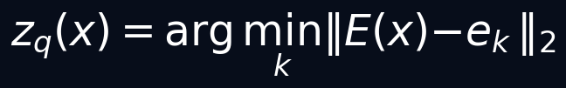


MODULE 2 · WORLD MODELS
Canonical Failure Modes (Part 2 / 2)
Perceptual Hallucination · Action Marginalization · Sim-to-Real Gap
FM 3
Unfamiliar objects are force-mapped onto the nearest codebook token. The model silently replaces what it cannot recognize, poisoning downstream decisions.
Perceptual Hallucination
FM 4
The model's predictions become invariant to control input — it hallucinates an 'autopilot' sequence and effectively ignores operator commands entirely.
Action Marginalization
FM 5
Synthetic data cannot fully replace real data. Sensor noise, contact variability, and long-tail physical phenomena guarantee a distributional gap.
The Sim-to-Real Gap
Every failure mode has a quantitative mitigation — no known deployment is beyond engineering control.
Notes:
Furthermore, if an encoder sees an unknown tool, it halluccinates it silently. Action Marginalization means the model ignores human control inputs entirely. And the sim-to-real gap guarantees purely synthetic training is never enough. We must have a hybrid data strategy. Every failure mode has a known engineering mitigation.

Slide 13
MODULE 3 · SYNTHETIC DATA BRIDGE
Synthetic Data as the Connective Tissue
A Four-Tier Taxonomy: Matching Data Quality to Risk Profile
Tier 1
Model-Generated Reasoning Traces
Cost: Low · Physics: None · Use: Reasoning, Q&A, code
Self-play · Tree search · MCTS rollouts
Tier 2
Statistically Grounded Tabular Data
Cost: Medium · Physics: Statistical · Use: Finance, EHR, sensor logs
Gaussian copulas · DP-GANs · VAE synthesis
Tier 3
Simulated Spatial Telemetry
Cost: High · Physics: Geometric · Use: Autonomous driving, drone nav
3D Gaussian Splats · NeRFs · USD Scene Graphs
Tier 4
Formally Verified Data
Cost: Very High · Physics: Certified · Use: Safety-critical industrial AI
Lean 4 · SMT solvers · ASIC-grade verification
Core Governance: Match the tier to the cost of failure. Safety-critical = Tier 4 only.
Notes:
Because human data is running out, synthetic data is our connective tissue. But it is not a monolith. It exists on a spectrum from cheap self-play up to ASIC-grade formally verified data. A mature governance strategy does not treat all synthetic data equally — it mandates Tier 4 where failure has human consequences.

Slide 14
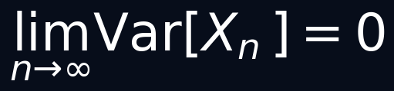
MODULE 3 · SYNTHETIC DATA BRIDGE
The Model Collapse Risk & The Accumulate Strategy
The Single Most Important Governance Constraint
⚠ THE COLLAPSE RISK (Replace Strategy)
✓ THE ACCUMULATE-AND-FILTER RESOLUTION
Variance Collapse Theorem
Governed Data Mixture Equation
Feeding a model its own unverified output causes its probability distribution to collapse onto its most likely modes.
Edge cases, failure states, and rare but critical scenarios are permanently forgotten.
Result: a confident, high-precision model that is catastrophically brittle.
Maintain a strict ratio α between real data and verified synthetic data.
Only synthetic samples that pass the programmatic Verifier gate are admitted.
α is a board-level governance parameter — not a hyperparameter.
Notes:
If you feed a model its own unchecked output, its variance collapses to zero. It forgets reality. To prevent this, we deploy an 'Accumulate-and-Filter' strategy. We maintain a strict mathematical ratio — alpha — between real data and synthetically verified data. This equation is the foundational governance constraint of our entire architecture.

Slide 15
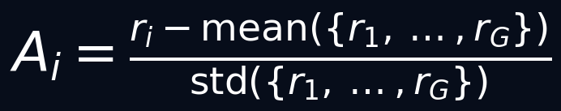
MODULE 3 · SYNTHETIC DATA BRIDGE
Synthetic Reasoning via GRPO
Group Relative Policy Optimization — Scalable Reward Without Human Labels
GROUP RELATIVE ADVANTAGE ESTIMATOR
01
02
03
Sample Group
Score via Verifier
Compute Advantage
Generate G candidate trajectories from the current policy π.
A deterministic physics engine / compiler assigns reward r_i to each trajectory — no human graders.
Normalize r_i against group mean and std. Train only on relative quality signal. No critic network needed.
The model teaches itself — verifiable tasks (robotics, code, physics) provide free, infinite, high-quality training signal.
Notes:
How do we scale this without human labels? We use Group Relative Policy Optimization. The system generates multiple candidate trajectories. A strict physics engine acts as the verifier, grading them against the group average. The model teaches itself by recognizing which actions outperformed the mean. This is how we achieve massive scale efficiently.

Slide 16
MODULE 3 · SYNTHETIC DATA BRIDGE
Physics-Informed Neural Networks (PINNs)
Enforcing Physical Laws as Hard Constraints During Synthetic Generation
PINN AUGMENTED LOSS FUNCTION
ℒ_data
Empirical fit to measured sensor telemetry
λ_pinn · ‖…‖²
Physics residual penalty — forces the model to obey the governing PDE
∂u/∂t
Time derivative of the physical field (temperature, stress, velocity…)
𝒩[u]
Differential operator encoding physical law (Navier-Stokes, elasticity, thermodynamics)
f
Known external forcing term (loads, heat sources, boundary conditions)
PINNs close the Executability Gap. Synthetic data generated under PINN constraints obeys the laws of physics — guaranteed.
Notes:
To close the executability gap, we rely on Physics-Informed Neural Networks. By injecting a differential-operator penalty into the loss function, we force the AI's imagination to strictly obey thermodynamics, mass conservation, and momentum. We are not generating convincing video; we are generating verified physics.

Slide 17

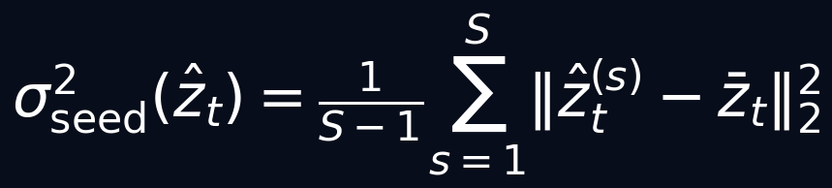
MODULE 3 · SYNTHETIC DATA BRIDGE
Real-Time Uncertainty Diagnostics
Production Safety: Managing Hallucination Through Statistical Confidence
METRIC 1 — RECONSTRUCTION RESIDUAL (Aleatoric / Input Uncertainty)
Measures how faithfully the model can reconstruct its own input.
A spike → the system has encountered an out-of-distribution physical configuration.
Action: PAUSE and flag for human review.
METRIC 2 — INTER-SEED DENOISING VARIANCE (Epistemic Uncertainty)
Measures disagreement across independently seeded denoising chains.
A spike → the model is deeply uncertain about the future state.
Action: HALT deployment in this region.
These two metrics constitute a real-time safety monitor. The system fails safely — never silently.
Notes:
In a production environment, safety is paramount. We monitor real-time uncertainty using two metrics: Reconstruction Residual and Inter-Seed Denoising Variance. If either spikes, the system pauses and flags the anomaly for review. It fails safely — never silently. This is our assurance framework for the board.

Slide 18
MODULE 3 · SYNTHETIC DATA BRIDGE
The Closed-Loop Flywheel Architecture
A Co-Development, Federated Data Ecosystem — The Ultimate Competitive Moat
01
TELEMETRY
02
CALIBRATION
03
GENERATION
04
DEPLOYMENT
05
FEEDBACK
Sparse, real-world
industrial sensor data
ingested & cleaned.
World model latent space
anchored to real-world
physical telemetry.
Large-scale synthetic
edge cases generated
& PINN-verified.
Zero-shot policy
deployed to target
physical environment.
Uncertainty-flagged
outcomes logged &
routed to Stage 01.
↺ Feedback loop is continuous — every real-world deployment enriches the next training cycle automatically.
THE MOAT: Compute is a commodity. This operational data flywheel — built on real industrial execution — is virtually impossible to replicate without years of deployment experience.
Notes:
This is the operational architecture. We take real telemetry, calibrate the world model, generate millions of verified synthetic edge cases, deploy the zero-shot policy, and log the uncertainties to feed back into the loop. This closed-loop flywheel is our ultimate competitive moat. You can buy compute, but you cannot buy this operational data ecosystem.

Slide 19
STRATEGIC SYNTHESIS
Engineering World Models for Physical AI
Engineering over Entertainment
Deploy physics-constrained world models (Schools II & III) — not consumer video generators. Verifiable physical laws are non-negotiable.
Automated Verification Pipelines
PINN-augmented synthetic generation automates the cleaning of industrial sensor telemetry and closes the Executability Gap at scale.
Mandate the Accumulation Ratio
Enforce α-governed data mixing at the board level. Model collapse is not a hyperparameter risk — it is a governance failure.
The Ultimate ROI
Shift CapEx from physical prototyping and manual annotation to scalable, OpEx-driven computational simulation via the closed-loop flywheel.
The future of industry is physical AI. The question is not whether to deploy — it is who deploys it first, and who deploys it right.
Notes:
To conclude: we are shifting away from physical prototyping to highly scalable, verified computational simulation. We are automating our data pipelines and mandating rigorous physics verification at every step. This architecture accelerates time-to-market and establishes a durable position of technical leadership. This is how we execute the future of physical AI. Thank you.

