Slide 1
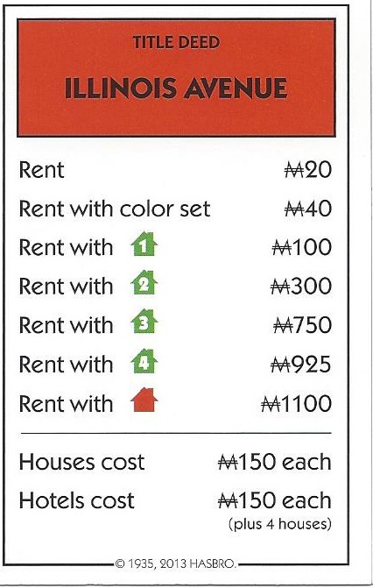
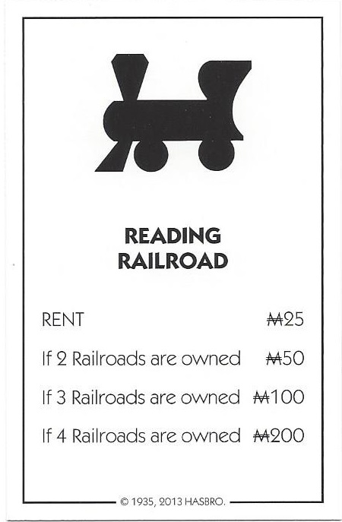
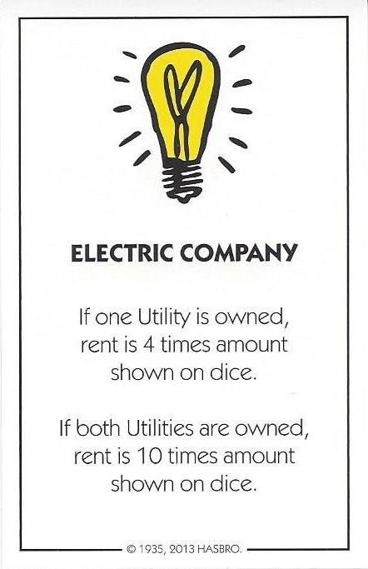
Property and Card Types
Properties
There are 4 types of Properties in Monopoly. RealEstate (the colored Properties), Utilities (Water Works, Electric Co.), and the Railroads. They each have different rent collection mechanisms.
Real estate properties rent is based on the number of houses that are on the property. This was simulated using an array of rent values.
public int calculateRent() {
if (hasColorSetMonopoly) {
if(this.numberOfHouses == 0)
return 2*rents.get(0);
return rents.get(this.numberOfHouses);
}
return rents.get(0);
}
Railroads simply double the base rent of $25 for every railroad passed the first owned by a player.
public int calculateRent() {
int rent = baseRent;
for (int i = 1; i < numOwned; i++) {
rent *= 2;
}
return rent;
}
Utilities rent is based on a multiplier to the roll of a dice (4 for one, 10 for both).
public int calculateRent(){
Dice dice = new Dice();
dice.rollDice();
if(ownBothUtilities)
return 10 * dice.getDieOne();
return 4 * dice.getDieOne();
}

Slide 2
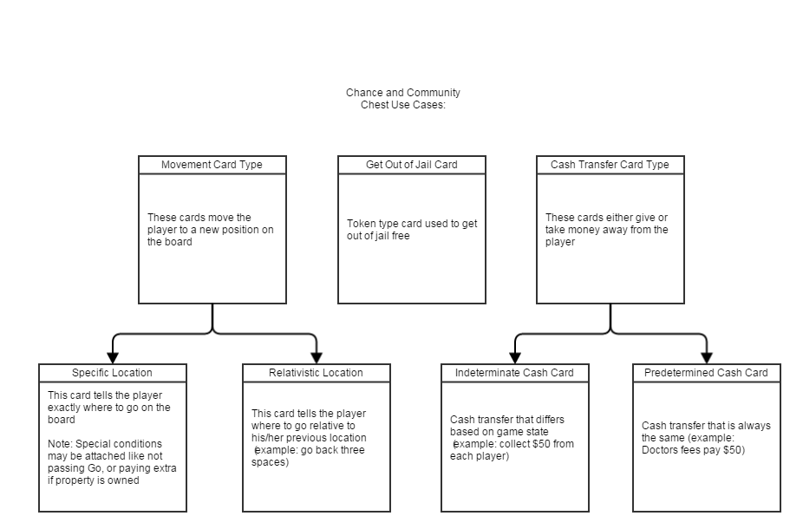
Property and Card Types
Card Types
Like properties the community chest and chance cards can be divided into classes. Most of the cards either direct the player to receive/give to the bank a specific amount of money or go to a specific space on the board, however there are a few cards that are more complicated.

