Slide 1
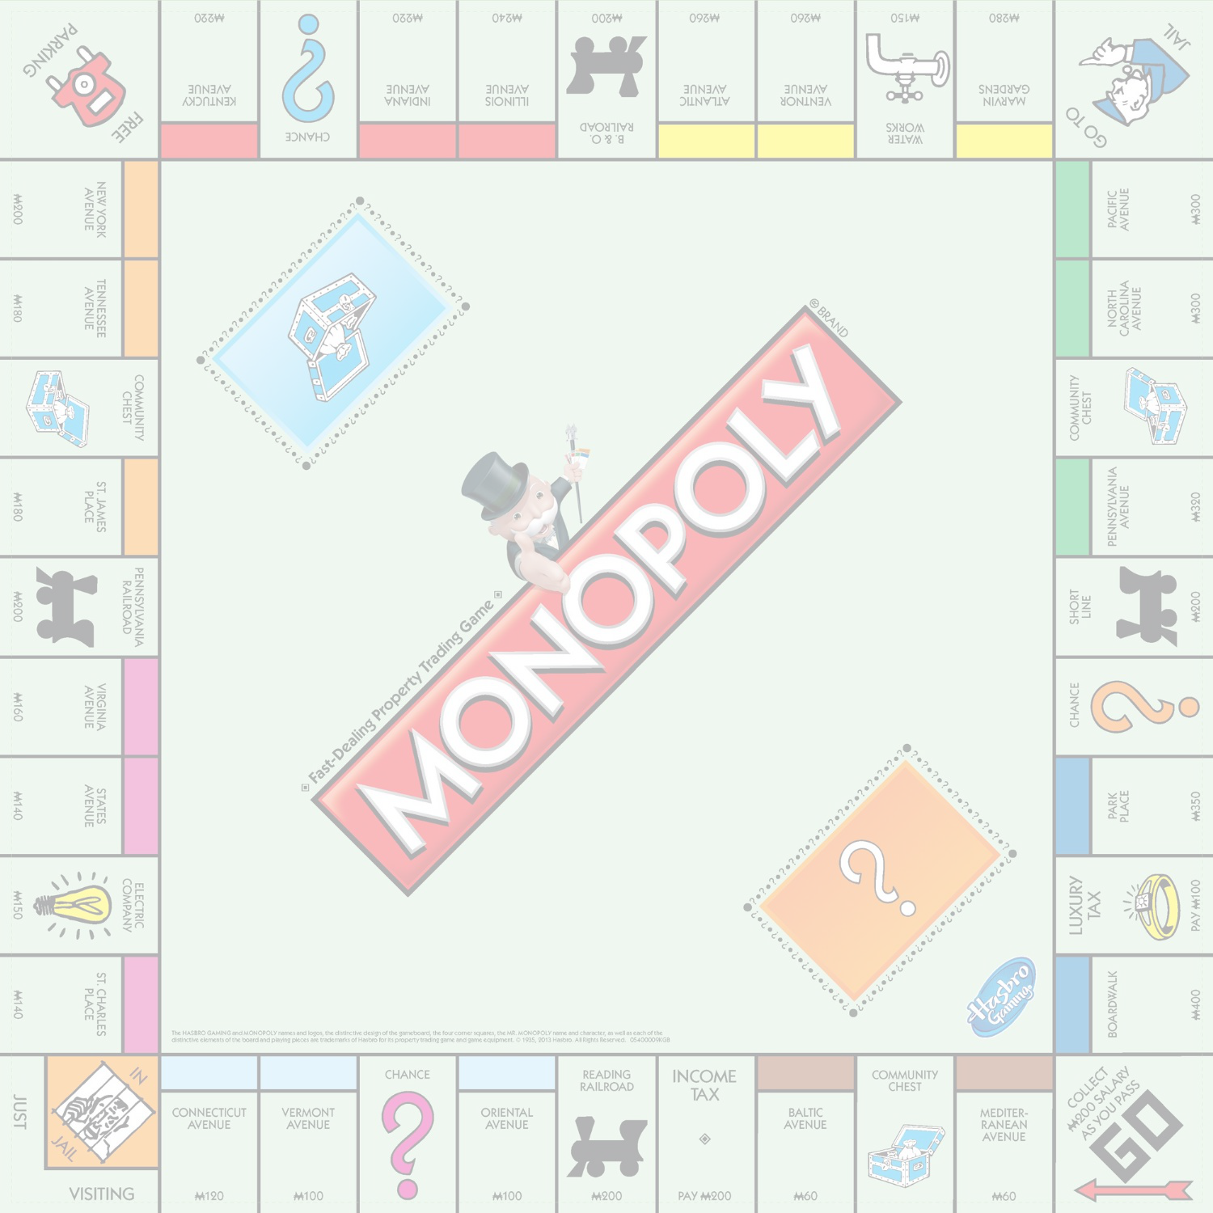
Web Based Multiplayer Monopoly
By
Cheryl Nelson, Gurpartap Gill, Kenneth Robertson, John Santos, Sylvain Ribstein

Slide 2
Use Cases
Actor User
Browsing the website
Register
Login
Logout
Get forgotten login username and password
Change password
Change avatar
Start a game for 2 to 4 players
      Actor Player: Chance and Community Chest Cards
Card: Bank pays Player
Card: Player pays Bank
Card: Player pays all other Players
Card: Player is paid by all other Players
Card: Move token to a specific Game Board space
Card: Advance token to nearest Utility, with 10 * dice rent paid.
Card: Advance token to the nearest Utility or Railroad, with double the rent amount paid.
Draw Go directly to Jail Card
Draw Get out of Jail Free Card
Use Get out of Jail Free Card
Actor Player
Game Starter Money
Manage mortgages
Collect fees and taxes
Pay Salary
Bank auctions property/houses/hotels (low priority item)
Player assigned a game turn order
Take a turn
Buy houses/hotels from the Bank
Buy properties from the Bank
Sell houses/hotels to Bank
Buy/sell/trade properties to other Players
Go bankrupt
Pay Rent
Go to Jail
Get out of Jail
Player leaves the game
Join a game in progress

Slide 3
Important Use Cases
Generally the use cases can be divided into approximately three categories.
-The web user registration/login, game lobby, and game initialization.
-The user interface (view) which controls actions by the users and converts them into game actions that effect the game state.
-The game model, this includes the main game logic as well as storing and manipulating all the local and database data.

Slide 4
Development Techniques and Software
The web page was largely written in html. Javascript was used to create the monopoly visuals with Ajax and Jquery being used to communicate with with the java servlets.
Concretely this meant that while javascript was being used to draw the monopoly board and interface to the screen, the actually logic was being handled by java servlets which made use of other java classes, and the database.

Slide 5
Challenges and Techniques
Challenges
Techniques
We encountered many challenges during the development of this game. One of the most obvious problems we had was that our schedules didn't line up very well. Which meant that it was hard to schedule meetings, and people had to use a lot of skyping.
We were also to ambitious especially in our choice of technology, it probably would have been better if we had made this game as an application instead of being built into a website. This would have reduced the amount of work that needed to be done, and reduced the need for people to learn new languages.
One advantage of monopoly is that the rules are fairly well established, so it was fairly easy to break the different types of actions with similar effects into classes. As was done with the property and community chest/chance cards. Unfortunately because the logic and model was written in a different language from the view it was not so easy to implement this logic in the actual game.
This ultimately lead us to start pairing down the functionality of the game to keep to the dead line.

Slide 6
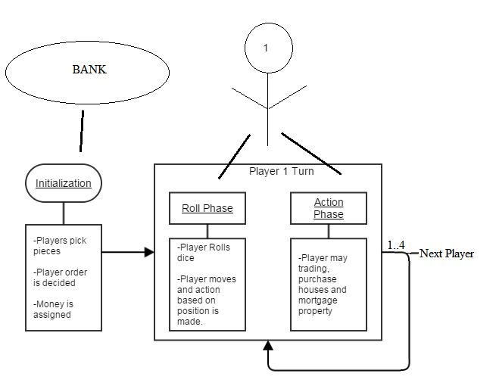
Basic Mechanics
The basic mechanics of the game is quite simple ones enough players have joined a perspective game the game launches. During the game a very simple loop is followed:
The gamePage.jsp asks the player to roll the dice for each players turn and then calls a gameServlet method that performs actions based on the location the player lands, and sends back to the gamePage a String that tells the gamePage what (if any) actions the gamePage must perform as a result of the player landing on the new location.

