Slide 1
OPENING
NimbusCart
Team members
Akshay Sunil Navani
Atharva Kulkarni
Joshini Naagraaj
Shantanu Zadbuke
E-commerce and Enterprise analytics platform
CMPE-282: Cloud Services
6
services
Team: CLOUD 9
3
PostgreSQL DBs
1
Redis cache
01
Notes:
Hi everyone, our project is NimbusCart for CMPE-282.
We are team cloud9.
The idea behind NimbusCart is to show a retail application as a real cloud services system, not only a frontend demo.
In this presentation I will walk through what we built, why the problem matters, how the services work together, and how the AWS deployment and CI/CD pieces fit into the project.

Slide 2
PROJECT
We built NimbusCart as an end-to-end cloud services project.
Vue storefront for browsing, cart, checkout, and orders
Our goal was to connect a working retail experience with the cloud pieces behind it.
Admin Enterprise Data Viewer for products, customers, orders, revenue
Five Express APIs plus a separate nginx-served UI
What makes it more than a shopping app
PostgreSQL and Redis chosen by data lifetime
CDK and CodeBuild make deployment part of the project
Every feature maps to a service, datastore, security rule, and AWS deployment concern.
02
Notes:
This slide is the best summary of what we actually built.
NimbusCart has a customer-facing shopping flow and an admin-facing enterprise data flow.
On the customer side, users can browse products, manage a cart, place an order, and view order history.
On the admin side, we built an Enterprise Data Viewer for products, customers, orders, and revenue.
The important part is that every screen maps to backend services, databases, security rules, and an AWS deployment path.

Slide 3
WHY IT MATTERS
Retail needs secure systems that scale with online demand.
Operational teams need product, customer, and order visibility in one protected portal.
$316.1B
Customers and admins share business data, but require different permissions.
U.S. retail e-commerce sales in Q4 2025
Monolithic designs make cart, catalog, checkout, and analytics harder to scale independently.
Source: U.S. Census Bureau, Quarterly Retail E-Commerce Sales, Mar. 10, 2026.
03
Notes:
The motivation is that retail apps are no longer just simple product pages.
They need secure customer access, operational data visibility, and infrastructure that can scale different workloads separately.
The Census Bureau reported that U.S.
retail e-commerce sales reached 316.1 billion dollars in Q4 2025, so this is a real business-scale problem.
NimbusCart addresses this by separating customer shopping flows from admin data access while keeping both under one secure platform.

Slide 4
DIFFERENTIATORS
NimbusCart is built as a deployable cloud system.
Service isolation
Federated auth
Six independently deployable services
Google login avoids custom password handling
Role control
Fast cart state
RBAC enforced in backend and frontend
Redis stores temporary cart data
Workflow orchestration
Repeatable cloud
Checkout calls cart, orders, then clears cart
AWS CDK defines infrastructure as code
Automated releases
AWS-native CI/CD builds and redeploys services
04
Notes:
What makes NimbusCart interesting is that we treated it like a deployable system.
The services are separated instead of putting everything in one server.
Google OAuth handles login, JWT carries the user identity, and RBAC controls what admins can do.
Redis is used for cart state because cart data is temporary.
PostgreSQL is used for durable business records.
We also added CDK and CodeBuild so deployment is part of the project, not an afterthought.

Slide 5
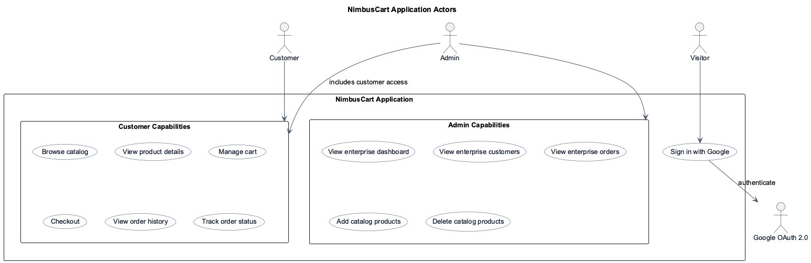
USE CASES
Three actors cover the core retail and operations workflows.
05
Notes:
There are three main actors in the system.
A customer signs in, shops, checks out, and tracks orders.
An admin has a different experience: they can view enterprise data and manage catalog items.
The system actor represents the invisible work happening behind the UI, such as JWT validation, API routing, persistence, caching, and deployment.
This helped us define permissions and service responsibilities clearly.

Slide 6
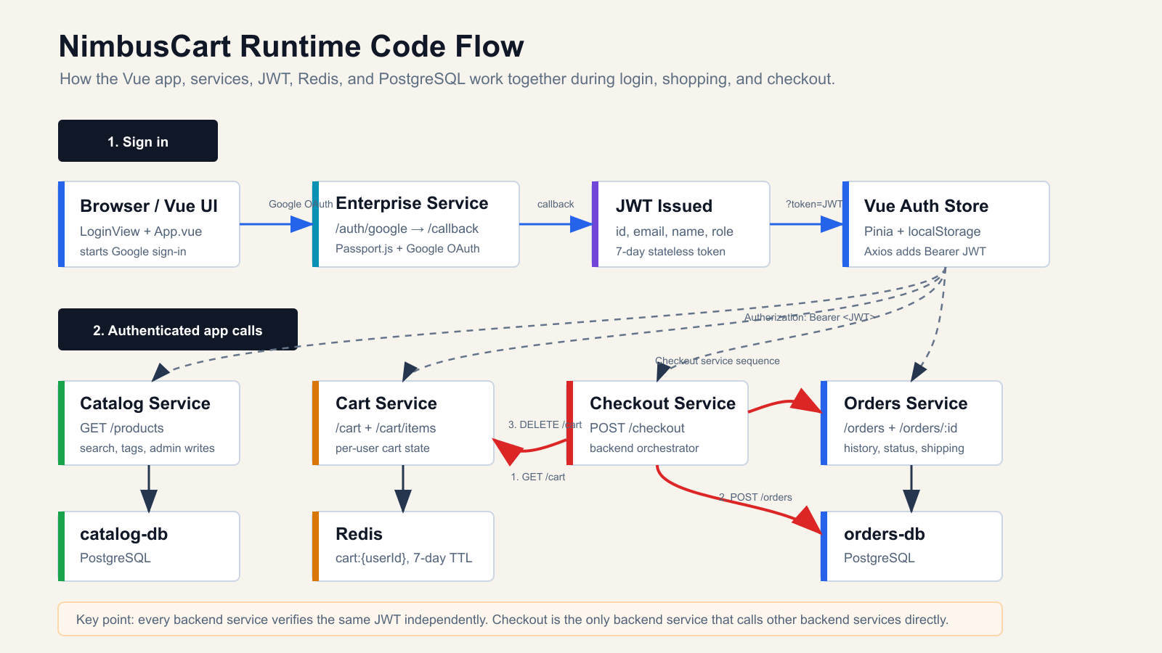
Notes:
This slide shows the runtime flow of NimbusCart.
The user signs in from the Vue UI using Google OAuth. The Enterprise service handles the OAuth callback and issues a JWT with the user’s identity and role.
The Vue app stores that token in Pinia and localStorage. After that, every API request includes the JWT as a Bearer token.
For shopping, the UI calls the Catalog service for products and the Cart service for cart updates. Catalog uses PostgreSQL, while Cart stores temporary cart data in Redis.
When checkout starts, the Checkout service gets the cart, creates an order through the Orders service, and then clears the cart.
The key point is that each backend verifies the JWT independently, and Checkout is the only backend service that calls other backend services directly.

Slide 7
STACK
The technology choices match the project’s cloud-service boundaries.
Frontend
Vue 3, Vite, Pinia, Vue Router, Axios
Backend
Node.js, Express, Passport.js, JWT
Data
PostgreSQL, Redis
Cloud
ECS Fargate, ALB, RDS, ElastiCache, ECR, Secrets Manager, CloudWatch
DevOps
Docker, Docker Compose, AWS CDK, CodePipeline, CodeBuild
09
Notes:
This slide lists the stack we used.
Vue 3 and Vite gave us a lightweight frontend.
Pinia handles frontend state like auth and cart data.
Node and Express were used for all backend services.
Passport.js supports Google OAuth, while JWT is shared across services for stateless authorization.
PostgreSQL stores durable records, Redis stores temporary cart state, and the AWS services provide the deployment, networking, secrets, images, logs, and pipeline.

Slide 8
CI/CD
A GitHub push can build images and trigger ECS rolling deployments.
GitHub
CodePipeline
CodeBuild
ECR
ECS Fargate
Source repo push
Source and build stages
Docker build x6
Commit tag + latest
Rolling redeploy
ECR login
Build images
Push images
Force ECS deployment
08
Notes:
The CI/CD pipeline starts from GitHub.
When code is pushed, CodePipeline can trigger CodeBuild.
CodeBuild logs in to ECR, builds Docker images for the UI and backend services, tags them, and pushes them to ECR.
After that, ECS services are forced into a rolling redeployment.
This matters because NimbusCart has multiple services, so the pipeline has to build and redeploy more than one container image consistently.

Slide 9
Notes:
This architecture diagram shows the cloud deployment view.
At the top is the CI/CD path: CodePipeline triggers CodeBuild, CodeBuild builds the service images, and ECR stores those Docker images.
In the runtime path, CloudFront and the load balancer provide the edge and routing layer.
The ALB forwards traffic into ECS Fargate, where the NimbusCart services run: UI, Enterprise/Auth, Catalog, Cart, Checkout, and Orders.
The services connect to RDS PostgreSQL for durable enterprise, catalog, and order data; ElastiCache Redis for cart storage; CloudWatch for logs and monitoring; and Secrets Manager for sensitive configuration.
Certificate Manager supports TLS at the edge.

Slide 10
DEMO FLOW
The demo follows the customer journey, then switches to admin controls.
1
Sign in with Google
2
Browse catalog and filter products
3
Add products to cart and update quantity
4
Place order with shipping details
5
View order history and details
6
Open admin Enterprise Data Viewer
7
Add or delete catalog products
10
Notes:
For the demo, I would start as a customer.
First, sign in with Google.
Then browse the catalog, filter products, add items to the cart, update quantities, and place an order with shipping details.
After checkout, show the order history and order detail view.
Then switch to the admin role and show the Enterprise Data Viewer.
Finally, demonstrate catalog management by adding or deleting a product.
This flow shows both user roles and the backend services behind them.

Slide 11
CLOSE
NimbusCart demonstrates a secure, cloud-native retail platform.
References
NimbusCart README.md and infrastructure/lib/nimbuscart-stack.ts
Secure customer and admin workflows
AWS-managed infrastructure and automated deployment
U.S. Census Bureau, Quarterly Retail E-Commerce Sales, Q4 2025
A foundation that can evolve toward production-grade retail operations
AWS documentation: ECS, ALB, RDS, ECR, Secrets Manager, CodePipeline, CodeBuild
Google OAuth 2.0 documentation
12
Notes:
To conclude, NimbusCart demonstrates the main ideas of a cloud services project: secure identity, service separation, managed data stores, container deployment, and automated delivery.
The project is not only about shopping features; it is about connecting those features to a real architecture.
The references here include our repository, the Census data used for the motivation slide, AWS documentation for the cloud services, and Google OAuth documentation for the authentication flow.

