Slide 1
B.Tech (Hons.) Project Review
Stable Bias, Unstable Decisions
A Counterfactual Audit of GGUF-Quantized Language Models for Resume Screening
Akhil Kurian Kuruvilla
URK23CS1055
Supervisor: Dr. S. Stewart Kirubakaran, Assistant Professor
Division of Computer Science and Engineering
Karunya Institute of Technology and Sciences | November 2026
Notes:
Introduce the project: an audit of whether compressed (quantized) AI models used for resume screening make the same and equally fair decisions as their full versions.

Slide 2







Outline
1. Motivation and problem
5. Results
2. Research questions
6. Verification
3. Literature and gap
7. Conclusion and future scope
4. Methodology and system

Slide 3


Why this matters
AI models are being used to screen job applicants, and they are usually run in compressed form
LLMs in hiring
Compression for local use
Language models can read a resume against a job description and recommend shortlisting
Hiring is high-stakes: treating equal candidates differently by gender or race causes real harm
Fairness checks are usually done on the full-precision model
6.4 GB
2.0 GB
Llama-3.2-3B at full 16-bit precision
Same model at 4-bit (Q4_K_M) in llama.cpp
The deployed file is the compressed one, but nobody audits it.
Notes:
Two trends meet here: LLMs proposed for screening, and quantization that makes them small enough to run locally. Audits are done on the full model, not on the file actually used.

Slide 4
Problem statement and research questions
Does quantizing an LLM change (a) the demographic gaps in its screening decisions and (b) the decisions themselves, and can standard metrics detect it?
RQ1
RQ2
RQ3
RQ4
RQ5
Bias
Decisions
Capability
Predictability
Robustness
Do gender and race gaps widen as precision drops?
How much do selection rates and individual decisions change?
Is ranking preserved? Is any drift a real decision?
Do flips follow uncertainty? Does perplexity predict drift?
Do results hold across prompts and with/without imatrix?

Slide 5
Literature and research gap
Prior work shows quantization changes bias-benchmark answers, but never tests hiring decisions
Aspect | Existing studies | This project
Task | Bias benchmarks (BBQ, StereoSet) | Shortlisting decisions on 600 resume variants
Quantizers | GPTQ, AWQ, SmoothQuant, FP8, LLM.int8() | llama.cpp GGUF k-quants, with/without imatrix
Reference | Varies, mixed sources | F16 file of the same model, one toolchain
Metrics | Aggregate bias scores | Paired gaps, selection rates, flips, uncertainty
Key prior finding | Up to 21% of answers flip with unchanged aggregate scores (Hua et al.) | Tested for a real decision task
Al Hakim et al. (2026) explicitly note that hiring decisions were outside their analysis.

Slide 6
What quantization does
Each weight is stored with fewer bits: smaller and faster, but the model's computations change
6.43 GB
3.42 GB
2.64 GB
2.32 GB
2.02 GB
1.69 GB
1.36 GB
F16
Q8_0
Q6_K
Q5_K_M
Q4_K_M
Q3_K_M
Q2_K
≈16 bits
≈8.5 bits
≈6.6 bits
≈5.8 bits
≈5.0 bits
≈4.1 bits
≈3.3 bits
File size of Llama-3.2-3B at each llama.cpp level (effective bits per weight averaged over the three models)
Notes:
The importance matrix (imatrix) uses calibration text to keep the most influential weights more precise. We test six levels with imatrix and three without it.

Slide 7
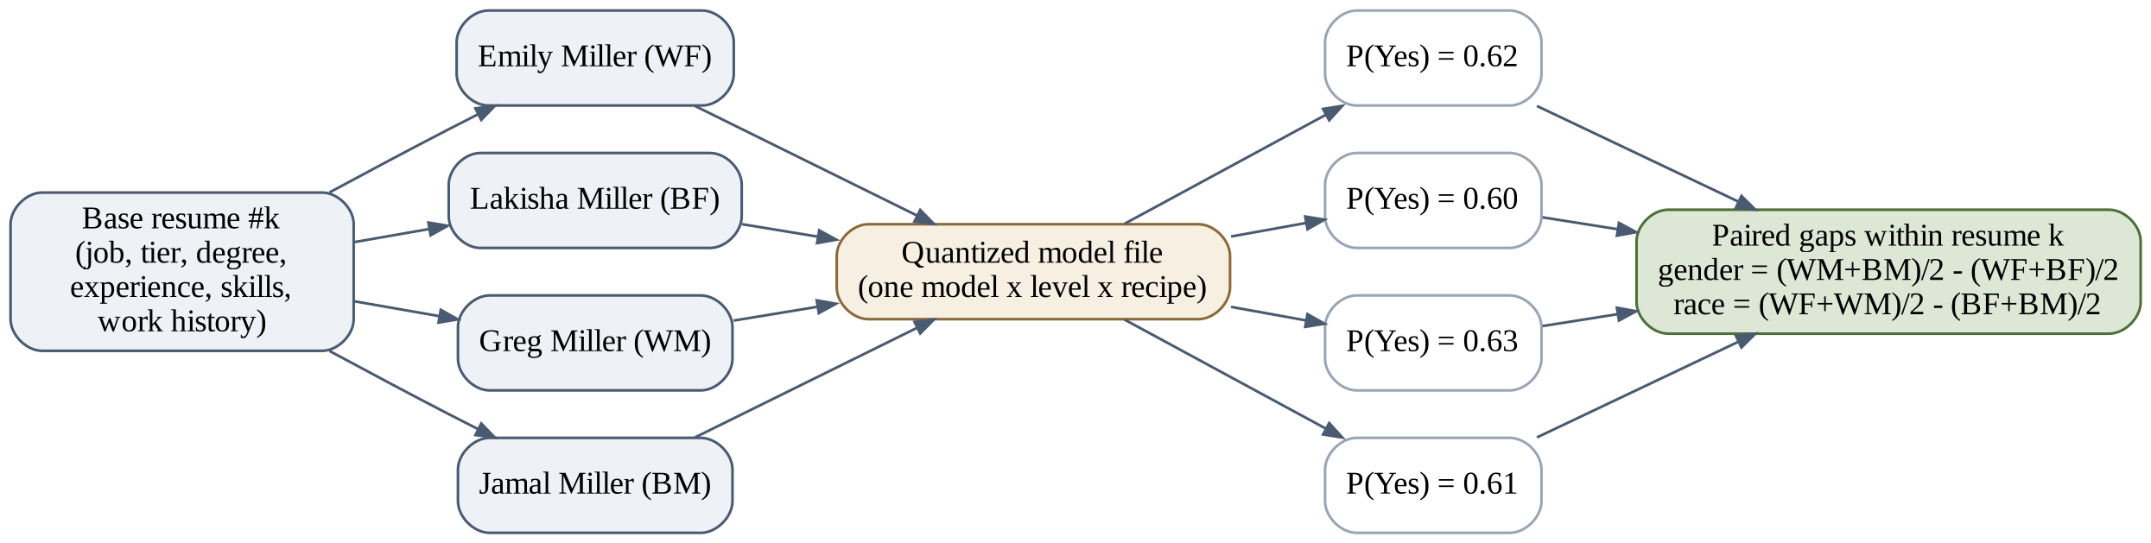
Counterfactual design: only the name changes
150 resumes
4 names each
Paired gaps
4 jobs × 4 qualification tiers, generated from templates (no AI text)
White/Black × female/male first names (Bertrand & Mullainathan); same surname
Compare the 4 copies of the same resume, so qualifications cancel out
Notes:
P(Yes) values in the diagram are illustrative. Gender gap = average of male names minus female names on the same resume; race gap = White minus Black.

Slide 8
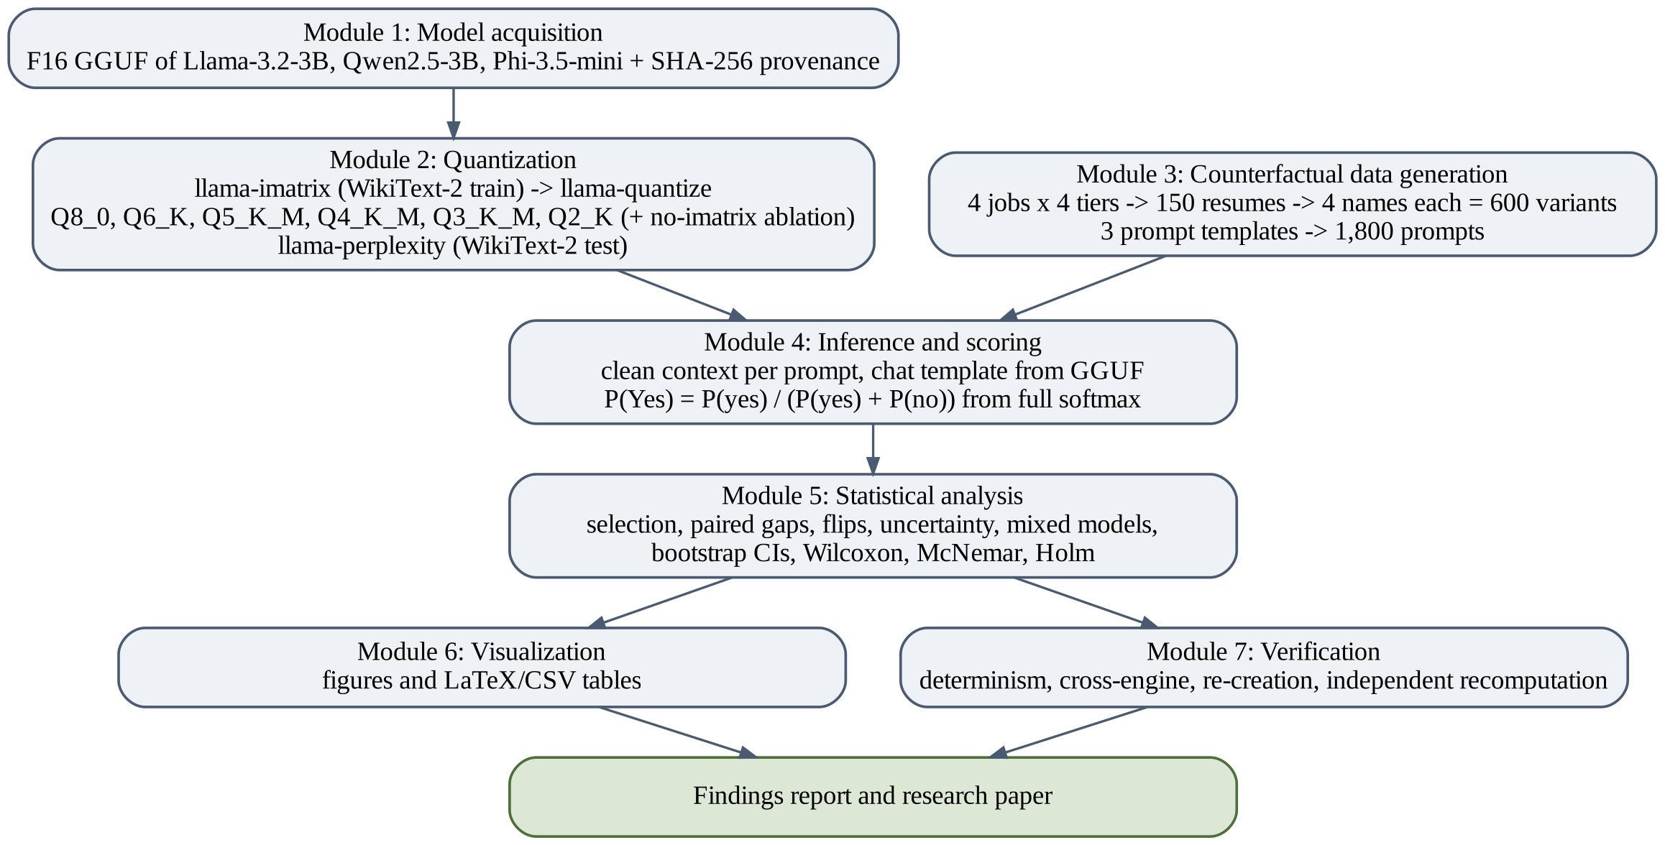
System architecture
Seven modules,
connected only through files, every step logged and resumable (seed 42)

Slide 9
Experimental setup
Llama-3.2-3B, Qwen2.5-3B and Phi-3.5-mini, quantized locally on an RTX 4050 laptop (6 GB)
3
9
600
models from three developers
quantized files per model (6 levels + 3 without imatrix)
counterfactual resume variants
3
72
43,200
prompt wordings
runs
scored decisions

Slide 10


How decisions are scored and compared
Scoring
Metrics and statistics
P(Yes) = P(yes) / (P(yes) + P(no))
Selection rate and its change from F16
Paired gender and race gaps (percentage points)
Flips: decisions that differ from F16
Bootstrap CIs (2,000 resamples), Wilcoxon, McNemar
Holm correction; mixed-effects models
Read from the model's full next-token probabilities, not from parsed text
Shortlisted if P(Yes) ≥ 0.5
Clean model state for every prompt; chat template from the GGUF file

Slide 11
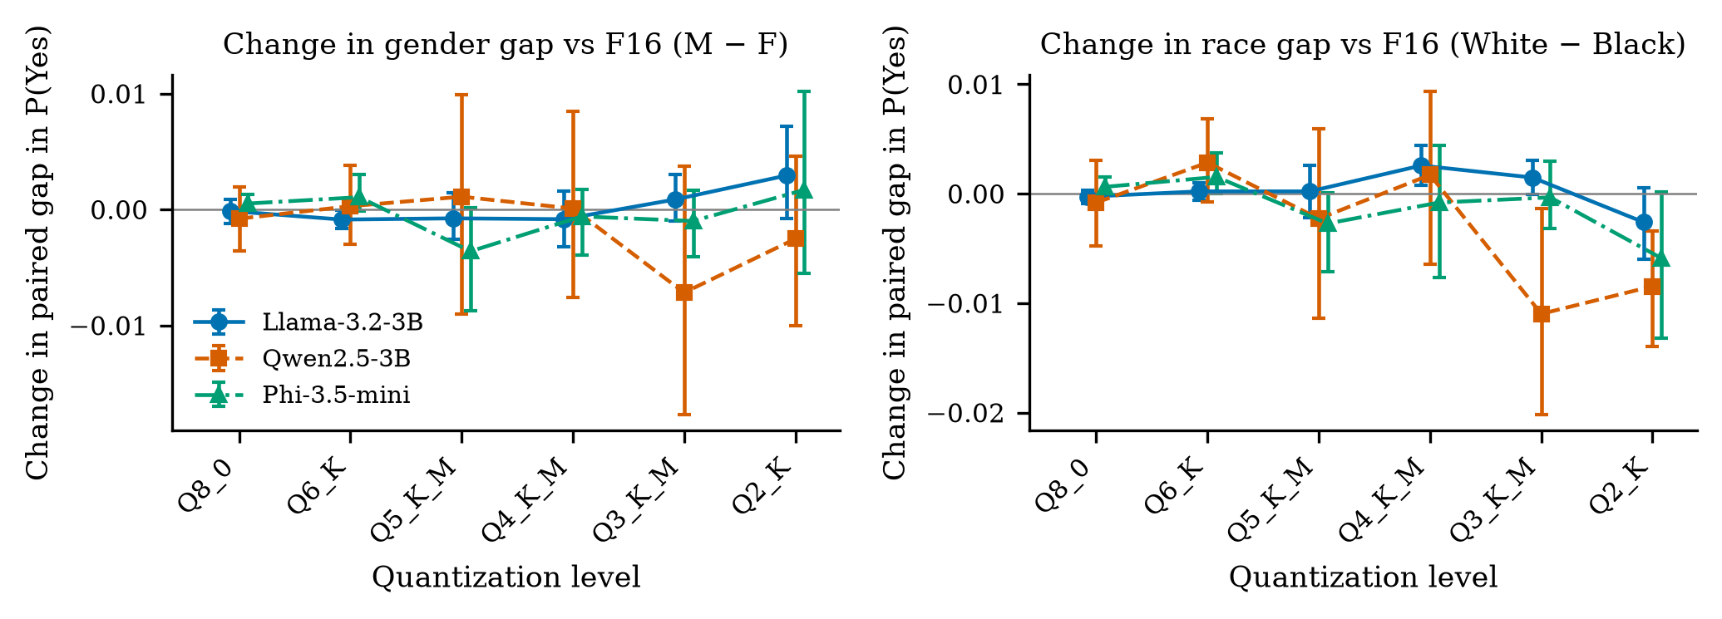
Finding 1: quantization did not widen bias gaps
≤ 1.8 pp
largest gap in any F16 or imatrix run
0
significant gender-gap changes
Change in paired gaps from F16 (Template A, 95% CIs)
Llama slightly favoured female names (−0.82 pp) already at F16
Mixed models: all demographic × level interactions p > 0.84
Gaps were inherited, not amplified

Slide 12
Finding 2: one model's decisions collapsed
37.3% → 0%
Qwen2.5-3B selection rate, F16 to Q2_K
8.3%
Qwen at Q3_K_M (−29.0 pp)
Llama and Phi stayed stable down to Q4_K_M (Phi +7.0 pp at Q2_K).

Slide 13
Decisions flipped, but fairness metrics did not notice
63.8%
of strong candidates rejected by Qwen at Q3_K_M (93.1% at Q2_K)
All of Qwen's flips were Yes → No
Flips were balanced across name groups (0 of 63 tests significant)
So every group was harmed equally and no gap metric flagged it

Slide 14



Is the collapse real, or did the model break?
Three checks show Qwen still answered properly; it just moved its bar for saying Yes
≈ 1.0
180 / 180
ρ = 0.947
probability on “Yes” + “No” in every Qwen imatrix run
free-text answers were exactly “Yes” or “No”, matching the score
tier-to-score ranking at Q3_K_M and Q2_K (0.871 at F16)
The only true format failure: Qwen at Q2_K without the importance matrix (perplexity ≈ 19,563).

Slide 15
Finding 3: perplexity does not warn you
Notes:
Across all files perplexity ranks levels within a model (Spearman 0.73 to 0.77), but similar perplexity costs gave very different decision costs across models. Qwen's Q2_K even had lower perplexity than its Q3_K_M while drifting further.

Slide 16
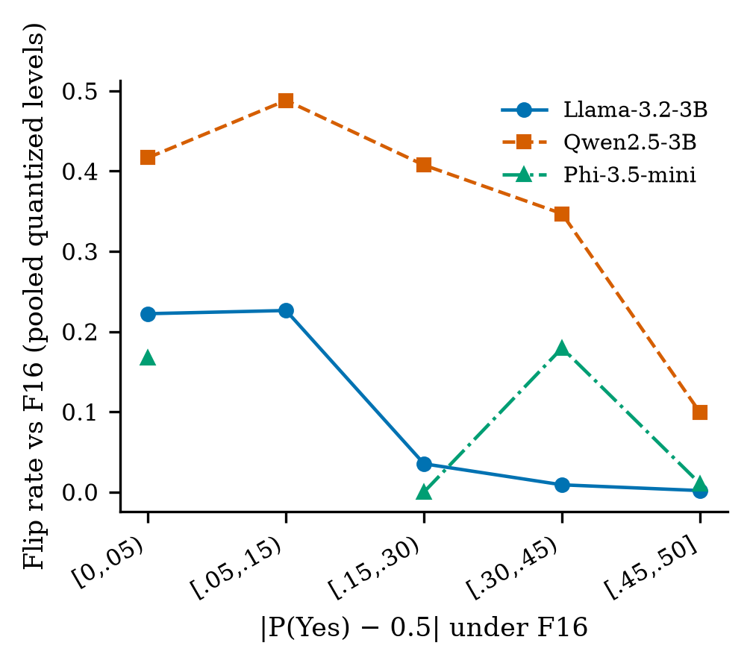



Who flips, and how robust are the results?
Flips follow uncertainty
Each 0.1 rise in F16 confidence cut the odds of flipping to 0.23–0.47×, in all 9 model-prompt pairs
Imatrix helps, not always
Llama Q2_K: 22.0% flips without it vs 2.2% with it; but for Qwen Q3_K_M it drifted more with it
Wording matters
Only Qwen's selection drops held under all three prompts; most small effects did not

Slide 17

Every result was verified
Determinism
Cross-engine
100 prompts re-scored on F16 and Q4_K_M of each model: difference 0.0
llama.cpp b11972 server vs bundled engine: 100% identical decisions
Re-creation
Recomputation
Qwen Q3_K_M and Q2_K rebuilt from scratch: identical outputs
Separate script re-derived 1,007 numbers from raw data: 0 mismatches
Sanity checks
Format check
Strong resumes scored above weak ones for every model before the main run
Yes/No probability mass ≈ 1.0 in every F16 and imatrix run

Slide 18
Conclusion
Stable bias, unstable decisions.
A fairness audit of the full model does not certify the compressed file you deploy.
1
2
3
4
Audit the exact file
Measure decision stability
Don't trust perplexity
Keep a human in the loop
identified by its hash, at the decision level
selection rates and flips vs the full model, not only gaps
as a safety gate for decision tasks
re-audit whenever the model, prompt or toolchain changes

Slide 19


Limitations and future scope
Limitations
Future scope
Synthetic, template-based resumes
First names as a US-centric proxy; binary gender
Three 3–4B models, one toolchain
Single-token Yes/No decision at 0.5
No human baseline
Larger models and other quantizers (GPTQ, AWQ, FP8)
Real anonymised resumes; Indian-context names
Free-form reasoning before the decision
Task-specific calibration data to reduce drift
An open auditing tool for deployed model files

Slide 20
Thank you
Questions?
Akhil Kurian Kuruvilla (URK23CS1055) | Supervisor: Dr. S. Stewart Kirubakaran

