Slide 1
EECE 5642 presentation Layout Representation Learning with Spatial and Structural Hierarchies
002839146 Yifan Wang
002839771 Qiwen Ding
002697053 Shuyue Li
Notes:
The paper most related to visualization, because this paper aim to use the network to learn the layout and ui, which are kinds of virtualization.

Slide 2
Overview of Presentation
Introduction(Task & Motivation)
Method & Visualization
Dataset and Evaluation Protocol
Result & Visualization
Conclusion

Slide 3
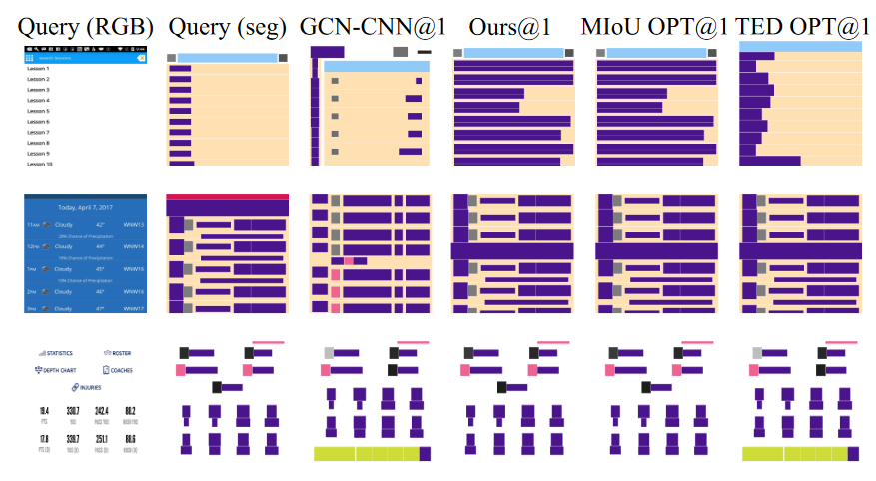
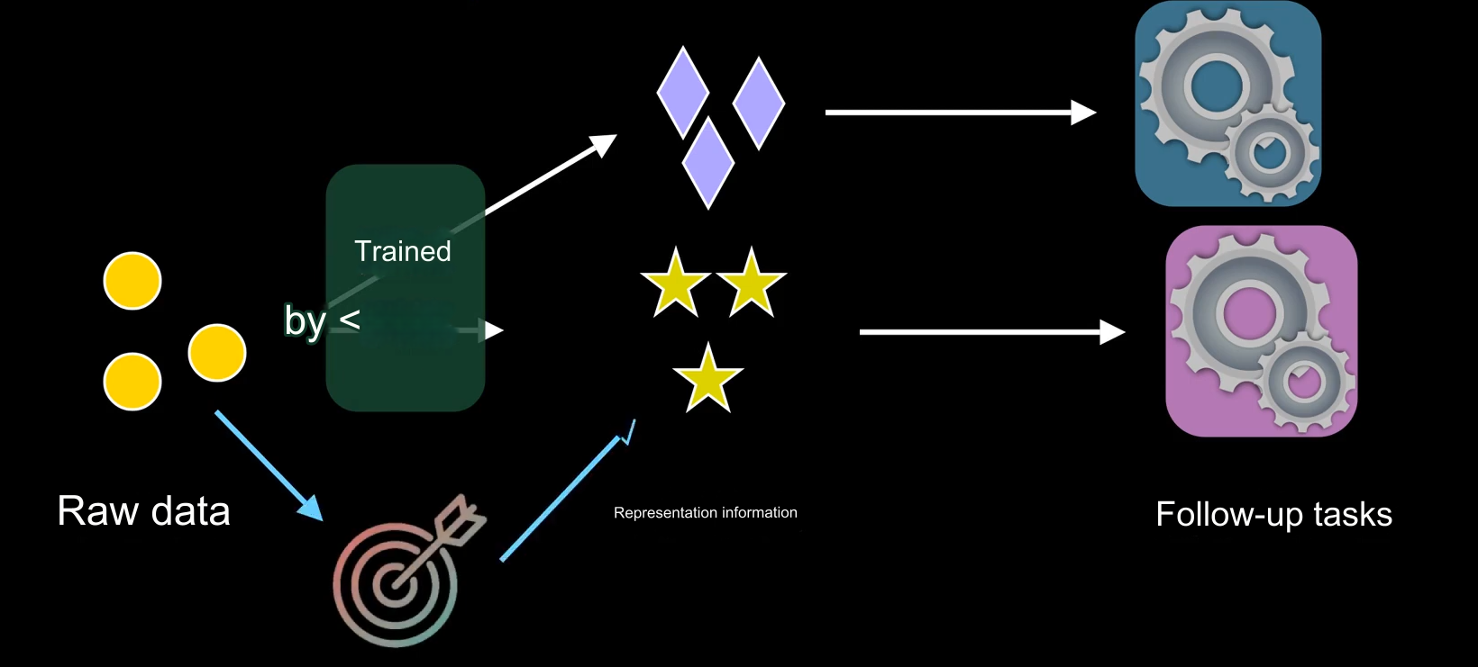
What is layout representation learning
Layout design set of complex tensors
Notes:
semantic map
Representation learning is a set of methods that allows a machine to be fed with raw data and to automatically discover the representations needed for detection or classification.
Learned representations can often be transferred or adapted to different but related tasks, enhancing the versatility and applicability of machine learning models.

Slide 4
Question1: Why we need layout representation learning?
Automating the Design Process (more efficient)
Enhancing Design Quality and Innovation
Help designer to reduce bad designs (reduce data ink, lie factor)
Help designer to create innovative layouts
Adaptability and Flexibility
Enhancing Personalization and User Experience (personalized design)
Notes:
1. Automating the Design Process: In fields such as graphic design, web design, and user interface design, the design process is often time-consuming and complex.
2. Model can capture and emulate the style and techniques of human designers and even create innovative layouts that surpass traditional design paradigms.
Reduce bad design, like microsoft
3. By analyzing user data and behavior, neural networks can create personalized design layouts that better meet individual preferences and needs.

Slide 5
Related Works
the works in (Deka et al. 2017;Liu et al. 2018) treat layout as images without encoding explicit geometric hierarchy.
recent works (Manandhar, Ruta, and Collomosse 2020; Patil et al. 2021) use GNNs to employ geometric features, but they form dense graphs which negates the hierarchical information.
the layout representations (Deka et al. 2017; Liu et al. 2018; Manandhar, Ruta, and Collomosse 2020; Patil et al. 2021) are designed only from spatial perspective by training to decode semantic maps.
Notes:
There are a bunch of the related works in the essay
Tell about their weakness
Most of them don’t care about the hierarchy which is quite important in layout
Most of them only care about the spatial, mainly rely on the spatial bounding boxes for feature extraction.

Slide 6
Model Innovations
Add Hierarchical encoder: a layout hierarchy is de-composed into multiple levels
First model to learn the layout representation by considering both spatial (semantic map) and structural (element organization) perspectives
Newly involving TED metric to supplement structural aspect evaluation
Notes:
for example, when users want to explore design variations with similar content, spatial aspect is more important as it provides information on how the designs are perceived visually.
when users want to customize designs arrangement, structural properties such as groupings and alignments are critical aspects as these relationships and structure define the blueprint of layout

Slide 7
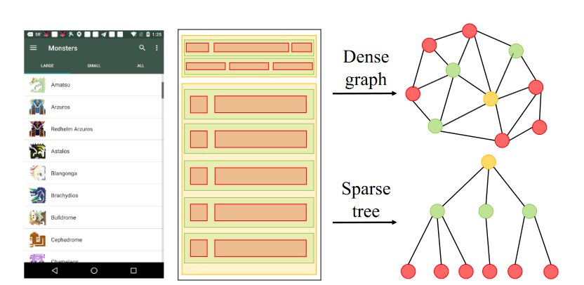
Hierarchy Construction

Slide 8
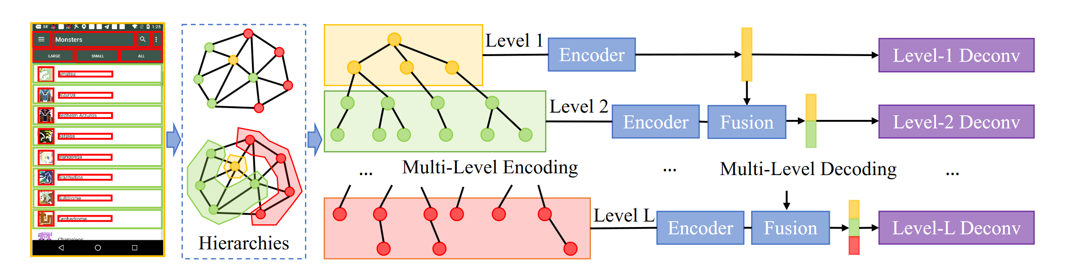
Question2: What can you see from the picture?

Slide 9



Hierarchical Auto-Encode
Level-wise Encoding
Level Fusion
Level-wise Decoding
An MLP that aligns the feature from level
level-wise features are recursively aggregated capturing layout attributes at different granularities. In this way, each level has a feature that contains integrated information from itself and all levels below it.
Notes:
1.First, let’s talk about the tree structure, V is the node, C is the edge ,and {V,C} is any sub tree of the whole tree
2.level wise decode is implemented as deconvolution blocks containing several layers of strided convolution that upsample the output to match the reconstruction supervision tensor.

Slide 10
A good example of model virtualization
Describe exactly what the model does
Easy to read
Use different colours to show the hierarchies of the layout

Slide 11
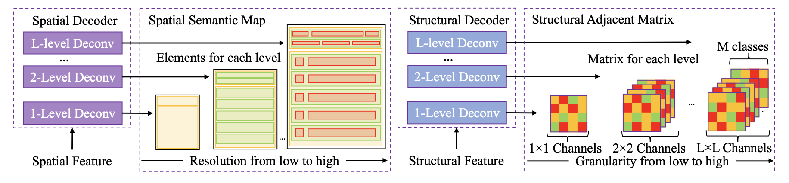
Method - Spatial and Structural Encoding
Spatial Decoder:
Inputs: Spatial features.
Process: Multi-level deconvolution.
Outputs: Spatial semantic maps.
Structural Decoder:
Inputs: Structural features.
Process: Multi-level deconvolution.
Outputs: Structural adjacency matrices.
Notes:
"Today, we're exploring the Spatial-Structural Hybrid Autoencoder, or SSH-AE, a groundbreaking model designed for UI layout generation. The SSH-AE model comprises two main decoders: the Spatial Decoder and the Structural Decoder. The Spatial Decoder takes spatial features as input and reconstructs the layout's spatial semantics using multi-level deconvolution. This process results in spatial semantic maps, where each representation, indicated by boxes, corresponds to UI elements such as text boxes and buttons. The depth of color signifies the element's category or level of importance.

Slide 12
Method - Spatial and Structural Encoding
Question3: Why is it essential to consider both spatial and structural information in design layouts?

Slide 13
Answer:
Spatial encoding focuses on the positioning and dimensions of elements, which determines the visual balance and navigability of a design.
Structural encoding captures the relationships and organizational hierarchy between elements, influencing how we process and interact with the design.
Together, they define the overall appearance and functionality of a design, ensuring that it communicates the intended message effectively and provides a seamless user experience.

Slide 14
SSH-AE Model Innovations
Hierarchical Autoencoder Design: Utilizes a multi-level approach to differentiate and integrate layout features with varying spatial and structural importance.
Innovative Encoding Mechanism:
Spatial-Structural Encoding: Simultaneously captures the spatial arrangement and structural relationships of UI elements, enhancing understanding of layout dynamics.
Two-Pathway Optimization: A unique optimization strategy that refines spatial and structural encodings separately yet concurrently, ensuring a robust layout representation.
TED: Use a Tree-Edit Distance to measure the layout structural similarity.
Notes:
Today, we're exploring the SSH-AE model, which introduces a groundbreaking approach in understanding and generating UI layouts."
"The model's hierarchical autoencoder design is a cornerstone of its innovation. It adeptly separates and merges layout features based on their spatial and structural significance, enabling a nuanced understanding of complex UI layouts."
"At the heart of SSH-AE is its innovative encoding mechanism, the spatial-structural encoding. This feature is pivotal because it does not just look at where UI elements are placed but also how they interact and relate to each other, offering a comprehensive view of the layout's functionality."
"Another critical innovation is the two-pathway optimization strategy. By refining the spatial and structural aspects independently and simultaneously, SSH-AE ensures the generated layouts are not just visually appealing but structurally sound as well."
"In summary, the SSH-AE model's approach to UI layout generation is transformative, promising more intuitive and functional design solutions."

Slide 15
Dataset
RICO Dataset:
Source: Deka et al., 2017.
Collection: 66K mobile app screenshots with hierarchical annotations.
Division: 53K training, 13K gallery, 50 queries.
POSTER Dataset: Innovation
Newly collected from Adobe Spark.
Contains: 35K professional poster templates with hierarchical annotations.
Division: 28K training, 7K gallery, 50 queries.
Q4: Why does the SSH-AE model use two different datasets for training and testing?
Notes:
These datasets play a pivotal role in the paper's methodology, specifically chosen for their rich hierarchical annotations. This choice underscores the paper's focus on hierarchical layouts, differentiating it from studies that might utilize datasets with flatter or more sequential structures

Slide 16
Answer:
The SSH-AE model employs two distinct datasets, RICO and POSTER, to evaluate its effectiveness in handling various types and styles of UI layouts.
The RICO dataset consists of a wide range of mobile app interfaces, while the POSTER dataset provides professionally designed poster templates.
Training and testing the model on these diverse datasets allows for a comprehensive validation of its generalization capabilities and performance across different UI design scenarios.

Slide 17
Evaluation Protocal
MIoU: Quick assessment of spatial accuracy.
TED: Innovation
Measures layout similarity by tree-edit distance.
Aligns with human perception of layout structure.
Crucial for evaluating hierarchical relationships.
NDCG: Evaluates retrieval effectiveness at various levels.
Notes:
Turning our focus to the evaluation protocol, particularly the introduction of Tree-Edit Distance, or TED@10, marks a significant advancement in our assessment toolkit. Unlike the more straightforward spatial accuracy captured by MIoU@10, TED@10 delves deep into the structural integrity of layouts. It quantifies the similarity between layouts by measuring the minimum number of operations required to transform one layout's tree representation into another. This approach is especially relevant for hierarchical layouts, resonating closely with human judgment on layout similarity. While MIoU@10 and NDCG provide insights into spatial accuracy and retrieval effectiveness, respectively, TED@10 stands out by offering a nuanced view of how well a model captures the intricate relationships that define a layout's structure. It's this depth of analysis that sets TED@10 apart, highlighting its importance in our comprehensive evaluation protocol

Slide 18
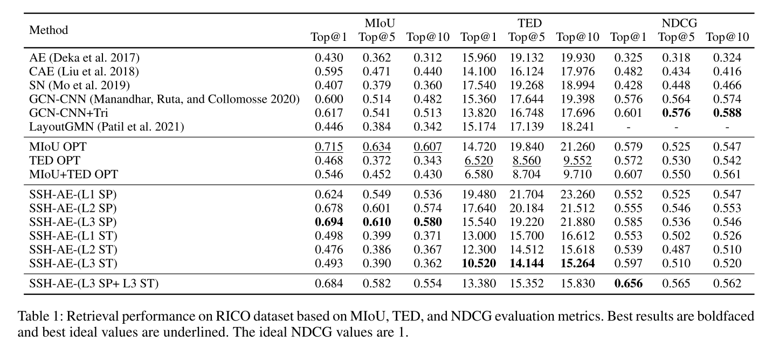
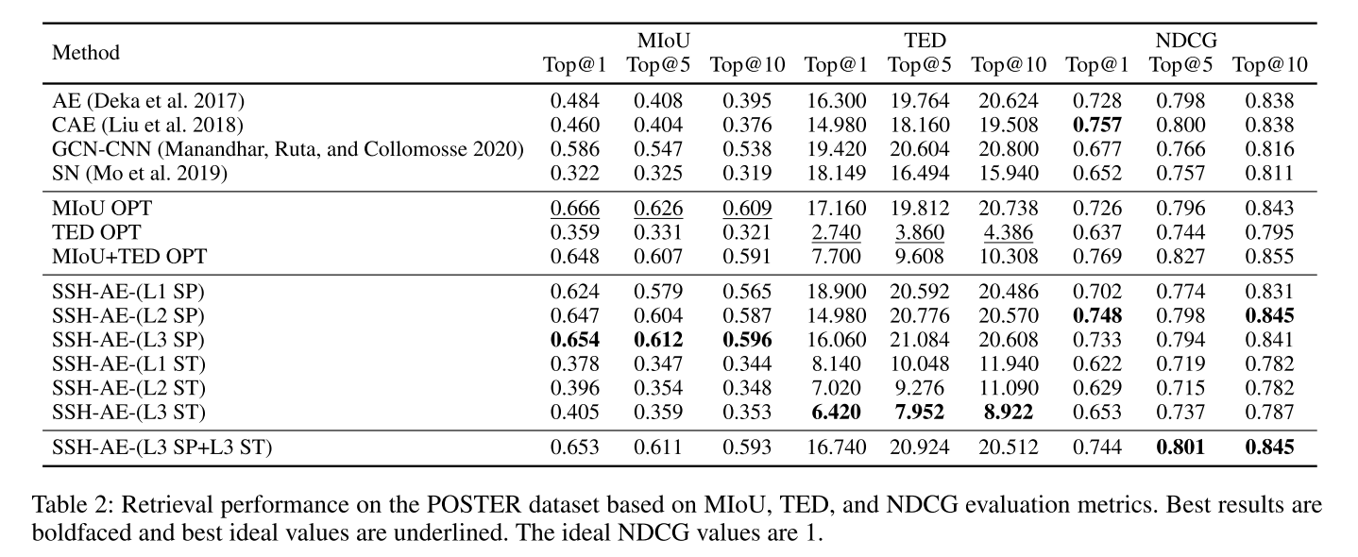
Table Result
Baseline methods
Optimal retrieval performance serves as the upper bound for MIoU and TED
Six variations of SSH-AE
A trade-off between the spatial and structural aspects

Slide 19
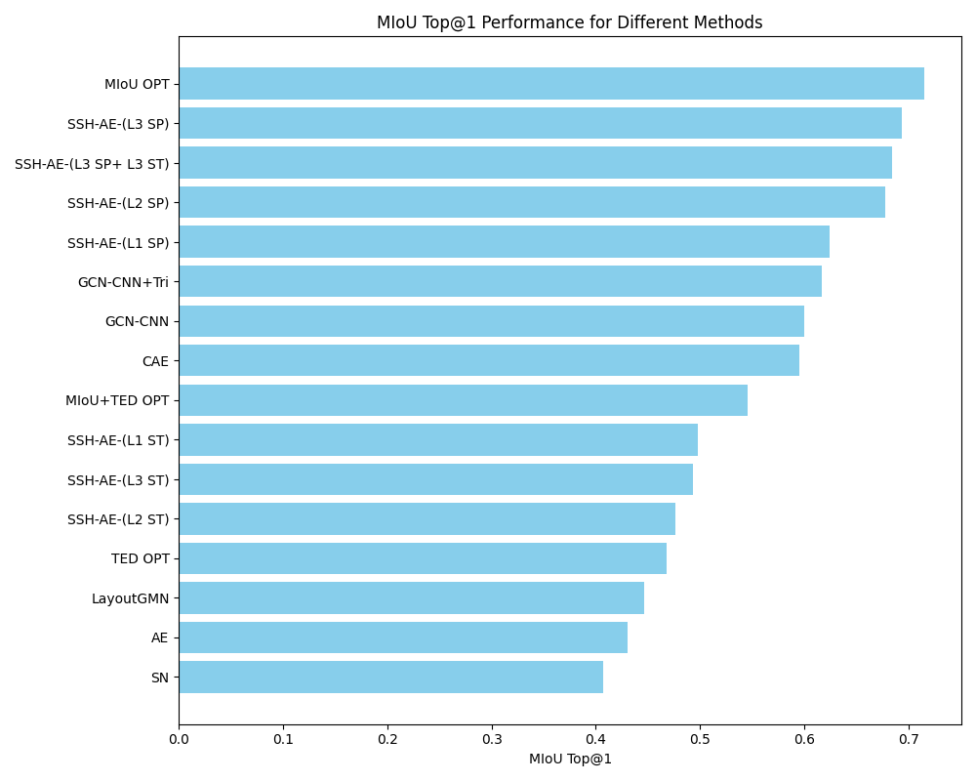
Question5
This is a bar chart that we have redrawn based on the data in table1, which visualization method do you prefer and why?

Slide 20
Answer
Bar Chart
Pros:
Visual appeal enhances understanding.
Facilitates quick comparisons.
Effective for showing trends.
Cons:
Can get crowded with many categories.
Not ideal for large data sets.
Table
Pros:
Offers precise data values.
Can contain more detailed information.
Cons:
Lacks visual intuitiveness.
Can be challenging to read with much data.

Slide 21
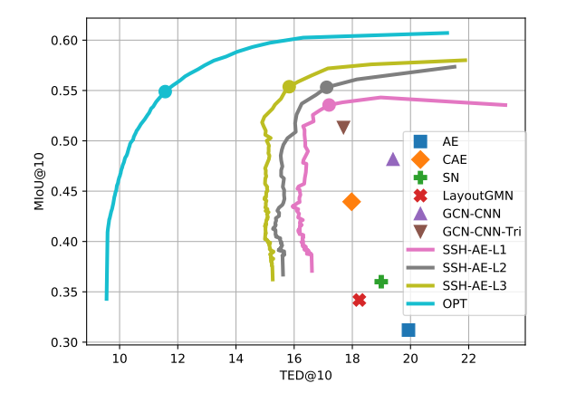
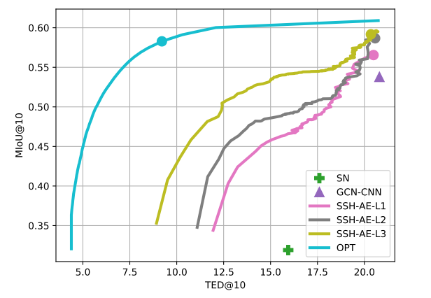
Visualization
Figure: Visualization of different methods’ operating curves and points for spatial/structural trade-off on RICO (left) and POSTER (right). The operating curve for each method exhibits inverse relationship between MIoU@10 and TED@10. SSH-AE has better results than others with the reference of the optimal metric (OPT) curve. The big dot on each curve indicates the point with best NDCG value.

Slide 22
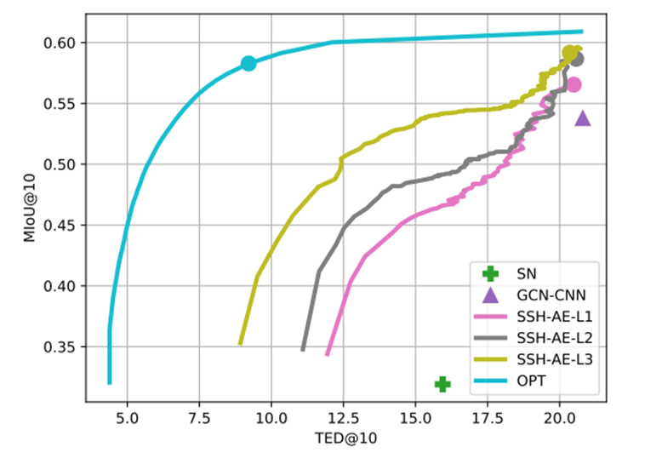
For each method, MIoU@10 usually decreases as TED@10 increases, reflecting the tradeoff between spatial similarity and structural similarity
This visual result map is very clever in the selection of horizontal and vertical coordinates, which plays a role in linking the two evaluation indicators
Highlighting the best of each curve helps the reader to locate it quickly
The information density is high, and the reader needs to grasp relevant information to help understand the visualization intention

Slide 23
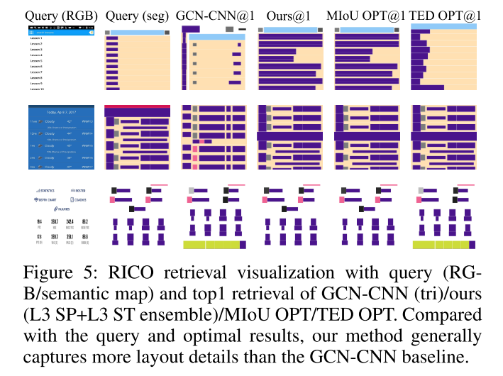
Query(RGB): This is the original image of the user query
Query(seg): This is a semantic segmentation map of the query image, showing the different elements in the image and their layout
GCN-CNN@1: This represents the first image that is most similar to the query (i.e., top1) returned using a combination of graph Convolutional networks (GCN) and convolutional neural networks (CNN)

Slide 24
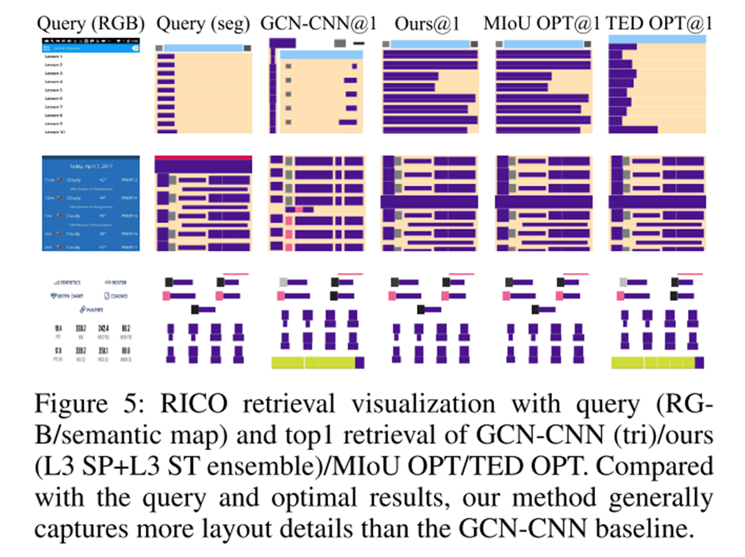
The result of this visualization is very intuitive, from the original image to the retrieval result
The contrast between the different models is strong
The scale of the drawing is ill-considered and the details are blurred
It is difficult for the reader to intuitively compare the advantages and disadvantages of different models from the figure

Slide 25
What we learned
Innovative Layout Learning: Introduces a novel method focusing on both spatial and structural aspects in layouts hierarchically.
SSH-AE Model: Launches the Spatial-Structural Auto-Encoder for complex layout data processing with hierarchical annotations.
Hierarchical Autoencoder: Employs a layered autoencoder architecture for feature extraction and integration based on spatial and structural relevance.
New Evaluation Approach: Proposes a fresh evaluation method and a tree-edit distance metric for better layout similarity assessment.
Flexible Data Visualization: Advocates for flexible horizontal and vertical data representation to suit varied data needs, avoiding a one-size-fits-all approach.
Accessible Visual Design: Aims for visuals that allow immediate understanding by viewers, regardless of their background knowledge.

Slide 26
Thank You!

