Slide 1
BuyMe - Online Auction System
CS 527 - Database Systems Project
By:
Atharv Manish Karbhari – amk546
Pavan Sai Komara – pk812
Chiranjeevi Bhuvaneshwari Pamarthy – cp1270
Shweatha Bathina Mallikarjuna – sb2808

Slide 2
Project Introduction
BuyMe is a local auction system designed to simulate real-world online bidding platforms like eBay.
Built with Node.js, Express, and MySQL, it supports buyers, sellers, admins, and customer reps.
Project hosted on local server with full relational DB and REST APIs.

Slide 3
Project Objective
Support real-time online auctions.
Implement user roles with authentication.
Enable secure bidding (manual + automatic).
Facilitate item browsing, alerts, sales reporting, and admin oversight.

Slide 4
User Roles & Responsibilities
End-Users: Register/login, buy/sell, search, set alerts.
Sellers: Create auctions, upload items, set reserves.
Buyers: Bid manually or automatically.
Customer Reps: Answer queries, manage bids/auctions.
Admin: Manage reps, generate reports.

Slide 5
Auction Features
Sellers create auctions with start/end time, category, subcategory, image, description.
Reserve price is hidden; winner is declared only if bid ≥ reserve.
Automatic bidding up to buyer-defined max with increments.
Alerts for overbids or limit reached.

Slide 6
Browsing and Search
Filter/sort items by price, type, subcategory.
View full bid history of any item.
Show similar items from past month.
Set alerts for specific items and receive notifications.

Slide 7
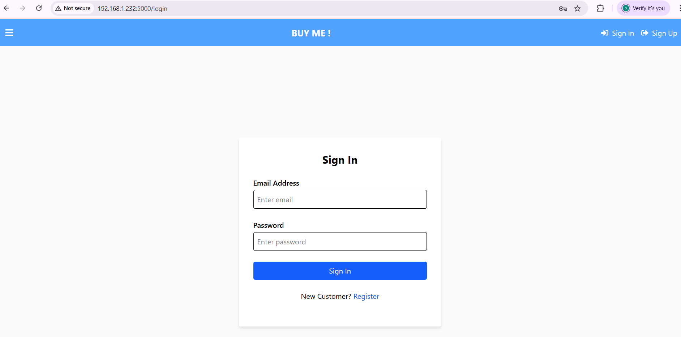
Login page
Secure login interface for users of the BuyMe platform. It allows both buyers and sellers to authenticate using their email and password. If users do not have an account, they are redirected to the registration page via the "Register" link. This ensures that only verified users can participate in auctions or post listings, maintaining the integrity of the platform.

Slide 8
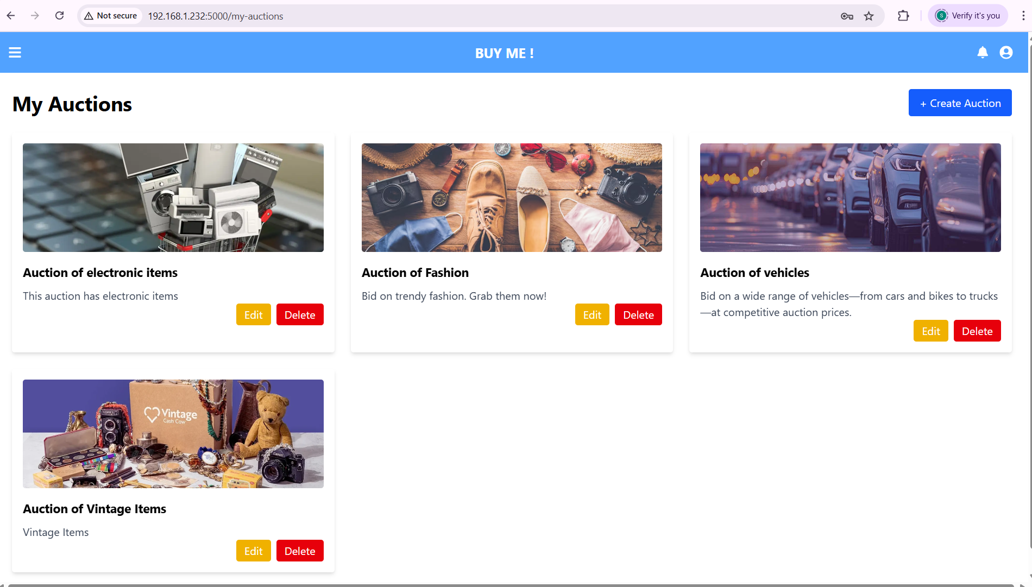
Auctions by category

Slide 9
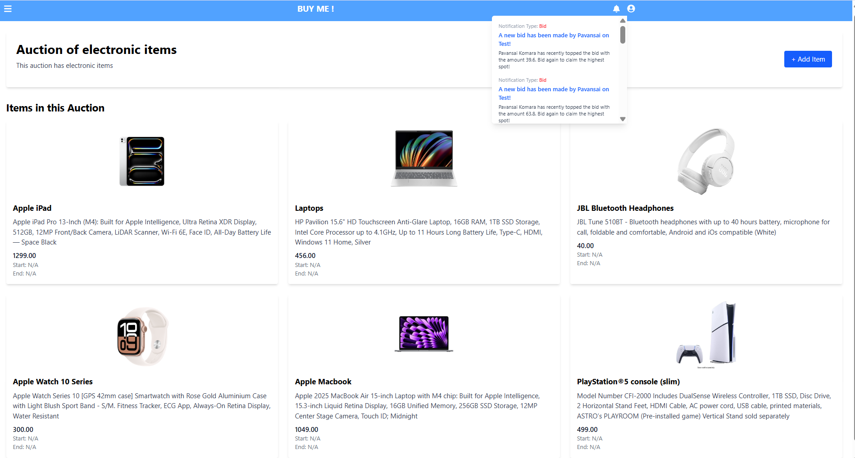
Auctions for electronic items made by one buyer

Slide 10
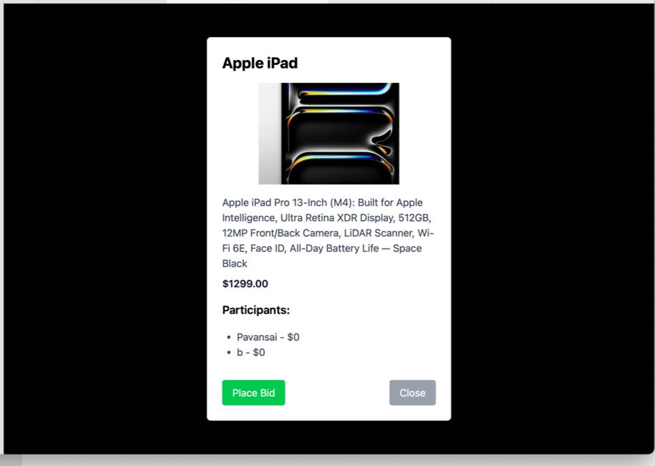
Placing a bid on item

Slide 11
Customer Support Features
Post and reply to questions via built-in Q&A module.
Customer Reps can view/search unanswered queries.
Reps can edit/delete user info, remove bids or auctions.

Slide 13
Admin Features
Create customer representative accounts.
Generate detailed reports:
- Total earnings
- Earnings per item / item type / user
- Best buyers and top-selling items.

Slide 14
Technology Stack
Frontend: HTML, Postman (testing)
Backend: Node.js + Express
Database: MySQL (Aiven cloud)
ORM: Sequelize (Model associations for Auctions, Bids, Users, etc.)
Auth: JWT-based role enforcement

Slide 15
Advanced Features
Alerts for auction events
Auto-bidding engine with upper limit
Search similarity logic
ER-based dynamic category fields
Middleware-based authorization

Slide 16
Testing & Demo
APIs tested using Postman
Demoed:
- User registration/login
- Auction creation & bidding
- Customer support and admin reporting
- Auto-bid simulation with alerts

Slide 17

Thank You ☺
Any Questions?

