Slide 1

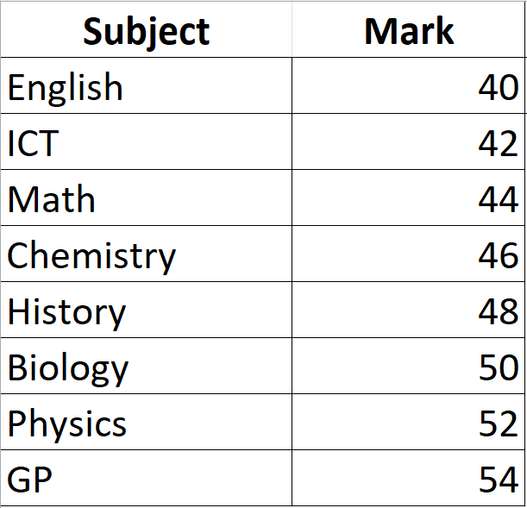
PERFORMANCE
Month
October
Subject
Filter
Atwine Elvis
Year 4
Class Teacher: Tr. Racheal

