Slide 1

SMART INDIA HACKATHON 2026
TITLE PAGE
Problem Statement ID – SIH26261
Problem Statement Title- AI-Powered Application Validation, Document Authentication and Regulatory Compliance Verification
Theme- Smart Automation
PS Category- Software
Team ID- 199020
Team Name (Registered on portal) OneVision

Slide 2

SATYA-EoA
OneVision
AI-assisted first-pass scrutiny of Extension of Approval (EoA) applications, with evidence for every committee that follows
Problem: A self-disclosure EoA is approved on what the institution declares. AICTE's Approval Process Handbook (APH 2024-27) gives it no scrutiny, expert visit or hearing before approval; the Council monitors only afterwards. The portal's Deficiency Report only does arithmetic on the declared data; it does not check any document with the authority that issued it.
Our solution: SATYA-EoA is designed to integrate with the AICTE approval portal (REST, webhooks, single sign-on). It reads AICTE's own templates, checks each document with its official issuer and reconciles every sworn claim. AI advises; AICTE officials decide.
Evidence: In 45 public application PDFs we studied, 3 carry a real PDF signature and 4 more show only a printed 'digitally signed' image; 0 of 4 audited statements carry a UDIN (the chartered accountant's document ID); 7 of 19 documents were not what their heading, filename or label said.
❖ Proposed Solution (Describe your Idea/Solution/Prototype)
Detailed explanation of the proposed solution
Innovation and uniqueness of the solution
Template-aware reading
Recognises each document by its content and issuer, never by heading or filename, and knows each year's AICTE templates.
Affidavit comparison
Compares the sworn 24-point affidavit with the portal's own draft for the same application and reconciles it with the Application Report.
Real vs printed signatures
A printed 'digitally signed' image is never counted as a signature; checks that the signer is the Chairman or Secretary.
Source checks with six clear labels
Each certificate is checked with its official issuer and gets one label: verified, mismatch detected, expired, verification pending, source unavailable or manual review required.
Stamp-paper checks
Checks the order stamp, notary, digital signature, upload; stamp-number reuse; and that the second party is AICTE.
CA certificate (UDIN) check
Checks the membership number inside the UDIN, one UDIN per financial year and no reuse across years.
Where SATYA-EoA helps in the approval journey
Evidence-linked flags
Every flag points to the page region, the rule, the handbook clause and a confidence level. The AICTE official records one of five dispositions.
1 Institution pre-check (private)
2 First-pass scrutiny of self-disclosure EoA
Issuer-specific checks
Matches the right authority for each state; checks fire-licence and building-licence height and area against the building data.
Handbook date rules
Applies the two-consecutive-year rule for partial occupancy certificates and the compliance window for the year of the EoA letter.
3 Evidence pack for the Scrutiny Committee
4 Risk band to target expert visits
Audit trail
A tamper-evident log of rules, records, source answers and actions; any case can be replayed at any rule version.
5 Expert Visit Committee video check
6 Dossier for hearing, executive and appeal committees
Land rule
Checks coordinates and that no more than 3 plots lie within 2 km (APH Annexure 3).
Designed around the real process
Shaped around self-disclosure EoA, the flow with no scrutiny; formats learned from 45 public PDFs.
7 Alerts and compliance deadlines
Infrastructure compliance check: Photos of labs, classrooms and the library, and the floor plan, are checked for: the same photo reused by another institution or in an earlier year; GPS and time that do not fit the campus and the application; room areas below the AICTE norm. Advisory only: flags 'additional evidence needed' or 'physical inspection recommended'.
Team: OneVision · 199020

Slide 3
TECHNICAL APPROACH
OneVision
❖ Technologies to be used (e.g. programming languages, frameworks, hardware)
❖ Methodology and process for implementation (Flow Charts/Images/ working prototype)
Outside SATYA-EoA
SATYA-EoA · self-hosted in India
Issuing sources
Three kinds of documents
Frontend
Next.js · PDF.js viewer with evidence highlights
AICTE approval portal
REST, webhooks, single sign-on
Officer workbench
Next.js + PDF.js
Gateway
secure sign-in (SSO), signed portal events
Digital-signature chain (CCA)
checked offline
AICTE fixed templates (affidavit, formats, certificates): read by their known layout and compared clause by clause
1
Backend / API
Python · FastAPI · REST + signed webhooks
Background processing (Celery + Valkey)
e-Stamp (SHCIL)
Issuer adapter
Document vault
fingerprint, mask personal data
Affidavit comparison
Signature and stamp checks
External certificates (fire, building, occupancy): checked against the issuing authority's profile and the handbook's date rules
2
Document AI
PaddleOCR (English, Tamil, Hindi) · layout anchors · content-based page classifier
Handbook rule checks
Issuer verification
Risk band
High / Medium / Low
Tamil Nadu building licence (Form D)
Issuer adapter
Template reader
Faculty identity check
Year-over-year check
Portal data and letters: reconciled with the application and with previous years
PDF forensics
pikepdf · qpdf · pyHanko (/ByteRange, modification analysis)
Tamil Nadu fire licence
Issuer adapter
3
Location check
Data
PostgreSQL · pgvector · perceptual hash · NetworkX
CA certificate UDIN (ICAI)
Issuer adapter
Database
PostgreSQL, pgvector, NetworkX
Audit ledger
tamper-evident, hash-chained
Rules and issuer profiles are versioned per state and per handbook edition; Tamil Nadu is covered first. Validated on synthetic and anonymised data. Each connector is enabled per issuer on authorised access.
Jobs
Celery · Valkey queue
Portal to SATYA-EoA: single sign-on link + signed events. Dashed = issuer adapter, enabled per issuer. Docker, no foreign LLM APIs. AI advises; officials decide in the portal.
1 RECEIVE
2 IDENTIFY
3 READ
4 CHECK
5 VERIFY
6 REVIEW
Security / Ops
Keycloak SSO + roles · Docker · self-hosted in India · no foreign LLM APIs
Signed upload; fingerprint, encrypt, mask personal data
Recognise each document by its content; split merged PDFs
Template anchors; OCR with confidence
Compare, verify signatures, apply handbook rules, year-over-year
Confirm with the official issuer, or mark 'source unavailable'
Risk-banded queue; the official records the decision
Team: OneVision · 199020

Slide 4
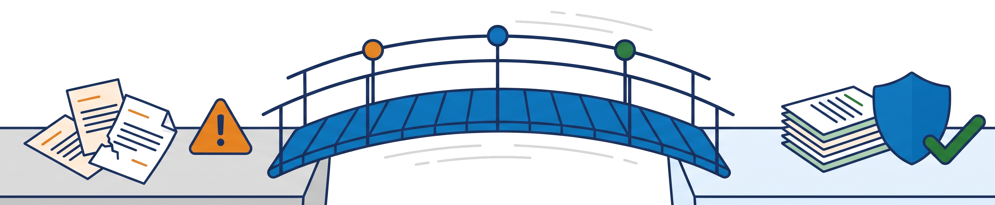
FEASIBILITY AND VIABILITY
OneVision
❖ Analysis of the feasibility of the idea
❖ Potential challenges and risks | ❖ Strategies for overcoming these challenges
Few issuers offer verification APIs | Issuer adapters return the six status labels; each connector is enabled per issuer on authorised access
Headings and filenames can't be trusted | Classify by content and issuer
Printed 'digitally signed' images look signed | Two separate checks, the issuer's signature and the uploader's; an image-only mark goes to manual review
Templates change every year | Template version read from the document itself
False flags could hurt honest institutions | Advisory only; evidence + APH clause on every flag; human review first
Repeating what the portal already does | We never repeat the portal's own Deficiency Report checks (norm arithmetic, duplicate faculty, PAN)
State fire and building rules change over time | Rule tables versioned by Act and effective date
Technical
Open-source stack hosted in India; no foreign AI services.
Data
Formats mapped from 45 real public PDFs; evidence is produced on synthetic and anonymised data.
Operational
Fits the existing approval stages; no new process for AICTE.
Economic
Rules are versioned config per APH edition: a new handbook is a config change, not code.
❖ Integration and deployment
API-first
REST + signed webhooks: portal events in, evidence-linked flags out.
SSO-linked workbench
Officials open any flag from the portal through single sign-on, with role-based access.
Self-hosted in India
Docker services run on infrastructure in India.
Privacy
Personal fields are rejected or masked at the gateway; faculty appear as pseudonymous IDs; role-based single sign-on.
Engineering assurance
Every change merges through a pull request gated by seven automated checks: lint, types and tests for the web and Python code, a full-stack smoke test with browser end-to-end scripts, secret scanning, and a guard that keeps real documents out of the repository.
No foreign LLM APIs
Documents are never sent to external AI services.
AI advises, officials decide
Every flag is evidence only; the AICTE official records the disposition in the portal.
Team: OneVision · 199020

Slide 5
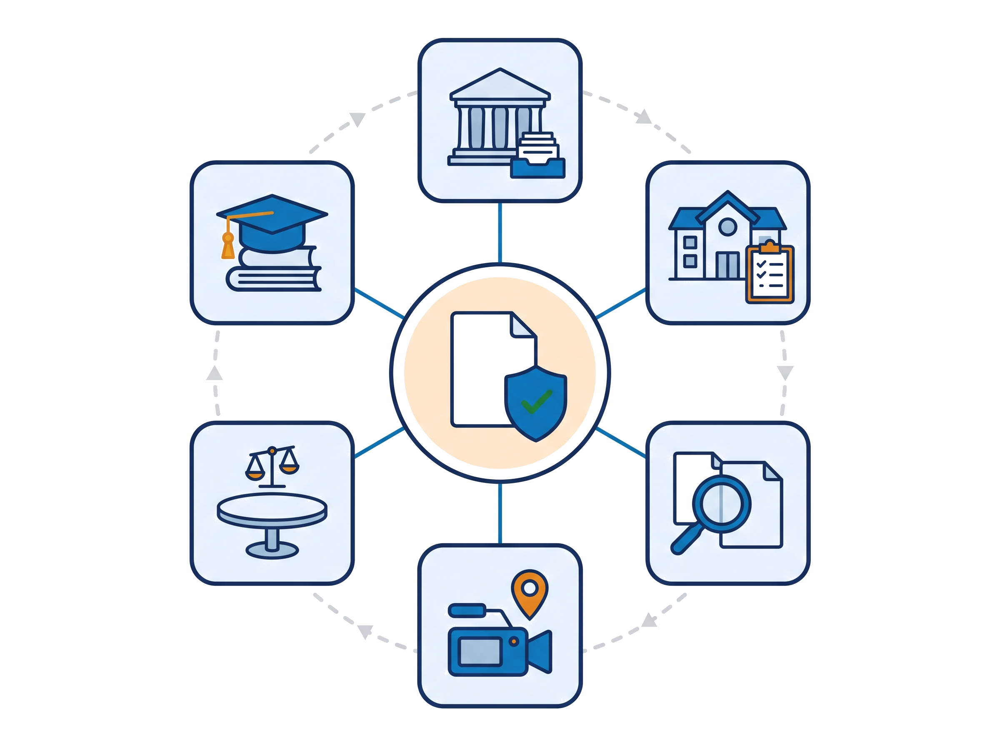
IMPACT AND BENEFITS
OneVision
❖ Potential impact on the target audience
❖ Benefits of the solution (social, economic, environmental, etc.)
Social
Same rules for every institution; protects students from deficient colleges
Economic
Fewer deficiency cycles; expert time goes where the evidence is
Environmental
Paperless, DSC-native checks; risk-targeted visits
Governance
Explainable flags and a replayable audit trail for hearings
Regulation Bureau officials
Students (indirect)
Institutions (private pre-check)
Before vs after, on the PS's own evaluation metrics
PS evaluation metric | Today | With SATYA-EoA | Measured by
Document-extraction accuracy | Manual reading | Template anchors + OCR confidence | Per-field accuracy
Validation accuracy | Self-declared, unchecked | Handbook rules with the clause cited | Correct and missed flags, per rule
Anomaly-detection performance | Ad hoc, by committee | Comparison, signature, stamp and year-over-year flags | Test set with known seeded anomalies
Successful source-verification rate | No check before approval | Six-label status per document | Share of documents resolved as verified or mismatch
Discrepancy-identification reliability | Depends on the reviewer | Same rule, same evidence, every case | False-flag rate
Average verification time | Manual process | Automated first pass | Minutes per application
Alert timeliness | At committee stage or after approval | At upload and on expiry | Time from upload to alert
Reduction in manual processing effort | Every page read by hand | Reviewer sees flags with evidence | Pages reviewed per case
Hearing, executive and appeal committees
Scrutiny Committee experts
Expert Visit Committee
Example: a Tamil Nadu college files a self-disclosure EoA. SATYA-EoA finds that the sworn affidavit is missing its category line, the Tamil Nadu fire licence lapsed before the processing date (issuer source: expired), and the occupancy certificate's 'digitally signed' mark is only an image (manual review required). The Regulation Bureau official reviews the evidence and records a disposition; the institution is asked to clarify through the portal.
Each metric is reported per rule on randomised, held-out test sets.
Team: OneVision · 199020

Slide 6
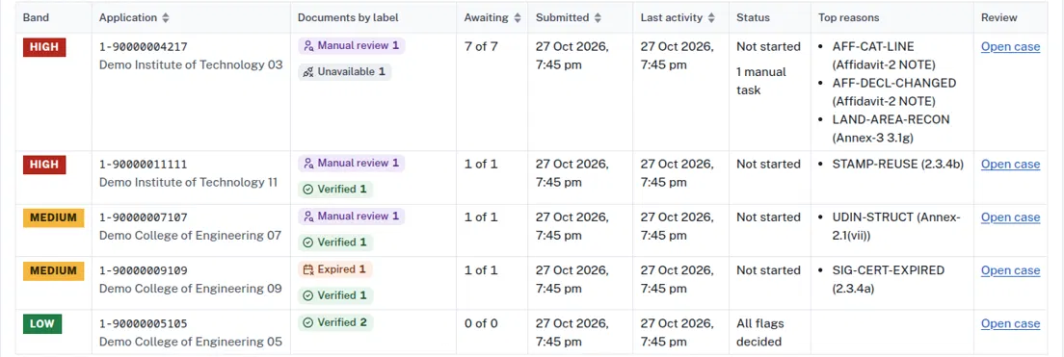
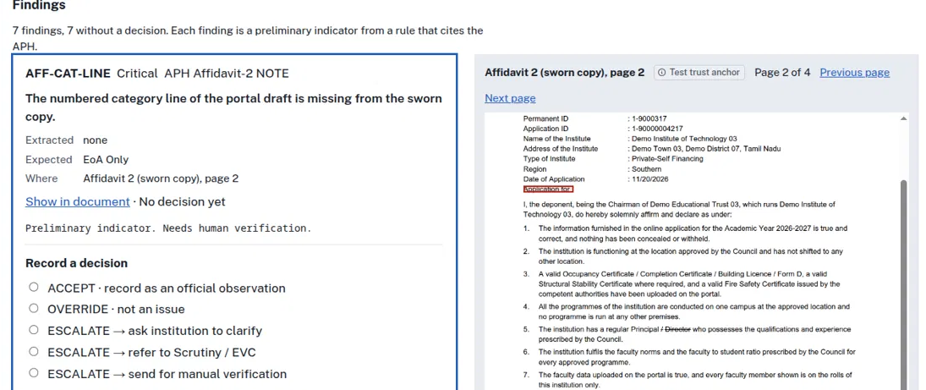
RESEARCH AND REFERENCES
OneVision
❖ Details / Links of the reference and research work
Existing approaches vs SATYA-EoA
[1] AICTE, Approval Process Handbook 2024-25 to 2026-27 (Table 2.3; cl. 1.8-2.25, 6.14, 7.4; Annex. 2, 3, 14, 18). aicte.gov.in
[2] AICTE, Smart India Hackathon 2026 problem statement SIH26261 (Smart Automation, Software).
[3] OneVision, analysis of 45 publicly published institutional PDFs (14 states/UTs, AY 2016-17 to 2026-27), Oct 2026 (team note).
[4] Govt. of Tamil Nadu, Tamil Nadu Public Buildings (Licensing) Act, 1965 (Act 13 of 1965) and Rules, 1966 (Form D).
[5] Govt. of Tamil Nadu, Tamil Nadu Fire Service Act, 1985 (as cited on TN fire licences).
[6] Y. Du, C. Li, R. Guo, X. Yin, W. Liu, J. Zhou, Y. Bai, Z. Yu, Y. Yang, Q. Dang, H. Wang, "PP-OCR: A Practical Ultra Lightweight OCR System," arXiv:2009.09941, 2020.
[7] ISO 32000-2:2020, Document management - Portable document format - Part 2: PDF 2.0 (digital signatures, /ByteRange).
[8] Verification channels: cca.gov.in · shcilestamp.com · tnedistrict.tn.gov.in · udin.icai.org
Capability | Today: manual scrutiny + portal Deficiency Report | Generic OCR and rule checkers | SATYA-EoA
Reads AICTE's fixed templates by their layout (affidavit, formats, certificates) | ✗ | Partial | ✓
Compares the sworn affidavit with the portal's own draft and data | ✗ | ✗ | ✓
Tells a real digital signature from a printed 'digitally signed' image | ✗ | ✗ | ✓
Checks each certificate with its official issuer, with six clear status labels | ✗ | Partial | ✓
Checks stamp-paper dates and reuse, and the UDIN on CA certificates | ✗ | ✗ | ✓
Applies the handbook's date and land rules (partial occupancy, plots within 2 km) | ✗ | Partial | ✓
Flags reused photos, GPS that does not fit, and floor-plan area below the norm | ✗ | Partial | ✓
Evidence-linked flags with handbook clause, tamper-evident audit trail and replay | ✗ | Partial | ✓
Generic checkers: tools that apply OCR, keyword rules and duplicate-file checks to any document.
Abbreviations: EoA Extension of Approval; APH AICTE Approval Process Handbook; DSC digital signature certificate; CCA Controller of Certifying Authorities; UDIN Unique Document Identification Number (ICAI, for chartered accountant certificates); OC occupancy certificate; SHCIL StockHolding Corporation of India (e-Stamp); EVC Expert Visit Committee; PS problem statement.
SATYA-EoA workbench · synthetic data
Team: OneVision · 199020

