Slide 1
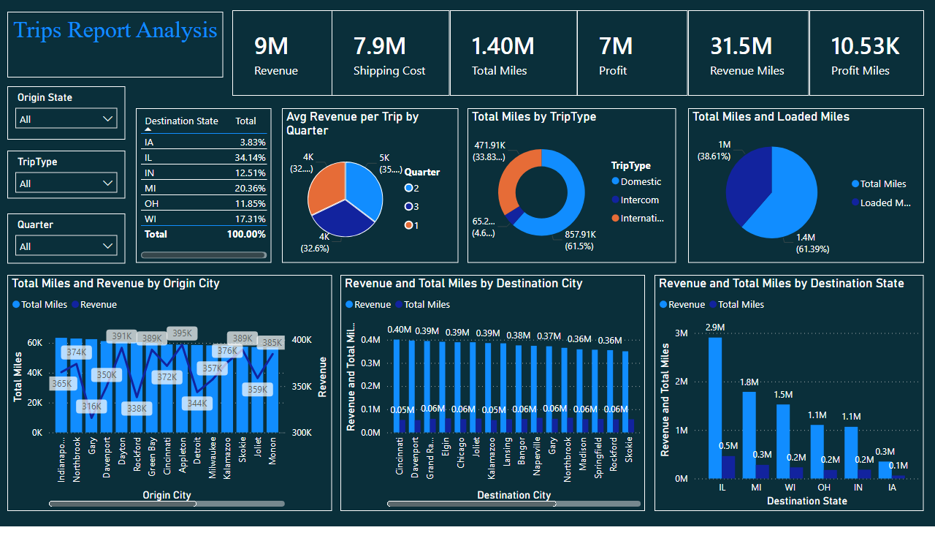
Trip Metrics Dashboard

Slide 2
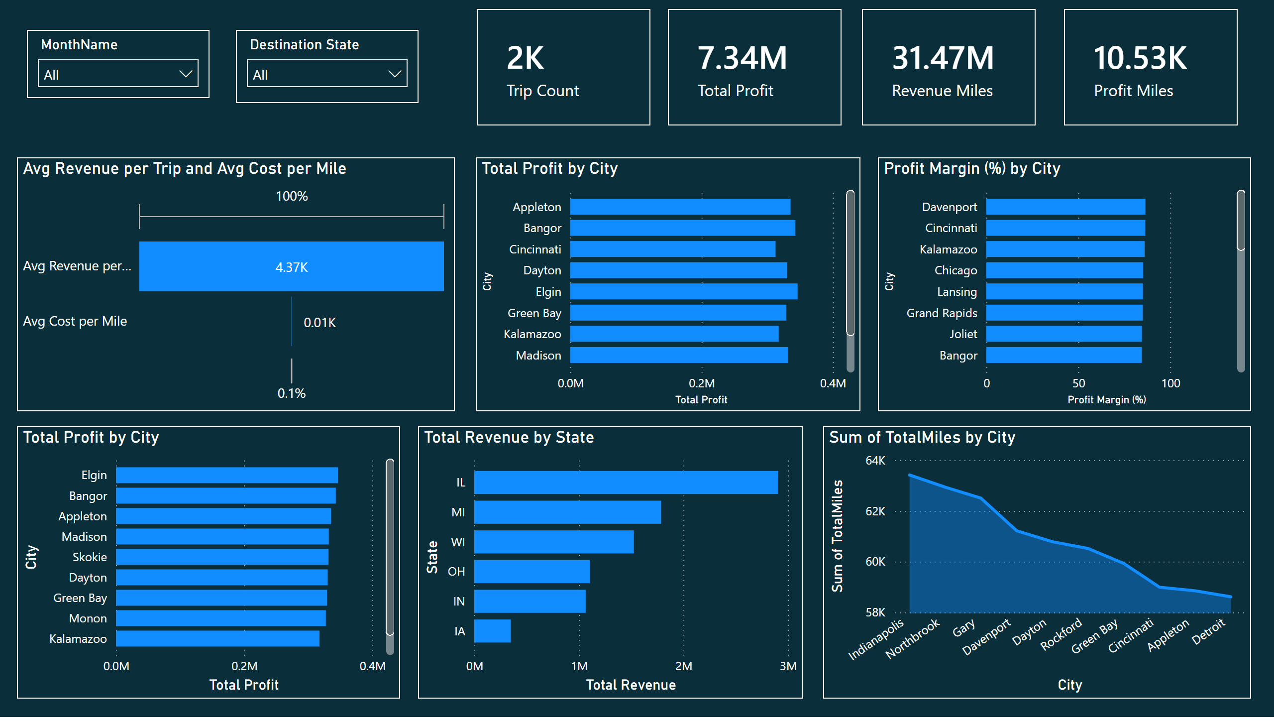
Trip Expense Navigator

Slide 3
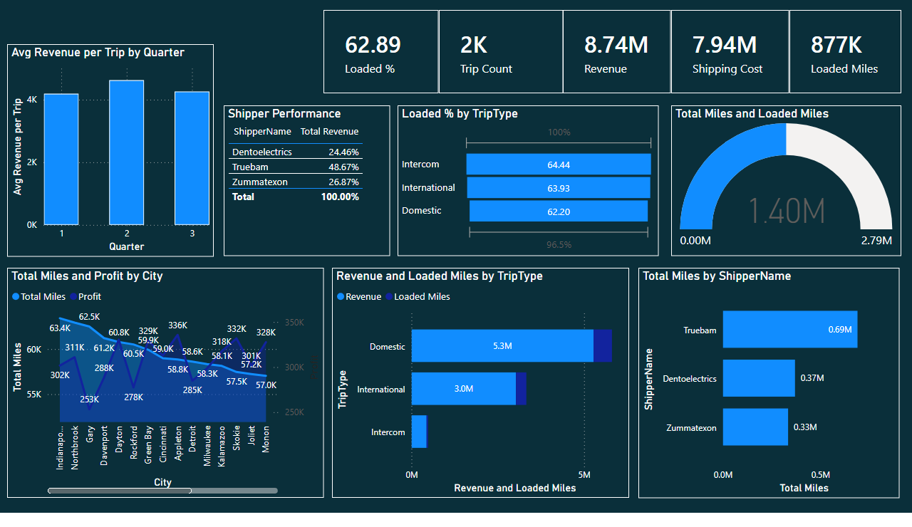
Journey Analytics

