Slide 1
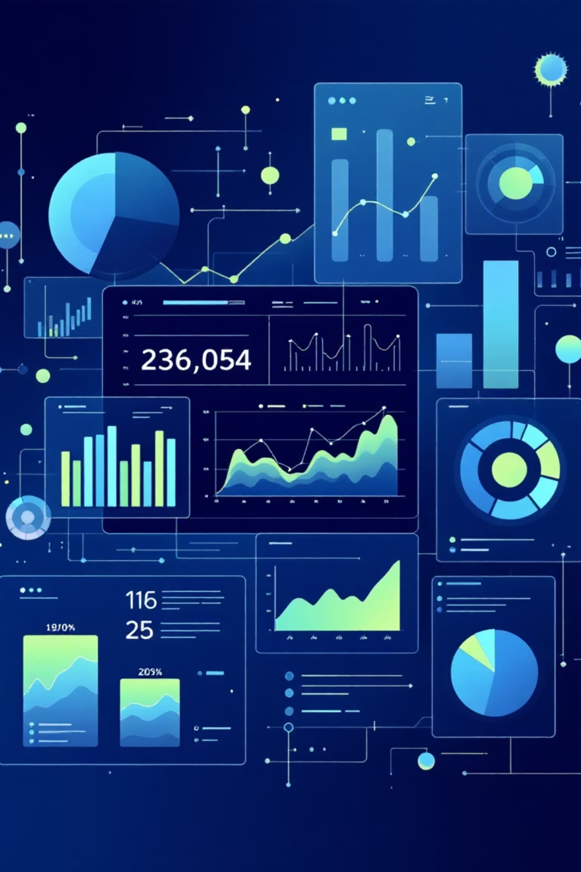
Trips Report Analysis Using Medallion Architecture
End-to-End Data Engineering & Analytics Solution
Transforming raw trip data into actionable business insights through a structured, scalable approach.
Presented by: Akash Kumar

Slide 2
Business Problem & Use Case
Data Volume Challenge
Quality & Reliability
Business Intelligence Needs
Large volume of raw trip data.
Data quality issue affect accuracy
Unstructured formats hinder
Inconsistent formats, missing values, duplicates.
Need reliable KPIs and insights.
analysis.
Bottlenecks for timely insights.
Current processes lack structure.
Reduces trust in analytics.
Struggle to deliver consistent, actionable metrics.
Our Solution
Convert raw trip data into clean, analytics-ready datasets, ensuring data quality, scalability, and governance.

Slide 3




Medallion Architecture Implementation
A structured approach to data transformation that progressively refines data quality and business value.
Raw Lakehouse
Bronze Layer
Stores unprocessed trip data in native formats. Preserves complete data history for audit and reprocessing.
Ingested and structured raw data. Initial validation and schema enforcement applied.
Silver Layer
Gold Layer
Cleaned, validated, and transformed data. Business rules applied, duplicates removed.
Aggregated, business-ready data. Optimized for reporting and analytics consumption.
Key Benefits
Technical Advantages
Ensures data quality and consistency
Clear separation of concerns at each layer
Supports scalability for growing data volumes
Reprocessing capability without data loss
Enables strong data governance practices
Optimized performance for analytics workloads

Slide 4
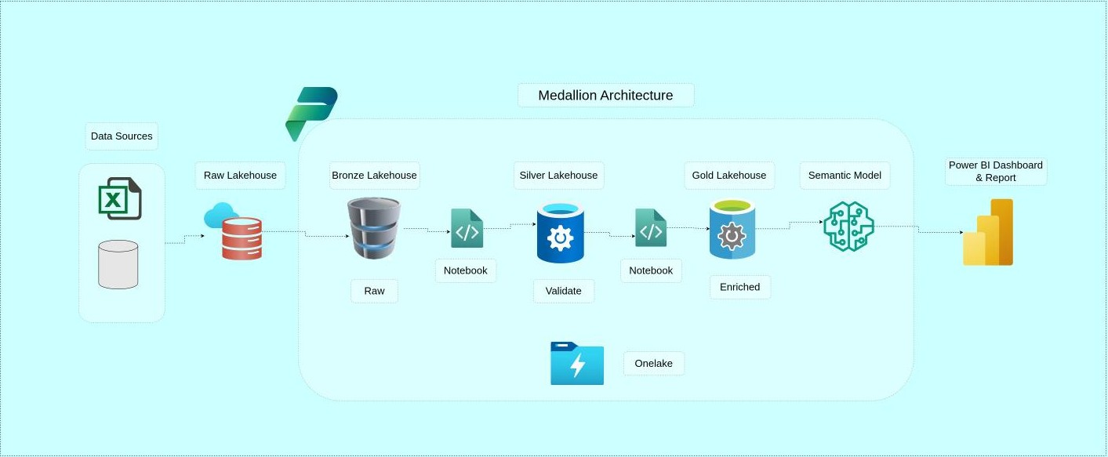
Architecture Diagram

Slide 5




Semantic Model & Power BI Dashboard
01
02
03
Semantic Model Design
Dashboard Development
User Experience
Built on top of Gold Layer with defined table relationships and calculated business measures.
Created interactive visualizations with drill-down capabilities for deep analysis.
Designed intuitive navigation and self-service analytics for business users.
Key Performance Indicators
Total Trips
Revenue & Fare Trends
Comprehensive trip volume tracking across all locations and time periods
Financial performance analysis with trend identification and forecasting
Trips by Location
Time-based Analysis
Geographic distribution and route analysis for operational optimization
Temporal patterns revealing peak hours, seasonal trends, and usage cycles

Slide 6



Key Learnings
Medallion Architecture
Data Quality & Semantic Model Design
End-to-End Analytics Flow
Structured, scalable approach to data transformation.
Integrates all components for a seamless pipeline.
Crucial for accurate business metrics.
Ensures progressive data refinement.
Delivers timely and actionable insights.
Enables reliable analytics across the organization.
From raw ingestion to curated insights.
Directly to business users.
Requires high data quality and robust semantic models.
Thank You

