Slide 1

Emertxe Information Technologies (P) Ltd
IOT based Home Automation Solution
Presented by: Akash L M and Chinmaya S Ram
NMAM Institute of Technology, Nitte
Date : 11/08/2022

Slide 2
Abstract:
Home Automation using Arduino (picsimlab)and Blynk application.
Controlling Garden Lights based on whether it is a Day or Night.
Controlling fans and heater based on whether it is a Hot or Cold and also sending respective notifications to LCD and application.
Controlling water level of the tank based on its capacity and also sending respective notifications to LCD and application.

Slide 3
What we learnt in this Internship:
Week 1:
C-programming and its Data Types.
Conditional statements and Different types of Operators.
Pointers and Functions
Strings manipulation and Storage classes.

Slide 4
What we learnt in this Internship:
Week 2:
Introduction to C++ classes, object creation
Constructors and Destructors.
Introduction to IoT and its applications.
Installation of Arduino IDE, Null modem emulator, Picsimlab and all the required libraries.
Week 3 and week 4, we started building our Home automation Project.

Slide 5
Overview:
1.1 Purpose
The purpose of this project is to bring up an IoT based Home Automation Solution for controlling appliances remotely, to make life more convenient for the users.
1.2 Scope
The Home automation is simulated using picsimlab simulator, and used Blynk iot mobile applications to control the home appliances. In this project we should be able to control the lights, temperature of the home, inflow and outflow of water in the water tank using Blynk mobile app.

Slide 6

2 Assumptions and Dependencies
2.1 Assumptions
All the peripherals are simulated and no real time objects are interfaced .
2.2 Dependencies
Based on Blynk Mobile app we are controlling devices.

Slide 7
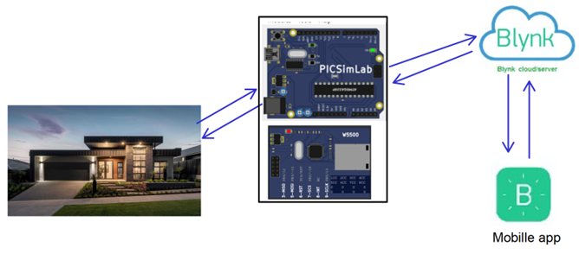
3.1 Functional Requirements
Fig 1: Schematic diagram

Slide 8
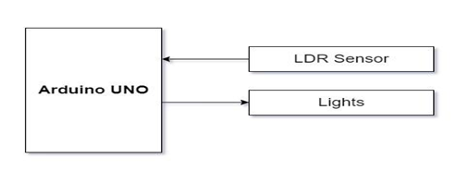
3.1.1 Garden lights control
Description :
Read the LDR sensor value, based on the reading from LDR, vary the brightness of the LED, which resembles controlling garden lights based on the availability of sunlight.

Slide 9
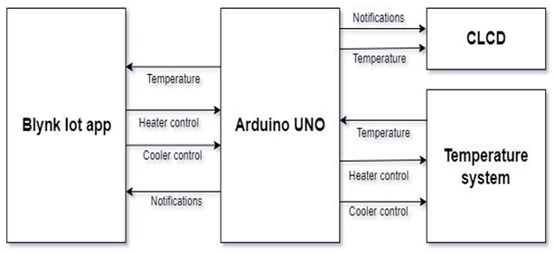
3.1.2 Temperature Control System
Description :
The temperature control system consists of a heating resistor, an LM35 temperature sensor, and a cooler. Which resembles the temperature control system at home. Read the temperature from the temperature sensor LM35 and display it on the CLCD. Control the temperature of the system by turning ON/OFF the heater and cooler through the Blynk IOT mobile app .

Slide 10
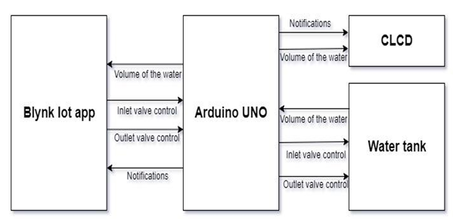
3.1.3 Water tank inlet and outlet valve control
Description :
Read the volume of the water in the tank through Serial Communication and display it on the CLCD, control the volume of the water in the tank by controlling the inlet and outlet valve, by sending commands through serial communication. Display the volume of water in the tank on the CLCD.

Slide 11
3.2 User Interfaces
BLYNK Application
Blynk was designed for the Internet of Things. It can control hardware remotely, it can display sensor data, it can store data, visualize it and do many other cool things.
Widgets on Mobile blynk application:
Button widgets to control heater, cooler, inlet valve , outlet valve.
Gauge widgets to display temperature and volume of the water in the tank on the mobile application
Terminal widgets to display the notifications whenever threshold is crossed like
“Temperature is more than 35 degrees”, “” turning OFF the heater”, “water level is full “
“Water inflow disabled”

Slide 12
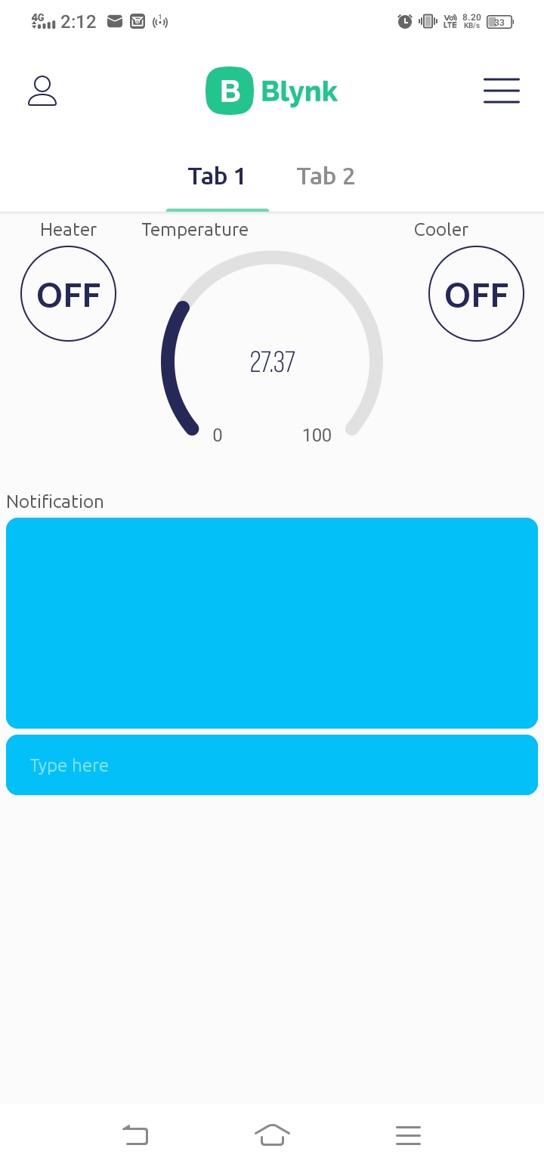
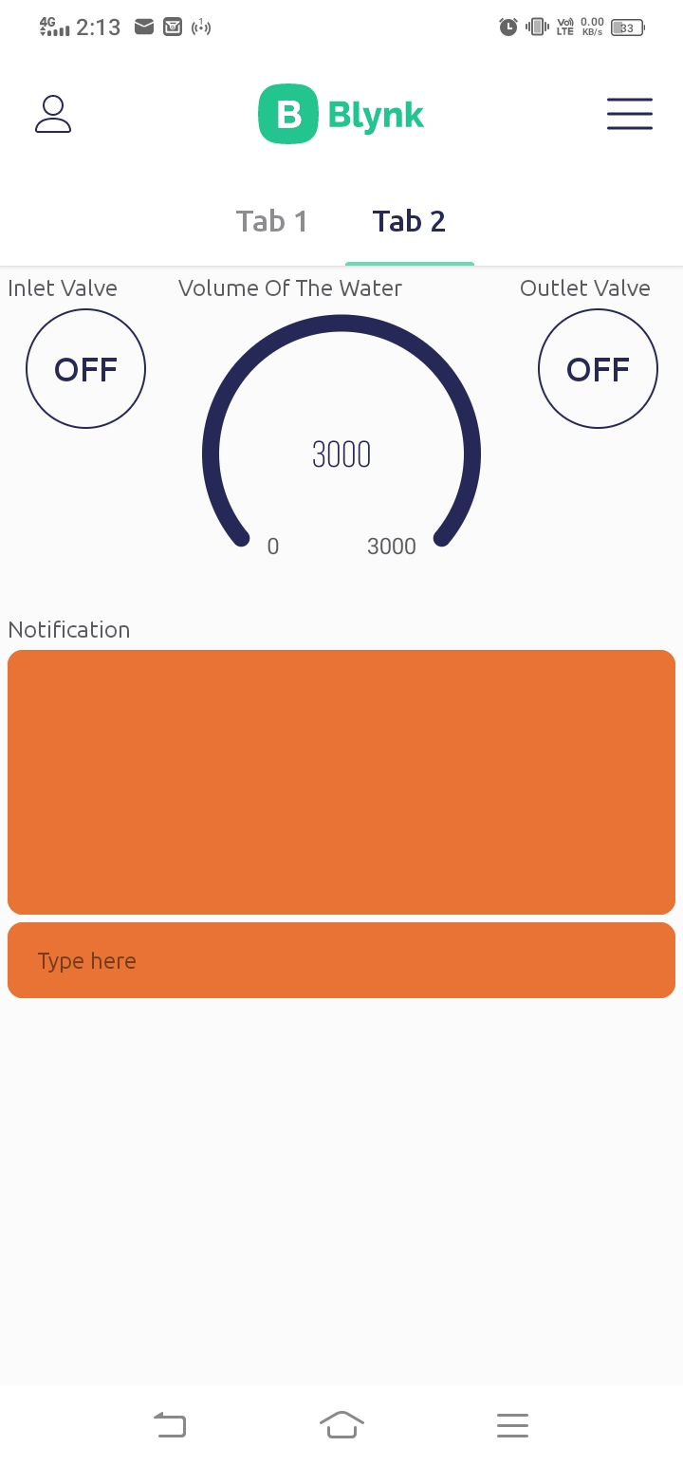
Blynk IoT App:
Fig 2:(Tab1) Button widgets to control the heater, cooler and gauge widget to display the temperature, and terminal to print the notifications.
Fig 3 : (Tab2) Button widgets to control inlet valve, outlet valve, gauge to display volume of water in the tank and terminal to print the notifications.

Slide 13
Threshold control
When the heater is ON if the temperature rises above 35 degree celsius then heater should turn OFF automatically and message “Temperature is more than 35 degree celsius Turning OFF the heater” should be displayed on the virtual terminal, “HT_R OFF” on CLCD.
When the water in the tank is full, turn off the inlet valve automatically and display “water level is full water inflow disabled”.

Slide 14
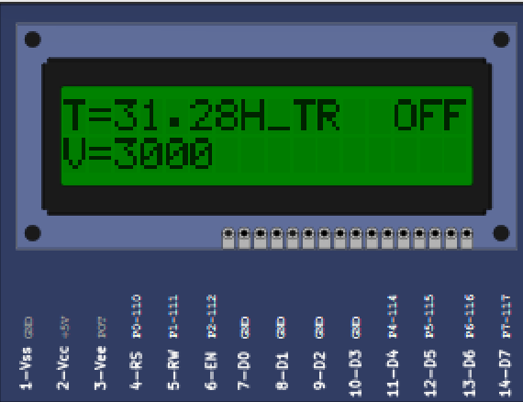
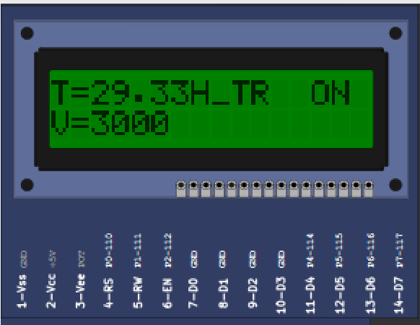
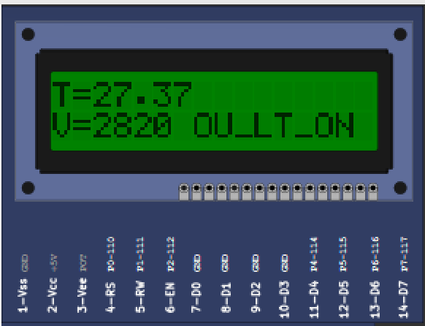
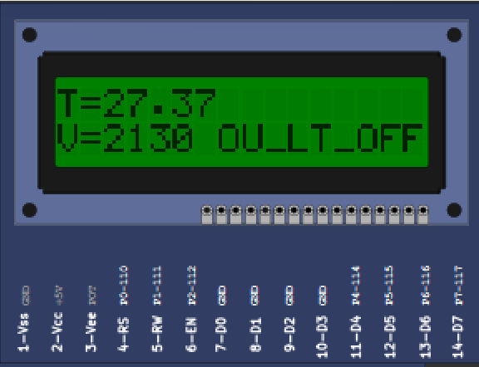
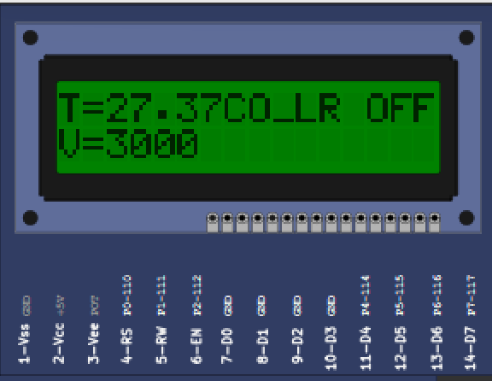
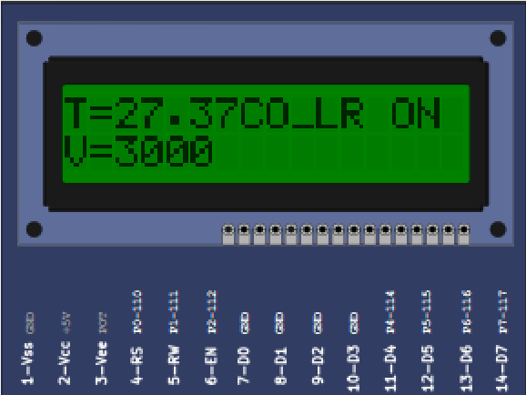
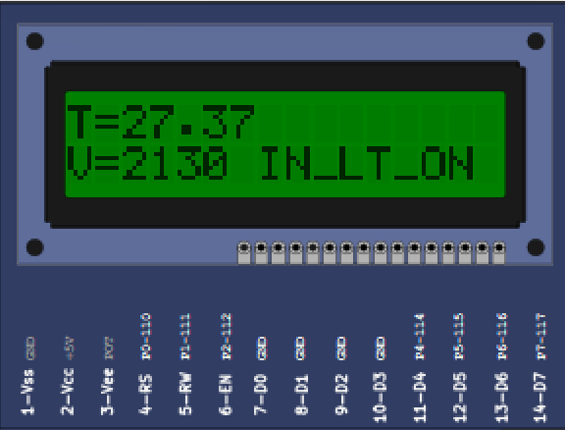
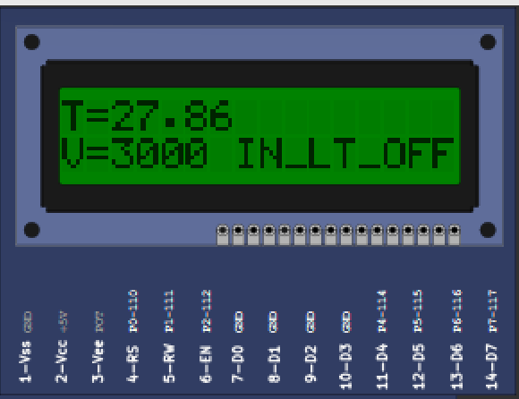
Notifications:
Fig 4 : Notifications on CLCD

Slide 15
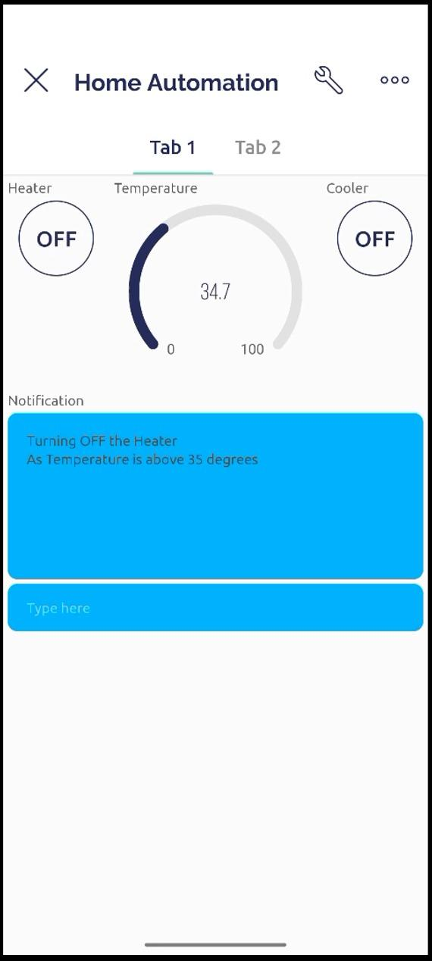
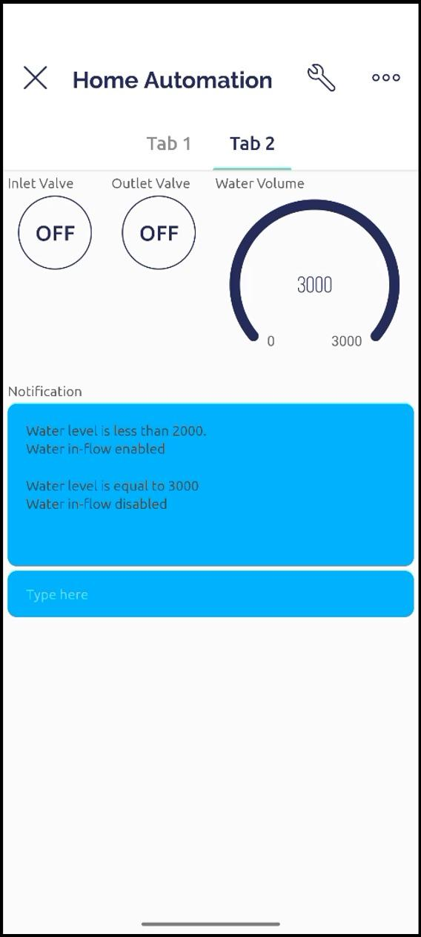
Notifications:
Fig 5 : Notifications on Virtual terminal

Slide 16
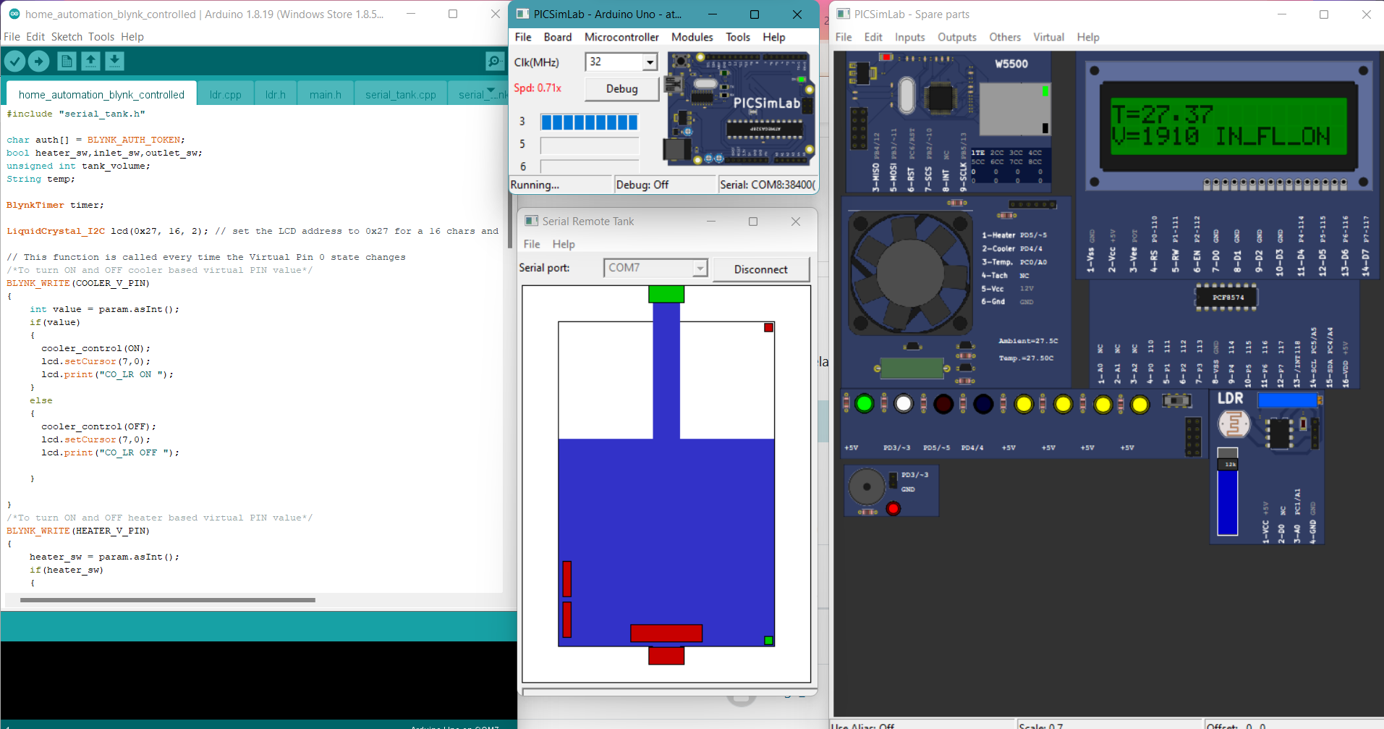
Project images:
Fig 6 : Home automation software setup

Slide 17
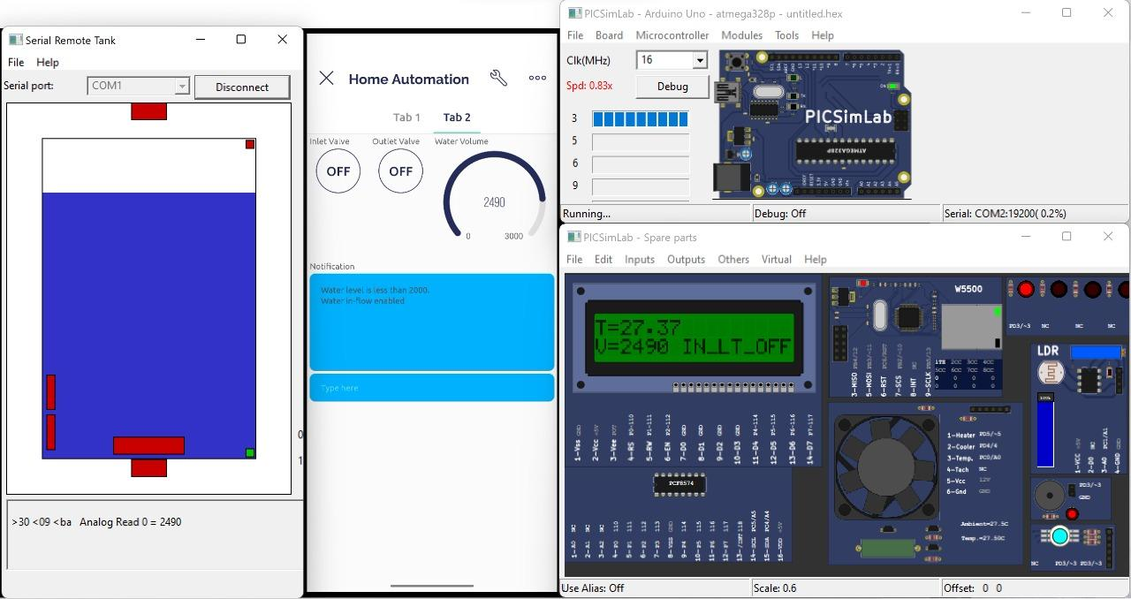
Project images:
Fig 7 : Project setup with mobile application

Slide 18
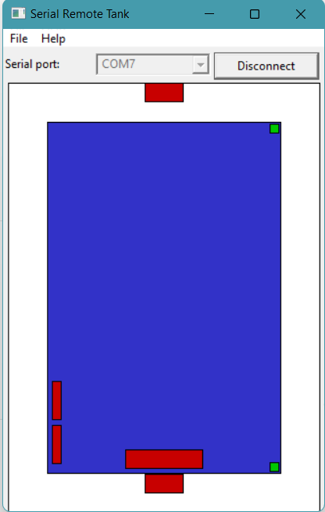
Project images:
Fig 8 : Blynk app Tab-1(Left), Blynk App Tab-2(Middle), Serial Tank(Right)

Slide 19
Conclusion
Using BLYNK Iot application and Picsimlab simulator, simulated home automation, where LED, temperature system, Serial tank - resembles Light, Heater, Cooler and Water tank in real time.
CLCD acts like a dash board used for displaying the events, Widgets from Blynk Iot app like button widgets are used to control heater, cooler and inlet valve, outlet valve.
Gauge widgets to display the temperature and volume of the water.

Slide 20

Demonstration ->

