Slide 1

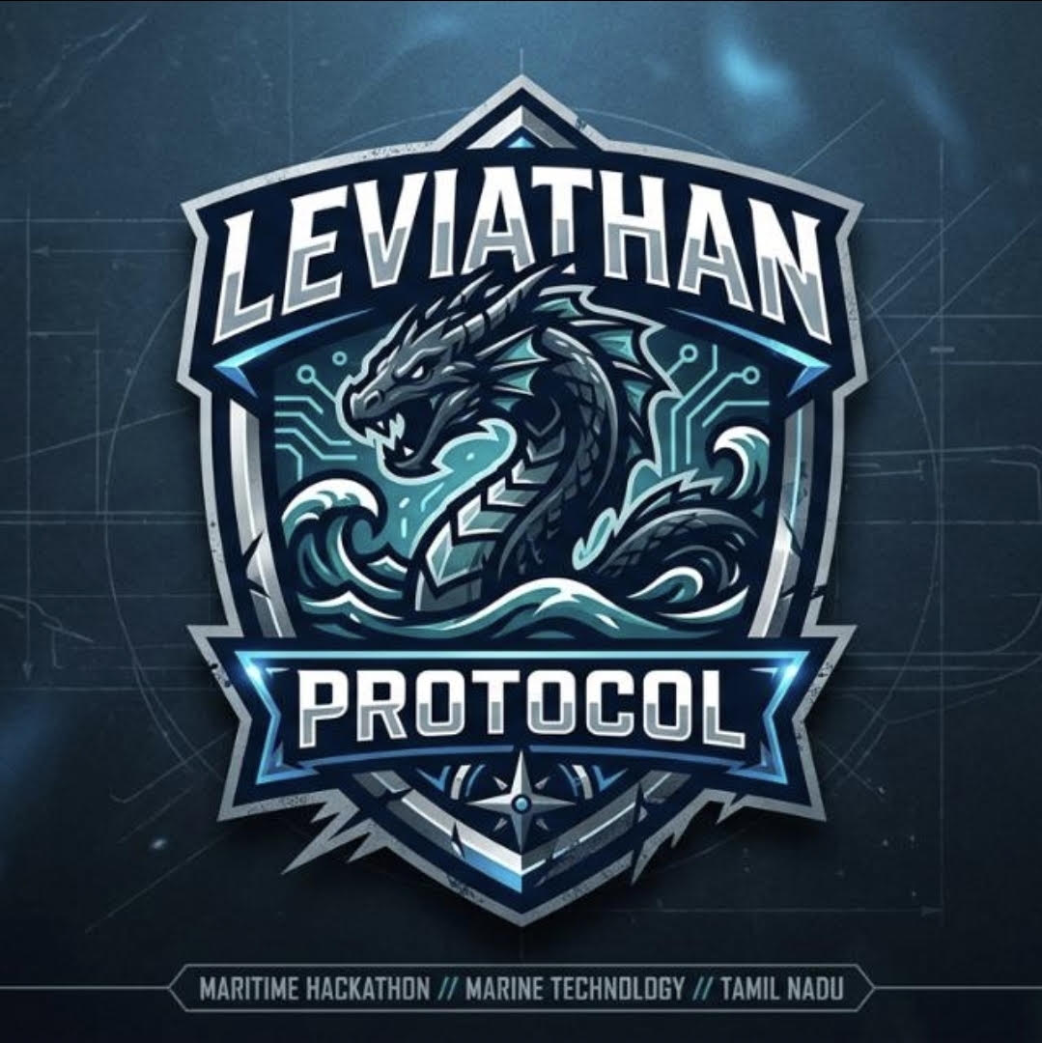
LEVIATHAN PROTOCOL
AUTONOMOUS MARITIME RESCUE SYSTEM
Project MOB Guard System

Slide 2
ABOUT The Project
Project MOB-Guard is an IoT-enabled maritime rescue system that solves critical man-overboard emergencies. Using a water-activated, GPS-tracking LoRa wristband, it detects falls instantly without cellular networks. An autonomous micro-boat launches immediately to deliver flotation aids, rations, and precise telemetry, dramatically reducing response times and preventing fatalities.
MOB – Man Over Board

Slide 3
PROBLEMs
Commercial Fishing & Trawling: Crews work slippery, exposed decks under heavy swell with minimal personnel on watch. If a crew member falls, others often don’t notice for hours.
Solo Sailors & Long-Distance Regattas: A single-handed sailor who falls overboard has zero chance of turning their boat around. An autonomous mini-tender launched from the stern is their sole physical lifeline.
Solo & Small-Crew Offshore Operations
High-Elevation Industrial Marine Work
Offshore Oil Rigs & Wind Turbines: Technicians work dozens of meters above the water. A fall can cause impact injury, loss of consciousness, or immediate disorientation. Immersion-triggered tracking ensures rescue launches without relying on manual activation.
Commercial Shipping & Night-Shift Transits
Unnoticed Night Falls on Cargo Vessels: On giant container ships and bulk carriers, crew members rarely walk the deck in groups at night. A missing person might only be realized during shift roll-call hours later.
Low-Visibility & Cold-Water Environments
Heavy Fog, Severe Swell, and Night Seas: Visual human search via binoculars and spotters fails in 3+ meter swells or dense fog. GPS-guided autonomous surface vehicles navigate blindly and accurately using sensor coordinates.

Slide 4
SOLUTION
A Man Overboard (MOB) system is an integrated safety and telemetry network designed to detect when a person falls from a vessel, track their drift in open water, and execute rapid recovery before cold-water incapacitation or drowning occurs.
An MOB (Man Overboard) watch or smart wristband is built for survival and rapid RF broadcasting rather than everyday smartwatch features. It prioritizes rugged sealing, high-visibility casing, and physical emergency sensors.

Slide 5
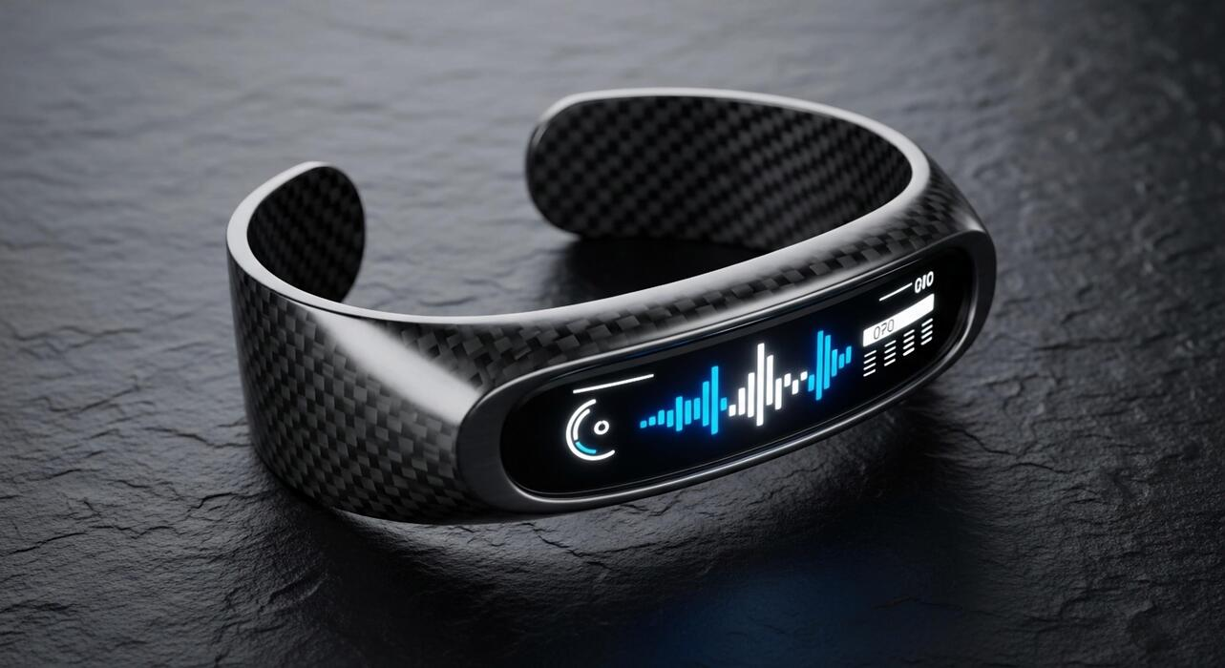
HOW IT WORKS ?
PHASE 1
The Fall (Instant Trigger): When a person falls into the sea, salt water touches sensors on their wristband. This immediately wakes the device up—even if the person is knocked unconscious and cannot press the SOS button.
PHASE 2
The Call (Radio Message): The wristband grabs the person's exact GPS coordinates and shoots a radio signal (using long-range LoRa, no cell service or internet needed) directly back to the ship.
PHASE 3
The Launch (Zero Delay): The ship's system instantly sounds the alarm on the bridge and automatically releases a small, unmanned motorboat into the water from the back of the ship to rescue the fallen off member
Note:
Under normal working conditions on the deck, the wristband is idle. The onboard microcontroller and the transceiver remain in deep-sleep mode, drawing only microamps of current to ensure months of standby battery life. Only the immersion circuit and the hardware interrupt pin connected to the recessed SOS button remain powered.

Slide 6
BENEFITS of MOB
Dimension | Traditional Maritime Rescue | Project MOB-Guard
Trigger | Manual observation (relies on eye-witnesses) | Automatic (water-immersion & depth sensors)
Response Initiation | Delayed; requires crew mustering | Instant; automated launch mechanism
First-Contact Time | 15–45 minutes (full ship turnaround) | 3–8 minutes (high-speed autonomous micro-boat)
Connectivity | Line-of-sight visual or paid satellite links | Direct, off-grid sub-GHz radio (LoRa)
Drift Management | Estimated search area expanding over time | Dynamic GPS tracking with lead-pursuit routing
Rescuer Risk | High (crew lowers rescue boat in rough seas) | Zero (unmanned craft deploys first)
Consciousness Dependency | High (victim must tread water/wave/signal) | Zero (sensor fires even if victim is unconscious)

Slide 7
Components required:
Category | Component / Product | Purpose
Microcontroller & RF | ESP32 with LoRa (e.g., TTGO T-Beam) or STM32WL55 | Handles low-power sleep cycles, reads sensors, and transmits Sub-GHz telemetry.
GNSS / Positioning | u-blox NEO-8M / SAM-M8Q GPS Module | Acquires latitude, longitude, and ground speed.
Pressure Verification | BMP280 or MS5837 waterproof pressure sensor | Reads hydrostatic pressure to filter out rain or splashes.
SOS Override | IP67/IP68 momentary waterproof push button | Enables manual triggering under a protective safety cap.
Power Supply | 3.7V 500–800 mAh LiPo battery + TP4056 charging IC | Compact power with low self-discharge.

Slide 8
SUMMARY
The Problem: Man Overboard incidents have high fatality rates caused by delayed detection, vessel turning inertia, and rapid hypothermia.
Our Solution: A closed-loop rescue system combining a water-activated GPS/LoRa wristband with an instantly deployed autonomous micro-boat.
The Impact: Cuts first-contact rescue time from 30+ minutes to under 8 minutes, operates entirely off-grid, and delivers immediate flotation before cold-water incapacitation sets in.
Takeaway: Turning chaotic search-and-rescue into calculated, autonomous life-saving precision.

Slide 9
THANK YOU
PROJECT BY
AKASH.S [CSE]
MUKILAN.R.M [CSE]
HARISARAN.D.A [MECH]
ASHVATH.U [MECH]

