Slide 1
Taskify A Task Management Application Internship Project documentation
Name :- Akash Deep
Date:- 03-03-2025

Slide 2
Context
Objective
Scope
Technologies Used
Key features
System Design
Api Endpoint
Conculsion

Slide 3
Objective
Develop a web Full stack application for efficient task management .
Implement Create ,Read,Update, Delete, Get All task, update important task
User Sign Up and Sign In and Log IN
With Great Ui layout

Slide 4
Scope
Exposure to the Software Development Lifecycle (SDLC).
Frontend Development: UI/UX design with modern frameworks.
Backend Development: REST APIs for task and user management.
Database Management: Store user data and tasks securely.
Version Control: Git and GitHub for collaboration.
Testing: Unit and integration tests.

Slide 5
Technologies Used
Html :- Hypertext Markup Language is the standard markup language for documents designed to be displayed in a web browser. It defines the content and structure of web content.
Tailwind Css :-Tailwind CSS is a utility-first CSS framework that streamlines web development by providing a set of pre-designed utility classes. These classes enable rapid styling without writing custom CSS, promoting consistency and scalability.
JavaScript :-
JavaScript (JS) is a lightweight interpreted (or just-in-time compiled) programming language with first-class functions. While it is most well-known as the scripting language for Web pages, many non-browser environments also use it, such as Node.js, Apache CouchDB and Adobe Acrobat. JavaScript is a prototype-based, multi-paradigm, single-threaded, dynamic language, supporting object-oriented, imperative, and declarative (e.g. functional programming) styles.
.

Slide 6
JSX (JavaScript XML):-JSX (JavaScript XML) is a syntax extension for JavaScript that allows you to write HTML-like code within JavaScript files. It is primarily used with React.js to describe what the UI should look
React JS:-React is a free and open-source front-end JavaScript library for building user interfaces based on components by Facebook Inc. It is maintained by Meta and a community of individual developers and companies. React makes it painless to create interactive UIs. Design simple views for each state in your application, and React will efficiently update and render just the right components when your data changes.
State Management: Redux / Context API
NodeJs:- Node.js is a runtime environment that allows developers to run JavaScript on the server side. It is built on Google Chrome’s V8 engine, making it fast and efficient.
Feature of Node Js:-
Asynchronous & Non-blocking I/O :– Handles multiple requests efficiently JavaScript Everywhere :– Use the same language for frontend & backend Fast Execution :– Uses the V8 engine for high performance Large Ecosystem :– NPM (Node Package Manager) has thousands of libraries Scalability :– Perfect for building real-time applications

Slide 7
Express.js :-Express.js is a fast, minimal, and flexible web framework for Node.js. It helps developers build server-side applications and APIs with ease.
Key Features of Express.js:
Lightweight & Fast: Minimal setup required.
Middleware Support: Easily add authentication, logging, and error handling.
Routing System: Handles different HTTP requests like GET, POST, PUT, DELETE.
Integration with Databases: Works with MongoDB, MySQL, PostgreSQL, etc.
Axios :- Axios is a popular HTTP client for making API requests from the browser and Node.js. It helps fetch and send data easily with support for promises and async/await.
Key Features of Axios :-
Supports GET, POST, PUT, DELETE requests.
Handles automatic JSON data conversion.
Built-in error handling and request cancellation.
Works in both browsers and Node.js.

Slide 8
Key Feature
1 .User Authentication:
1:Signup, Login, Logout.
2:Password reset functionality.
2.Task Management:
Create, View, Update, Delete tasks.
Categorize tasks (Work, Personal, Shopping).
Add deadlines and priority levels.
3.Dashboard:
Responsive UI for task visualization.
Sorting and filtering tasks.

Slide 9
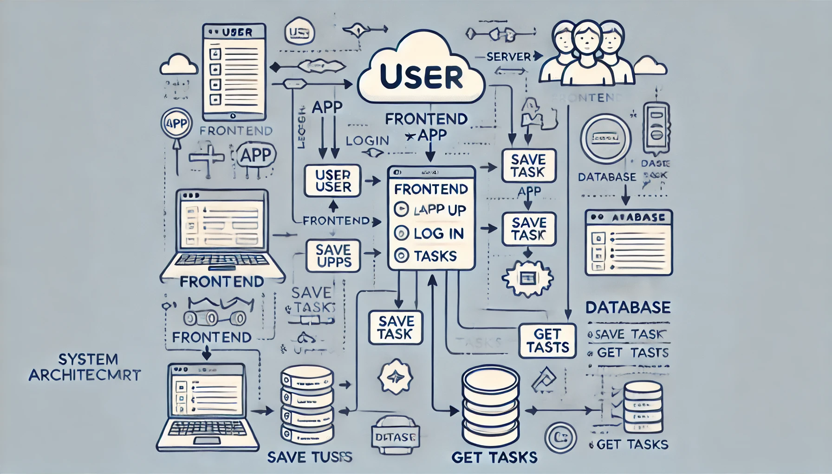
System Design

Slide 10
System Architecture Overview
1. System Components
The system consists of four main components:
A.User
Represents the end-user interacting with the application.
Performs actions such as signing up, logging in, and managing tasks.
B.App (Frontend)
The user interface where users interact with the system.
Allows users to:
Sign up and log in
Create, update, delete, and view tasks
Sends requests to the backend server.

Slide 11
Server (Backend):-
Processes user autdsfhentication and task management requests.
Verifies login credentials and issues a token for authenticated sessions.
Handles CRUD (Create, Read, Update, Delete) operations for tasks.
Communicates with the database to fetch or store data.
Database :-
Stores user information and tasks.
Ensures data persistence and retrieval for task management.

Slide 12
2. Data Flow (Step-by-Step Process)
A.User Sign Up / Login:-
The user enters their credentials (email & password).
The App (Frontend) sends a login request to the Server (Backend).
The Server verifies the credentials and returns a token.
The token is stored in the frontend for authentication.
B.Task Management (CRUD Operations):-
The user creates, updates, or deletes a task.
The App sends the request to the Server with the authentication token.
The Server verifies the request and updates the Database.
The updated task list is sent back to the App.

Slide 13
Data Storage & Retrieval :-
The Database stores all user accounts and tasks.
When a user logs in or requests their tasks, the Server retrieves the data from the Database and sends it back to the App.

Slide 14
Conclusion :-
The Task Management App follows a structured full-stack architecture, ensuring seamless interaction between the user interface, backend server, and database. The system efficiently handles:
User Authentication using a token-based system.
Task Management through CRUD operations (Create, Read, Update, Delete).
Data Persistence by securely storing tasks and user information in a database.

Slide 15
Thank you Miamin System for this wonderful opportunity. This project helped me enhance my skills and gain valuable experience in full-stack development.

