Slide 1

TITLE:"CNN-Powered Paddy Variety Detection Using AI and ML"
PRESENTED BY:
AKASH K-210624243005
MANOJ M-210624243045
GOKULANATHAN K-210624243019

Slide 2
1.0 .ABSTRACT:
Paddy variety detection is essential in agriculture due to differences in yield, growth time, and resistance among rice types. Traditional identification methods are manual and often inaccurate.
This project introduces an AI-based solution using Convolutional Neural Networks (CNN) to automatically classify paddy varieties from grain images. A diverse dataset is collected and preprocessed to improve image quality.
The CNN model is trained to recognize features like grain shape, size, texture, and surface patterns. The system is evaluated using metrics such as accuracy, precision, and recall, showing strong performance.
This approach offers a fast, reliable, and efficient way to identify paddy varieties, helping farmers and quality control systems.

Slide 3
2.0.PROBLEM STATEMENT:
Paddy variety identification is critical for crop yield, maturity, grain quality, and pest resistance.
Traditional methods are manual, time-consuming, and depend on expert knowledge.
These methods are subjective, error-prone, and inefficient, especially in large-scale operations.
Misidentification can lead to poor crop performance, financial loss, and quality issues.
There is a need for an automated, accurate, and scalable system for paddy variety detection.
AI and ML, especially CNNs, offer a reliable solution by minimizing human error and improving consistency.

Slide 4
3.0.EXISTING SYSTEM:
1.Identification Process
Based on visual inspection of paddy grain features (shape, size, texture).Involves physical comparison with known samples, without automation
2. Expert Dependency
Requires agricultural specialists with deep domain knowledge.Accuracy depends on the judgment and experience of the expert
3. Time and Labor
The process is slow and manually intensive.Not practical for large-scale or rapid assessments
4. Human Error
Results are often subjective and inconsistent between evaluators.Prone to fatigue and misclassification during long sessions
5. Scalability Issues
Not suitable for bulk or real-time processing.Lacks integration with modern, data-driven systems.

Slide 5
3.1.ADVANTAGES
1. Automation
Eliminates manual inspection through fully automated analysis.Reduces the need for human intervention and expertise
2. High Accuracy
CNN model can detect subtle visual differences in grain features.Offers high classification accuracy with consistent results
3. Speed and Efficiency
Capable of processing thousands of images quickly.Suitable for real-time or large-scale applications
4. Consistency
Provides uniform and objective results, removing subjectivity.Performance is not affected by fatigue or bias
5. Scalability
Easily expandable to include more paddy varieties.Can be integrated into digital agriculture systems and mobile apps.

Slide 6
3.2.DISADVANTAGES:
1.Data Dependency
Requires a large, high-quality image dataset for training.Performance may drop if the data is imbalanced or noisy
2. Technical Complexity
Involves complex model design, training, and tuning.Needs AI/ML expertise for development and maintenance
3. Generalization Issues
Model may not perform well on unseen or rare varieties.Needs frequent updates or retraining to stay accurate

Slide 7
4.0.PROPOSED SYSTEM:
1. System Overview
Uses Convolutional Neural Networks (CNN) to classify paddy grain images.Aims to automate variety detection based on visual grain features like shape, size, and texture
2. Image Dataset
Collect images of multiple paddy varieties under controlled lighting.Preprocess images to remove noise, resize, and normalize for model training.
3. Model Training
Train a CNN model using labeled image data.CNN learns features through multiple layers (convolution, pooling, etc
4. Classification and Prediction
Once trained, the model can accurately predict the paddy variety from a new image.The model outputs theclass label with a confidence score
5. Evaluation Metrics
Accuracy, Precision, Recall, F1-score, and Confusion Matrix used for performance evaluation.Ensures robustness and reliability of the system.

Slide 8
4.1.ALGORITHMS AND TECHNOLOGIES
CNN (Convolutional Neural Network)→ A deep learning algorithm that automatically extracts and classifies image features.
Best suited for image classification tasks.
Automatically learns features like grain shape, size, texture, and color.
Offers high accuracy and generalization if trained well.

Slide 9
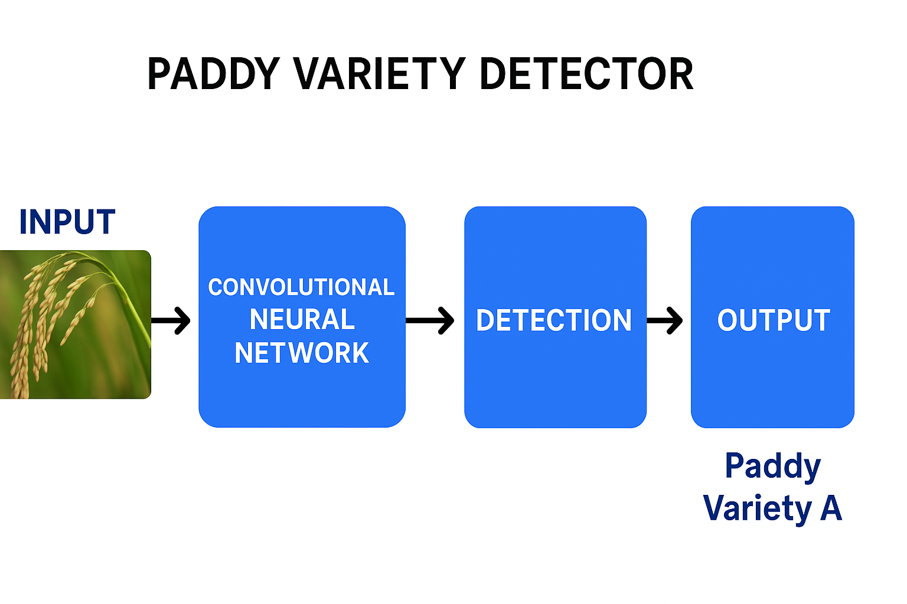
4.2.ARCHITECTURAL DAIGRAM

Slide 10
5.0.REFERENCE
LeCun, Y., Bengio, Y., & Hinton, G. (2015). Deep learning. Nature, 521(7553), 436–444.2. Chollet, F. (2017).
Deep Learning with Python. Manning Publications
TensorFlow Documentation – https://www.tensorflow.
Keras API Docs – https://keras.io
OpenCV Python Docs – https://docs.opencv.org
Google Colab – https://colab.research.google.co
Kaggle Datasets – https://www.kaggle.com

