Slide 1
Presentation on “Self Driving Car”
Submitted By:
Akash Kumar
Roll No.1901280100013
Sumit Kumar Roy
Roll No.1901280100089
Chirag Agrawal
Roll No.1901280100056
Akhand Sharma
Roll No.1901280100016
Project Mentor:
Ms. Shubhangi Sharma
Project Guide
Dept. of CSE
DR. A.P.J. ABDUL KALAM TECHNICAL UNIVERSITY, LUCKNOW
NOVEMBER 2021
1

Slide 2
Abstract
Self-driving cars have the potential to greatly improve public safety. It can drive itself . It can stop whenever there is pedestrian on road or some obstacle or red light on the straight . It can take turn of it own , that means it can take right turn , left turn it can go upward , downward and all these direction by detecting which one is road .And it’s also reach the destination by it own.
2

Slide 3
Contents
S.No. | Title
1. | Introduction
2. | Problem Description Existing Problem Proposed Solution
3. | Hardware Software requirements
4. | UML Diagrams
5. | Pseudo Code
6. | Advantages and Drawbacks
7. | Outputs
8. | Conclusion and Future Scope
 | References
3

Slide 4
Introduction
1. It can drive itself
2. It can stop when ever there is pedestrain on rod or some of obstacle or a red light on the straight
3. It can take turn of it's own that means it can take right turn , left turn it can go upward , downward and these all direction by detecting which on is road
4. It can reach the direction by it's own
4

Slide 5
Problem Description
Existing Problem:-
Expensive. High-technology vehicles and equipment are expensive. ...
Safety and security concerns. Though it has been successfully programmed, there will still be the possible unexpected glitch that may happen. ...
Prone to Hacking. ...
Fewer job opportunities for others. ...
Non-functional sensors.
Proposed Solution:-
Prevention of car crashes. Of the 37,133 vehicle fatalities in 2017, 94% of the crashes were due to human error. ...
Societal cost-savings. ...
Traffic efficiency. ...
Better access and mode of transportation. ...
Environmentally friendly.
5

Slide 6
Hardware Software requirements
Hardware Requirement
Intel Pentium or and processors with speed minimum T4300,(2.10Ghz)
Minimum 1GB RAM.
Accelerated graphics card.
Minimum 50MB hard disk.
Better performance with 2.10ghz and above cache memory
Software:-
Visual Studio Code
PyCharm
Operating System : Windows 10 Ultimate
6

Slide 7
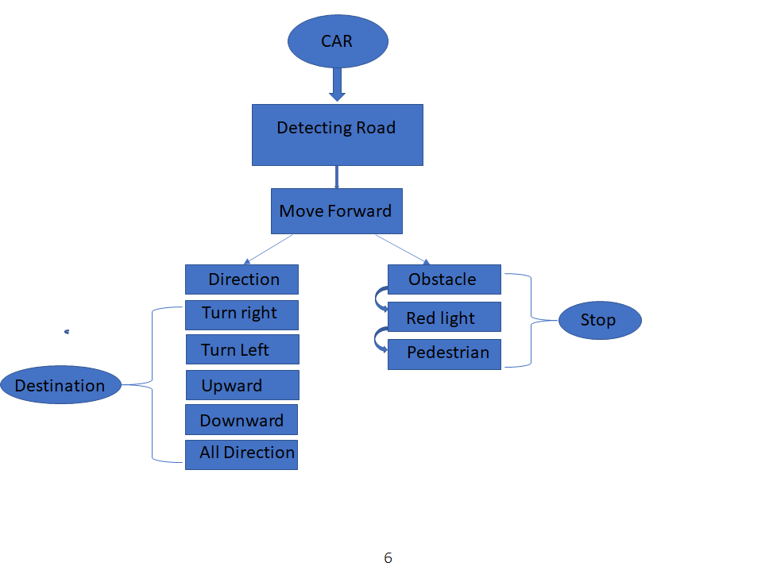
Block Diagrams
7

Slide 8
Advantages and Drawbacks
Advantages
1. Decreased the number of accidents
2. Lessens traffic jams / Traffic efficiency
3. Stress-free parking
4. Time-saving vehicle
5. Accessibility to transportation / Better access and mode of transformation
6. Environmentally friendly
Drawbacks
1. Expensive
2. Safety and security concerns
3. Prone to Hacking
4. Non-functional sensors
5. Job losses
6. Machine error
8

Slide 9


Output
9

Slide 10


10

Slide 11


11

Slide 12

12

Slide 13

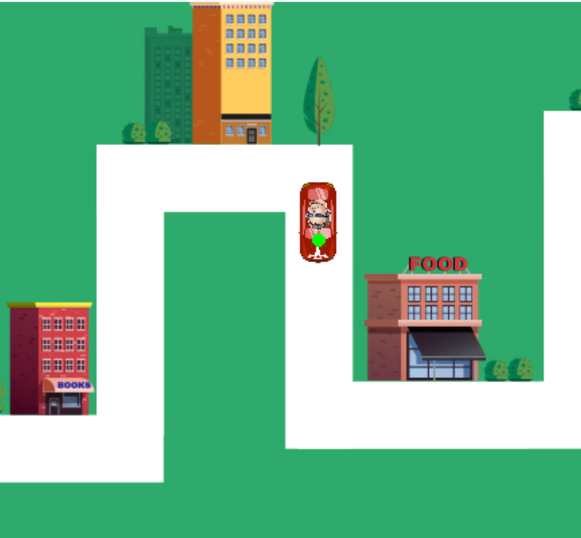
13

Slide 14
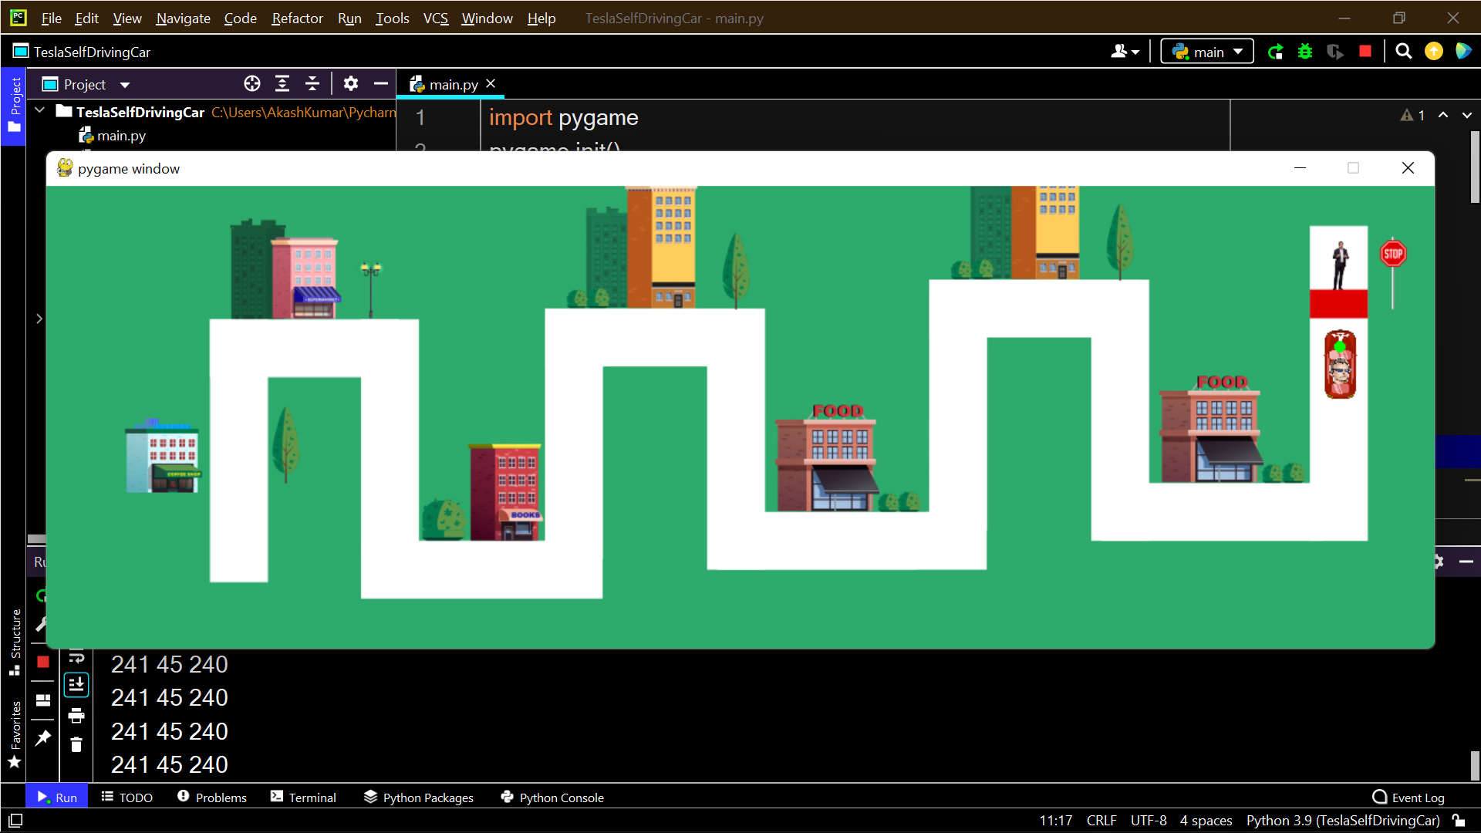
14

Slide 15
Conclusion and Future Scope
Good Things
With the amount of public interest in self-driving cars and the number of companies investing in them , self-driving cars are going to happen.
Bad Things
Overall self driving cars are unsafe
May be good but many risk
It is estimated that when autonomous vehicles come in, travel time could be cut by as much as 40 percent. This time saved will help boost economies where driverless cars will be in use. If all they will be needed, traffic law enforcers will also have an easier time maintaining sanity on the roads.
The future of transportation involves moving into new, smarter sources of energy, modes of transport and physical and technological infrastructure to support these transportation innovations. Three common themes in transportation innovation are: smart technology. Electrification.
15

