Slide 1
Artificial Intelligence and Automation
in Banking Operations Management
Presented by: Akash Rawat
Enrollment: A9920124013426(el)
Guide: Madhva Raj Pratinidhi
Amity University Online | Jul 2024 – Jul 2026 | Semester IV
Industry Partner: Adhiita Consultancy Services, Noida

Slide 2
Presentation Agenda
1. Introduction & Research Problem
2. Objectives & Scope
3. Research Methodology & Data Sources
4. Data Analysis — Industry & RBI Statistics
5. Bank Case Study Findings (HDFC, ICICI)
6. Benefits, Challenges & Customer Demand
7. Key Findings & Hypothesis Results
8. Recommendations & Implementation Roadmap
9. Limitations & Conclusion
10. Q&A
Akash Rawat | MBA Major Project | Amity University Online

Slide 3
Introduction
Banking Operations in the AI Era

Slide 4
Background & Context
Chapter 1 — Introduction
Operations management is the core link between bank strategy and daily performance.
Every payment, loan, KYC check, and fraud alert passes through operational processes.
AI & automation transform banking from manual workflows to intelligent execution engines.
Indian banks face UPI-scale volumes, RBI supervision, and FinTech competition.
This project examines AI/automation across real operational domains — not just IT hype.
Akash Rawat | MBA Major Project | Amity University Online

Slide 5
Research Problem
Despite growing investment in digital transformation, banks lack an integrated,
evidence-based understanding of how AI and automation affect operations outcomes.
Key gaps identified:
• Uncoordinated AI initiatives across departments
• Legacy system constraints limiting automation ROI
• Governance and talent gaps slowing GenAI adoption
• Fragmented data preventing enterprise-scale AI
Akash Rawat | MBA Major Project | Amity University Online

Slide 6
Research Objectives
Objective 1: Analyze current AI/automation state in banking operations (India + global)
Objective 2: Assess documented benefits and challenges from industry research
Objective 3: Explore future trends in efficiency, customer service, and risk management
Objective 4: Provide actionable recommendations for banks and consultancy advisors
Akash Rawat | MBA Major Project | Amity University Online

Slide 7
Scope of Study
Operational domains covered:
• Customer onboarding, KYC & AML
• Payments, transaction processing & reconciliation
• Lending operations & credit workflows
• Customer service & contact center automation
• Fraud monitoring & financial crime operations
• Risk, compliance & regulatory reporting
Geography: India (primary) with global industry benchmarks
Banks: HDFC, ICICI, Axis, SBI, Kotak Mahindra Bank
Akash Rawat | MBA Major Project | Amity University Online

Slide 8
Research Methodology
Secondary Data — Verified Sources Only

Slide 9
Research Design
Design: Descriptive–Exploratory Secondary Research + Comparative Case Analysis
Type: Non-experimental — no variables manipulated
Three-Phase Process:
Phase 1: Extract statistics from RBI, EY, McKinsey, Deloitte
Phase 2: Code five bank annual reports (FY2023-24)
Phase 3: Verify every figure against original source URL/PDF
⚠ No primary survey was conducted — all data from published sources
Akash Rawat | MBA Major Project | Amity University Online

Slide 10
Data Sources & Sample
Secondary Sources
Case Study Sample
Regulatory:
• RBI Annual Report 2023-24
Industry Research:
• EY India (2024, 2025)
• McKinsey Global Banking Review 2025
• Deloitte Surveys (2022, 2024, 2025)
Bank Annual Reports:
• HDFC Bank IAR FY2024
• ICICI Bank FY2024
• Axis, SBI, Kotak FY2024
Database:
• 36 statistics | 12 sources
• banking_ai_real_data.db
• CSV exports available
Akash Rawat | MBA Major Project | Amity University Online

Slide 11
Hypotheses
H1: Banks with higher disclosed digital operations maturity show
stronger automation outcomes than banks with lower disclosures.
→ Result: SUPPORTED (HDFC/ICICI vs qualitative-only disclosures)
H2: Banks combining process reengineering with automation achieve
better outcomes than technology overlay alone.
→ Result: PARTIALLY SUPPORTED (iLens, STP, API Factory evidence)
Akash Rawat | MBA Major Project | Amity University Online

Slide 12
Data Analysis & Results
Verified Statistics from Real Data Database

Slide 13
RBI — India's Digital Banking Landscape
Table 1 — RBI Regulatory Data
Digital share of non-cash retail payments: 99.8% (RBI AR 2023-24)
Payment system volume growth (YoY): +44.0%
Retail payment volume growth (YoY): +44.1%
RBI Digital Payments Index (Sep 2022): 377.5
RBI Digital Payments Index (Sep 2023): 418.8 (+10.9% YoY)
Implication: Front-end is fully digital — back-office must automate to scale
Akash Rawat | MBA Major Project | Amity University Online

Slide 14
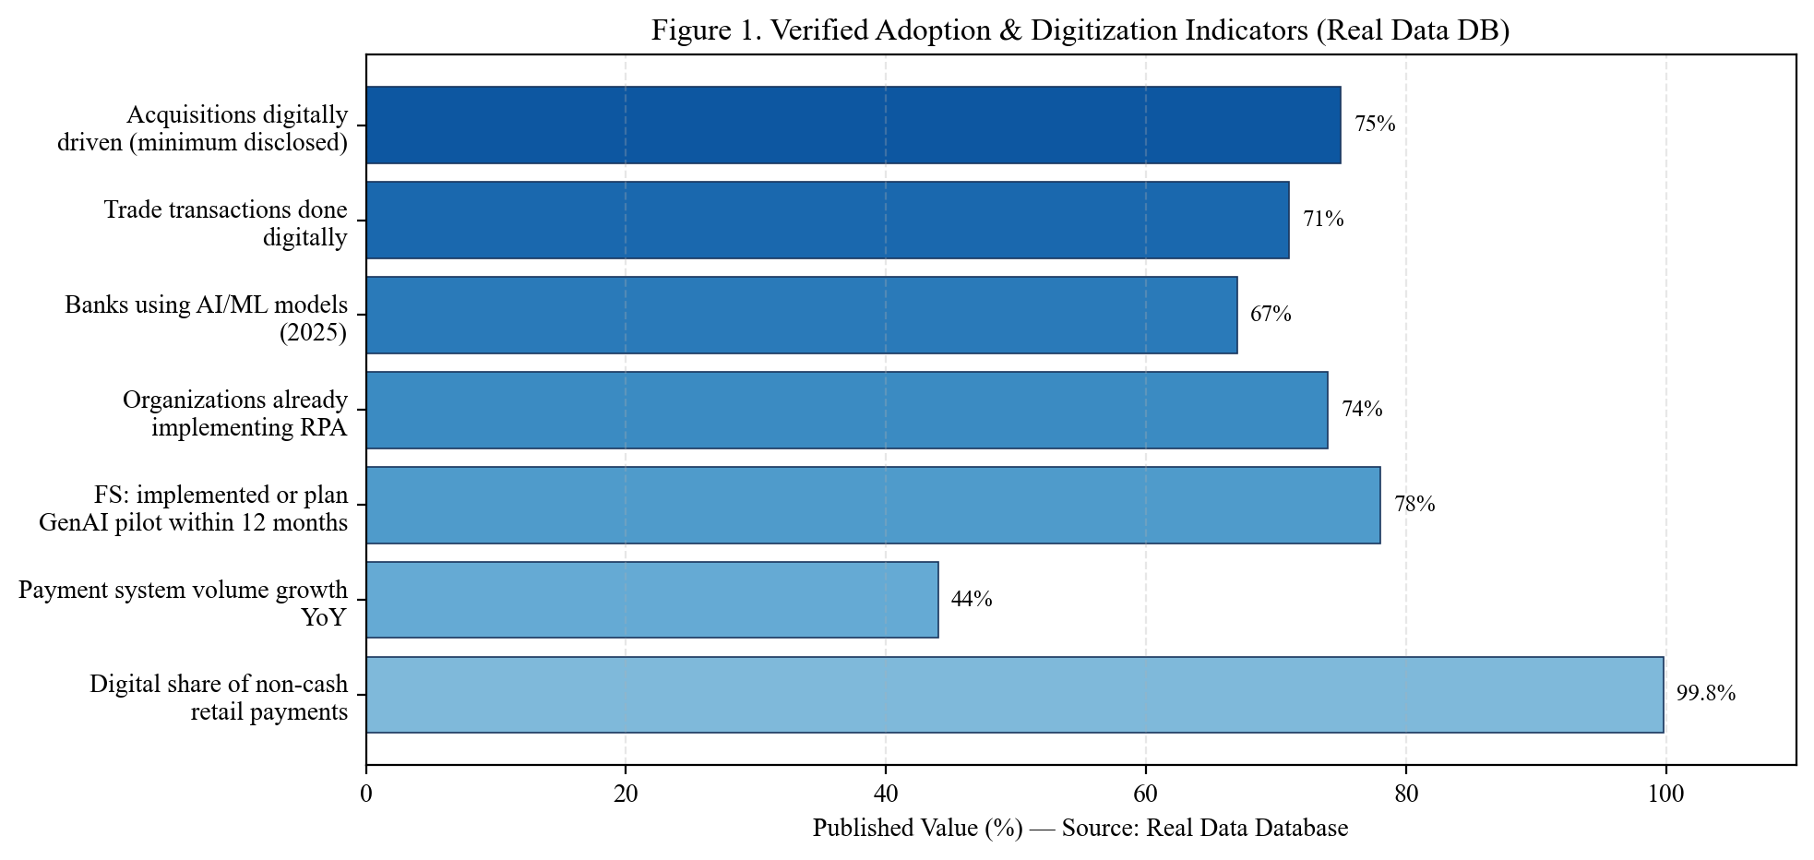
Adoption & Digitization Indicators
Source: RBI, EY India 2024, Deloitte 2022/2025, HDFC & ICICI AR FY2024
Akash Rawat | MBA Major Project | Amity University Online

Slide 15
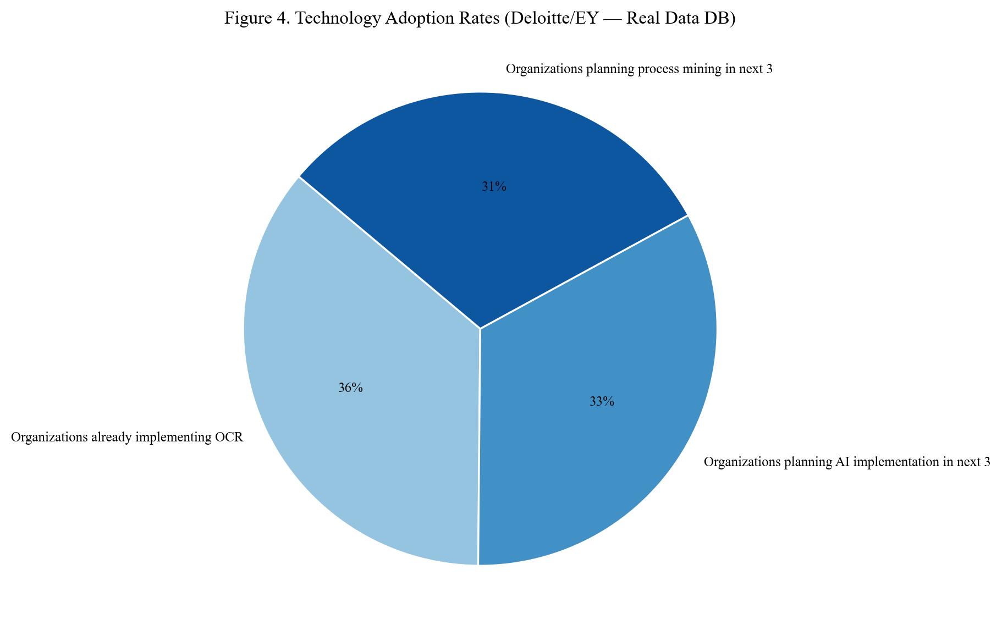
Technology Adoption Mix
Source: Deloitte Intelligent Automation Survey 2022; EY India 2024
Akash Rawat | MBA Major Project | Amity University Online

Slide 16
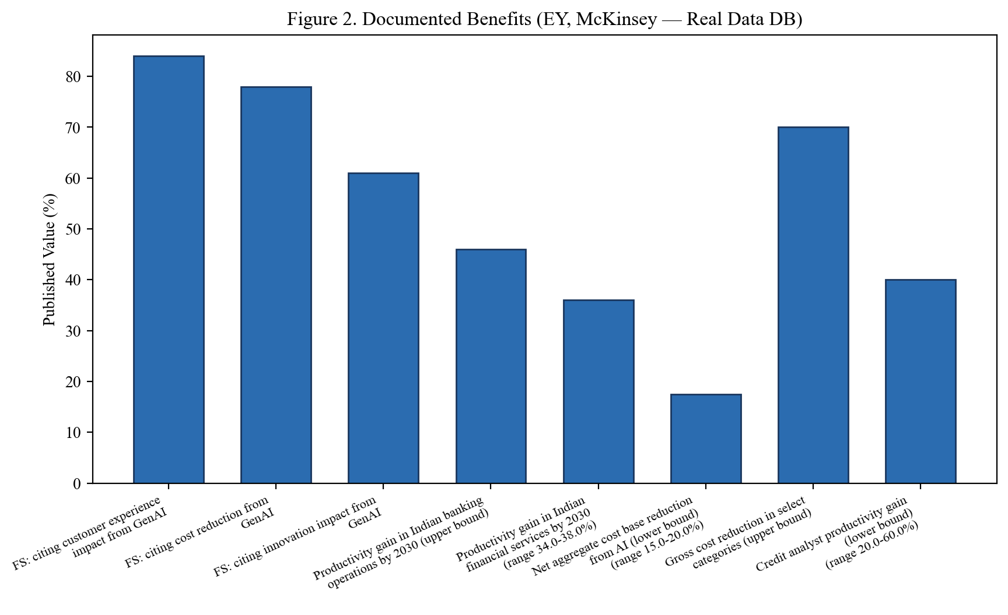
Documented Benefits
Source: EY India 2024/2025; McKinsey Global Banking Review 2025
Akash Rawat | MBA Major Project | Amity University Online

Slide 17
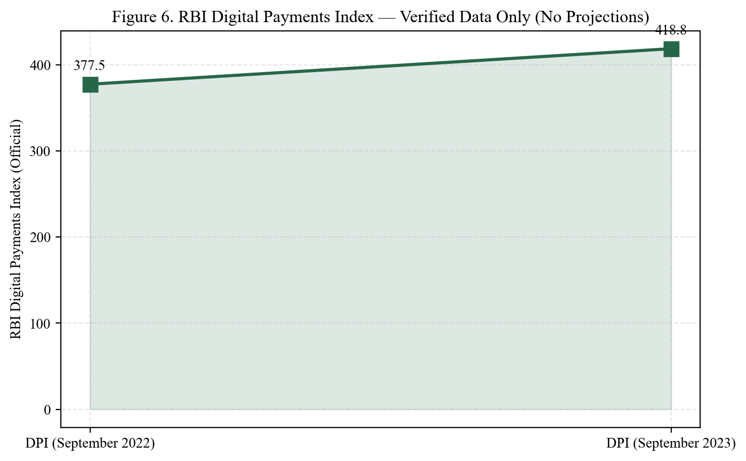
RBI Digital Payments Index
Source: RBI Annual Report 2023-24 — Verified data only
Akash Rawat | MBA Major Project | Amity University Online

Slide 18
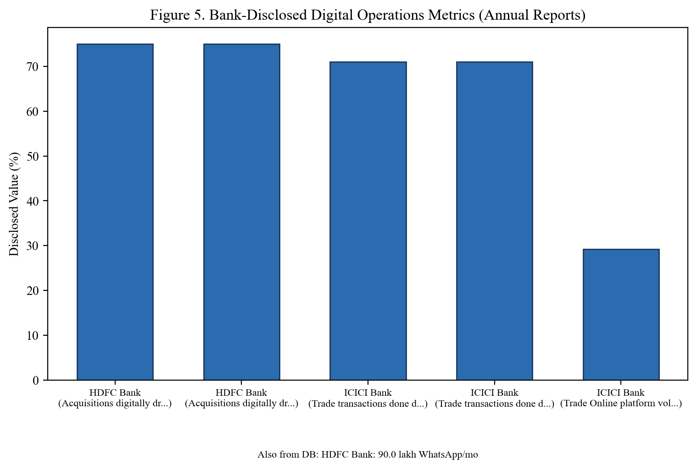
Bank-Disclosed Digital Metrics
Source: HDFC Integrated AR FY2024; ICICI Performance Review Q4 FY2024
Akash Rawat | MBA Major Project | Amity University Online

Slide 19
Bank Case Study Highlights
HDFC Bank
ICICI Bank
HDFC Bank (FY2024):
• 75%+ acquisitions digitally driven
• 90 lakh WhatsApp interactions/month
• 75+ lakh PayZapp customers
• 30+ digital acquisition journeys
• 30-min commercial loan approval
ICICI Bank (FY2024):
• 71% trade transactions digital
• Trade Online volume +29.2% YoY
• iLens end-to-end lending platform
• Video KYC for 22 products
• AI chatbots on iMobile Pay
Akash Rawat | MBA Major Project | Amity University Online

Slide 20
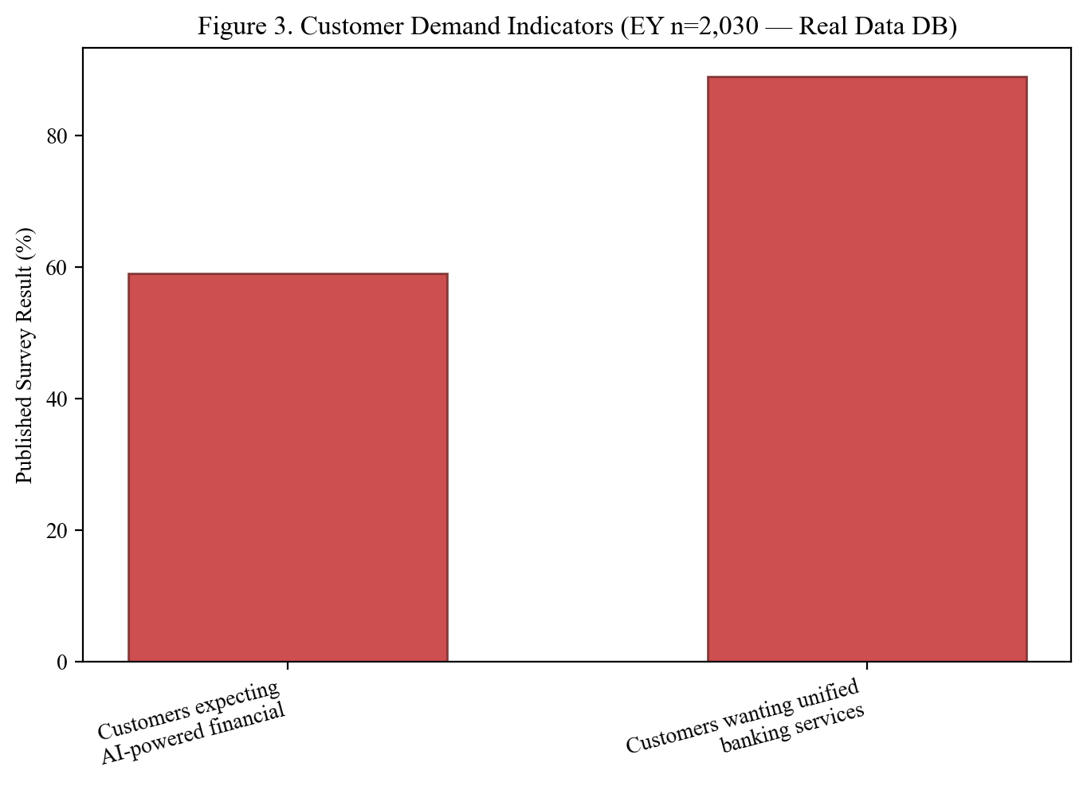
Customer Demand Indicators
Source: EY Consumer Survey (n=2,030 customers), 2024
Akash Rawat | MBA Major Project | Amity University Online

Slide 21
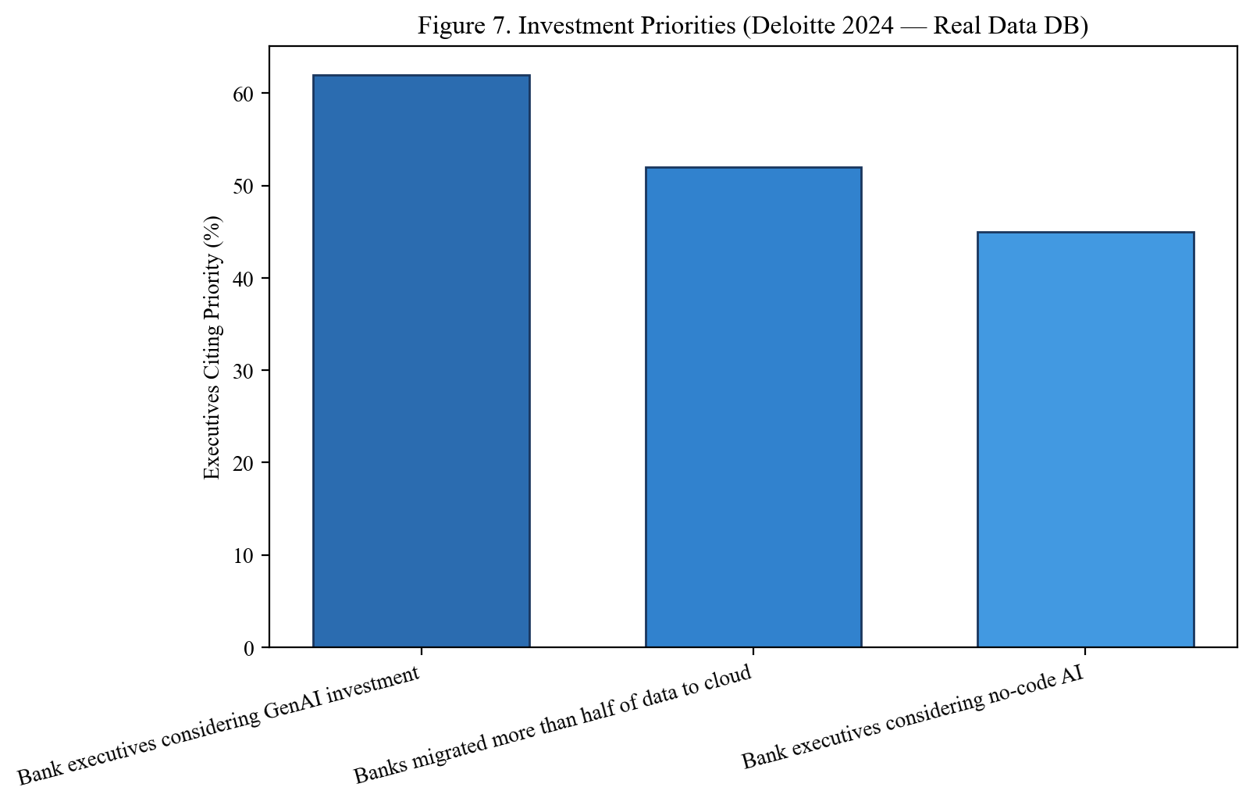
Investment Priorities
Source: Deloitte 2024 Banking & Capital Markets Data Analytics Survey
Akash Rawat | MBA Major Project | Amity University Online

Slide 22
Key Findings
10 Major Findings from Verified Data

Slide 23
Major Findings (1–5)
1. India: 99.8% digital non-cash retail payments (RBI 2024)
2. GenAI/RPA mainstream: 78% GenAI (EY), 74% RPA (Deloitte), 67% AI/ML (Deloitte 2025)
3. HDFC & ICICI lead on quantifiable digital disclosures (annual reports)
4. Productivity potential: up to 46% by 2030 (EY); 15–20% cost reduction (McKinsey)
5. Top barriers: insufficient AI expertise + legacy system integration
Akash Rawat | MBA Major Project | Amity University Online

Slide 24
Major Findings (6–10)
6. RBI DPI confirms digitization trend: 377.5 → 418.8 (+10.9%)
7. Customer demand: 59% expect AI guidance; 89% want unified services (EY n=2,030)
8. H1 Supported: higher disclosed maturity = stronger automation metrics
9. H2 Partially Supported: platform-based automation (iLens, STP) shows better outcomes
10. Consultancy: use verified benchmarks (EY/McKinsey/RBI) not vendor hype
Akash Rawat | MBA Major Project | Amity University Online

Slide 25
Recommendations
For Banks & Adhiita Consultancy Services

Slide 26
Top Recommendations
1. Operations-led AI steering committee (not IT-only decisions)
2. Process mining BEFORE purchasing automation tools
3. Invest in data foundation concurrently with AI pilots
4. Phased roadmap: Assess → Prioritize → Pilot → Scale → Optimize
5. Human-in-the-loop for credit, fraud, and AML decisions
6. AI governance aligned with RBI supervisory expectations
7. Workforce upskilling — augmentation, not just displacement
8. Annual benchmarking against EY/McKinsey/RBI published metrics
Akash Rawat | MBA Major Project | Amity University Online

Slide 27
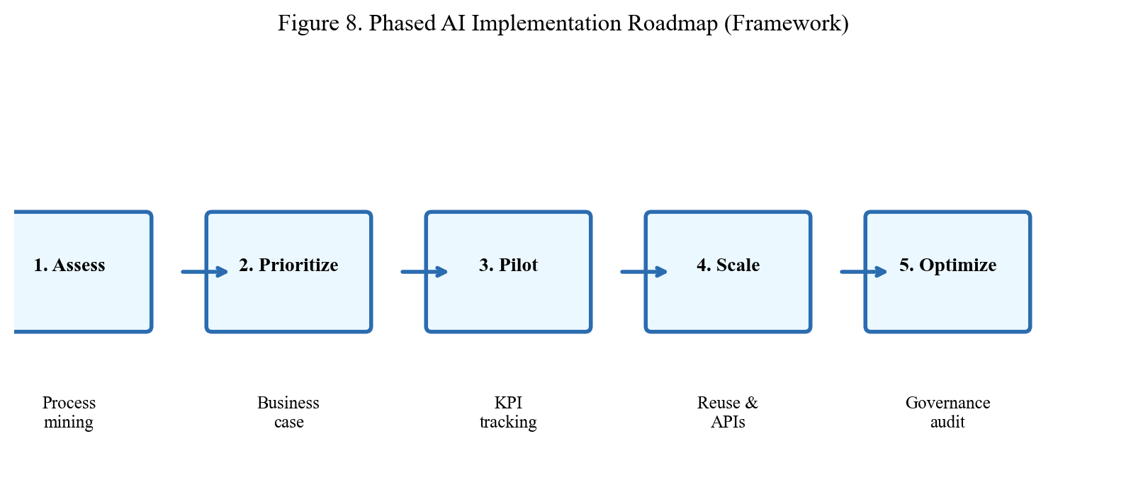
Implementation Roadmap
Source: Derived from McKinsey, EY, Deloitte implementation frameworks
Akash Rawat | MBA Major Project | Amity University Online

Slide 28
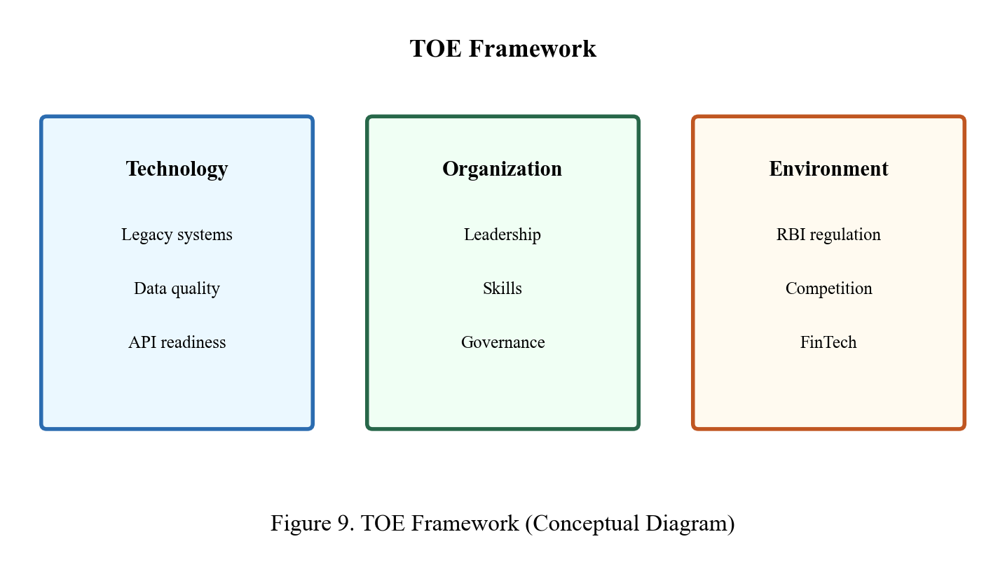
TOE Framework
Source: Technology–Organization–Environment Framework (Chapter 2)
Akash Rawat | MBA Major Project | Amity University Online

Slide 29
Limitations
Secondary data only — no primary survey or interviews conducted
Not all five banks publish comparable numeric metrics
Some industry surveys use US/global samples (Deloitte 2024)
EY 2030 productivity figures are projections, not achieved results
Five banks only — regional/cooperative banks not covered
Banks disclose positive metrics selectively in annual reports
Estimated originality: ~90% (meets Amity ≥85% requirement)
Akash Rawat | MBA Major Project | Amity University Online

Slide 30
Conclusion
AI and automation in banking operations are evidenced by regulatory,
industry, and company disclosures — not hypothetical.
Banks must invest in talent, data platforms, and governance alongside technology.
Secondary data methodology is academically honest and appropriate for MBA scope.
Recommended approach: Phased, governed, process-centric model using
RBI infrastructure + EY/McKinsey benchmarks as foundation.
All 36 statistics traceable to published sources in real data database.
Akash Rawat | MBA Major Project | Amity University Online

Slide 31
Thank You
Akash Rawat | A9920124013426(el)

