Slide 1
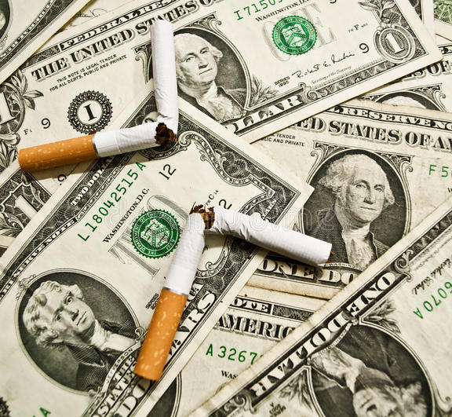
Tobacco: Lucrative or Lethal
Andrew Case

Slide 2


Motivation
Tools Used
I have been working with people in recovery most of my professional life. During this time, I have worked with alcoholics, meth addicts, heroin users, and more. In my experience, nicotine is one of if not the most challenging thing to walk away from. Everyone knows that smoking is harmful or even deadly. So why do we continue to see these products on the selves?

Slide 3

Tobacco use in the US
How often are tobacco products used in the US? How much is made from said products, and what would the economic impact be if these items were no longer in circulation? What are the current effects of the products on Americans’ health? Is our government doing enough to combat the negative outcomes?

Slide 4
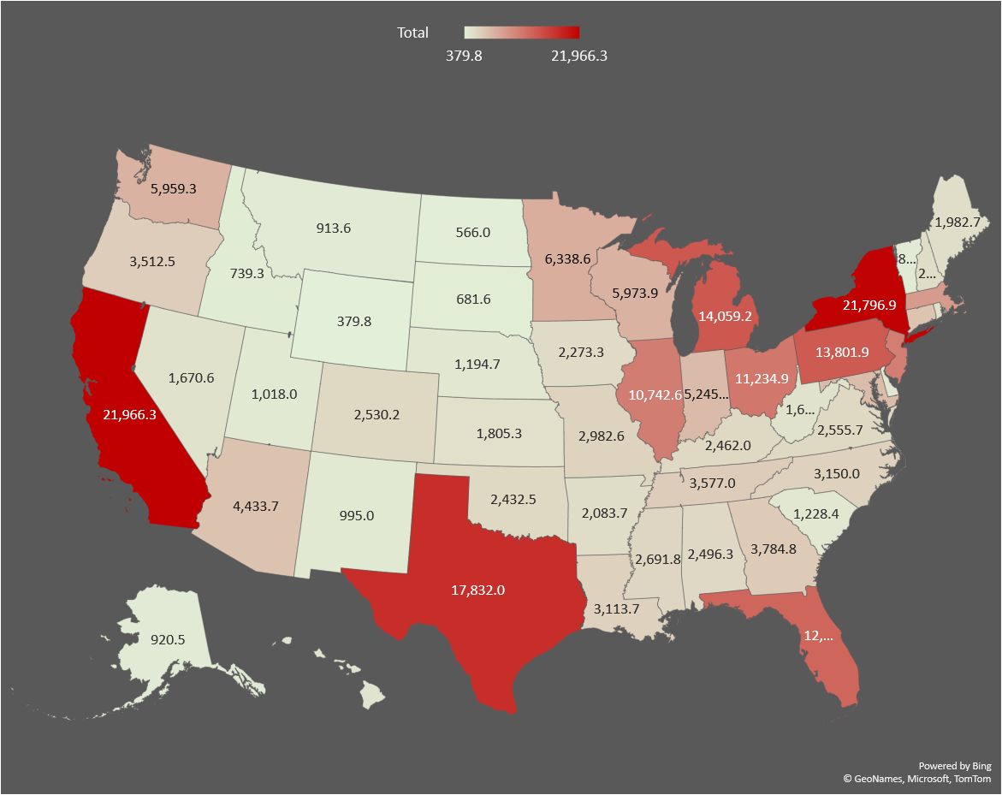
Revenue brought in per state (by millions)

Slide 5
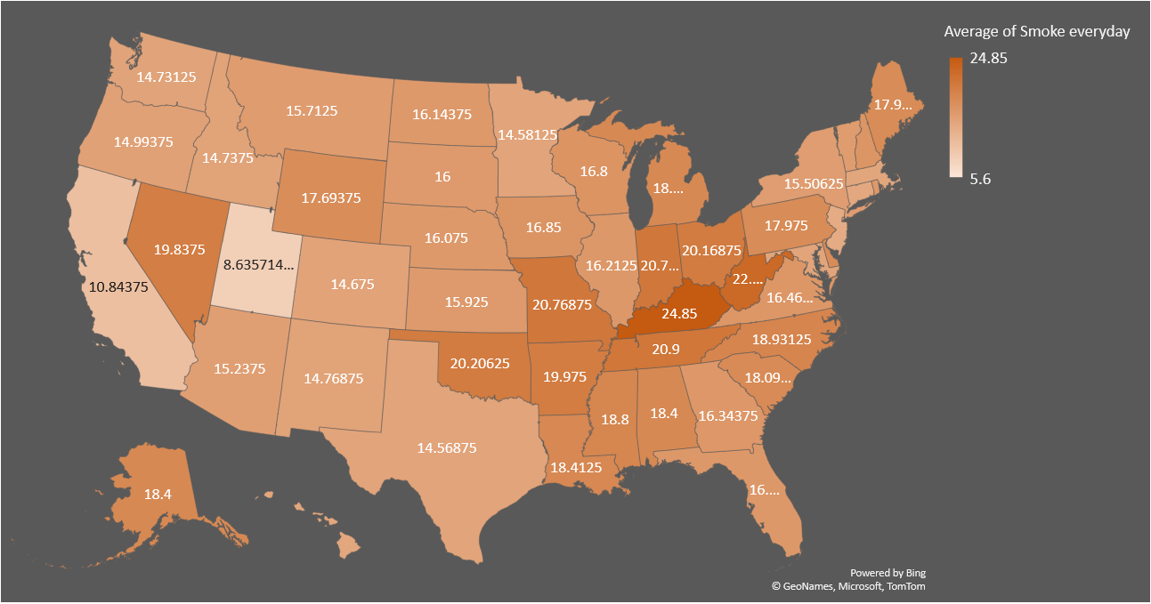
Percent of tobacco users

Slide 6
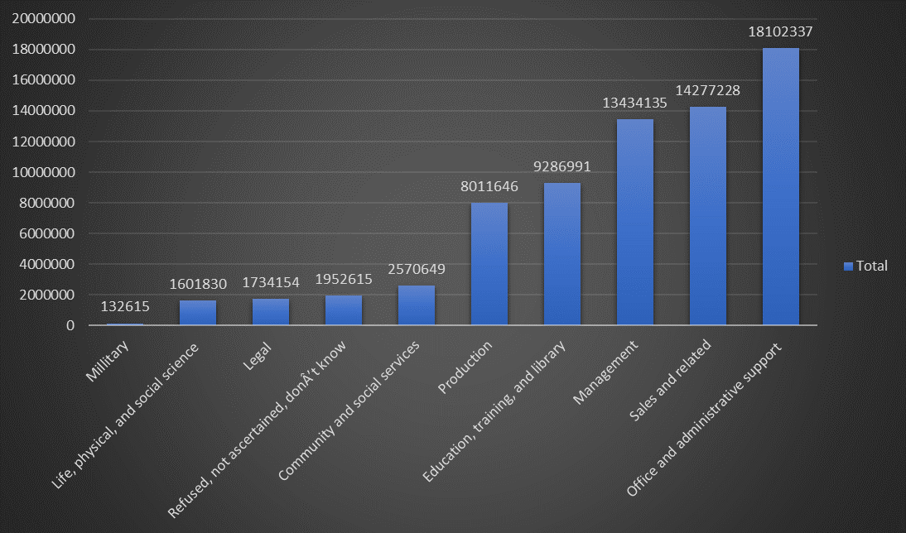
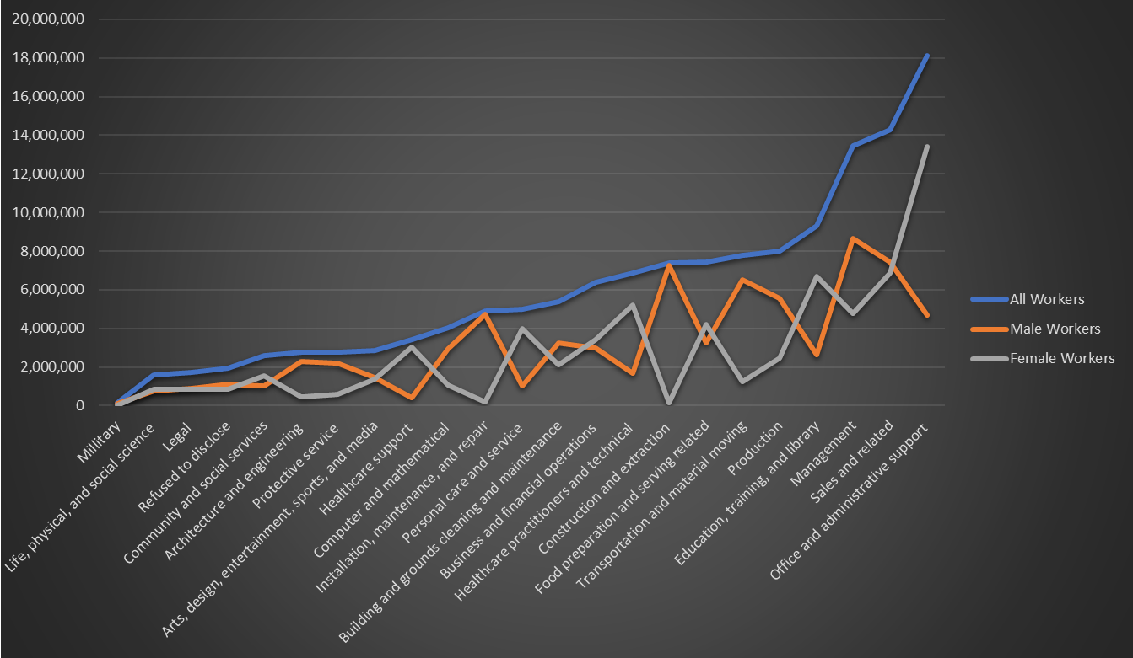
Tobacco use per Industry

Slide 7
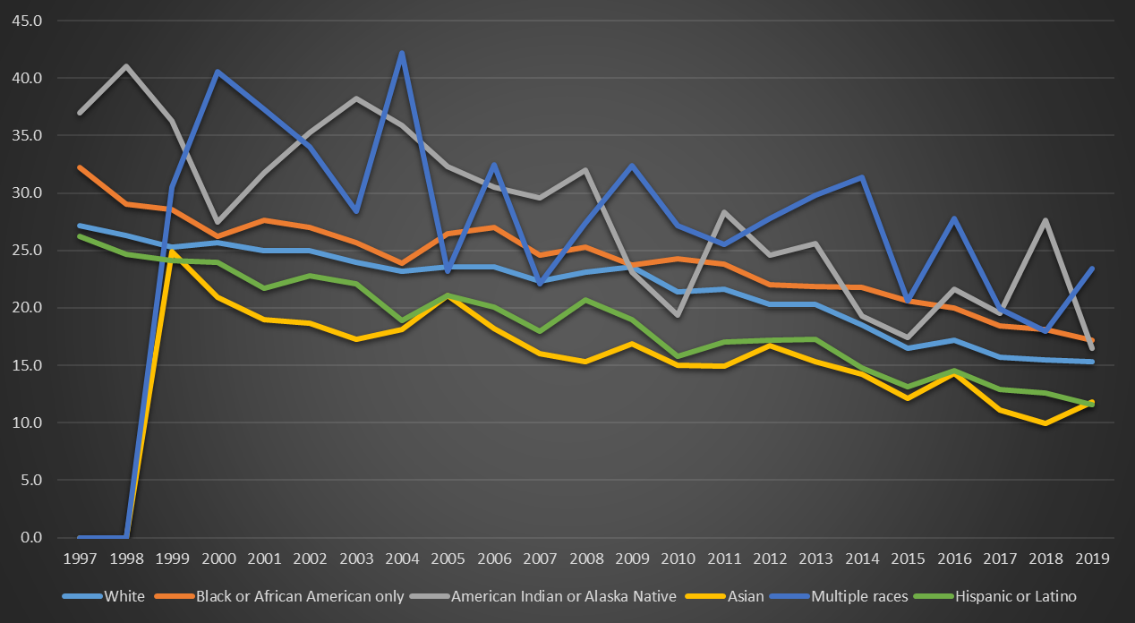
Tobacco Use by Race in Adults

Slide 8
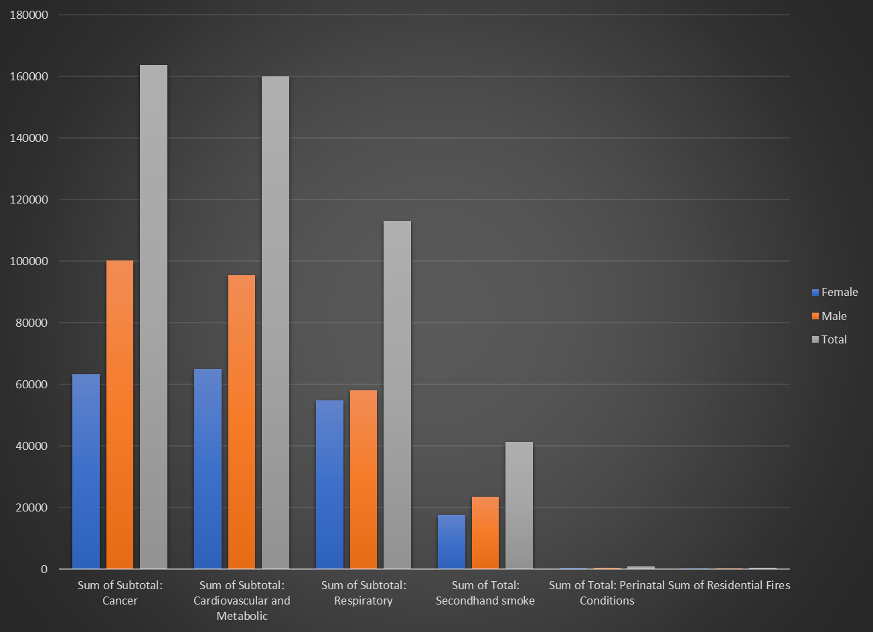
Tobacco related deaths per year

Slide 9
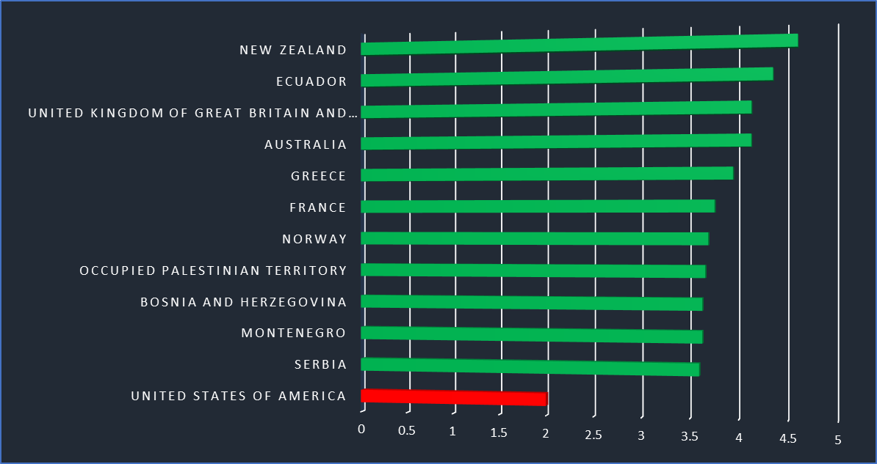
WHO Overall Score 2014-2020
Scale being from 1-5
Based on Price, Tax Share, Tax Structure, and Affordability Change
United States ranks 90th worldwide

Slide 10
Conclusion
The farming community in the US still has a large reliance on tobacco sales
When you divide the financial revenue by the number of deaths per year, you get $507,503.38 per life.
States that have higher revenue does not always have a direct correlation with tobacco users
Further exploration would consist of what laws and taxes enforced have been proven to be successful and how can we implement them further
What other crops can supplement the income that tobacco currently provides?

Slide 11
Thank You
Andrew Case

