Slide 1

Tobacco Lucrative or Lethal
Andrew Case

Slide 2



Agenda
Topic one
Topic two
Topic three
Topic four
Topic five

Slide 3




Introduction
In 2019, the largest tobacco companies spent $8.2 billion marketing cigarettes and smokeless tobacco in the United States. This amount translates to about $22.5 million each day, or nearly $1 million every hour.

Slide 4

Tobacco use in the US
Subtitle

Slide 5
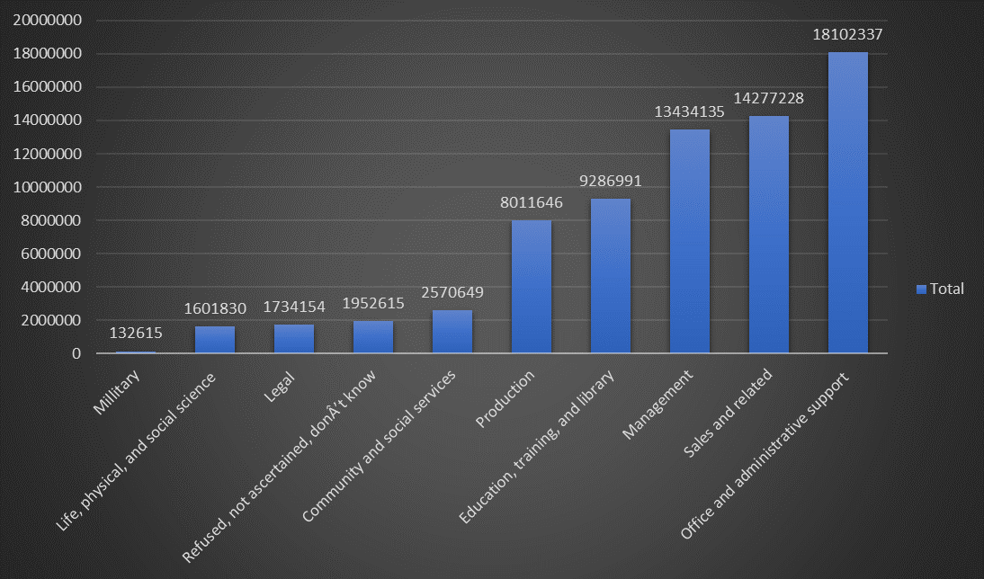
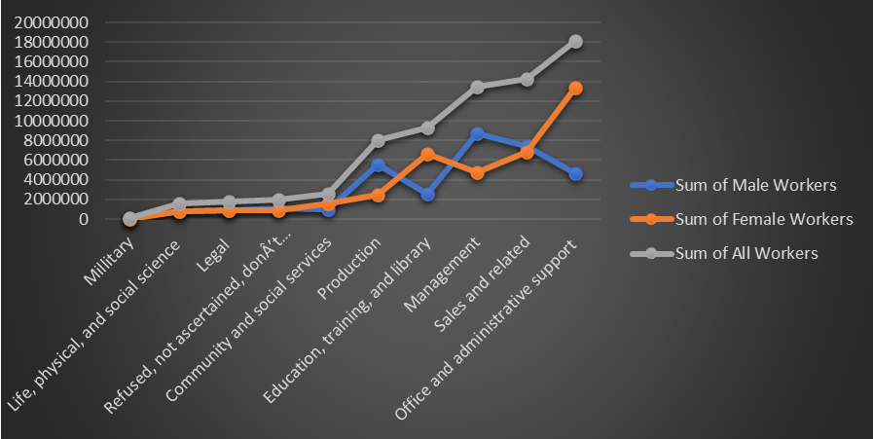
Tobacco use per Industry

Slide 6
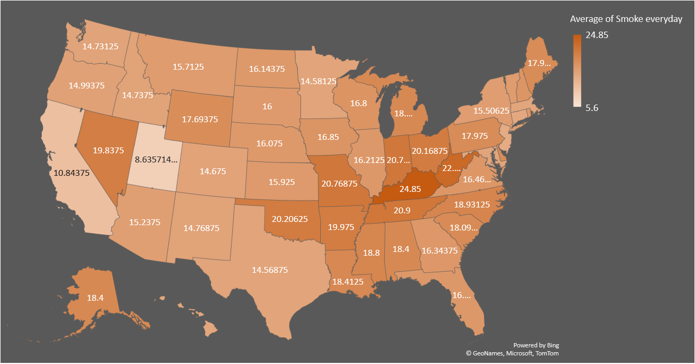
Percent of tobacco users per day

Slide 7
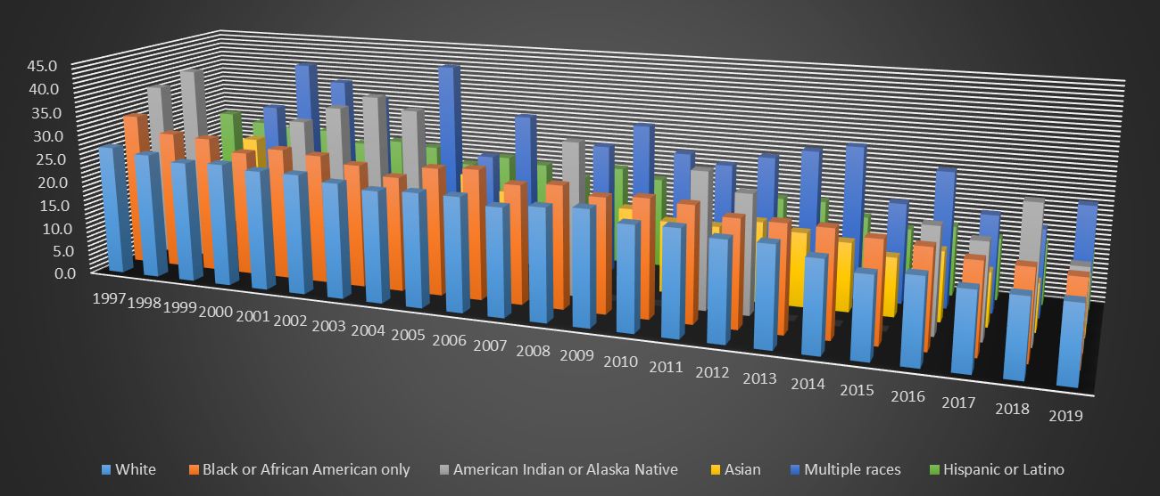
Tobacco Use by Race in Adults

Slide 8




Team
Name
Name
Name
Name
Title
Title
Title
Title

Slide 9
Timeline
Title
To start a presentation, go to the Slide Show tab, and select From Beginning.
Title
To display Presenter view, in Slide Show view, on the control bar at the bottom left select the three dots, and then Show Presenter View.
Title
During your presentation, the speaker notes are visible on your monitor, but aren't visible to the audience.
Title
Title
If you don’t see the Notes pane or it is completely minimized, click Notes on the task bar across the bottom of the PowerPoint window.
The Notes pane is a box that appears below each slide. Tap it to add notes.

Slide 10
Tobacco use International
Subtitle

Slide 11
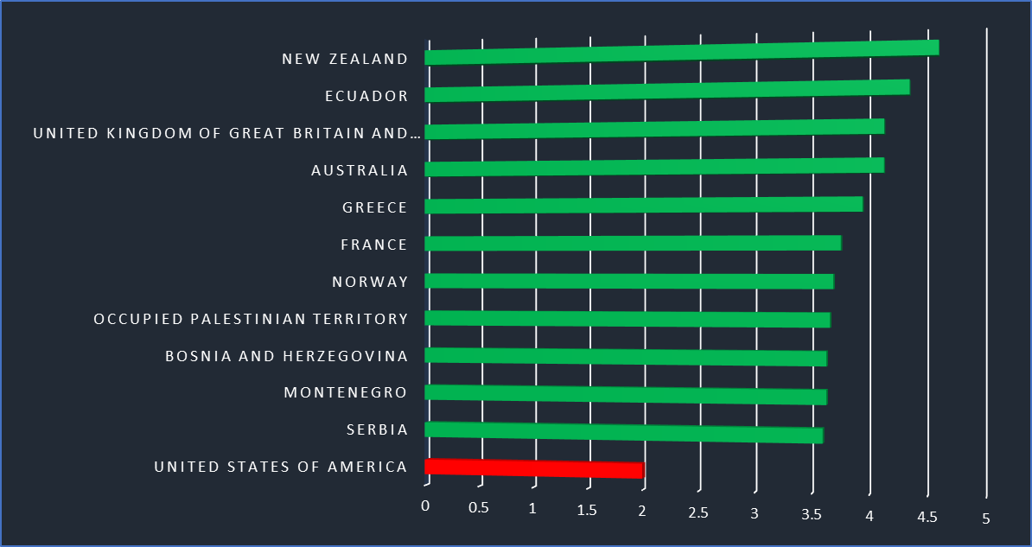
WHO Overall Score 2014-2020
Scale being from 1-5
Based on Price, Tax Share, Tax Structure, and Affordability Change
United States ranks 90th worldwide

Slide 12
Content 2
subtitle
subtitle
Add text, images, art, and videos.
Add transitions, animations, and motion.
Save to OneDrive, to get to your presentations from your computer, tablet, or phone.
Open the Design Ideas pane for instant slide makeovers.
When we have design ideas, we’ll show them to you right there.
Add text, images, art, and videos.
Add transitions, animations, and motion.
Save to OneDrive, to get to your presentations from your computer, tablet, or phone.
Open the Design Ideas pane for instant slide makeovers.
When we have design ideas, we’ll show them to you right there.
Add text, images, art, and videos.
Add transitions, animations, and motion.
Save to OneDrive, to get to your presentations from your computer, tablet, or phone.
Open the Design Ideas pane for instant slide makeovers.
When we have design ideas, we’ll show them to you right there.

Slide 13

Summary
With PowerPoint, you can create presentations and share your work with others, wherever they are. Type the text you want here to get started. You can also add images, art, and videos on this template. Save to OneDrive and access your presentations from your computer, tablet, or phone.

Slide 14


Thank You
Presenter name
Email address
Website address

