Slide 1
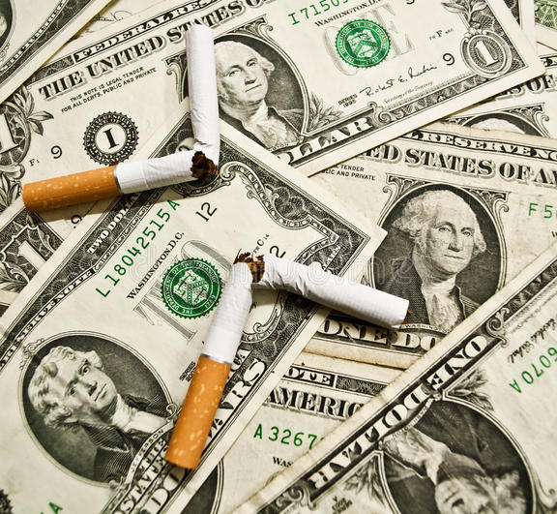
Tobacco: Lucrative or Lethal
Andrew Case

Slide 2

Tobacco use in the US
Subtitle

Slide 3
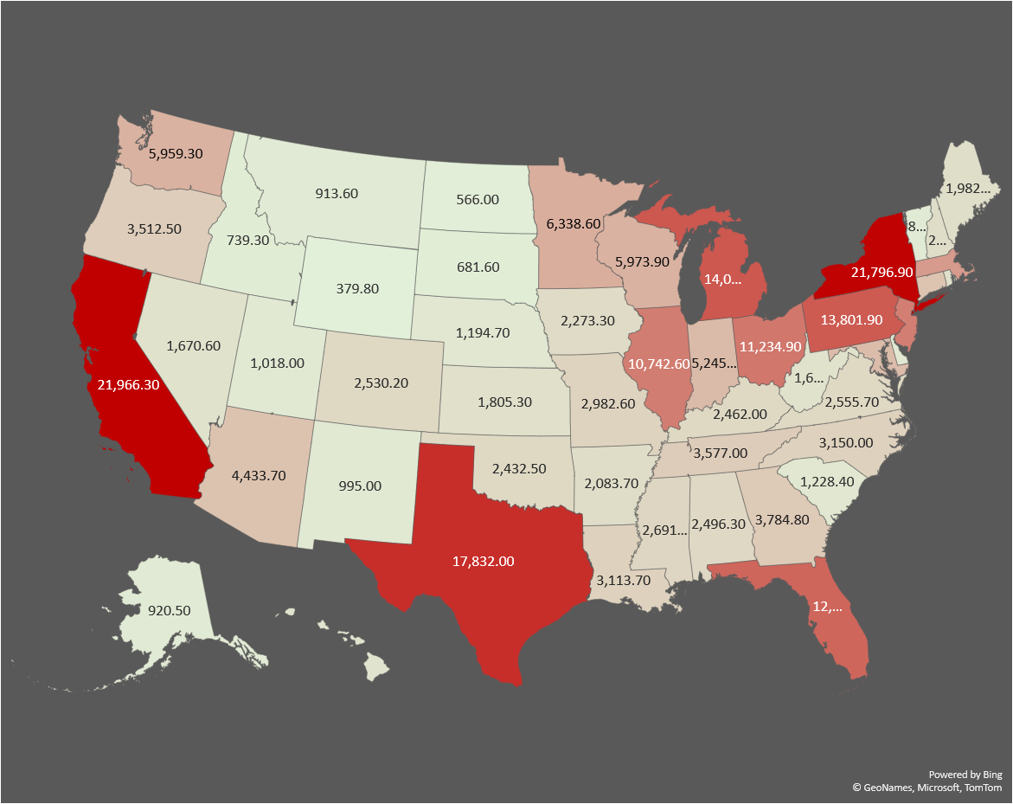
Revenue brought in per state (by millions)

Slide 4
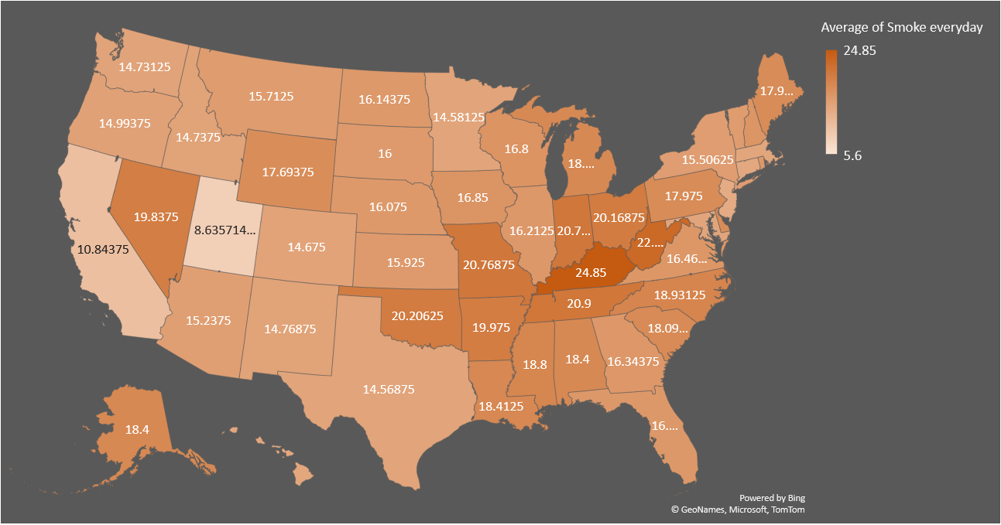
Percent of tobacco users

Slide 5
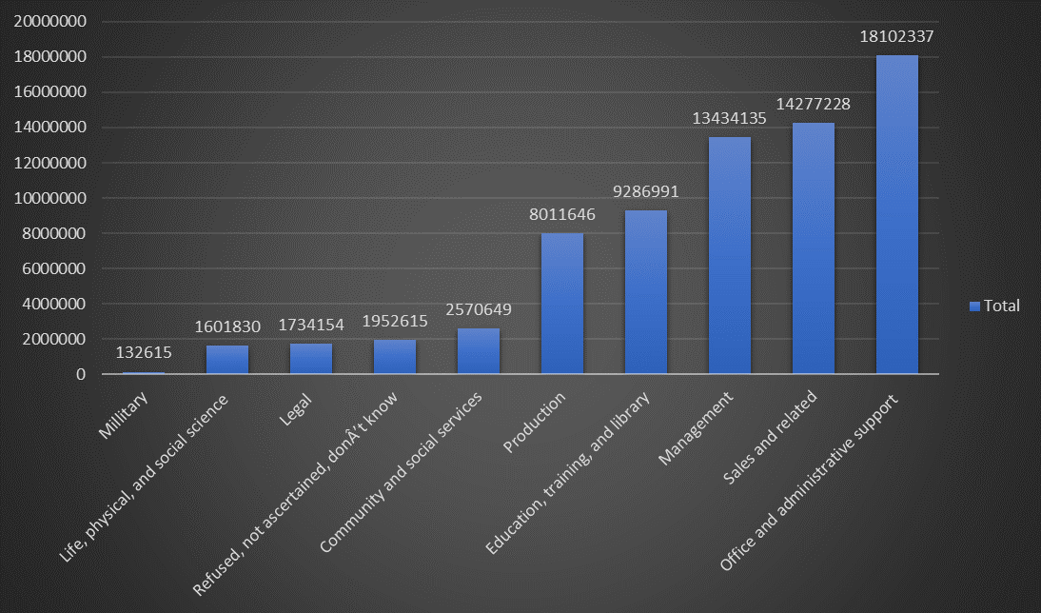
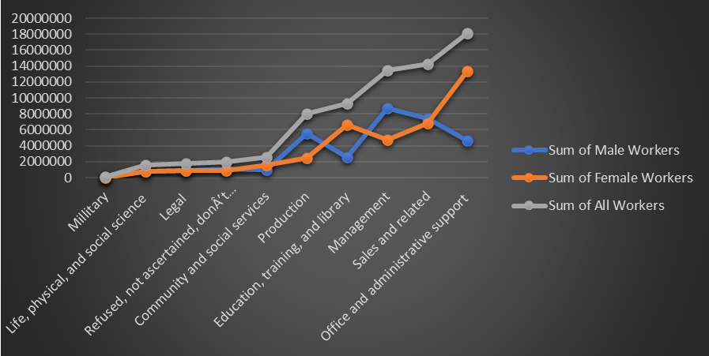
Tobacco use per Industry

Slide 6
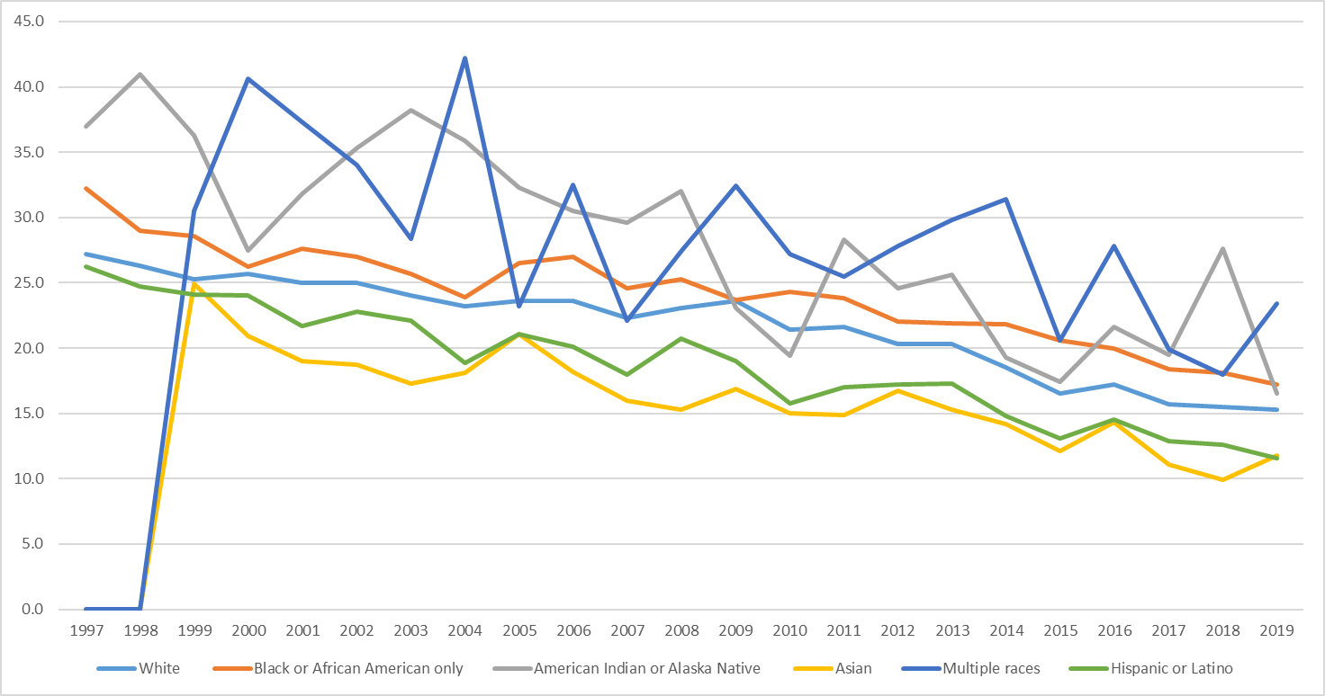
Tobacco Use by Race in Adults

Slide 7
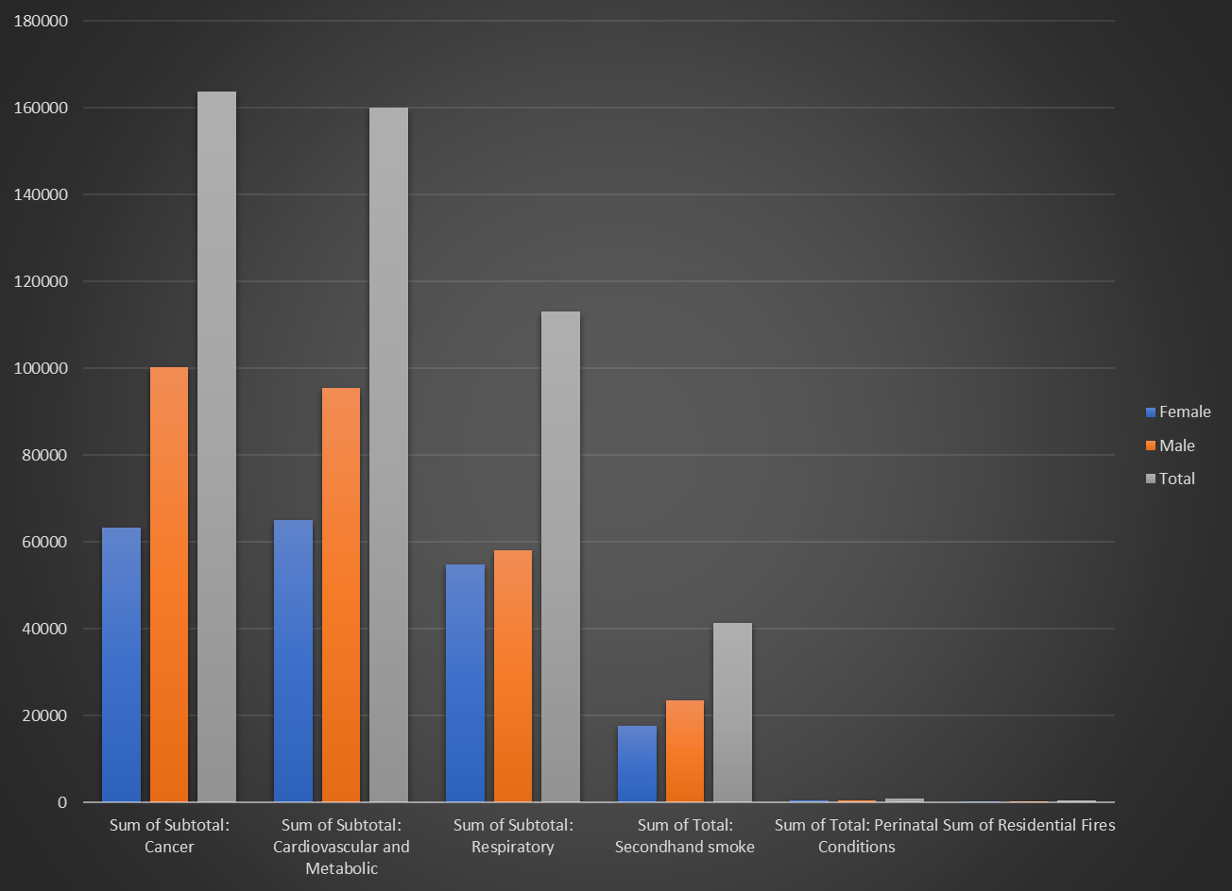
Tobacco related deaths per year

Slide 8
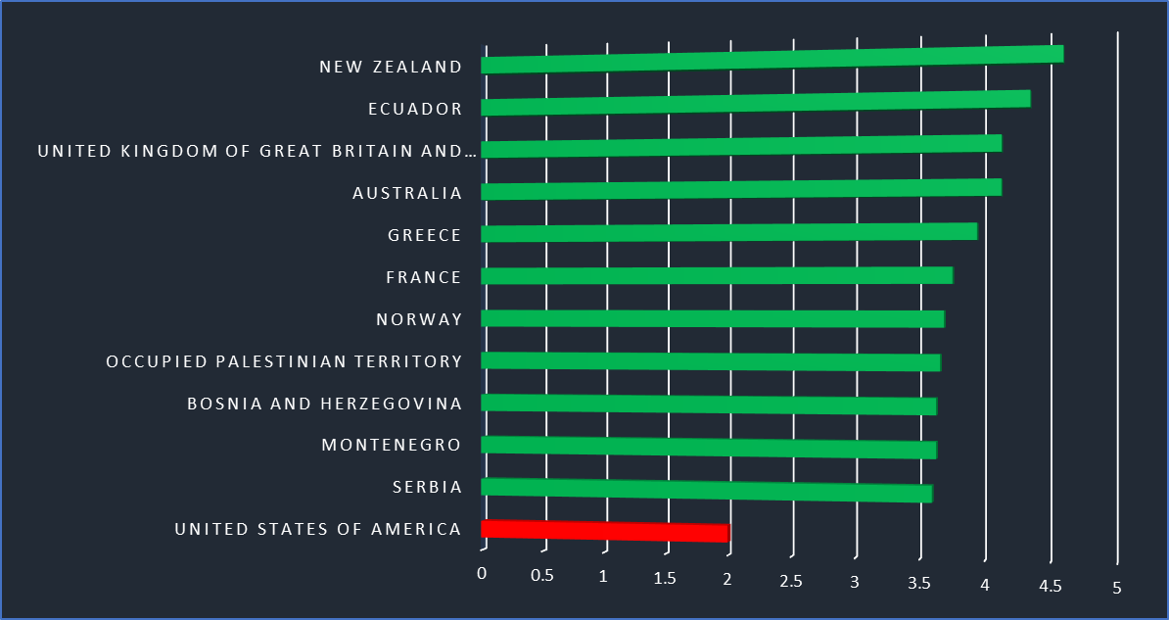
WHO Overall Score 2014-2020
Scale being from 1-5
Based on Price, Tax Share, Tax Structure, and Affordability Change
United States ranks 90th worldwide

Slide 9


Thank You
Presenter name
Email address
Website address

