Slide 1
EcoCheck
AI-Powered Misinformation & Bias Detection
"Ensuring truth, not lies, leads the way."

Slide 2
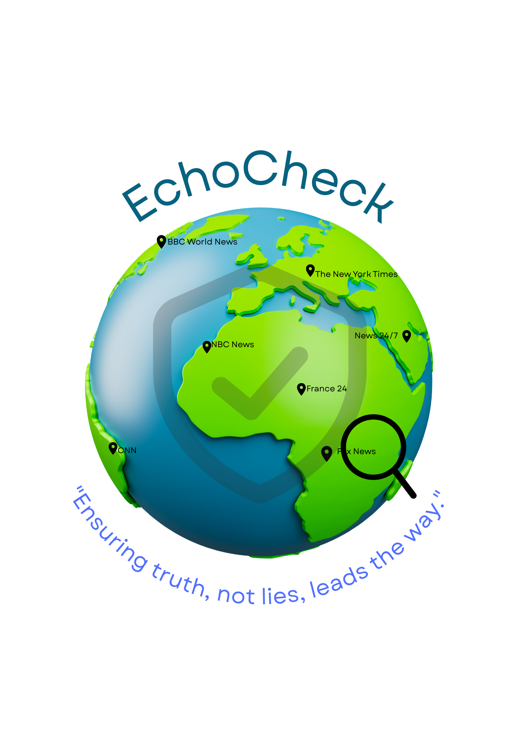

Slide 3
The Problem: The Age of Digital Deception
We are in an information crisis. Misinformation is no longer just noise; it's a weapon.
Speed & Scale: Fake news spreads 6 times faster than verified truth, shaping public opinion in real-time.
Societal Impact: This "infodemic" erodes trust in democratic institutions, fuels social division, and poses a direct threat to public safety and stability.
Economic Cost: Disinformation campaigns inflict billions in reputational damage on businesses and manipulate financial markets.
Current Defenses are Obsolete: Manual fact-checking is like trying to stop a tsunami with a bucket. It's slow, expensive, and can't scale.

Slide 4

Our Solution: An AI-Powered Intelligence Engine
EchoCheck is not just a fact-checker. It's a real-time intelligence platform that brings comprehensive report in seconds. We provide a multi-layered analysis of any claim, delivering a comprehensive report in seconds.
Instant AI Verdict: Is the claim Confirmed, Debunked, or Complex/Mixed?
Real-World Evidence: Our AI generates supporting headlines from real, recognizable news sources to justify its verdict.
Statistical Bias Analysis: A clear, visual breakdown of the political leaning of the sources, exposing the narrative landscape.
"Sanity Check" Protocol: Our system instantly flags claims that defy fundamental scientific reality, preventing wasted analysis.

Slide 5
The EchoCheck Innovation
Traditional Fact-Checkers | The EchoCheck Advantage
Slow & Reactive: Takes hours or days to analyze a claim. | Instant & Proactive: Provides a verdict in seconds, at the speed of social media.
Opaque Process: The reasoning is often hidden in a "black box." | Radical Transparency: We show you the evidence and the bias of the sources, building user trust.
Limited Scope: Relies on a small, internal set of sources. | Vast Global Knowledge: We leverage the power of: Google's Gemini for the logical purpose. Top ten news channel to scan a massive, real-time global knowledge base.
High Cost to Scale: Scaling requires hiring more human analysts. | Infinitely Scalable: Our AI-driven, cloud-based architecture can handle millions of requests with minimal marginal cost.
Our approach is fundamentally different and superior to existing solutions for the following many reasons we have showcased in the table.

Slide 6

Architectural Diagram: How It Works
Our system is built on a modern, secure, and scalable client-server architecture.
User Query (Frontend): A user submits a claim through our clean web interface.
API Server (Python/Flask): Our powerful Python backend receives the request.
Sanity Check: The server first checks for fundamentally impossible claims.
Gemini AI Core: The statement is sent to the Google Gemini API. The AI performs a complex, multi-step analysis:
It accesses its vast internal knowledge base.
It determines the most likely verdict.
It generates realistic supporting headlines from real news sources.
It analyzes and assigns a political bias to each source.
Structured Response: The complete analysis is returned to our backend as a clean JSON object.
Visualization (Frontend): The frontend displays the verdict and uses Chart.js to render the professional statistical bias graph.

Slide 7
Core Technologies
AI & Machine Learning
The foundation of our truth detection engine.
Natural Language Processing (NLP).
Analysing text for misinformation cues.
Sentiment & Bias Detection
Uncovering hidden perspectives and agendas.
Cloud Computing
For a scalable and secure deployment.
Blockchain (Optional)
Ensuring tamper-proof credibility tracking.

Slide 8

Key Algorithms
We use a curated stack of professional, industry-standard tools for maximum performance and reliability.
Backend:
Python: The undisputed global standard for AI and data science development.
Flask: A lightweight, high-performance framework for building our secure API server.
AI & Machine Learning:
The core of our intelligence engine. We chose Gemini for its state-of-the-art reasoning capabilities, its real-time knowledge of world events, and its ability to generate structured, reliable data.
News Media API : Getting the API from the top 10 best news channel and getting the desired result on the basis of majority.
Frontend:
HTML, CSS, JavaScript: The robust and universal foundation of the web.
Tailwind CSS: A utility-first CSS framework that allows us to build a modern, fully responsive design.
Chart.js: A powerful library for creating the beautiful, animated, and interactive data visualizations that set our reports apart.

Slide 9

Advantages & Challenges
A transparent assessment of our strengths and our engineered solutions.
Advantages:
Unmatched Speed & Scalability: Our AI-first approach delivers real-time analysis at a global scale with minimal operational cost.
Credibility through Transparency: We build user trust by showing the evidence and source bias behind every verdict.
Adaptability: The system is easily configured to analyze content in any language and focus on specific regions.
Challenges & Our Solutions:
AI Reliability: AI can hallucinate or miss nuance.
Our Solution: We mitigate this with highly specific prompts, a "Complex/Mixed" verdict for nuanced topics, and a caching system to ensure consistent results for popular queries.

Slide 10

Go-to-Market Strategy
1. Target Audience
News agencies, educational institutions, government, and corporates.
2 . Channels
Social media campaigns, webinars, and academic conferences.
3. Partnerships
Collaborate with media houses, NGOs, and fact-checking organizations
4. Pilot Programs
Offer free trials for news portals and universities to drive adoption.
5. Context- Aware Ad Strategy
Ads are aligned with user preferences (e.g., tech, education, finance). No spammy or misleading promotions. Enhances engagement & brand trust.

Slide 11

Investment & Financial Projection
Investment Required
5.5 Lakhs
To build the prototype and fund pilot programs.
Projected Revenue (Year 3)
40+ Lakhs
From enterprise SaaS subscriptions and partnerships.
Break-even Point
18-20 Months
Achieving profitability within two years.

Slide 12
The Opportunity & Proposal
Funding Sought
5.5 Lakhs Seed Support
For prototype development and initial trials.
Projected ROI
~120% (3 Years)
Scaling through a robust SaaS and partnership model.
Our Vision
From Campus to Nationwide Impact
Making verified information accessible to every citizen.

Slide 13
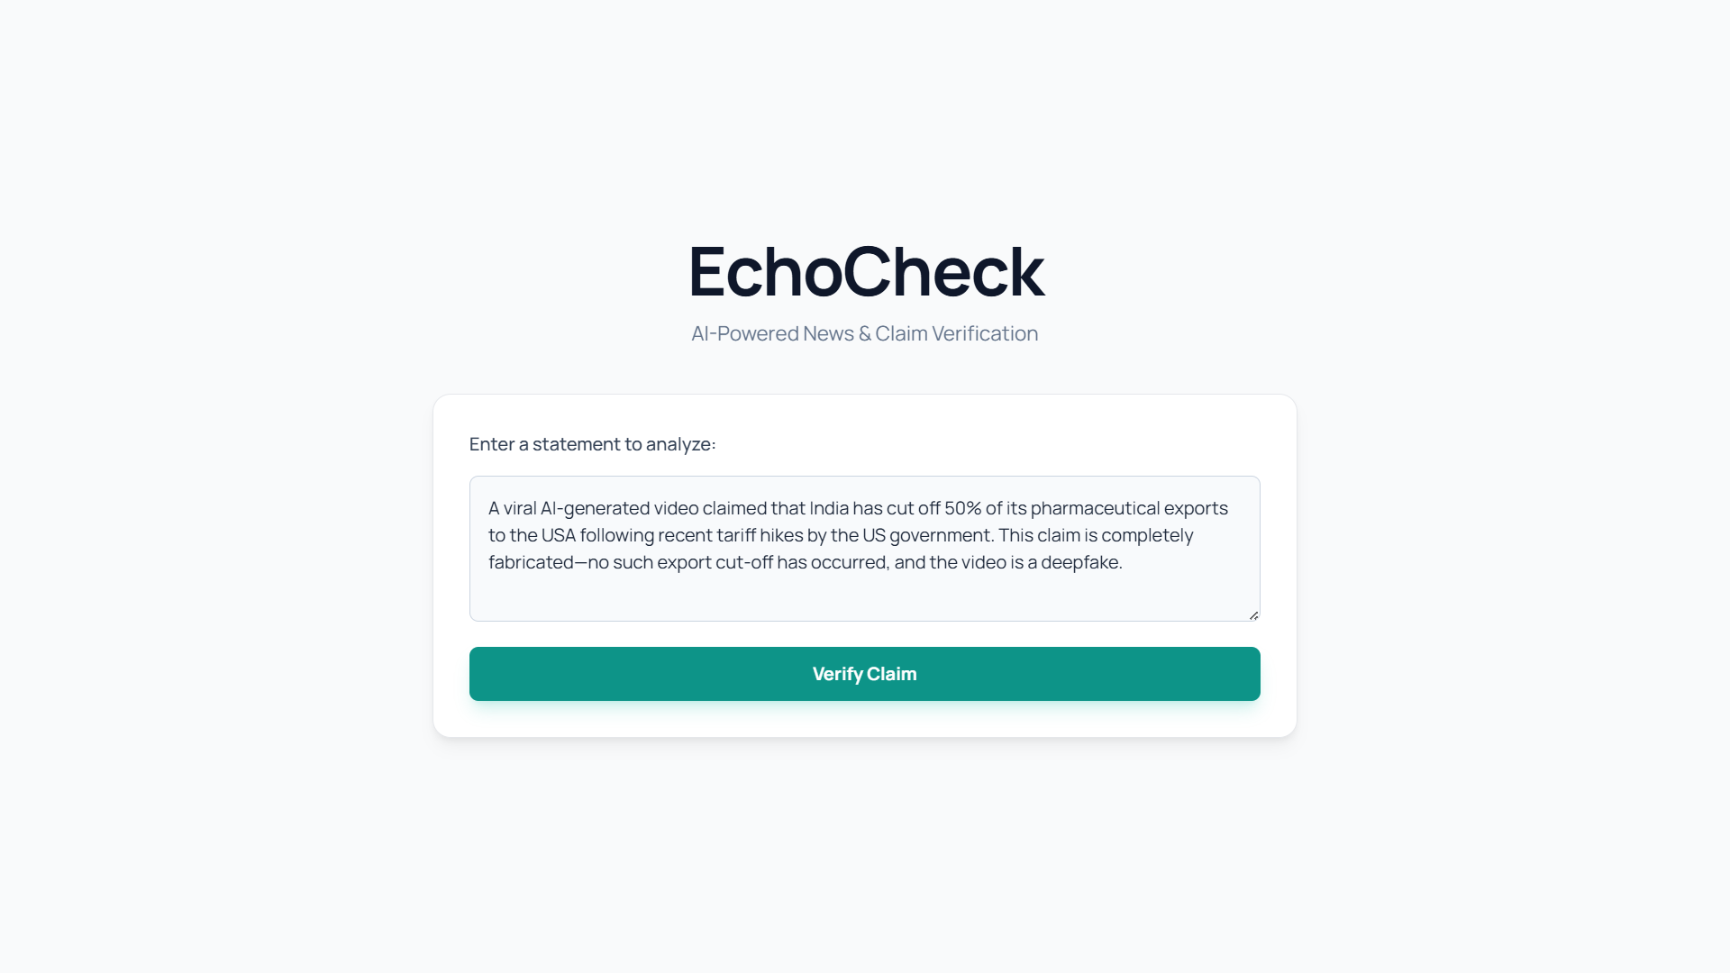

Slide 14
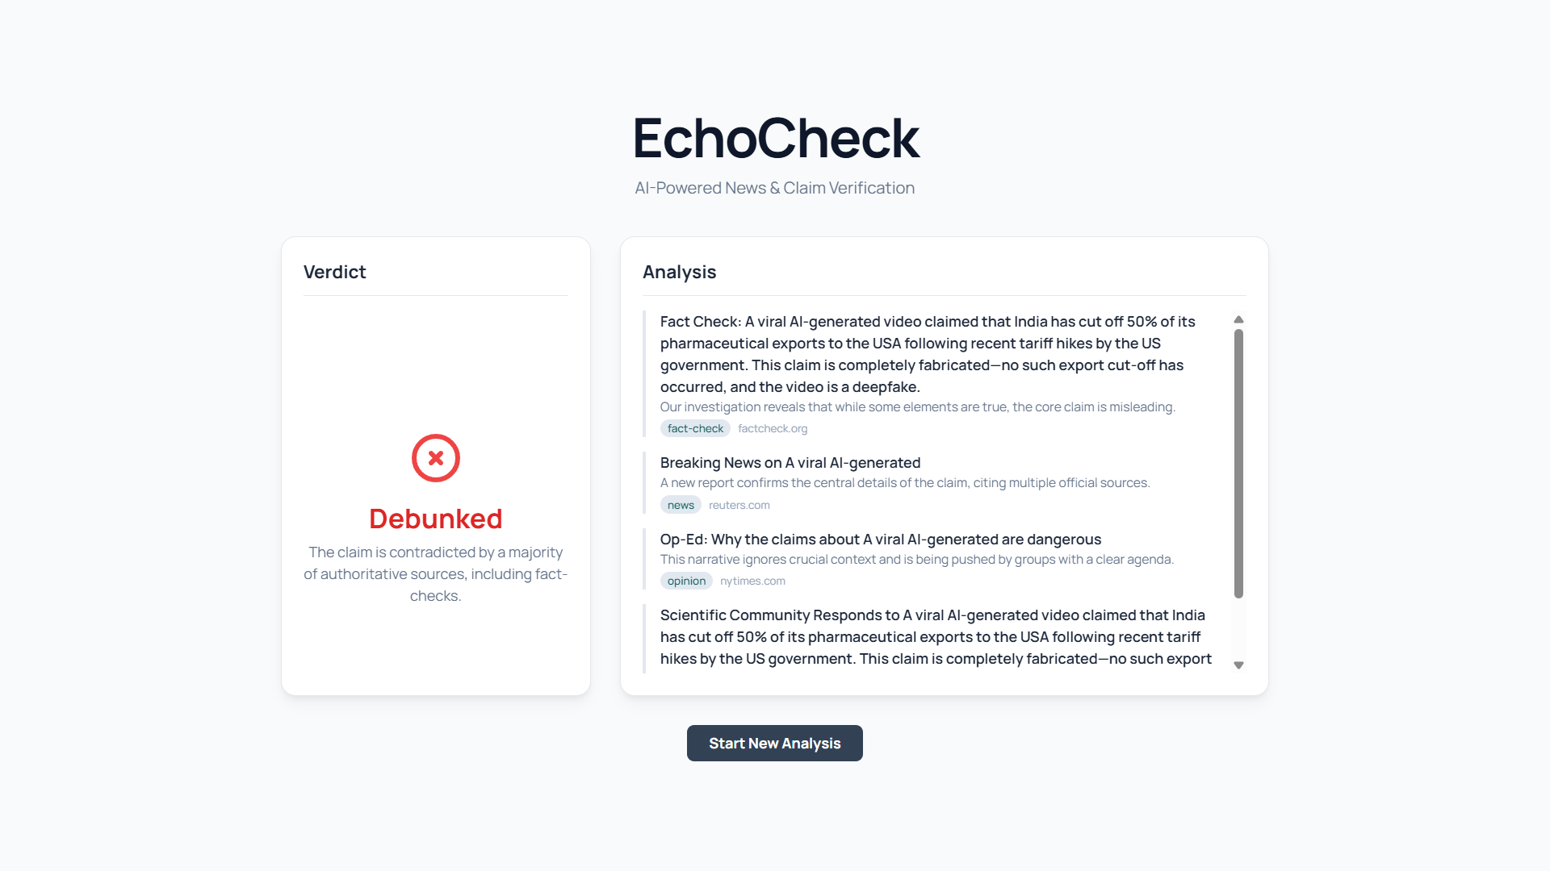

Slide 15
Thank You
EcoCheck - Truth Above All
Let's build a more informed future, together.

