Slide 1
Capstone – Final Best location for a restaurant in Manitoba, Canada
Ganesh, May 2019

Slide 2
Introduction
Succesful restaurent chain in the eastern region of Canada seeks to expand to Manitoba
Restaurent Owner wants to mostly avoid the competetion while having attaractions nearby
Owner wants to make use of data analytics to decide the most beneficial location to start his new restaurent.

Slide 3
Data
This project relies on public data from
- Wikipedia
- FourSquare.
List of communities in Manitoba by population has been retrieved from Wikipedia (https://en.wikipedia.org/wiki/List_of_communities_in_Manitoba_by_population)
Details about the venues in Manitoba had been received from Foursquare API.
Additional work on marking attractions and identifying competition had performed by owner of the restaurent chain on a scale of 0-10 (0-low 10-high).

Slide 4
Methodology
Retrieved the list of communities in Manitoba by Population.
Able to get the location coordinates using geopy
Obtained all the venues in neighborhood in Manitoba using FourSquare API
Assign weights to each venue by taking attraction and competetion into account.
Use Kmeans clustering algorithm to compute clusters and the cluster with highest average weight is the best location for the restaurent.

Slide 5
Recommendation
Our analysis shown that the best location for the restaurant is near Winnipeg out of all communities in Manitoba.
To be precise, The Location is near highway 14, Winkler, Winnipeg. This is inline with what we are expecting..
Map shown on the next slide

Slide 6
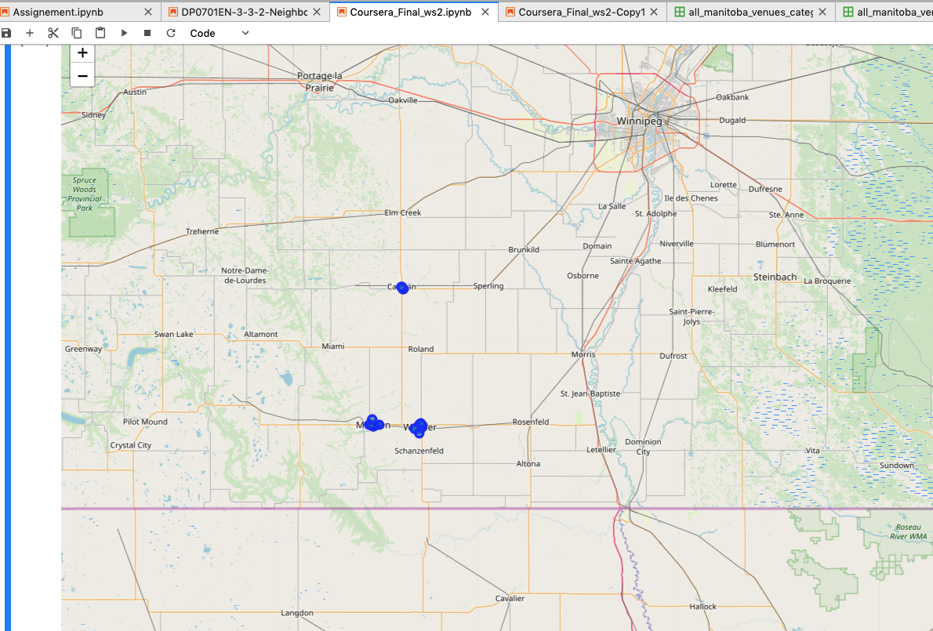

Slide 7
Thank you

