Slide 1
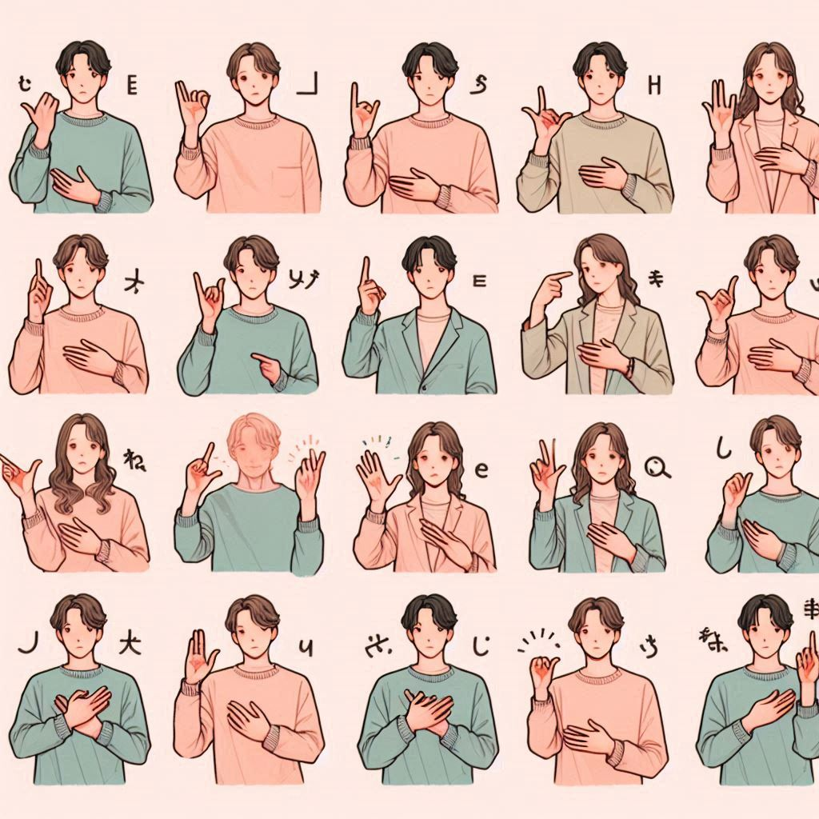
Indian Sign Language Detection
Ganesh A K

Slide 2
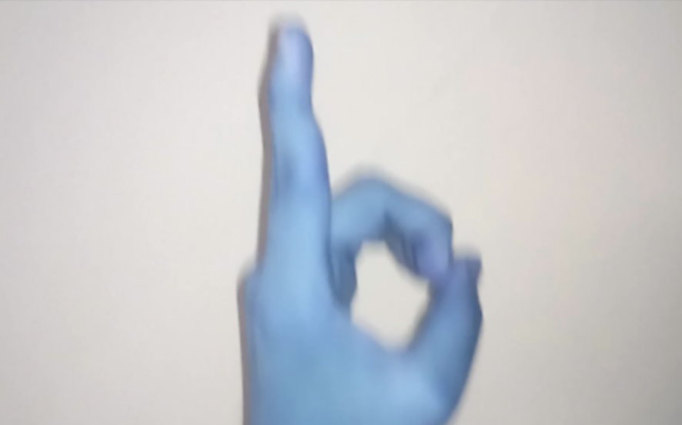
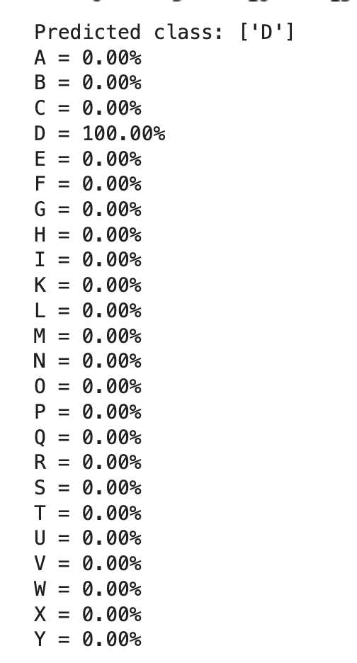
Indian Sign Language – Hand Gesture Recognition
What are you going to solve? Image recognition and classification
What are the inputs? Picture of the hand gesture
What are the outputs? Predicted class and probabilities

Slide 3
Motivation
Why is it important to solve this problem? Solving the problem of ISL detection has the potential to significantly improve the lives of deaf and dumb individuals in India and create a more inclusive society. It's a challenging but rewarding field with significant social impact.
What larger applications does it have? EdTech HealthCare & Emergency Social Inclusion & Economic Opportunities

Slide 4
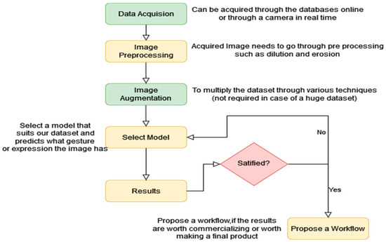

Slide 5
Methods: Stage 1
What was the method? Image processing and classification using SVM, NN
Technical Details around it (read from papers, internet, etc.) https://arxiv.org/pdf/2108.10970 https://www.sciencedirect.com/science/article/pii/S2590005622000121 https://www.mdpi.com/2673-4591/59/1/96

Slide 6
Results: Stage 1
Where did it work well? Baseline approach and classification
Where did it fail? Images with large size – Training is time/CPU intensive. Biased towards the training data.
Why do we need better methods? To get rid of the bias and solve the problem efficiently.

Slide 7
Methods: Stage 2
What was the method? Resizing the images. Feature Engineering techniques. Hyperparameter tuning.
Technical Details around it (read from papers, internet, etc.) Same as earlier
WHY IS IT BETTER?

Slide 8
Results: Stage 2
Where did it work well? - Resizing the images significantly improved the training time. - Accuracy was improved with feature engineering like OTSU.
Where did it fail? - Still the bias towards training data
Is it better or worse than prior solutions? - Better

Slide 9
Future Directions
How can you address the shortcomings of existing methods you’ve tried? - Using techniques like HOG, SURF etc to improve feature extraction. - Using DeepLearning for Image Classification.

Slide 10
Conclusion
Your largest personal learning from the project. - End to end ML project setup + Deployment
Your top 3 technical learnings from the project. - Working with images, Morphology, and Image processing - Classification, SVM with hyperparams - Model dump/read and deployment

