Slide 1
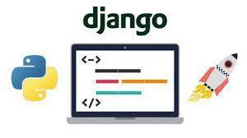
PRESENTATION ON DJANGO-WEBSITE
INTRODUCTION TO DJANGO WEB FRAMEWORK
High-level Python Web Framework
Develop fast
Automate the repetitive stuff
Notes:
EUE

Slide 2
MODULES USED IN PROJECT
django web frame work
Request module
PIP (INBUILT PACKAGE INSTALLER)
Django is a high-level Python web framework that encourages rapid development and clean, pragmatic design. Built by experienced developers, it takes care of much of the hassle of web development, so you can focus on writing your app without needing to reinvent the wheel. It’s free and open source.
Ridiculously fast.
pip is the package installer for Python. You can use pip to install packages from the Python Package Index and other indexes.
Please take a look at our d

Slide 3
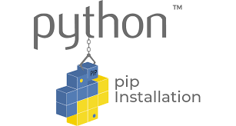
INSTALLATION OF MODULES
INSTALLATION IN LINUX:-
BY USING TERMINAL COMMANDS
pip3 install request
pip3 install django

Slide 4
IMPORTANT COMMANDS
django-admin startproject <project_name>
python manage.py makemigrations
python manage.py migrate
python manage.py collectstatic
python manage.py startapp <app_name>
python manage.py createsuperuser
python manage.py changepassword <username>
python manage.py runserver

Slide 5
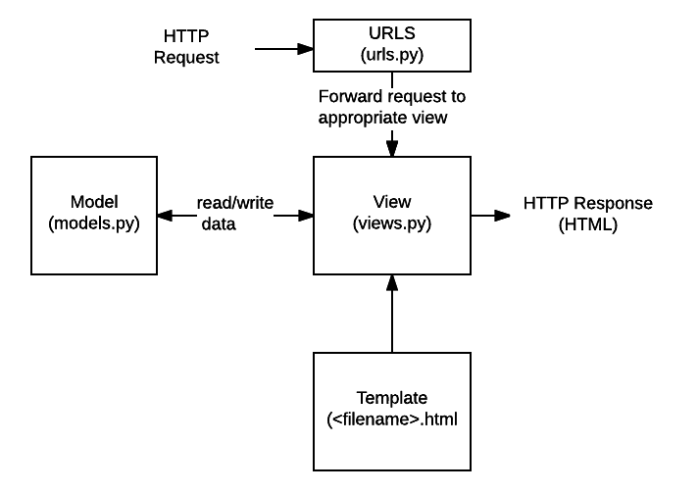
from django.db import models
# Create your models here.
from django.db import models
# Create your models here.
BACKEND WORKING
def index(request):
return render(request,"index.html")
def news(request):
response=requests.get('https://tech-news3.p.rapidapi.com/nineto5mac/?rapidapi-key=1f6d397b61mshec934a43212edd1p1ae62cjsn734f39016558').json()
return render(request,'news.html',{'response':response})
def about(request):
return render(request,"about.html")
from django.contrib import admin
from django.urls import path
from blogs import views
urlpatterns = [
path('admin/', admin.site.urls),
path('', views.index, name='index'),
path('news', views.news, name='news'),
path('about', views.about, name='about')
]
from django.db import models
# Create your models here.

Slide 6
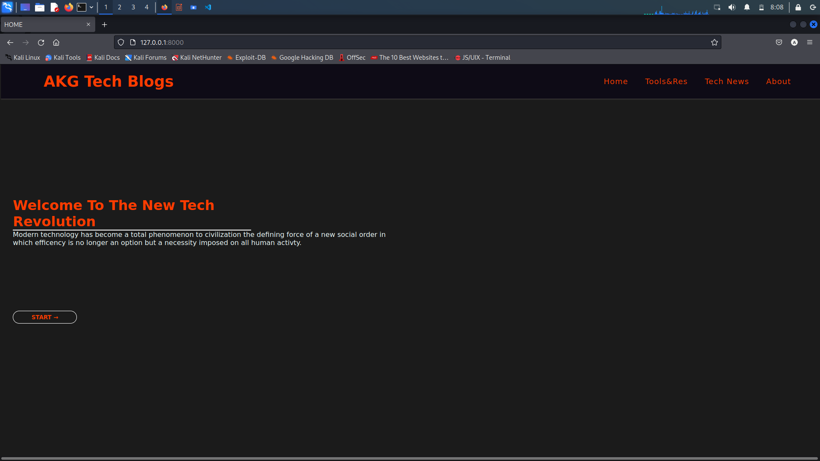
INDEX OF WEBSITE

Slide 7
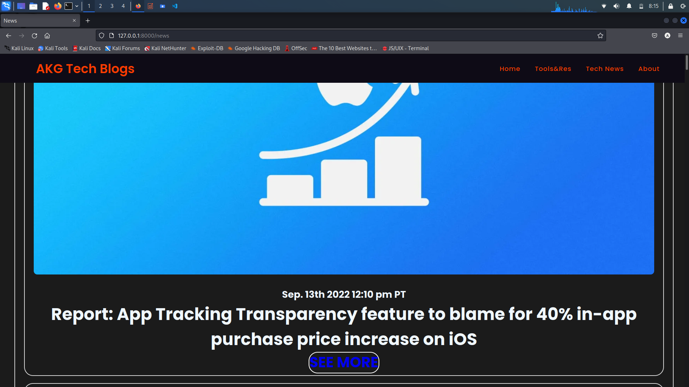
Tech News

Slide 8
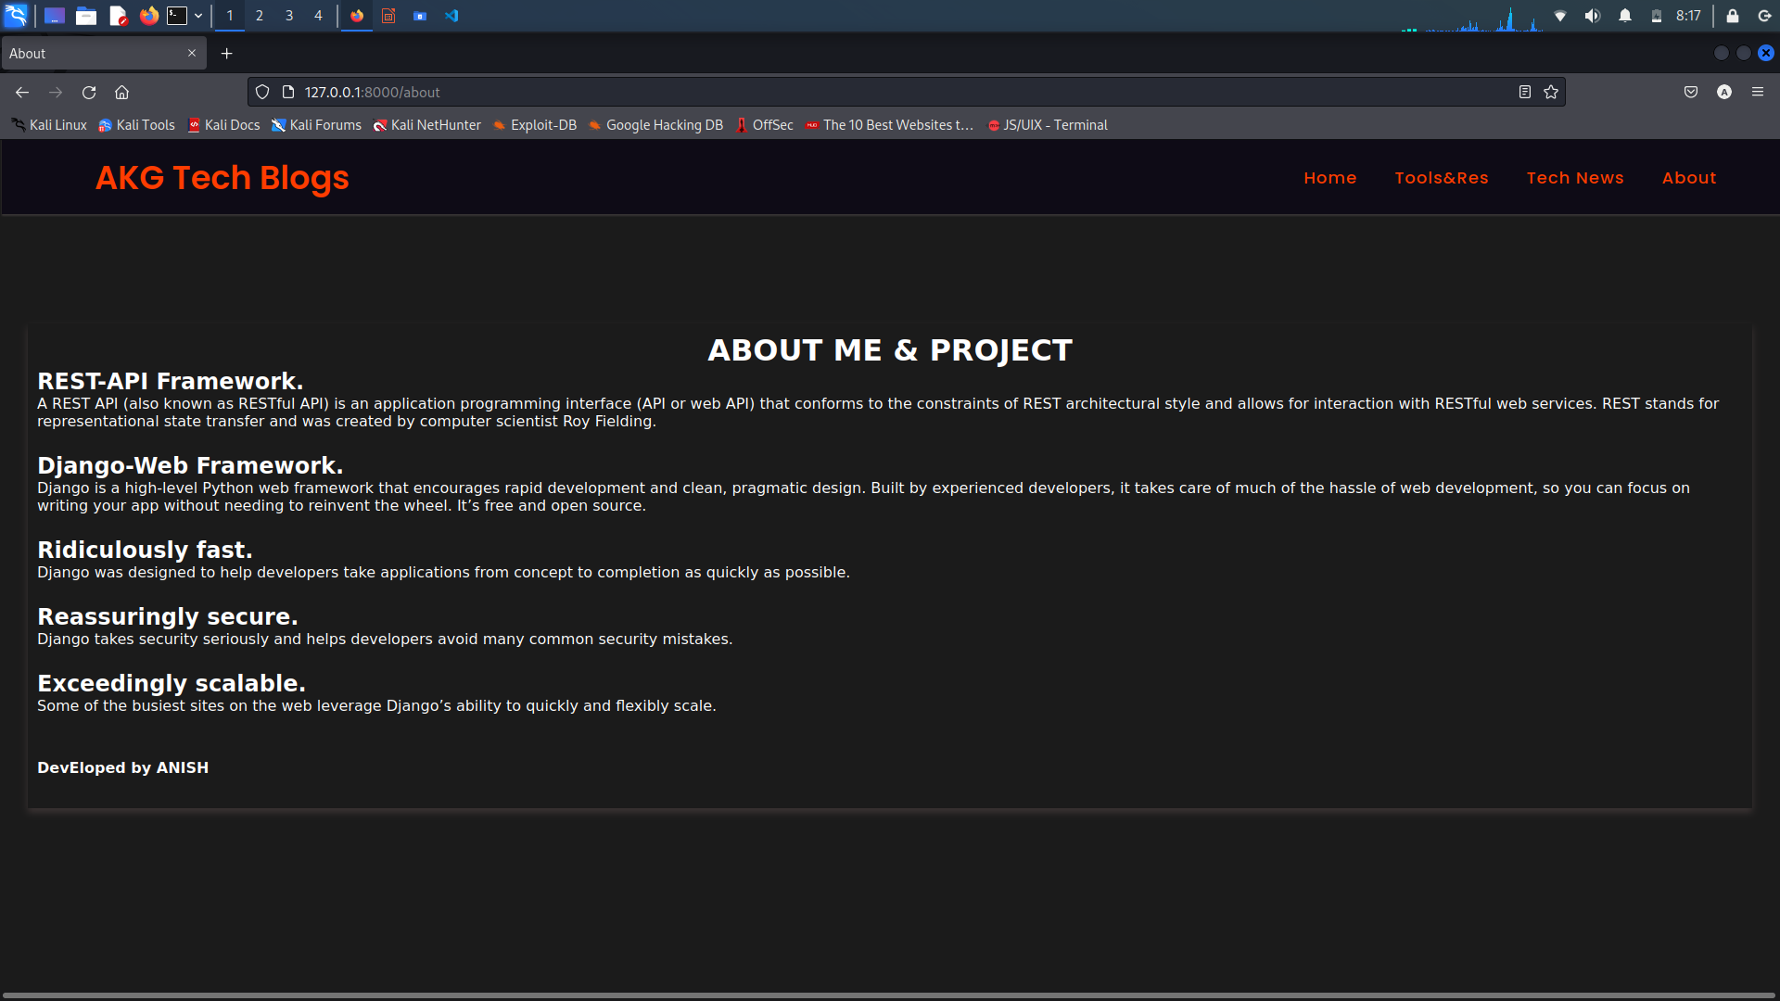
ABOUT ME & PROJECT

Slide 9
Thank You

