Slide 1
Smart card

Slide 2
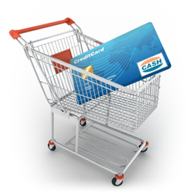
Presentation
The smart card has become a trader between the world's members and facilitates anyone to own it, but smart cards in banks or pay money for daily purchases, but this project will talk about its use in transportation, which facilitates the payment and makes the state control and This is through the connector device and each means of transportation containing the entrance to the entrance to the withdrawal of funds and know the number of passengers within the transportation and means of the maximum passenger and the remaining number of places and this project is granted a new feature of the smart card .

Slide 3
Project charter
• Project name : - Smart card (for transportation)
• Project sponsor : - Ministry of transport.
• Project manager : - Eng \ Khaled Ali .
• Purpose of the project : - Facilitate the payment process in the means of transportation for people.

Slide 4
Project scoop
1. Control of transportation prices imposed by the state
2. Facilitate the payment process for the user
3. Increasing the chances of dealing with banks
4. Knowing the actual profits achieved by the means of transportation

Slide 5
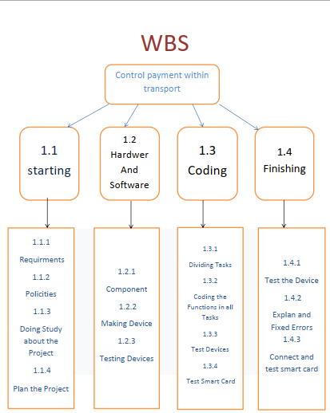
WBS

Slide 6
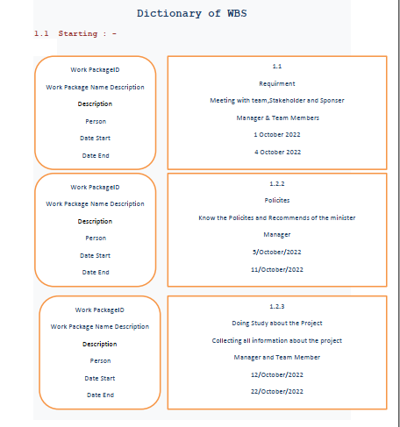
Dictionary of WBS

Slide 7
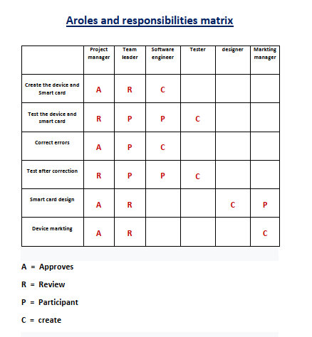
responsibilities matrix

Slide 8
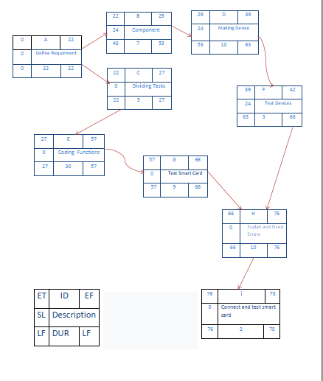
Project Network

Slide 9
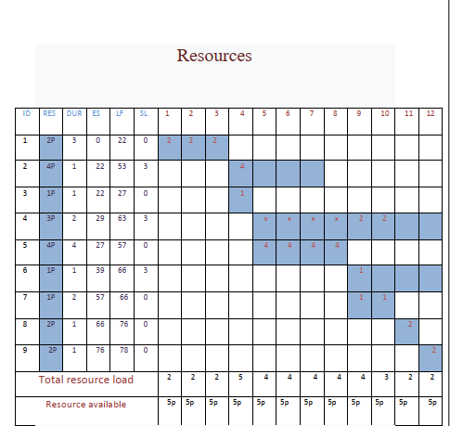
Resources

Slide 10
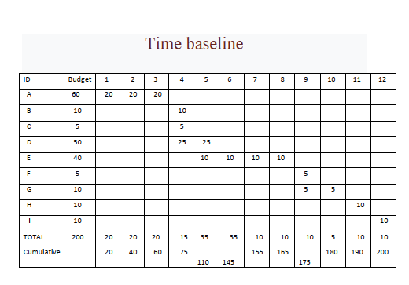
Time baseline

Slide 11
Risk Manageent
There are some risks facing the project, including : -
1_ increase in the cost : -
• we can deal this risk through, Reducing project requirements.
2_ people not interact with modern technology.
• _we can deal this risk through, Good marketing by spreading the
benefit of the project and its importance.
3_the possibility of hacking the device.
_we can deal this risk through, increase the protection of the device and
know is trying to hack the device.

